Slide 1
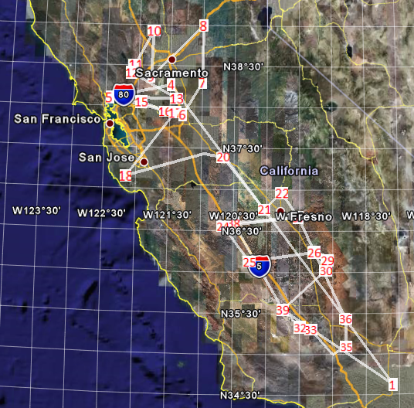
Central Valley Survey Flight Plan (Final)
06/20/2008
Nominal Altitude:
Point 1 – 4: 20 kft.
Point 5 – 40: 1 – 3 kft.
MOPITT Spiral at point 4 from 20 to 2 kft and then descent to 1 kft.
SF Bay Spiral at point 5 from 1 to 5 kft and back to 1 kft.
Proposed take-off at 10:25
Estimated Flight time: 6:00
On-route 20 kft cooling pop-up as needed.

