Slide 1
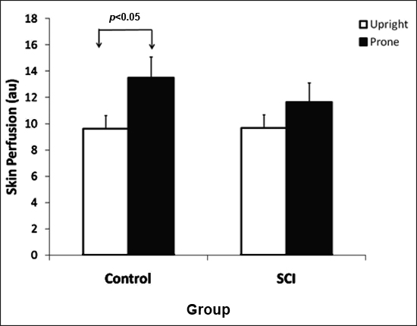

Figure 5. Scatter plots of skin perfusion and sympathovagal balance during upright and prone postures in (a) nondisabled controls and (b) people with spinal cord injury (SCI). (a) In nondisabled controls, there is relationship showing that higher sympathovagal balance is associated with lower skin perfusion (p < 0.05). (b) In people with SCI, relationship between sympathovagal balance and skin perfusion is not obvious (not significant). People with SCI between cervical 4 and thoracic (T)5 are expressed in white color and people with SCI between T6 and T12 are expressed in black color. HF = high frequency, LF = low frequency.
Jan YK, Anderson M, Soltani J, Burns S, Foreman RD. Comparison of changes in heart rate variability and sacral skin perfusion in response to postural changes in people with spinal cord injury. J Rehabil Res Dev. 2013;50(2): 203–14.
http://dx.doi.org/10.1682/JRRD.2011.08.0138
Notes:
Figure 5. Scatter plots of skin perfusion and sympathovagal balance during upright and prone postures in (a) nondisabled controls and (b) people with spinal cord injury (SCI). (a) In nondisabled controls, there is relationship showing that higher sympathovagal balance is associated with lower skin perfusion (p < 0.05). (b) In people with SCI, relationship between sympathovagal balance and skin perfusion is not obvious (not significant). People with SCI between cervical 4 and thoracic (T)5 are expressed in white color and people with SCI between T6 and T12 are expressed in black color. HF = high frequency, LF = low frequency.

