Slide 1
Clinical Pharmacology Overview
From the Antiviral Perspective
Kellie Schoolar Reynolds, Pharm.D.
Pharmacokinetics Team Leader
Office of Clinical Pharmacology and Biopharmaceutics
Antiviral Drug Products Team
Notes:
Pharmacokinetic data could potentially be used to increase the efficiency of the clinical evaluation of new formulations and and alternative dosing regimens. However, to use pharmacokinetic data appropriately , relationships between pharmacokinetic parameters or exposure measures and safety and efficacy of antiretroviral drugs need to be well defined.

Slide 2
Outline
Terminology
Bioequivalence
Scenarios with antiretroviral drugs
  New formulations
  Alternative dosing regimens
  Drug interactions
  Dosing pediatric patients
PK/PD Considerations
Standard of Evidence
Notes:
I will first define some terms that will be used throughout the presentations today.
Next, I will describe bioequivalence, which is the most frequent way that PK data are used for approval of new formulations, including generic drugs.
I will then describe several scenarios that we face with antiretroviral drugs. I will describe how each scenario differs from the typical bioequivalence situation.
During the presentation of the scenarios, I will point out regulations or guidances that allow us to use PK/PD data to link new formulations or regimens to previously approved formulations and regimens.
I will also discuss important consideration when evaluating the available PK/PD data for antiretroviral drugs.
Finally, I will discuss the standard of evidence that is necessary for approving these changes.
Throughout this presentation I will discuss several real examples. These examples come from NDA or supplement reviews. I would like to point out that these examples do not mean that particular drugs and sponsors are good or bad. The examples were chosen to help illustrate our decision process.

Slide 3
Terminology
Pharmacokinetics (PK): time course of drug concentrations in the plasma (sometimes in other fluids and tissues) resulting from a particular dosing regimen.
Pharmacodynamics (PD): relationship between drug concentrations in plasma (or other fluids and tissues) and a resulting pharmacological effect.
Notes:
The resulting pharmacologic effect can be related to efficacy or safety.

Slide 4
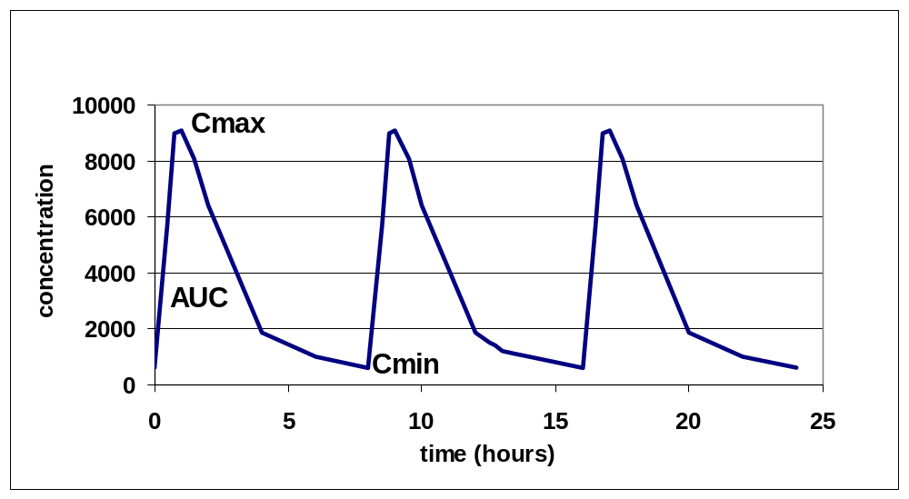
Terminology
Notes:
This graph illustrations the time course of plasma drug concentrations over 24 hours, following administrations a drug every 8 hours.
The y-axis is concentration, the X-axis is time.
AUC is the area under the curve. We can determine AUC for one dosing interval or over the entire day. AUC represents exposure to the drug.
Cmax is the highest concentration.
Cmin is the lowest concentration. Cmin is also refereed to as trough concentration or pre-dose concentration.

Slide 5
Terminology
IC₅₀: Concentration of a drug required to inhibit viral replication by 50%.
EC₅₀: concentration where patients demonstrate 50% maximal reduction in HIV RNA.
Notes:
There is not good agreement on the definitions of IC50 and EC50, but I am going to give examples of the definitions.
IC=Inhibitory concentration. IC50 is… it is determined in vitro, in cell cultures.
EC= effective concentration. EC50 is.. It is determined in patients.
Based on the scientific principle that maintaining plasma concentrations above a threshold necessary to inhibit viral replication (such as IC50 or EC50) throughout an entire dosing interval is essential, many investigators embrace the concept that C_{min} is the most important exposure measure for predicting virologic success. Although this concept is highly plausible, clinical data have not confirmed this.

Slide 6
Outline
Terminology
Bioequivalence
Scenarios with antiretroviral drugs
  New formulations
  Alternative dosing regimens
  Drug interactions
  Dosing pediatric patients
PK/PD Considerations
Standard of Evidence
Notes:
I will next discuss bioequivalence.
Although you probably hear bioequivalence discussed most frequently in the context of generic drug approval, it is evaluated in other situations when a formulation change is made.

Slide 7
Bioequivalence
Relative Bioavailability
Comparison between a test and reference drug product
  commercial formulation vs. clinical trial material
  generic drug vs. reference listed drug
  drug product changed after approval vs. drug product before change
Notes:
When evaluating whether 2 drug products are bioequivalent, the bioavailability of a test product relative to a reference product is determined.
The test and reference products may be:
commercial formulation vs. clinical trial material
generic drug vs. reference listed drug (innovator or brand name product)
drug product changed after approval vs. drug product before change

Slide 8
Bioequivalence
21 CFR 320.1 (e)
the lack of a difference in the rate and extent to which the active ingredient or active moiety in pharmaceutical equivalents or pharmaceutical alternatives becomes available at the site of drug action when administered at the same molar dose under similar conditions in an appropriately designed study.
Notes:
This is the regulatory definition of bioequivalence.
It states that BE is a lack of a difference in the rate and extent to which a drug becomes available at the site of action, when administered at the same molar dose.
It also indicates that the BE assessment made be made in an appropriately designed study. There are also regulations that discuss study design.

Slide 9
Determining Bioequivalence
Formulations:
  Reference
  Test
Study design (typical):
  healthy volunteers
  single dose, two-way crossover
  administer drug under fasted conditions
Notes:
Bioequivalence is determined between 2 formulations, as I have discussed.
In a typical BE study, healthy volunteers are studied, although it is acceptable to use patients. The studies are usually single dose studies, in which each subject receives a single dose of each formulation, with an appropriate washout period between treatments. The formulations should be administered under fasting conditions.
The current design of BE studies is expected to be the most sensitive for detecting differences between formulations.

Slide 10
Determining Bioequivalence
Compare Test vs. Reference
  Ratios for AUC and Cmax
  Determine 90% confidence interval for ratios
  Criteria for log-transformed data:
    90% CI: 0.8 to 1.25 (80% to 125%)
Notes:
Exposure measure are determined for each formulation. Test vs. reference rations are determined for AUC and Cmax.
A 90% confidence interval is constructed around the ratios.
Using log-transformed data, the 90% confidence intervals for both AUC and Cmax must fall entirely within 0.8 to 1.25 to conclude bioequivalence.
Using this standard, we are 90% confident that the formulations differ by no more than 20%. However, the mean difference between generic and brand name formulations is generally much less than 20%.
Comment on mean differences in approved generic drugs.

Slide 11
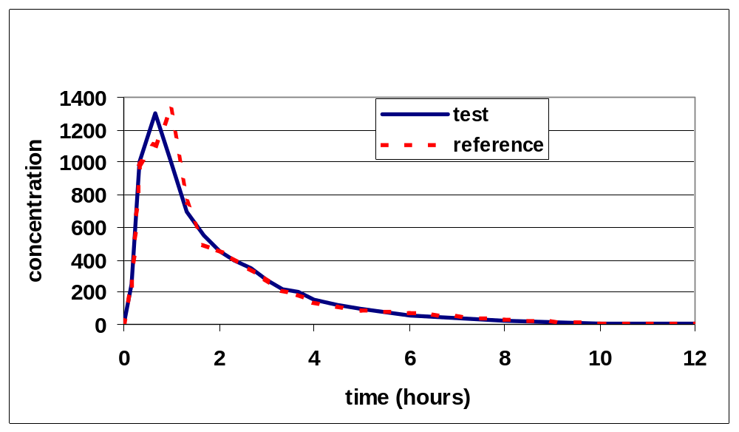
Bioequivalence
Notes:
This graph illustrates the concentration vs. time profiles for two products that are bioequivalent.

Slide 12
Bioequivalence:
Assumptions
Plasma concentration data- surrogate for active site
Rate and extent of absorption are similar- no significant difference in exposure to drug
Can extrapolate safety and efficacy data from reference product to test product
Notes:
When using bioequivalence to approve new drug products, we make the following assumptions:
1. Plasma concentration data are a surrogate for drug concentrations at the active site.
2. If rate and extent of absorption are similar, there is no significant difference in exposure to the drug.
3. We can extrapolate safety and efficacy data from the reference product to the test product.

Slide 13
Bioequivalence
Flexibility of BE criteria
  No flexibility for approval of generic drugs
  Innovator drugs- There is some room for flexibility. Safety and efficacy data or exposure-response data may make it possible to determine that differences are not meaningful.
Notes:
There is no flexibility in the bioequivalence criteria for generic drugs, because clinical safety and efficacy data are not submitted.
However, with innovator drugs, there is some room for flexibility. Safety and efficacy data or exposure-response data may make it possible to determine that differences in AUC or Cmax are not meaningful.

Slide 14
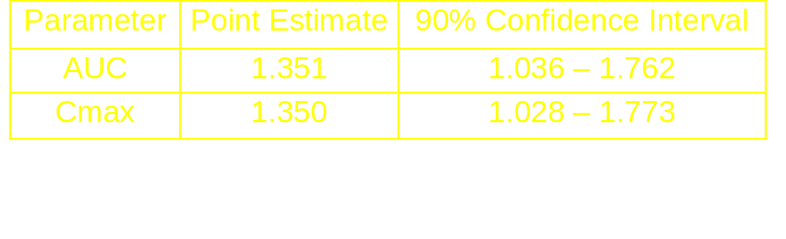
Bioequivalence- Flexibility
Example
Ritonavir SGC vs. Liquid
Notes:
Here is one example where we used our knowledge of clinical data to approve a new formulation that did not meet the typical BE criteria.
These are the results of the bioequivalence study comparing ritonavir soft gelatin capsule to the approved liquid.
The results indicate that the AUC and Cmin following administration of the SGC are 35% higher than following administration of the liquid.

Slide 15
Bioequivalence- Flexibility
Example
Ritonavir SGC vs. Liquid
Assessment
  Outliers
  Low reference formulation bioavailability
    Review of previous studies
  Supporting safety data from NDA: 700 mg bid
Notes:
In our review, we noted that there were several subjects, mainly following administration of the liquid, who had very low ritonavir concentrations.
Although it was not documented, it is possible that these subjects vomited soon after the dose.
When comparing these data to previous studies, it appeared that the 35% difference was due to low bioavailability of the reference liquid, not higher bioavailability of the SGC.
We also evaluated the potential impact of higher ritonavir concentrations, in case the SGC did actually have higher bioavailability. Supporting safety data from the original ritonavir NDA indicated that the 700 mg BID dose was not tolerated as well as the approved 600 mg dose, but did not pose any new safety concerns.
Thus, we approved the SEC.

Slide 16
Outline
Terminology
Bioequivalence
Scenarios with antiretroviral drugs
  New formulations
  Alternative dosing regimens
  Drug interactions
  Dosing pediatric patients
PK/PD Considerations
Standard of Evidence
Notes:
I am now going to discuss several scenarios we face with antiretroviral drugs, that may benefit from pharmacokinetic comparisons similar to the determination of bioequivalence.

Slide 17
Scenarios with
Antiretroviral Drugs
New formulations
Alternative dosing regimens
Drug interactions
Dosing pediatric patients
Apply principles of bioequivalence, to demonstrate “comparable pharmacokinetic profiles”.
Notes:
There are several scenarios where sponsors may want to extrapolate from an approved dosing regimen or drug product or one used in clinical trails to a different regimen or formulation. Sponsors may also want to make comparisons to approved regimens when evaluating drug interaction data. They may compare PK data from children to data from adults.
Although BE refers only to comparisons of 2 formulations administered at the same dose, the principles of BE can be used in other situations, such as those I have just described. In these either situations, we attempt to demonstrate that comparable plasma concentrations are achieved under different conditions.
I will define each of the scenarios, give some examples, and indicate how the scenarios differ from the typical bioequivalence situation.

Slide 18
New Formulations
Apply typical BE criteria
In many cases, we do not expect the formulations to be bioequivalent.
Examples:
  Modified release formulations and prodrugs
  Formulations with increased bioavailability
Notes:
The first scenario s the development of new formulations. In this situation, we can apply the typical bioequivalence criteria. However, in many cases we do not expect the formulations to be bioequivalent.
Examples:
Modified release formulations and prodrugs
Formulations with increased bioavailability

Slide 19
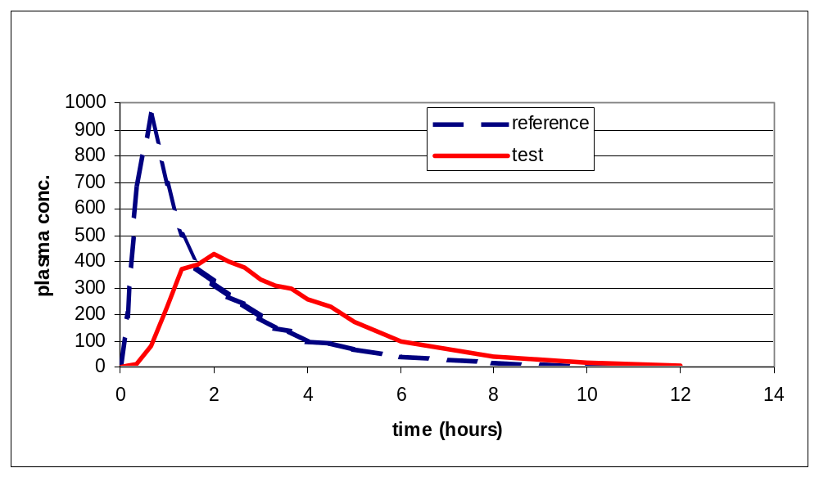
New Formulations
Modified release formulations or prodrugs
Notes:
This graph either compares a modified release/delayed release product to an immediate release product that was approved first. Or, it compares a prodrug to administration of the active drug.
For both modified release drug products and prodrugs, there may be a delay in the appearance of the drug in the plasma. This delay may lead to a plateau, rather than the sharp peak of the previous formulation.
In many cases, when exposure measures for the new product are compared to the previous product:
AUC- the same or similar
Cmin- the same or similar
Cmax- may be 50% lower

Slide 20
New Formulations
21 CFR 320.23 (b)
... Some pharmaceutical equivalents or pharmaceutical alternatives may be equivalent in the extent of their absorption but not in their rate of absorption and yet may be considered bioequivalent because such differences in the rate of absorption are intentional and are reflected in the labeling, are not essential to the attainment of effective body concentrations on chronic use, and are considered medically insignificant for the particular drug product studied.
Notes:
The regulations do allow us to determine that products with such differences in Cmax are bioequivalent. However, there are some caveats.
Read slide.
Particularly important to this discussion are the following:
intentional
not essential to the attainment of effective body concentrations on chronic use
medically insignificant
Thus, there needs to be concrete evidence that the difference in Cmax is not meaningful.

Slide 21
New Formulations
No approved modified release or prodrug antiretroviral drug products
Another situation: new formulation with increased bioavailability
Notes:
There are no approved antiretroviral drug products that are modified release products or prodrugs.
Another situation in which the bioequivalence criteria will not be met is new formulations with intentionally increased bioavailability.

Slide 22
New Formulations
Formulations with increased bioavailability
Example: Fortovase vs. Invirase
Fortovase 1200 mg tid vs. Invirase 600 mg tid: approximately a 9-fold increase in AUC.
Concentrations higher at all times with Fortovase
Safety question
Need to demonstrate improved efficacy
Notes:
One example of a product with increased bioavailability is the Fortovase formulation of saquinavir.
When the proposed 1200 mg tid dose of Fortovase was compared to the approved 600 mg tid dose of Invirase, there was an approximately 9-fold increase in saquinavir AUC.
Concentrations were higher at all time with Fortovase.
There was a safety question due to the increased concentrations.
There was also a need to demonstrate improved efficacy, to provide a rationale for the dramatic increase in exposure.
We requested a safety database of approximately 500 patients followed for 16 to 24 weeks. Efficacy data were provided for a smaller number of patients.

Slide 23
Change in Dosing Regimen
Attempting to simplify dosing regimens (TID to BID, BID to QD)
Attempt to demonstrate comparable plasma drug exposure to the approved regimen
Not likely that all exposure measures will be similar between regimens
Notes:
The second scenario we encounter is a change in dosing regimen.
Many sponsors are attempting to simplify dosing regimens (TID to BID, BID to QD).
They attempt to demonstrate comparable plasma drug exposure to the approved regimen.
But, it is not likely that all exposure measures will be similar between regimens.

Slide 24
Change in Dosing Regimen
Example- Nelfinavir
Nelfinavir:
  Original regimen: 750 mg TID
  New regimen: 1250 mg BID
Sponsor conducted clinical trial
PK data submitted with clinical trial data
Notes:
Nelfinavir is an example of a protease inhibitor for which we approved a less frequent dosing regimen.
Nelfinavir:
Original regimen: 750 mg TID
New regimen: 1250 mg BID
Sponsor conducted clinical trial
PK data submitted with clinical trial data. These data were collected from a subset of subjects in the clinical trial.

Slide 25
Change in Dosing Regimen
Example- Nelfinavir
PK change for 1250 mg BID vs. 750 mg TID
AUC ↑ 20%
Cmax ↑ 35%
Cmin, a.m. ↑ 57%
Cmin, p.m. ↓ 28%
Concern: safety and efficacy
Notes:
When comparing the exposure measures for the BID regimen to the TID regimen.:
AUC ↑ 20%, Cmax ↑ 35%, Cmin, a.m. ↑ 57%, Cmin, p.m. ↓ 28% (This compares the end of the 1st 8 hour interval for the TID regimen, to the end of the 1st 12 hour interval for the BID regimen.
If we were reviewing the PK data, with no supporting clinical trail, there would be a safety question due to the increased AUC and Cmax, and an efficacy question due to the decreased Cmin.
Although nelfinavir pharmacokinetics are complicated due to the presence of an active metabolite, comparisons between regimens are similar when comparing parent drug alone or parent plus metabolite.

Slide 26
Change in Dosing Regimen
Example- Nelfinavir
Clinical Trial Data
Study 542: 1250 BID vs. 750 TID, with stavudine and lamivudine
Results at 48 weeks
  1250 BID (n=323): 61% of patients had <400 copies/mL
  750 TID (n=192): 58% of patients had <400 copies/mL
  Safety: similar for both regimens
Notes:
The clinical trial submitted in support of nelfinavir twice daily dosing compared Nelfinavir 1250 BID vs Nelfinavir 750 TID, both arms included stavudine and lamivudine. This study was conducted in protease inhibitor naïve patients.
The results at 48 weeks indicated that similar proportions of patients in each arm had <400 copies of HIV RNA per mL.
Safety was also similar for the two regimens.

Slide 27
Change in Dosing Regimen
Example: Protease inhibitor with short plasma half-life
  Change from TID to BID
  Expect:
  Similar or higher AUC over 24 hrs.
  Higher Cmax (safety question)
  Lower Cmin (efficacy question)
Notes:
The elimination half-life for Nelfinavir is approximately 4 hours. For another example, we will consider what might happen with a protease inhibitor with a much shorter half-life.
In this case, if there is a change from TID to BID dosing, we might expect:
Similar or higher AUC over 24 hrs. (depending on whether the increase in concentrations is dose proportional)
Higher Cmax (which would raise a safety question)
Lower Cmin (which would raise an efficacy question)

Slide 28
Change in Dosing Regimen
Example of efficacy data
Indinavir 800 mg q8hr vs. 1200 mg q12hr
24 weeks:
  The 1200 mg q12hr regimen was less efficacious than the 800 mg q8hr regimen.
Notes:
An example of efficacy data for this type of drug compares Indinavir 800 mg q8hr with Indinavir 1200 mg q12hr, in combination with 2 NRTIs, in PI naïve patients. (??? confirm)
At 24 weeks, efficacy, based on proportion of patients with undetectable virus, was superior for the every 8 hour regimen, as compared to the every 12 hour regimen.

Slide 29
Change in Dosing Regimen
Not likely that all exposure measures will be similar between regimens.
In some cases, may change formulation and dosing regimen.
Notes:
As both of these examples indicate, it is not likely that all exposure measures will be similar between regimens.
In some cases, a sponsor may change formulation and dosing regimen at the same time, in an effort to match all exposure measures.

Slide 30
Change in Dosing Regimen
Formulation change may allow a change in dosing regimen, with little change in AUC, Cmax or Cmin.
In addition to comparing AUC, Cmax and Cmin, need to consider shape of the concentration vs. time curve.
Notes:
Although the formulation change may allow a change in dosing regimen, with little change in AUC, Cmax or Cmin.
In addition to comparing AUC, Cmax and Cmin, it is important to consider the shape of the concentration vs. time curve.

Slide 31
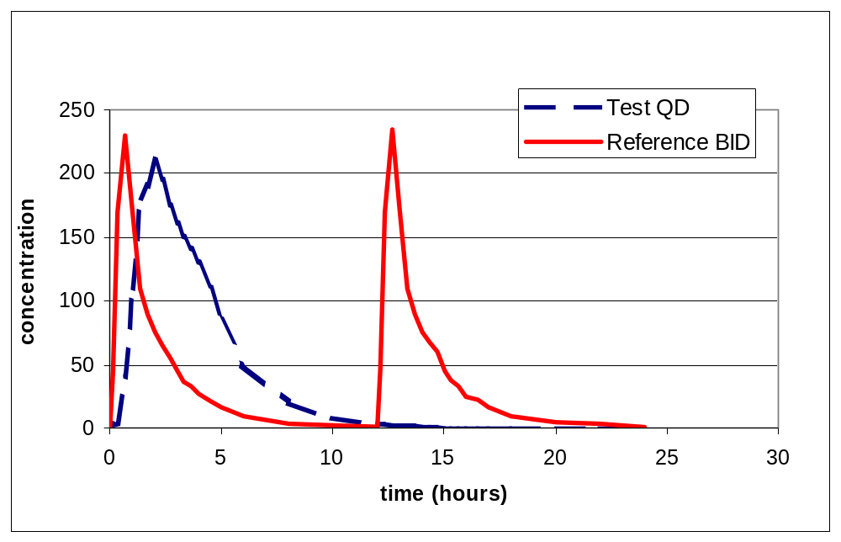
Change in Dosing Regimen
Notes:
In this hypothetical example, the 2 sharp profile are for the original formulation, administered twice a day. The broader profile is for the new formulation, administered once per day.
In this case Cmax is similar, AUC over 24 hours is similar; and Cmin is similar between the two regimens.
However, the shape of the curve is different. The new formulation administered once per day has only one peak. An, there is a longer consecutive period of time with low concentrations.

Slide 32
Guidance for Industry: Providing Clinical Evidence of Effectiveness for Human Drug and Biologic Products
To use pharmacokinetic data for approval, when BE or “comparable concentrations” have not been demonstrated:
Need to understand the relationship between blood concentrations and response, including the time course of the response.
Notes:
As indicated in the Efficacy Guidance to which Dr. Jolson referred, this type of change can be made using pharmacokinetic data. But- there must be an understanding of the relationship between blood concentrations and response, including the time course of the response.

Slide 33
Drug Interactions
Coadministration of two or more drugs results in a change in exposure and the potential need for a dose adjustment
PK enhancer: intentional use of subtherapeutic dose one drug to increase concentrations of another drug
Notes:
The next scenario I will discuss is drug interactions.
Drug interactions with antiretroviral drugs occur under two different circumstances.
Under the first situation, coadministration of two or more drugs results in a change in exposure and the potential need for a dose adjustment of one or both drugs.
The PK enhancer situation is the intentional use of a subtherapeutic dose one drug to increase concentrations of another drug.

Slide 34
Drug Interactions
Antiretroviral drugs in combination with other drugs: conventional dose modification situation
Example: Indinavir and rifabutin
Notes:
The conventional dose modification situation occurs when antiretroviral drugs are administered in combination with other drugs.
One example is the coadministration of indinavir and rifabutin.

Slide 35
Drug Interactions- Typical
IDV 800 mg q8hr + RIF 150 mg qd vs. IDV 800 mg q8hr
  IDV AUC ↓ 32%
  IDV Cmax ↓ 20%
  IDV Cmin ↓ 40%
Recommendation:
  Increase IDV dose to 1000 mg q8hr when administered with RIF.
Notes:
Because they already know that indinavir increases rifabutin concentrations, the sponsor evaluated the interaction using one half the usual dose of rifabutin.
When Indinavir exposure measure following administration of IDV 800 mg q8hr + RIF 150 mg qd were compared to those following administration of IDV 800 mg q8hr alone,
IDV AUC ↓ 32%
IDV Cmax ↓ 20%
IDV Cmin ↓ 40%
The Recommendation based on these results was to:
Increase the IDV dose to 1000 mg q8hr when administered with RIF.

Slide 36
Drug Interactions
RIF 150 mg qd + IDV 800 mg q8hr vs. RIF 300 mg qd
  RIF AUC ↑ 54%
  RIF Cmax ↑ 29%
  25-desacetyl-RIF AUC ↑ 300%
  25-desacetyl-RIF Cmax ↑ 143%
Recommendation:
  Reduce RIF dose to one-half the standard dose when administered with IDV.
Notes:
Rifabutin and metabolite exposure measures were compared following administration of RIF 150 mg qd + IDV 800 mg q8hr to those observed following administration of RIF 300 mg qd
RIF AUC ↑ 54%
RIF Cmax ↑ 29%
25-desacetyl-RIF AUC ↑ 300%
25-desacetyl-RIF Cmax ↑ 143%
The recommendation based on these results was to:
Reduce the RIF dose to one-half the standard dose when administered with IDV.
This recommendation was made by evaluating previous rifabutin and metabolite safety data and considering the available dose strengths of rifabutin.

Slide 37
Drug Interactions
Medical decision: coadminister two antiretroviral drugs. However, there may be a PK interaction between these drugs.
Should the dose of either drug be altered?
Notes:
We encounter a similar drug interaction situation when 2 antiretroviral drugs are coadministered.
In this situation, there is first a medical decision to coadminister two specific antiretroviral drugs. However, there may be a pharmacokinetic interaction between these two drugs.
It is important to know whether the dose of either drug should be altered.

Slide 38
Drug Interactions
Indinavir and efavirenz
Indinavir 800 mg q8hr plus efavirenz:
  No significant change in efavirenz PK
  Indinavir AUC ↓ 31%
  Indinavir Cmax ↓ 16%
Notes:
For example, there may be a decision to coadminister efavirenz and indinavir.
IN the first study of this combination, following administration of indinavir 800 mg q8hr with efavirenz,
There was no significant change in efavirenz PK
Indinavir AUC ↓ 31%
Indinavir Cmax ↓ 16%

Slide 39
Drug Interactions
Increase indinavir dose to 1000 mg q8hr:
  AUC similar to typical 800 mg q8hr
  Cmax higher (50%)
  Cmin similar
Clinical trial included indinavir 1000 mg q8hr with efavirenz 600 mg qd (n=429)
Notes:
Thus, the combination was evaluated with an increased dose of indinavir, 1000 mg q8hr.
I this case
indinavir AUC was similar to that typically observed following administration of 800 mg q8hr
Cmax was higher (50%)
Cmin was similar
Any potential safety concern regarding the increased peak concentrations was alleviated, because one efavirenz Clinical trial included indinavir 1000 mg q8hr with efavirenz 600 mg qd (n=429).

Slide 40
Drug Interactions
PK Enhancers
PI in combination with potent metabolic inhibitor (e.g., low dose ritonavir)
Intent: increase concentrations of PI, not antiviral efficacy of 2nd drug
Alter dosing regimen for PI
Exposure measures may be quite different from approved regimens
Notes:
The pharmacokinetic enhancer situation is quite different from the examples I have just given.
In this case, a PI is administered in combination with a potent metabolic inhibitor (e.g., low dose ritonavir).
The intent is to increase concentrations of the PI, not obtain antiviral efficacy from 2nd drug.
This usually involves altering the dosing regimen for the PI.
The exposure measures may be quite different from approved regimens

Slide 41
Drug Interactions
PK Enhancers
Example 1:
  Increase AUC, Cmax, Cmin
Indinavir/Ritonavir
Notes:
In some cases, AUC, Cmax, and Cmin may be increased.

Slide 42
Drug Interactions
PK Enhancers
IDV/RTV 800/100 mg BID vs. IDV 800 mg q8hr:
  IDV AUC ↑ 170%
  IDV Cmax ↑ 58%
  IDV Cmin ↑ 10-fold
IDV/RTV 800/200 mg BID vs. IDV 800 mg q8hr:
  IDV AUC ↑ 260%
  IDV Cmax ↑ 79%
  IDV Cmin ↑ 25-fold
Notes:
This is the case for two dosing regimens that combine indinavir with low dose ritonavir, in BID regimens,
When indinavir 800 mg BID is administered with 100 mg of ritonavir,
IDV AUC ↑ 170%
IDV Cmax ↑ 58%
IDV Cmin ↑ 10-fold
When indinavir 800 mg BID is administered with 200 mg of ritonavir, there are slightly greater increases in AUC and Cmax, and a much greater increase in Cmin.
For both regimens, the increased exposure measures raise safety questions.

Slide 43
Drug Interactions
PK Enhancers
Example 2:
  Cmin higher, other exposure measure(s) lower
Amprenavir/Ritonavir
Notes:
In other cases, Cmin may be higher with the regimen that includes the PK enhancer, but some other exposure measures may be lower.

Slide 44
Drug Interactions
PK Enhancers
Simulated amprenavir concentrations
APV/RTV 450/100 mg BID vs. APV 1200 mg BID:
  APV AUC ↔
  APV Cmax ↓ 56%
  APV Cmin ↑ 340%
APV/RTV 600/100 mg BID vs. APV 1200 mg BID:
  APV AUC ↑ 30%
  APV Cmax ↓ 42%
  APV Cmin ↑ 500%
Notes:
The amprenavir exposure measures for the amprenavir/ritonavir combinations are based on simulated data, these data are not from actual pharmacokinetic studies.
The simulated amprenavir exposure measures are compared to exposure measures following the approved 1200 mg bid amprenavir regimen.
The first two regimens that include low dose ritonavir are BID regimens. In these cases, there is no increase or a small increase in amprenavir AUC, an approximately 50% decrease in amprenavir Cmax, and several fold increase in amprenavir Cmin.

Slide 45
Drug Interactions
PK Enhancers
Simulated amprenavir concentrations (continued)
APV/RTV 900/200 mg QD vs. APV 1200 mg BID:
  APV AUC ↔
  APV Cmax ↓ 34%
  APV Cmin ↑ 200%
APV/RTV 1200/200 mg QD vs. APV 1200 mg BID:
  APV AUC ↑ 22%
  APV Cmax ↔
  APV Cmin ↑ 300%
Notes:
The next two regimens that include low dose ritonavir are once daily regimens. In these cases, there is again no increase or a small increase in amprenavir AUC, no change or a less than 50% decrease in amprenavir Cmax, and several fold increase in amprenavir Cmin.
Of course, for all of these combinations, and for the indinavir/ritonavir combinations, there is a change in the overall shape of the plasma concentration vs. time profile.

Slide 46
Pediatric Dosing
There are many factors to consider when evaluating new formulations, alternative dosing regimens and drug interaction results for antiretroviral drugs.
Considering these factors in the context of dosing pediatric patients adds another layer of complexity.
Notes:
The final scenario I will discuss is pediatric dosing.
As I have been discussing, there are many factors to consider when evaluating new formulations, alternative dosing regimens and drug interaction results for antiretroviral drugs.
Considering these factors in the context of dosing pediatric patients adds another layer of complexity.

Slide 47
Pediatric Dosing
21 CFR 201.57(f)(9)(iv)
Allows inclusion of pediatric use information in the label without controlled clinical trials of the use in children.
Course of disease should be similar in pediatric and adult populations.
Sponsor must provide other information to support use in children.
Notes:
The regulations do allow the inclusion of pediatric use information in the label without controlled clinical trials of the use in children.
For this to apply, the course of disease should be similar in pediatric and adult populations.
And, the sponsor must provide other information to support use in children.

Slide 48
Pediatric Dosing
Additional information- PK data for drug in pediatric population, to allow dose selection
Evidence of comparable concentrations between children and adults, or exposure-response data, can link efficacy data.
Some additional safety data may be requested.
Notes:
The additional information may include PK data for the drug in pediatric population, to allow dose selection.
Evidence of comparable concentrations between children and adults, or exposure-response data, can link efficacy data from adults to children.
Some additional safety data may be requested.
Approving pediatric dosing regimens based on comparable pharmacokinetics to the approved regimen in adults is very useful, due to feasibility problems with pediatric clinical trials.

Slide 49
Pediatric Dosing
Example: Nelfinavir
Pediatric dose: 20-30 mg/kg TID
Compare to Adults: 750 mg TID
Age 2-7 yr (n=6) Age 7-13 yr (n=8)
  AUC ↔ AUC ↔
  Cmax ↑ 30% Cmax ↓ 15%
  Cmin ↑ 12% Cmin ↑ 16%
Greater PK variability in pediatric patients
No BID PK data available for pediatric patients. Thus, cannot extrapolate from adult BID safety and efficacy data.
Notes:
One example of the approval of pediatric dosing based on a comparison to adult pharmacokinetic data is nelfinavir.
The pediatric clinical study was ongoing at the time of the NDA submission and approval.
Because early PK studies indicated that nelfinavir clearance was more rapid in children. A dose 2-3 time the adult dose, on a mg/kg basis, was selected.
The pharmacokinetic results submitted with the NDA indicated that after two weeks of treatment with 20 mg/kg t.i.d., nelfinavir plasma concentrations in children were similar to those in adult patients from Phase II studies who received doses of 750 mg t.i.d. There was higher PK variability in the pediatric patients.
We did request safety data for pediatric patients. Multiple dose data from 47 patients were submitted and reviewed.
There are no BID PK data available for pediatric patients. Thus, we cannot extrapolate from adult BID safety and efficacy data.

Slide 50
Scenarios
Summary of Potential Issues
New formulations:
  May not meet BE criteria, particularly for Cmax
Change in dosing regimen:
  Target AUC or Cmin, other exposure measures will be different
  Different shape of concentration vs. time curve
Drug interactions: typical
  Target AUC or Cmin; do not have flexibility to match all exposure measures
Notes:
As a summary, I will indicate how each Scenario I discussed differs form the well-defined bioequivalence situation.
Many new formulations:
May not meet BE criteria, particularly for Cmax.
When there is a change in dosing regimen:
The sponsor may target AUC or Cmin, but other exposure measures will be different.
There is also a different shape of concentration vs. time curve
When drug interactions occur
Changes in dosing may target AUC or Cmin; but there usually is not enough flexibility to match all exposure measures to the approved regimens.

Slide 51
Scenarios
Summary of Potential Issues
Drug interactions: PK enhancers
  Increase all exposure measures (safety question)
  Increase some exposure measures, decrease others (safety and efficacy questions)
Pediatric dosing
  Try to match AUC or Cmin, other exposure measures may be different
Notes:
When PK enhancers are used,
There May be an increase all exposure measures (safety question)
Or, there may be an increase some exposure measures, and a decrease in others (safety and efficacy questions)
With Pediatric dosing
The sponsor may try to match AUC or Cmin, but other exposure measures may be different from the adult regimen.

Slide 52
Scenarios
Summary of Potential Issues
Overall:
In most situations, it will not be possible to match AUC, Cmax, and Cmin.
  Some lower concentrations: efficacy question
  Some higher concentrations: safety question
Notes:
Overall:
In most situations, it will not be possible to match AUC, Cmax, and Cmin.
If there are some lower concentrations: there may be an efficacy questions
If there are some higher concentrations: there may be safety questions

Slide 53
Outline
Terminology
Bioequivalence
Scenarios with antiretroviral drugs
  New formulations
  Alternative dosing regimens
  Drug interactions
  Dosing pediatric patients
PK/PD Considerations
Standard of Evidence
Notes:
Although we would like to determine PK/PD relationships for antiretroviral drugs that would allow us to use pharmacokinetic data to approve new formulations that are not bioequivalent and alternative dosing regimens, there are several important considerations that complicate matters.

Slide 54
Using PK/PD
Goals:
  Identify specific exposure measures (AUC, Cmax, Cmin) that are related to PD endpoints.
  Design exposure-response studies that will allow the assessment of the clinical implications of changing formulations or dosing regimens of antiretroviral drugs.
Notes:
A goal when evaluating a PK/PD relationship is to identify specific exposure measures (AUC, Cmax, Cmin) that are related to PD endpoints.
One could then design exposure-response studies that will allow the assessment of the clinical implications of changing formulations or dosing regimens of antiretroviral drugs.

Slide 55
Using PK/PD
PD endpoints
  Efficacy
  Safety
Notes:
It is important to remember that PD endpoints include both efficacy and safety. The efficacy endpoint of most interest is durable suppression of virus.

Slide 56
PK/PD Considerations
Pharmacometrics Consultation
Pharmacometrics Group:
Office of Clinical Pharmacology
and Biopharmaceutics
Notes:
During our preparation for this meeting we, consulted with the Pharmacometrics group in the Office of Clinical Pharmacology and Biopharmaceutics. This group has expertise in PK/PD evaluations and modeling.
Drs. Peter Lee and Dan Wang from the Pharmacometrics Group evaluated the submissions that sponsors sent in response to a data request for this meeting, they reviewed relevant literature citations, and they evaluated in house data that we felt might be helpful. Their ultimate goal was to provide suggestions for the design of exposure-response studies that would allow the assessment of the clinical implications of changing formulations or dosing regimens of antiretroviral drugs.
Many of the considerations I am presenting were either determined or confirmed during their review. Due to these issues, it is not possible for us to recommend a specific exposure-response study design for antiretroviral drugs.

Slide 57
Pharmacokinetic Considerations
Correlation of exposure measures with one another
Time of sampling can affect Cmax and AUC
Diurnal variation
Shape of concentration vs. time curve
Identification of Cmin
Adjustment for protein binding
Notes:
The following pharmacokinetic consideration complicate the evaluation of PK/PD relationships.
Correlation of exposure measures with one another
Time of sampling can affect Cmax and AUC
Diurnal variation
Shape of concentration vs. time curve
Identification of Cmin
Adjustment for protein binding
I will discuss each consideration.

Slide 58
Pharmacokinetic Considerations
Correlation of exposure measures with one another
Cmin
Cmin
Cmax
Cmax
Notes:
Many studies published in the literature correlate AUC or Cmin with the efficacy specific antiretroviral drugs. However, the design of most studies does not allow us to rule out the contribution of other exposure measures, such as Cmax.
In most cases, efficacy and safety data are available for only a few doses of a particular drug. Usually the same regimen (BID or TID) is used in most studies. This results in this type (Left graph) of correlation between exposure measures.
In order to conclude that one exposure measure is important for efficacy and another is not, the measures cannot be correlated with each other. To have a lack of correlation between exposure measures (As shown in the right graph) the sponsor would probably have to collect safety and efficacy data following a mix of regimens (qd, bid, tid).

Slide 59
Pharmacokinetic Considerations
Time of sampling can affect Cmax and AUC
  Example: Typical Cmax observed at 1 hour
  Sample at 0, 0.5, 1, 2, 4, 6 hours
    Cmax = 5100
  Sample at 0, 0.5, 1.5, 2.5, 4, 6 hours
    Cmax = 4000
  Sample at 0, 2, 4, 6 hours
    Cmax = 3000
Notes:
In some cases, the reported differences between regimens that were evaluated in different studies may be due to different PK sampling schemes.
For example:
Consider a drug whose typical Cmax is observed at 1 hours
Sample at 0, 0.5, 1, 2, 4, 6 hours
Cmax = 5100
Sample at 0, 0.5, 1.5, 2.5, 4, 6 hours
Cmax = 4000
Sample at 0, 2, 4, 6 hours
Cmax = 3000

Slide 60
Pharmacokinetic Considerations
Diurnal variation
  usually estimate AUC₀₋₂₄ as
    AUC₀₋₈ x 3
    AUC₀₋₁₂ x 2
  Estimation assumes that PK profile is the same in the morning and evening.
  There is some evidence that this estimation is not appropriate, but do not have data for most drugs.
Notes:
Diurnal variation should be considered when comparing AUC values across regimens.
When comparing different regimens, AUC₀₋₂₄ is usually estimated as
AUC₀₋₈ x 3
AUC₀₋₁₂ x 2, rather than collecting samples for 24 hours.
This estimation assumes that PK profile is the same in the morning and evening.
There is some evidence that this estimation is not appropriate. AUC in the afternoon is lower than in the morning, so this method of estimation may overestimate AUC(0-24). But we do not have data for most drugs.

Slide 61
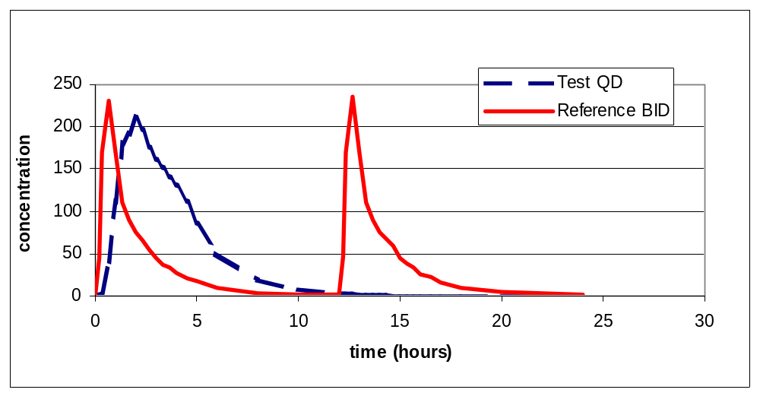
Pharmacokinetic Considerations
Shape of concentration vs. time curve
Notes:
As mentioned previously, demonstrating comparable AUC, Cmax, and Cmin between regimens does not guarantee that the shape of the concentration vs. time profile is the same.
In this case, the exposure measures are similar, but for the new regimen, there is only one peak rather than two and there is a longer consecutive period of time with low concentrations.

Slide 62
Pharmacokinetic Considerations
Identification of Cmin
  high variability
  arithmetic mean vs. geometric mean vs. median
  example:
    arithmetic mean = 145
    geometric mean = 102
    median = 121
  time of sample collection
    different dosing intervals
Notes:
Traditionally, Cmin has been considered one of the most important exposure measures for PIs and NNRTIs.
The literature may indicate that attaining a specific Cmin predicts success, but it is difficult to interpret the meaning and utility of that conclusion.
Cmin values are high variable
There will be differences in the value reported, depending on whether Cmin is summarized by arithmetic mean, geometric mean, or median
for example, when a representative series of approximately 70 Cmin values is summarized:
arithmetic mean = 145
geometric mean = 102
median = 121
Some individuals may have Cmin values much less that the summary statistic indicates.
time of sample collection can also affect Cmin values.
Cmin value may differ For different dosing intervals, this may be due to diurnal variation.

Slide 63
Pharmacokinetic Considerations
Adjustment for protein binding
  Assume all patients have the same fraction of drug bound to protein?
  Example:
    Drug that is 99% (average) protein bound
    Patients 1 and 2 have Cmin = 1000
    Patient 1: 99.5% bound, 0.5% unbound, corrected Cmin = 5
    Patient 2: 98% bound, 2% unbound, corrected Cmin = 20
Notes:
The final pharmacokinetic concern I will discuss is adjustment for protein binding.
It is the unbound drug that is active. When we adjust for protein binding, can we assume that all patients have the same fraction of drug bound to protein?
Example:
Consider a drug that is, on average, 99% protein bound
Patients 1 and 2 have Cmin = 1000
Patient 1: 99.5% bound, 0.5% unbound, corrected Cmin = 5
Patient 2: 98% bound, 2% unbound, corrected Cmin = 20

Slide 64
Pharmacodynamic Considerations
Suppression of virus: Different doses or regimens may have similar efficacy early in treatment, but may diverge at later times.
Notes:
For pharmacodynamics, our biggest concern is related to suppression of virus.
There have been several instances in which different doses or regimens had similar efficacy to one another early in treatment, but diverged at later times. For example, efficacy may diverge between 16 and 24 weeks.

Slide 65
Additional Considerations
Mechanism of action
Other exposure measures
Multiple drug therapy
Compliance
Consumption of other agents or food
Active metabolites
Response in naïve vs. previously treated patients
Notes:
In addition to the factors I have discussed, there are a number of other considerations that complicate the evaluation of PK/PD relationships for antiretroviral drugs.
These include:
Mechanism of action- The NRTIs require intracellular activation. Thus, it is more difficult to determine the relevance of plasma exposure measures.
Other exposure measures- Are there measures other than, AUC, Cmax, and Cmin that might be important. For example- time above a specific threshold concentration.
Multiple drug therapy- It is more difficult to evaluate the PK/PD relationship for one drug, when patients are receiving other drugs for the same indication.
Compliance- Response may be less than optimal if patients do not comply with the prescribed regimen.
Consumption of other agents or food- Consumption of other agents, such as botanical products or food, may alter exposure to the drug and alter response. The prescriber may not be aware of the patient’s consumption of other agents.
Active metabolites- complicate the evaluation of a PK/PD relationship of a drug. It may be necessary include the metabolite in the PK/PD model. In situations of drug interactions, the proportion of parent drug and metabolite may change.
Response in naïve vs. previously treated patients.- the relationship between drug exposure and response may be different in naïve and previously treated patients, due to the presence of different strains of the virus.

Slide 66
PK/PD Considerations
If we do establish a PK/PD relationship, does it apply to all situations?
  3 drug classes
  All drugs within a class
  All populations
Notes:
If we are able to establish a PK/PD relationship for antiretroviral drugs, does it apply to all situations?
Would the same model apply to all 3 drug classes
or, all drugs within a specific class
or all patient populations?
If there are pharmacokinetic and pharmacodynamic considerations that make it difficult to design exposure response studies that allow the approval of non-bioequivalent formulations or alternative dosing regimens, we may consider whether we can find a study design that allows more effective screening of regimens. Such a design might allow sponsors to weed out some failures early? A longer term study would still be needed to confirm the efficacy of promising regimens or formulations.

Slide 67
Outline
Terminology
Bioequivalence
Scenarios with antiretroviral drugs
  New formulations
  Alternative dosing regimens
  Drug interactions
  Dosing pediatric patients
PK/PD Considerations
Standard of Evidence
Notes:
In my concluding remarks, I would like to comment on the standard of evidence needed for regulatory decisions.

Slide 68

Standard of Evidence
Under different scenarios, there may be different standards of evidence.
        New formulation
        Change in dosing regimen
        PK enhancer
        Drug interaction
Notes:
Under different scenarios, there may be different standards of evidence.
New formulations are held to a high standard. The new formulation may replace the previous one, leaving no room for patient management. All formulations need to be of high well-defined quality, because they are the backbone of a dosing regimen.
There is more room for flexibility when interpreting drug interaction data. First, the combination may not last for the duration of therapy with specific antiretroviral drugs. In many cases, the drug interactions were encountered during the clinical trials. However, when 2 antiretroviral drugs are combined or in the PK enhancer situation, dose adjustment recommendations may possibly be viewed as an approved dosing regimen, which may mean a higher standard is needed.
The standard of evidence for a change in dosing regimen or PK enhancer interaction probably falls between the standards for new formulations and drug interactions.
Finally, how much uncertainty can we accept for pediatric patients. There are feasibility issues with clinical trials in pediatric patients, and these patients have less treatment options. However, we want to be certain that the options we approve are well understood, safe and effective.

Slide 69
Standard of Evidence
The standard of evidence differs for regulatory decisions vs. managing an individual patient.
Notes:
When considering the standard of evidence needed for these different situations, it is important to remember that the standard of evidence differs for regulatory decisions as compared to managing an individual patient.

