Slide 1
Archived File
The file below has been archived for historical reference purposes only. The content and links are no longer maintained and may be outdated. See the OER Public Archive Home Page for more details about archived files.

Slide 2

http://enhancing-peer-review.nih.gov/
PRAC
December 3, 2007
Lawrence A. Tabak, D.D.S., Ph.D.
On behalf of:
ACD WG on Peer Review
SC WG on Peer Review

Slide 3
http://enhancing-peer-review.nih.gov/
A Self-Study by the NIH
in Partnership with the Scientific Community
to Strengthen Peer Review in
Changing Times

Slide 4
Principles Behind the Study
The increasing breadth, complexity, and interdisciplinary nature of biomedical science are creating new challenges for the system used by NIH to support biomedical and behavioral research
Peer review is a key component of this system
The Charge:
“Fund the best science, by the best scientists,
with the least administrative burden…”

Slide 5
Study has been driven by two Working Groups
ACD WG on Peer Review SC WG on Peer Review
Jeremy Berg, Ph.D., NIGMS,
Co-Chair
Lawrence Tabak, D.D.S., Ph.D., NIDCR,
Co-Chair
Marvin Kalt, Ph.D., NIAID
Story Landis, Ph.D., NINDS (Co-chair EAWG)
Roderic Pettigrew, Ph.D., M.D., NIBIB
Norka Ruiz Bravo, Ph.D., OD/OER
(Co-chair EAWG)
Toni Scarpa, M.D., Ph.D., CSR
Lana Skirboll, Ph.D., OD/OSP
Brent Stanfield, Ph.D., NIDDK
Jane Steinberg, Ph.D., NIMH
Betty Tai, Ph.D., NIDA
Ex officio
John Bartrum, OD/OB
Jack Jones, Ph.D., Acting CIO
Catherine Manzi, OGC
Jennifer Spaeth, OD
Keith Yamamoto, Ph.D., UCSF,
Co-Chair, ACD, Boundaries Report
Lawrence Tabak, D.D.S., Ph.D., NIDCR,
Co-Chair
Syed Ahmed, MD, MPH, Dr. PH, MWC COPR
Bruce Alberts, Ph.D., UCSF,
Chair, Boundaries Report
Mary Beckerle, Ph.D., U. Utah, ACD
David Botstein, Ph.D. , Princeton, ACD
Helen Hobbs, M.D., UTSW, HHMI
Erich Jarvis, Ph.D., Duke
Alan Leshner, Ph.D., AAAS, ACD
Philippa Marrack, Ph.D., Natl. Jewish Med.,
HHMI, Boundaries Report
Edward Pugh, Ph.D., U. Penn., PRAC
Tadataka Yamada, M.D., Gates Foundation, ACD
Ex officio
Norka Ruiz Bravo, Ph.D., OD/OER
Toni Scarpa, M.D., Ph.D., CSR

Slide 6

Some Current CSR Initiatives
Shortening the Review Cycle
Immediate Assignment of Applications to IRGs
Realignment of Study Sections
Electronic Reviews
Shortening the Size of Applications
The Steering Committee WG is
coordinating their efforts with CSR’s initiatives

Slide 7
Project Phases
Diagnostic
Implement
“low hanging
fruit”
Design pilots
New NIH Peer-Review Policies
Implementation
and analysis
of pilots
Jul 07 – Jan 08
Feb 08 –

Slide 8
Project Phases
Request For Information:
>2600 responses
Diagnostic:
Data Collection
Jul 07 – Jan 08

Slide 9
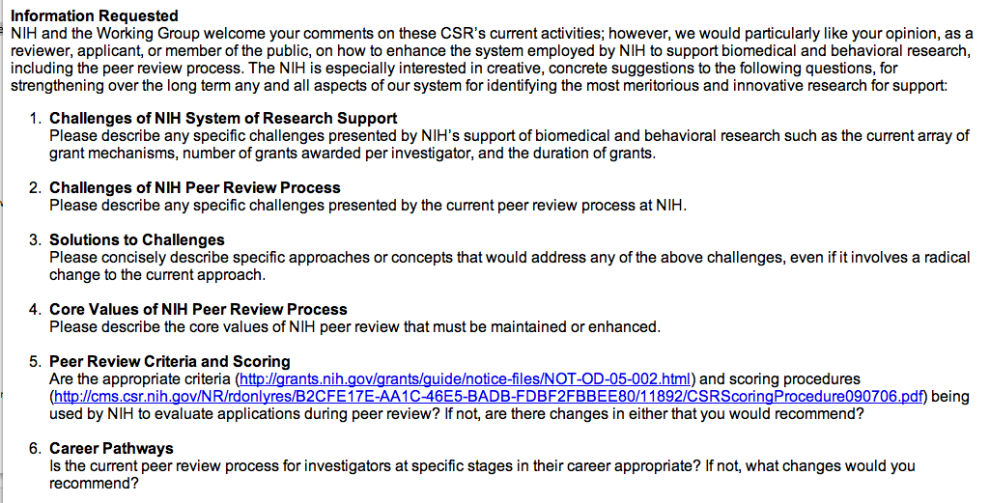
Project Phases
Diagnostic Phase
  NIH received strong response to a Request for Information

Slide 10
Project Phases
Request For Information:
>2600 responses
Diagnostic:
Data Collection
2 Deans Teleconferences
~100 participants
5 Regional Meetings:
Washington, DC
Chicago
New York City
San Francisco
Washington, DC
Jul 07 – Jan 08
Scientific Liaisons
NIH Staff
>200 responses via website

Slide 11
Project Phases
External Synthesis:
Request for Information
Diagnostic:
Analysis
Jul 07 – Jan 08

Slide 12
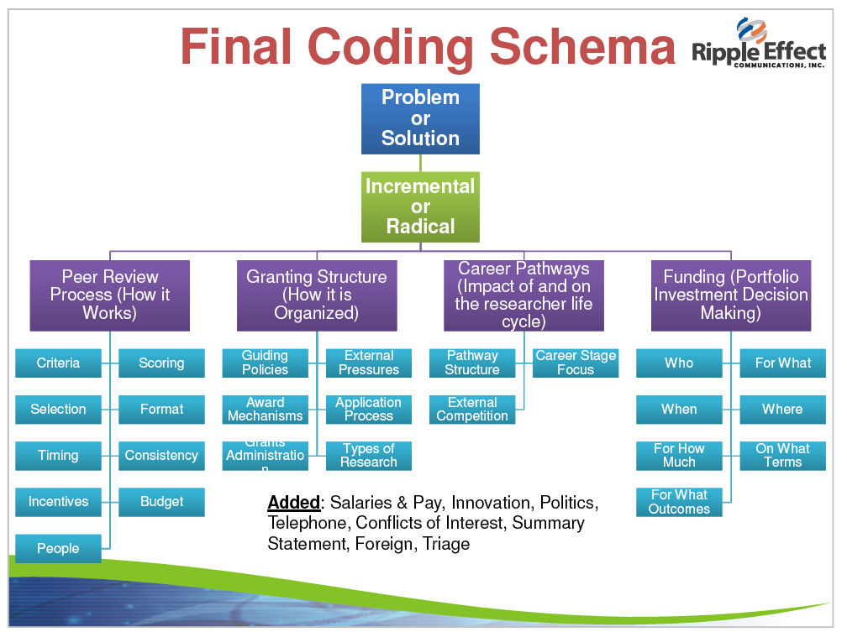

Slide 13
Project Phases
External Synthesis:
Request for Information
Diagnostic:
Analysis
Internal Synthesis:
Tabular Summary of Input
Analysis of Other Agencies:
Domestic
International
Jul 07 – Jan 08
Working Group Meetings:
Steering Committee WG
Advisory Council to the Director WG

Slide 14
Project Phases
February 2008:
NIH Leadership determines next steps, including pilots
Implement
“low hanging
fruit”
Design pilots
March 2008:
Design and initiation of pilots and associated evaluations commence
Feb 08 –

Slide 15
Project Phases
Implementation plan
Briefings
Expansion of
successful Pilots
Implementation
New NIH Peer-Review Policies

Slide 16
http://enhancing-peer-review.nih.gov/
Some Emerging Ideas*
*Please note: These are not in any priority order. They are presented only to facilitate discussion and feedback and to encourage attendees to think of additional issues
In addition, selection of ideas for follow-up is not predicated on the “Village vote”

Slide 17
Some emerging ideas
    Review Criteria
      Reviewing the project versus the person
        Retrospective versus prospective reviews for competing applications
      Many suggestions about how to change review criteria to increase risk taking/”innovation”/impact or public health focus
        Matrix scoring to evaluate multiple dimensions of an application
      Too much emphasis on methodology and preliminary data
        R21’s have become “mini R01’s”
        Kills innovative/risky ideas that typically have minimal precedent

Slide 18
Some emerging ideas (cont.)
New Models of Review
  New models of review
    The “Wisdom of the Crowd”
      Even though many lament that there are too many people on study sections - more, rather than fewer people should review applications
      Electronic review / asynchronous discussion / blogs
      Two stage review: editorial board model
    Establish applicant/reviewer dialogue to correct factual errors
    Reviewers should be blinded to applicant identity during first phase of review; “environment” and investigators are rarely an issue
    Different types of review for different types of science
      Clinical/Community-based research
        requires involvement of patients/community members in the review

Slide 19
Some emerging ideas (cont.)
Maximization of Review(er) quality
  Provide in depth training for reviewers
  Incentives to attract and retain most qualified reviewers
    Add time to extant grants
    Supplement extant grant for p/t administrative help
    Make service more flexible - 2 rather than 3 times per year
    Increase honorarium to reflect effort required
  Rate the Reviewers/Scientific Review Officers
  Don’t publish reviewer ID (e.g. NSF)// Identify reviewers
  Place an ombudsperson on each study section

Slide 20
Some emerging ideas (cont.)
Reviewer Mechanisms/Mechanics
  Rethink design of an original submission in view of low A0 success rates- “clogs” queue
    Pre-applications to provide rapid identification and separation of competitive from non-competitive ideas, and meaningful advice to A0 applicants
      Locus of pre-application review: electronic review by Peers -- NIH staff
    Administratively consider those applications that can contain minor, easily correctable deficiencies, for funding, rather than placing them back into the queue
  Provide more useful feedback to applicants
    Provide scores to applications currently “un-scored”or score and discuss all applications (particularly for new investigators)
    Tell applicants, unambiguously, if the application is “NR”- not recommended for revision and resubmission

Slide 21
Some emerging ideas (cont.)
Peer Review Culture
  Do “peers” make the best reviewers?
  How can we re-capture the prestige of being a reviewer?
  How much “context” should Reviewers be provided (“firewall”)
    Portfolio analysis of the Institute/NIH current investment in area?
    NIH/Institute priorities?
    Should there be a “third” level of review assessing public health and societal impact?
  “Face-to-face” versus “virtual” dynamics
  Change evaluation to focus on strengths not weaknesses
    Focus on the potential impact of the proposal and not the methodology
    Role is not to “re-write” proposal but to review it’s merit

Slide 22
Some emerging ideas (cont.)
Scoring
  Have study section rank each proposal reviewed at the end of the meeting (and then revisit scores to each to ensure consistency and fairness)
    All members must remain to have their vote “count”
  Completely redo scoring system to break old habits
  Use a 7 point scale rather than the 150 (de facto) point scale
  Use matrix scores for each criteria or dimension
    For example, two scores - application as received/best potential score
    Criteria could be weighted (e.g. Public health impact)

Slide 23
Some emerging ideas (cont.)
  Mechanisms
    Reinstitute mechanism for new investigators (R23/29) that is reviewed separately and is appropriately resourced
    Review different mechanisms in different study sections or at different times of the meeting
    Sharply reduce the number of mechanisms - too confusing and used for different things by different Ics
    Do we need different mechanisms for scientists at different stages of their careers?
      New investigators - entry into the system
      “Established” investigators - stability
      Senior investigators - giving back
    Make the NIH system more accessible for “non academic” organization

Slide 24
Some emerging ideas (cont.)
  Other issues related to system used to support research
    How many R01’s is enough?
      Too many overlapping R01’s
      Require minimum percent effort as PI (20/25/33/40%) with no transfer to junior associates allowed except in extraordinary circumstances (illness; PI is leaving academia and is relinquishing all grants)
    Should R01s remain the “gold standard” of investigator success? - (Support for R01s vs. “top down”/”big” science)
    Indirect costs

