Slide 1
EOS Validation
Data Flow
November 17, 1999
Dick Olson - rjo@ornl.gov
Bob Cook - xcx@ornl.gov
Oak Ridge National Laboratory
Oak Ridge, Tennessee
http:www-eosdis.ornl.gov

Slide 2
Elements of Distributed System
Terra Products - MODIS at EDC DAAC
Field Data
  24 core validation sites
  many investigators collecting data at sites
  other data sources (MQUALS, AERONET)
Mercury System - ORNL DAAC
  Web-based, distributed data search and delivery
EOS Land Validation Web page
Validation Investigators
  comparison of products and field data

Slide 3
Data Flow: Loading Metadata
MODIS
Products
MODIS
Validation
Web Page
EDC DAAC
FTP Site
Mercury
(Metadata)
ORNL DAAC
Site 3
OME
Validation
Investigators
Site 2
ORNL
Validation
Web Page
PI-1
PI-2
Site 1
Other
Data
PI-3
…
PI- n

Slide 4
Data Flow: Retrieving Data
MODIS
Products
MODIS
Validation
Web page
EDC DAAC
FTP Site
Site 3
Mercury
(Searching)
ORNL DAAC
Validation
Investigators
Site 2
ORNL
Validation
Web page
PI-1
PI-2
Site 1
Other
Data
PI-3
…
PI- n

Slide 5
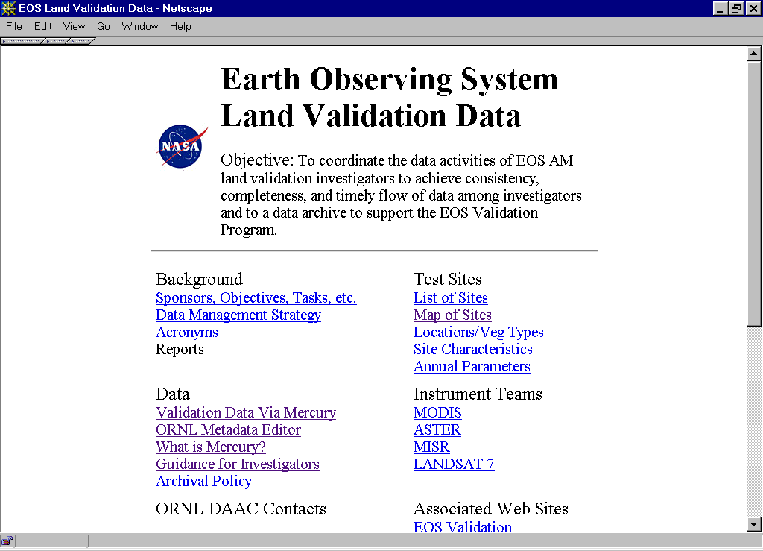
http://www-eosdis.ornl.gov/eos_land_val/valid.html

Slide 6
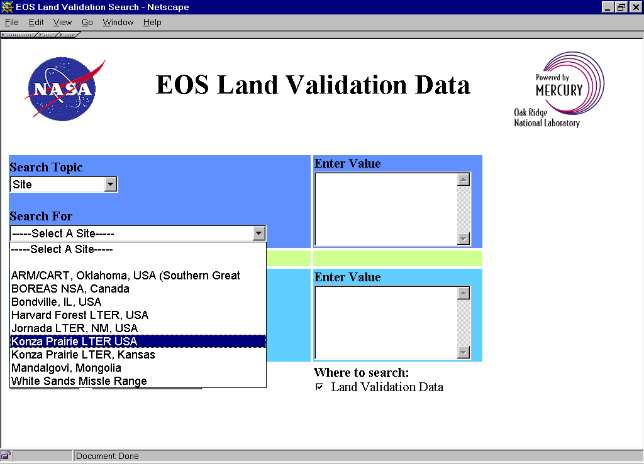
http://mercury.ornl.gov/servlet/landval

Slide 7
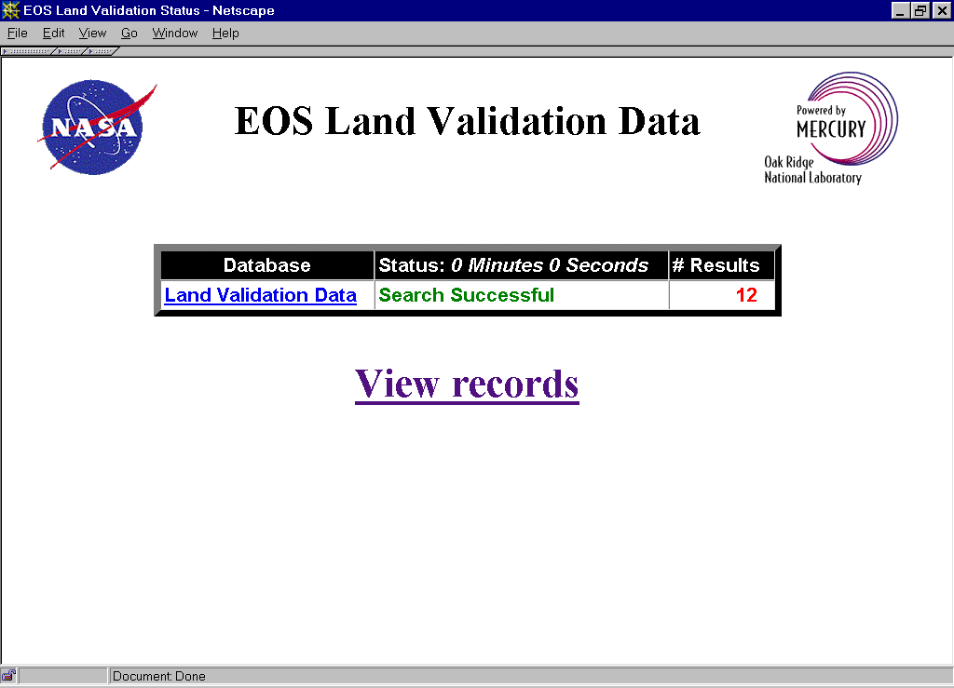

Slide 8
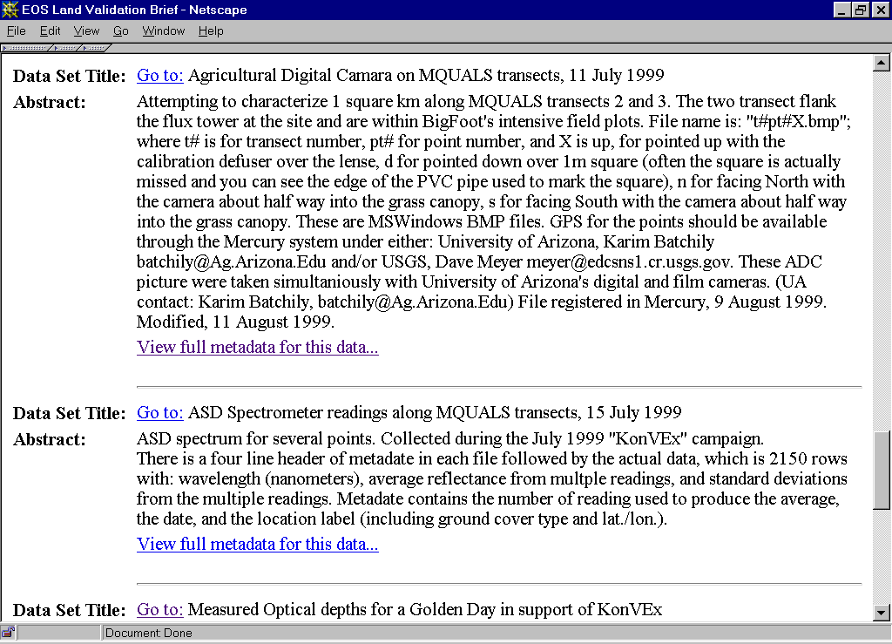

Slide 9
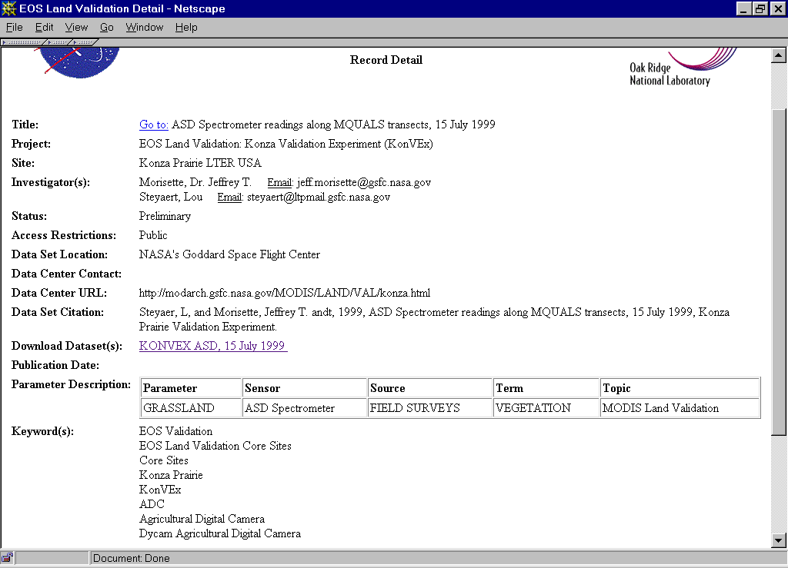

Slide 10
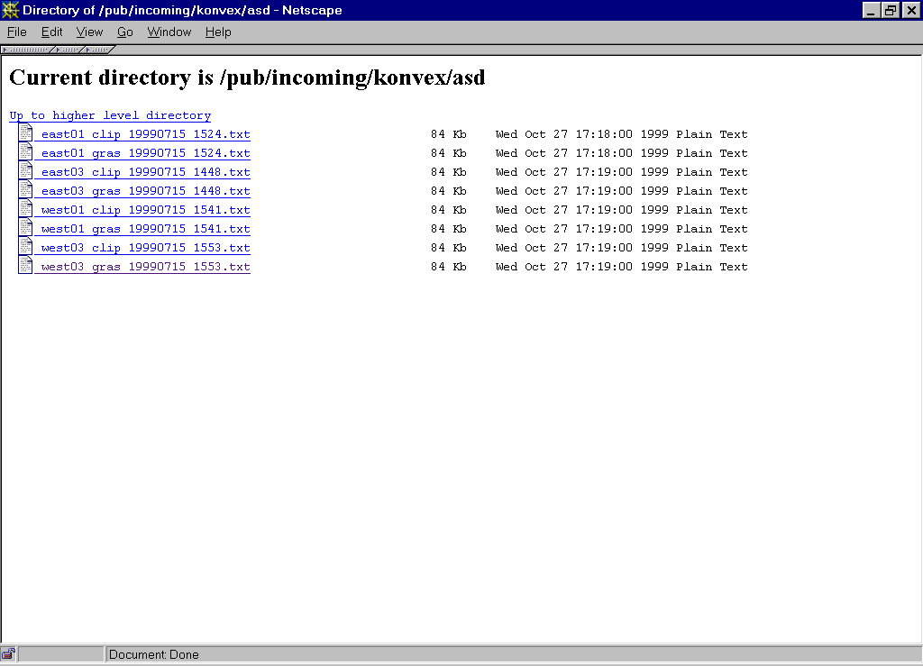
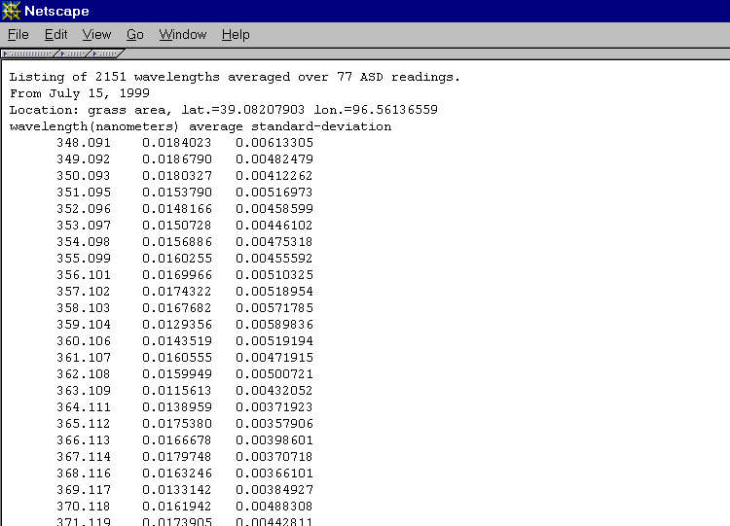

Slide 11
Using the Mercury System and OME (ORNL Metadata Editor)
Organize your data
Put data on a local Web or FTP server
Request user ID for OME
Enter metadata with OME (links to data)
Make data “Searchable”
Metadata are harvested each night
If needed, make data “UnSearchable” and update your data

Slide 12
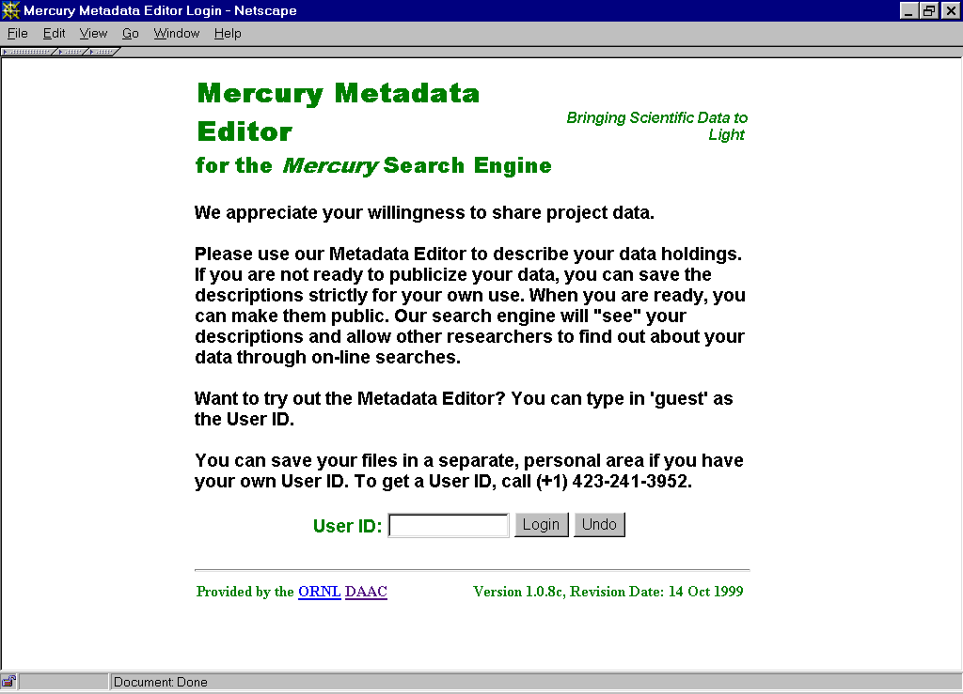
http://daacl.esd.ornl.gov/cgi-bin/MDE/MERCURY/access.pl

Slide 13
Registering for the
ORNL Metadata Editor
Email:
  Name
  Project - EOS Validation
  Preferred login name, if any.
  Email address
  Phone number
Send to: Cindy Myers <mye@ornl.gov>
You will receive an email confirmation

Slide 14
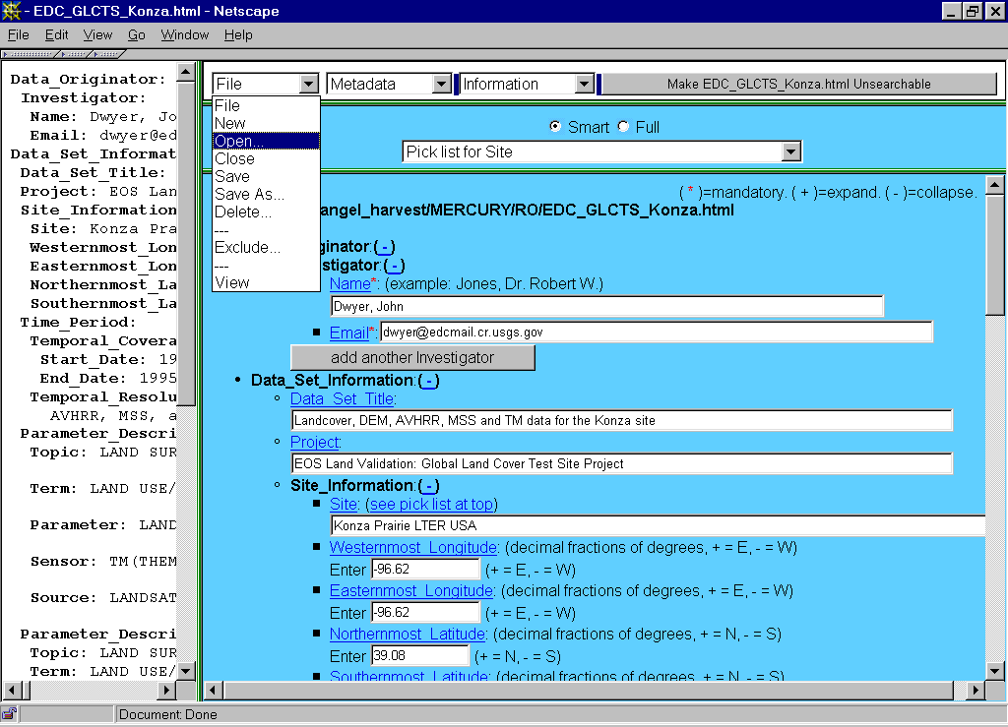

Slide 15
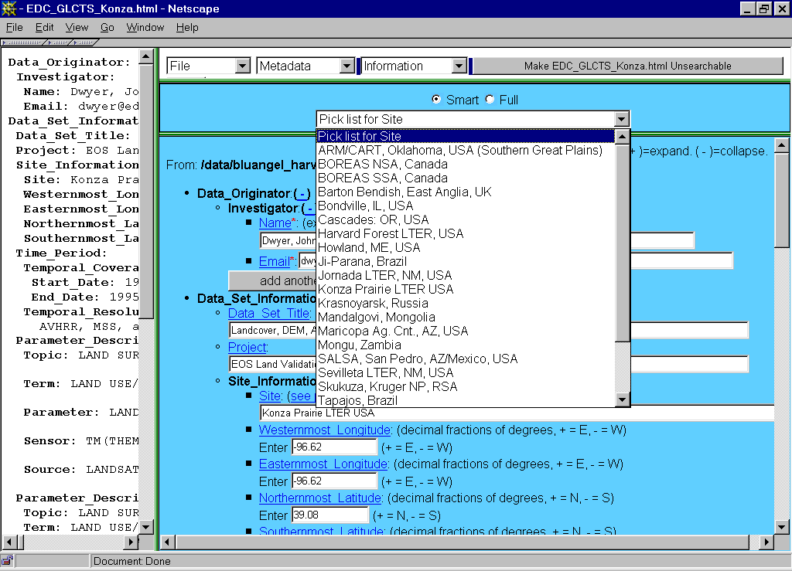

Slide 16
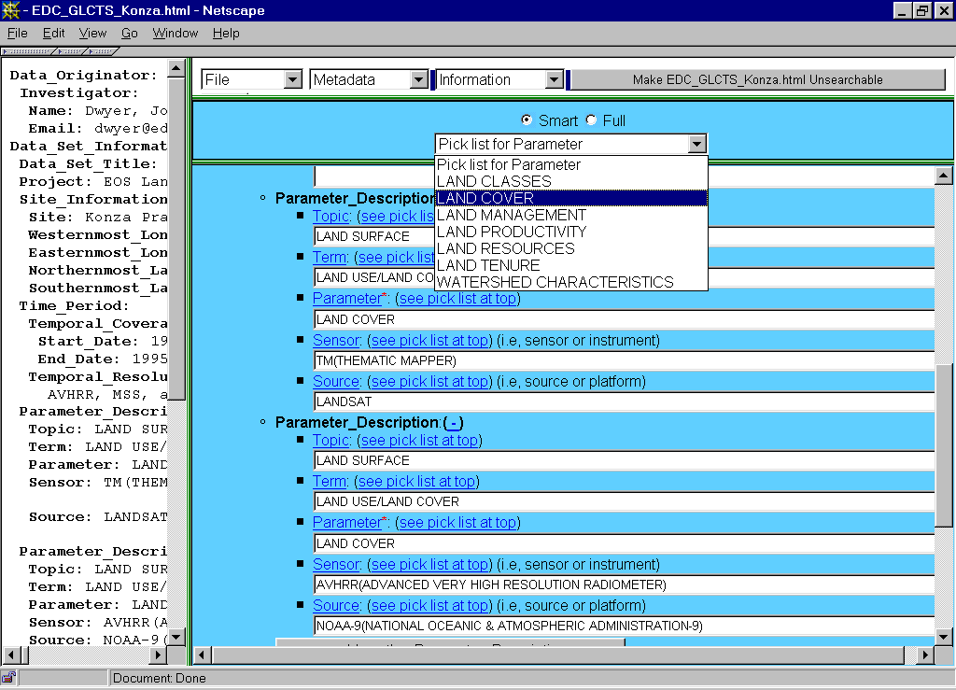

Slide 17
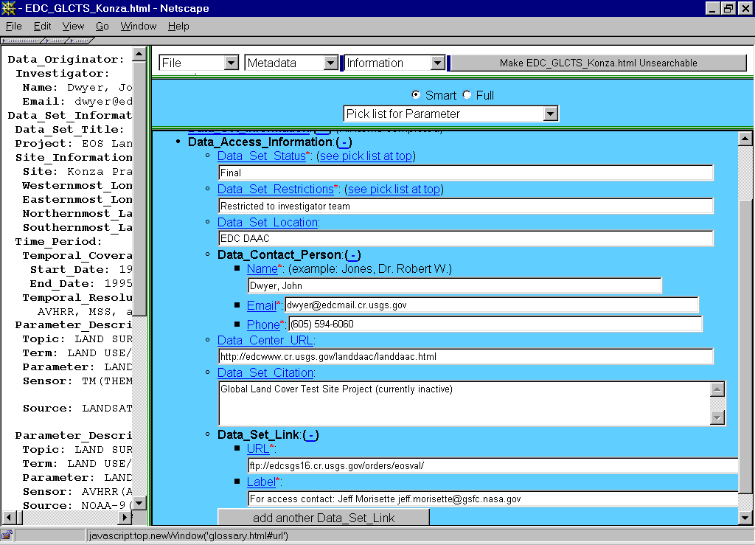

Slide 18
Data Concerns
Validation data may not be available from investigators as soon as needed
Different formats, file organization, units of measure for each site/investigator
  should small field-data files be HDF?
Comparison of MODIS products to field measurements may not be performed in a routine and consistent manner at each site

Slide 19
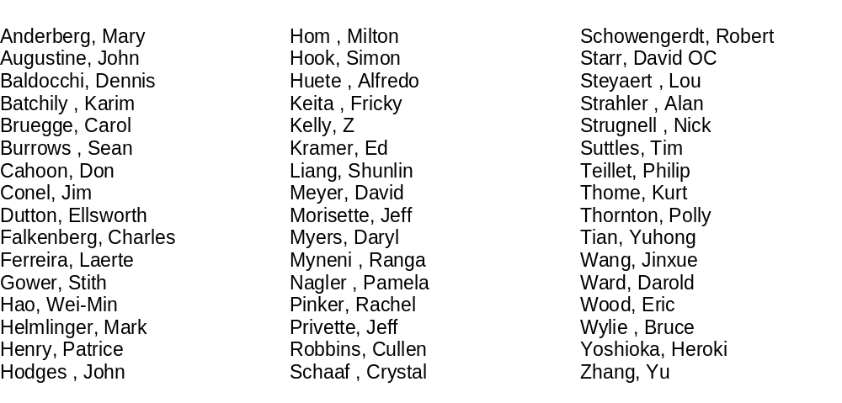
Validation Scientists Registered with the ORNL Metadata Editor

