Slide 1
Fermi Timing Systems and Project X

Slide 2
Multi-Level System Timing
    TCLK
      High Level Machine Coordination
    Beam Sync Clocks
      Machine Specific Bunch Level Timing
    Machine State on data links
      MDAT
      Ethernet

Slide 3
TCLK
    Provides high level machine coordination for complex
      Overall complex timing set via Timeline Generator (TLG)
    Available in all machine locations
    10MHz Carrier
    Modified Manchester Encoding
    10 bit event frame
      Start bit (0)
      8 bit event data (256 events)
      Parity bit
    2 carrier cycle minimum event spacing
      Minimum event spacing 1.2 uS
    Event prioritization
    Jitter ~1nS (multimode fiber transmission)

Slide 4
Timeline Generator (TLG)
    Provides primary TCLK system interface via D69 application
      Allows quick reconfiguration of operational scenario(s) for accelerator complex
    Supercycle
    Timeline
      Continuous timelines
      One shot timeline function
      Sequencer loading
    Timeline Modules
      Multimode modules
      Intermixing modules

Slide 5
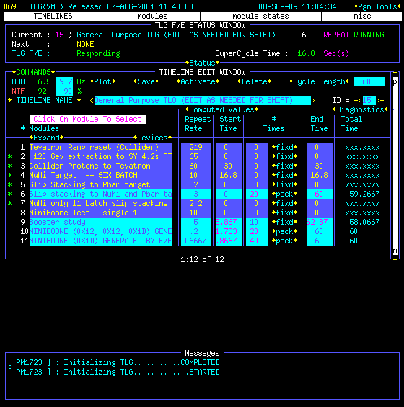

Slide 6
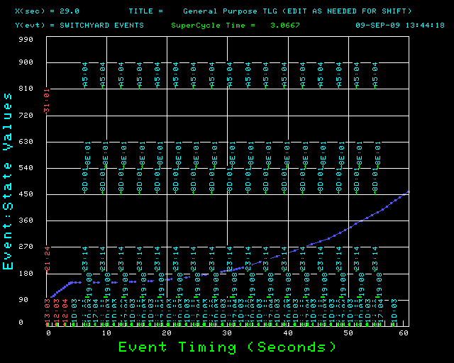

Slide 7
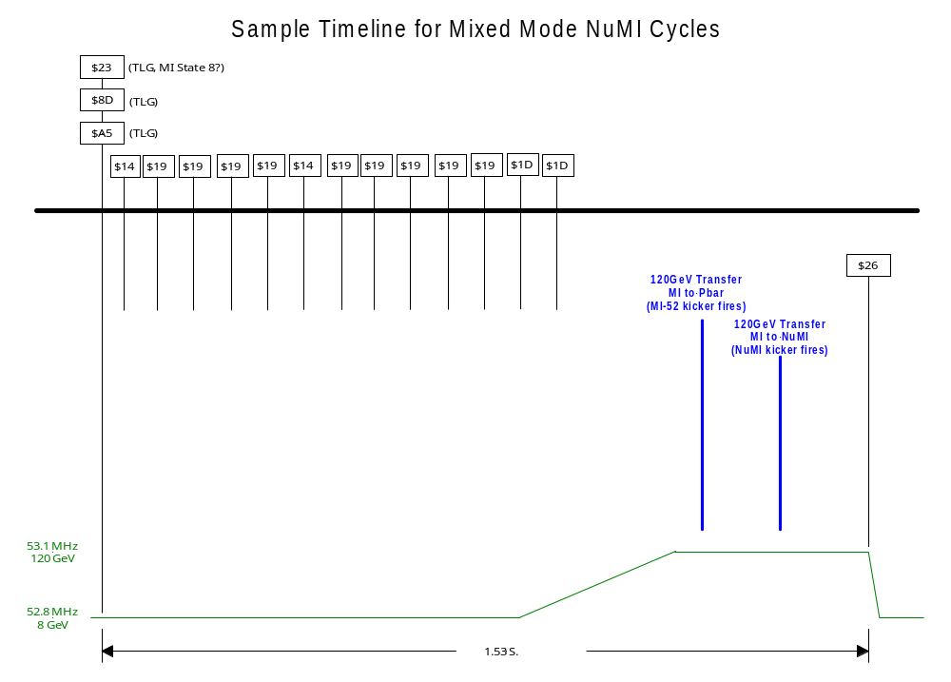

Slide 8
Beam Sync Clock(s)
    Machine Specific
      Separate clocks for MI, RR & Tevatron
    Provides bunch level timing
      Kickers, BPMs, etc.
    Turn Markers
    Beam transfer events
    Machine rf/7 carrier
    Modified Manchester encoding
    10 bit event frame
      Start bit (0)
      8 bit event data
      Parity bit
    Minimum event spacing ~1.6 uS
    Jitter ~1nS (multimode fiber transmission)

Slide 9
Machine State on Data Links
    MDAT Link
      Carries data frames for ramps, intensities, machine states, etc.
      Frames update/repeat at 720 Hz.
      Continuous transmission
    Ethernet Multicast
      Single Ethernet broadcast on change in machine state

Slide 10
Project X Clock System Configurations
    8 GeV Linac
      Project X Clock
        TCLK available to legacy equipment
      RRBS provided to source for synchronization
    2 GeV Linac with Rapid Cycling Synchrotron (RCS)
      Project X Clock
        TCLK available to legacy equipment
      RCS Beam Sync Clock provided to source for Linac to RCS synchronization
      RRBS provided to RCS for RCS to Recycler synchronization

Slide 11
Project X Clock (ACLK/XCLK?)
    Upgrade/eventual replacement for TCLK
      Will provide high level machine coordination for complex
      Will need to be synchronized with TCLK to provide support for existing hardware (MI, RR, NuMI, etc.)
    Gigabit (or faster)
    16 bit clock events
      $0000 - $00FF match existing TCLK event definitions
    Event count (16/32 bit?)
      Allows for unique Event & Count for data sorting
    Sourced by new TLG
      Also source TCLK to enforce synchronization
    Open frame space under TCLK event frames may be used to broadcast non-TCLK events ($0100-$FFFF)
    Transmission path through Linac opposite beam

Slide 12
RCS Beam Sync Clock
    Provide bunch level timing
      Kickers, BPMs, etc.
    Turn Markers
    Beam transfer events
    Machine rf carrier (50-52.8 MHz)
    Modified Manchester encoding
    10 bit event frame
      Start bit (0)
      8 bit event data
      Parity bit
    Minimum 2 rf cycle between event frames
      Minimum event spacing ~240 nS

