Slide 1
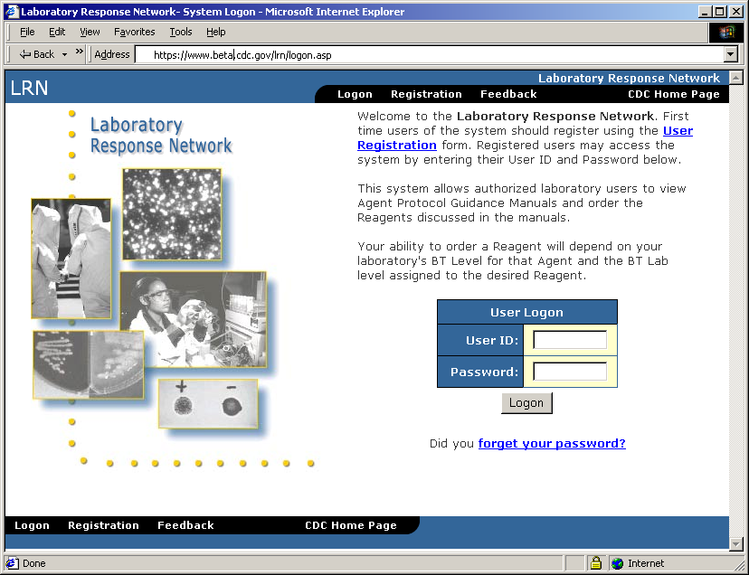
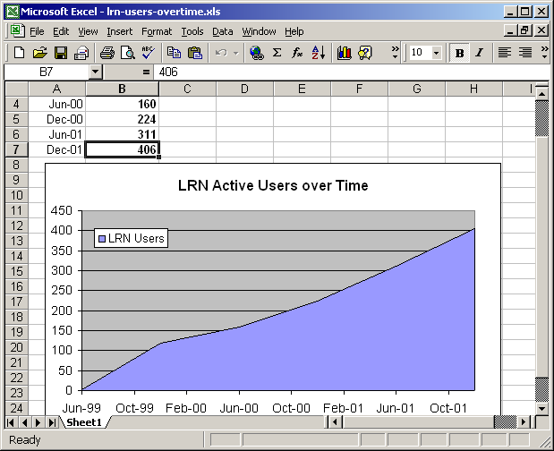
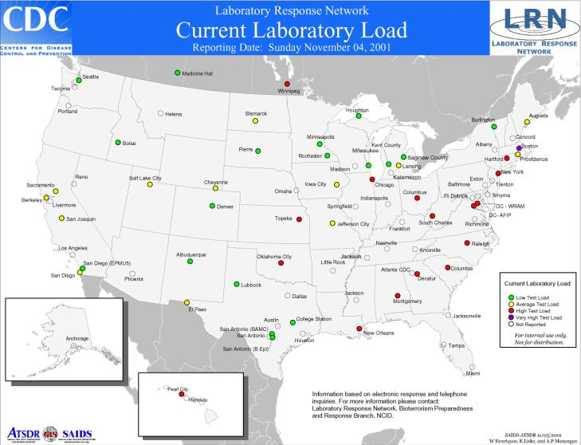
Proposed LRN Laboratory Reporting Using NEDSS Standardized Messages
Data
available for sentinel surveillance
Level 0
Interim
MS Excel
Spreadsheet
Standardized
Parser
Upload
to LRN site
Data
generates
GIS maps on
LRN site
Downloaded from LRN site
Spreadsheet available in 8 weeks
Interoperability
to communicate w/ other State & Federal partners
Data
available for BT sentinel surveillance
Level 1
Improvement
…
MS Access
Template
w/ Messaging Client
Parser
Messages
sent to LRN
Data
generates
GIS maps on
LRN site
Downloaded from LRN site
Template available in 6 months, allowing for more robust reporting & receipt
Interoperability
to communicate w/ other State & Federal partners
Data
available for BT sentinel surveillance
Level 2
Robust
…
Custom
LITS
HL7 compliant
Parser
Messages
sent to LRN
Data
generates
GIS maps on
LRN site
Custom-built database(s), w/ parser linked
Standardized message in 8 weeks
Morris, Bray et al, CDC

