Slide 1

Diabetic Foot Ulcer Treatment and Amputation Prevention in Non-Tertiary VA Care Facilities
Gregory J. Raugi, MD, PhD
Gayle E. Reiber, MPH, PhD
VA Puget Sound Health Care System
Funding Support from VA HSR&D, RR&D – VISN 20

Slide 2
The VA Situation for Veterans with Diabetes
5,000,000+ patients in the VA system
1,000,000+ have diabetes
150,000+ will develop a foot ulcer some time during their lives

Slide 3
Unique VA Diabetic Foot Ulcer and Amputation Patients by Setting
FY 2003-2004
 | Tertiary Care Centers (66) | Primary and Secondary Care Centers (91) | Community- Based Outreach Clinics (862)
Total number of unique ulcer patients | 21,817 | 15,826 | 7,787
Amputations | 3,426 | 1,612

Slide 4
Standards for Diabetic Foot Ulcer Care
  “Good Wound Care”
  Set of principles should be applied to every patient at each encounter:
    →Debride callus, devitalized tissue
    →Measure the wound
    →Treat invasive bacterial infection
    →Offload weight
    →Provide moist healing environment
    →Provide a global assessment
    →Schedule regular follow-up – continuity of care

Slide 5
Walla Walla Project
Diabetic Foot Ulcer Treatment and Amputation Prevention in a Rural VA Facility
  Retrospective analysis of data abstracted from veterans with diabetic foot ulcers
  Prospective study of patient and ulcer outcomes; patient, provider, and institutional acceptance.

Slide 6
Specific Questions
Will good wound care be delivered and documented more frequently in diabetic foot ulcer patients during the intervention period versus the comparison period?
Will delivering a package of good would care be associated with decreases in time to healing and increases in ulcer-free survival?
Will delivering a package of good wound care improve patient, provider and institutional acceptance for organized wound care?
Will a package of good wound care be safe and transportable for a subsequent VA clinical trial of diabetic foot ulcer treatment in non-tertiary care facilities?

Slide 7
Walla Walla VA
Primary Care VA Medical Center
Serves ~70,000 veterans; catchment area of 42,000 square miles
  3 CBOCs
10 primary care providers
  No full-time specialists
  Community podiatrists – contract care
26-bed Skilled Nursing Home

Slide 8
Assessing the Foot Ulcer Problem at Walla Walla VA
Review of administrative data on foot ulcers and amputations:
    180 foot-ulcer-coded patients in 2003-4
    125 unique patient records
    46 had diabetic foot ulcer (diabetes, at least one foot, and an ulcer at or below the malleoli) - 37%
    79 did not have a diabetic foot ulcer – 63%
      8 veterans were dead before FY 2004
      5 had no documented history of diabetes
      47 had no documented ulcer during FY 2004
      19 had lower limb ulcers but did not meet criteria for the diagnosis of diabetic foot ulcer

Slide 9
Assessed Interest Level of Administrators and Providers
Interviews with key Walla Walla VA and community providers
Surveyed providers, 77% responded
Identified a need for organized wound care

Slide 10

Implementing the Project
We wrote, negotiated, and signed a cooperative agreement with the site PI (CMO)
Stipulated:
  Purpose, time frame
  Walla Walla leadership selects team
  Seattle trains and monitors team
  Seattle provides clinical back-up
  Seattle provides Foot Ulcer CPRS template
  Both provide resources

Slide 11
Intervention Components:
Team Education and Training
University of Washington Nursing and Medical School courses
Practicums, Seattle VA and Harborview
Study protocol and procedure manual
On-site supervised experience
Certification Exams

Slide 12

Intervention Components
Team Building
Bimonthly visits to Walla Walla
3-hour Derm/Wound clinics
Patient rounds
Journal Club, M&M conferences, CNE
Team meetings, activities
Open Medical Center meetings

Slide 13

Intervention Components:
Team Communication and Coordination
Weekly V-tel conference – progress and problems
Tele-wound consultation
24/7 back-up
Assist with patient transfers

Slide 14
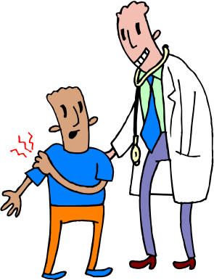
Intervention Components:
Patients
Usually same day care
Very high satisfaction
Consultation as needed

Slide 15
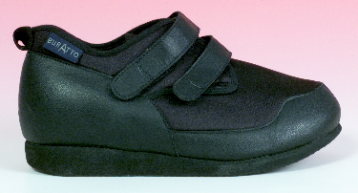
Intervention Components:
Logistics
Space and scheduling
Clinic equipment
Same day Rx and dressing supply formularies
Same day off-loading devices

Slide 16
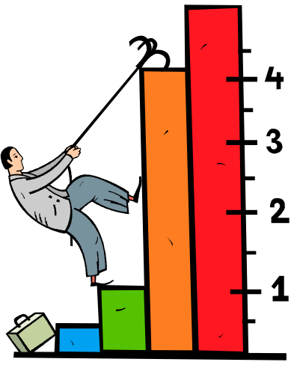
Intervention Components:
Medical Center Staff
Co-locate wound clinic in primary care
Within medical center, recognition of service potential
Consults (drive by, scheduled)
Bimonthly clinics, education
Involved in problem solving

Slide 17
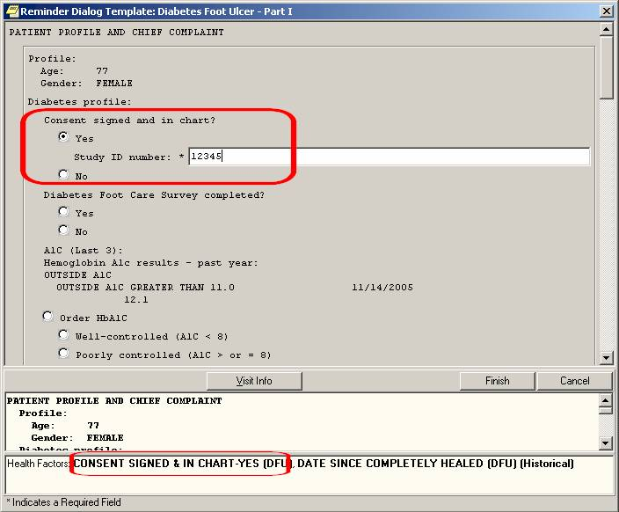
Chart Note Template

Slide 18
Intervention Components:
Clinical Information System
Notebook computers with stylus
Foot ulcer data collection template built into CPRS
Automatically gathers information from prior encounters and “feed forward” to today’s visit
Based on principles of “good wound care” thus collects and integrates the proper data
Prevents important omissions
Allows oversight by off-site experts/case managers; pictures, x-rays, images shared
Streamlines ordering, justifies coding, & documentation
Facilitates communication with PCPs

Slide 19

Intervention Components:
Other Measures
Provider Assessment X2
Patient Baseline Questionnaire
Patient Healed Questionnaire
Patient Satisfaction @ each visit

Slide 20
Enrollment
All wound patients seen
10-1-06 – 9-30-07
N=217
Patients with diabetes
and foot ulcers
66
No diabetes,
other ulcers
N = 151
Met Expert Panel
definitions
Did not meet
criteria
16 patients
Analysis Data
50 patients
84 ulcers

Slide 21
Findings
No patients with a diabetic foot ulcer declined to participate in the study.
No patients were lost to follow-up.
One patient withdrew (in anticipation of death).

Slide 22
Patient Characteristics
Age (years) | Mean = 66 ± 11 Range = 46 - 89
BMI | Mean = 34 ± 7.4 Range = 19 - 51
Level of Diabetes Control HbA1c ≥ 8.0% | 32%
Renal Disease Cr ≥ 2.0 mg/dl | 6%
Pre-existing amputation at baseline | 10 patients 20 amputations

Slide 23
Clinician versus Patient Report
 | Clinician Report | Patient Report
Neuropathy present at baseline | 81% | 58%
Foot Deformity present at baseline | 30% | 30%
Depression present at baseline | 2% | 34%

Slide 24
Findings
  Accounting for competing risks, the intervention group had significantly shorter times to healing and a greater percentage of healed ulcers (p=0.002) comparing the 2003 to the 2007 period. The amputation rate was 23.4% in 2003 and 12.5% in 2007.

Slide 25
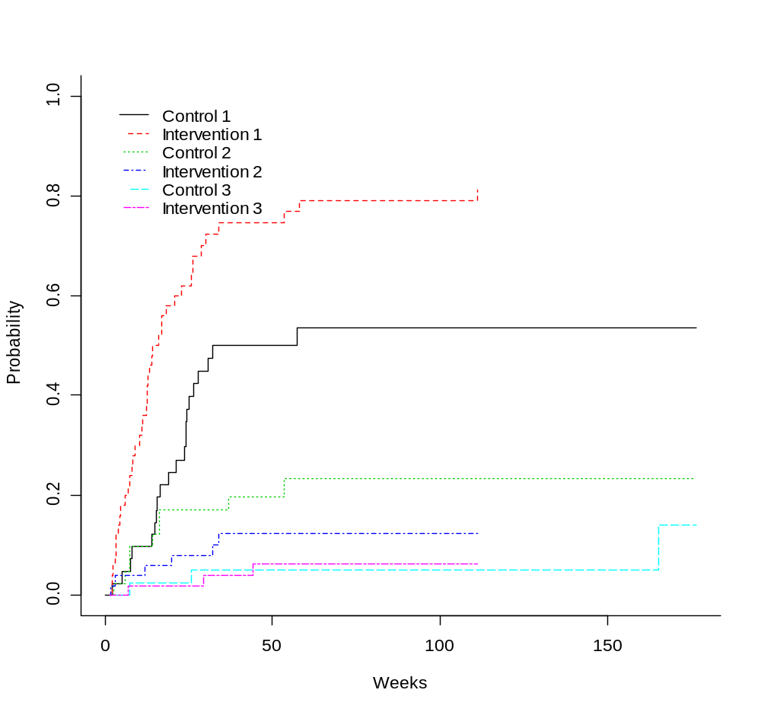
Time to Healing, Amputation and Death in FY 04 Comparison Group and FY 07 Intervention Group
Probability
Weeks

Slide 26
Patient Satisfaction
At the end of each encounter, study patients were given a patient satisfaction form to fill out anonymously and mail to the study coordinator.
The average number of satisfaction reports per patient was 6.3; SD 3.5. The range was 1-18.

Slide 27
Patient Satisfaction Results
25.4 % of study ulcer patients reported their health as fair or poor
96% of patients reported their satisfaction with foot care at excellent, very good or good
6.6% identified there were VA foot care services not received
2% identified they were not involved enough in their foot care

Slide 28
Specific Questions
Will good wound care be delivered and documented more frequently in diabetic foot ulcer patients during the intervention period versus the comparison period?
Will delivering a package of good would care be associated with decreases in time to healing and increases in ulcer-free survival?
Will delivering a package of good wound care improve patient, provider and institutional acceptance for organized wound care?
Will a package of good wound care be safe and transportable for a subsequent VA clinical trial of diabetic foot ulcer treatment in non-tertiary care facilities?

Slide 29
Summary
The wound care program is continuing, now with a screening and surveillance component
Leadership is critical in implementing a wound care program
Training, educational updates, clinical back-up, regular review and discussion are all important staff considerations
Patients have been well served

Slide 31
Implementation Analysis
We asked colleagues at the Ann Arbor VA
to independently evaluate the program
at Walla Walla.
Their findings follow.

Slide 32
The “Perfect Storm”
Ann Arbor Findings
The PCP who ultimately became the team leader was already aware that the facility was unable to properly treat wounds.
  The COS was also aware.
Tension for change was high.
  The PCP had already started trying to care for patients with wounds.
  She recognized the need for more training, access to clinical expertise.
“Good Wound Care” had a relative advantage over other potentially competing programs because of built-in access to Seattle experts.

Slide 33
Two Key Factors
Ann Arbor Findings
Intentional enrollment of team members and related team-building processes.
  Active involvement of the COS in recruitment.
  Widespread respect for the Team Leader among her peers.
  Exceptionally enthusiastic and professional nurse.
  Intuitive and proactive health technician.
  Enthusiastic OT who gracefully balanced pressures from several fronts.
  Multi-tasking scheduler managed patient and staff issues.

Slide 34
Two Key Factors
Ann Arbor Findings
Research facilitators struck a good balance between accomplishing the research goals and giving ownership of the program to the on-site stakeholders.
  Tension between how much the research facilitators should do and how much the local practitioners should do.

Slide 35
Team Building
Ann Arbor Findings
Significant amount of time was invested in education and training in Seattle.
Research facilitators were available throughout the implementation and study.
Mutual trust and respect evolved into genuine friendships.

Slide 36
Ripple Effects
Ann Arbor Findings
Team leader willingly consulted for other PCP’s patients without a formal consult.
    Garnered awareness and trust.
    PCP identified problems earlier.
    Rapid referral to Wound Clinic.
Team members were energized by success – expansion of the wound clinics.
Positive experiences of the team creates a fertile context for future innovations.
New working relationships across 4 major services at WW benefits collaborative work in other areas.
COS involvement in problem-solving increased staff confidence in his leadership.

