Slide 1

Improving Collection of Client Identifiers
July 29, 2010

Slide 2

Welcome!
The State Office of AIDS is now working with providers to improve the quality of data that is collected and entered into ARIES.
Today’s webinar will focus on Client Identifiers – particularly client’s Middle Initial (MI) and Mother’s Maiden Name (MMN).

Slide 3
What are Client Identifiers?
Each client in ARIES has an extended unique record number (e-URN). The e-URN helps distinguish one client from another.
The e-URN is composed of the first and third characters of the client’s first and last name, his date of birth and gender, his middle initial, and the first and third characters of his mother’s maiden name.
All of these fields are required by ARIES. A user can not register a new client without this information.

Slide 4
What are they used for?
It is important to accurately collect and correctly enter Client Identifiers because this information is required by all programs and is needed to complete HRSA’s Ryan White Services Report (RSR) and Ryan White Data Report (RDR).

Slide 5
What are they used for?
This information may also be used by:
  Your agency to locate the correct client record when adding new medical or service data for a given client or to run the HAB Quality Management Reports (Group 1 and 2).
  Administrative Agencies and/or the ARIES Help Desk to correctly merge duplicate client records.
  Health Departments and the Office of AIDS to calculate an accurate, unduplicated client count.

Slide 6
Editing Client Identifiers
We’re going review the steps for editing Client Identifiers for an existing client.
We’ll also give tips for collecting accurate information. These guidelines apply to creating new client records as well.

Slide 7
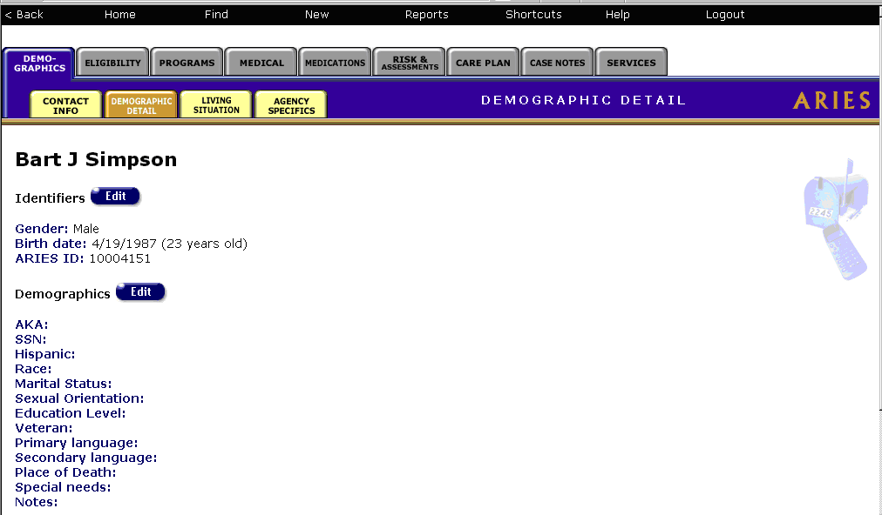
Begin by finding the client record and…
Clicking the “edit” button on Identifiers
under the Demographic Detail tab.

Slide 8
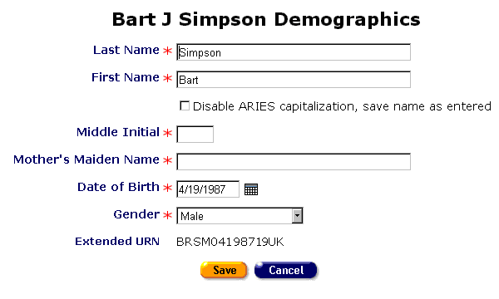
First and Last Name
If necessary, edit the client’s first and last name if necessary.
Avoid using nicknames or initials in these fields.

Slide 9
Middle Initial
Make an effort to collect the client’s middle initial. In this example, Bart’s middle name is Jo-Jo so you should add a “J” to this field.
If the client does not have a middle name, or is unwilling to provide the middle initial, leave this field blank.

Slide 10
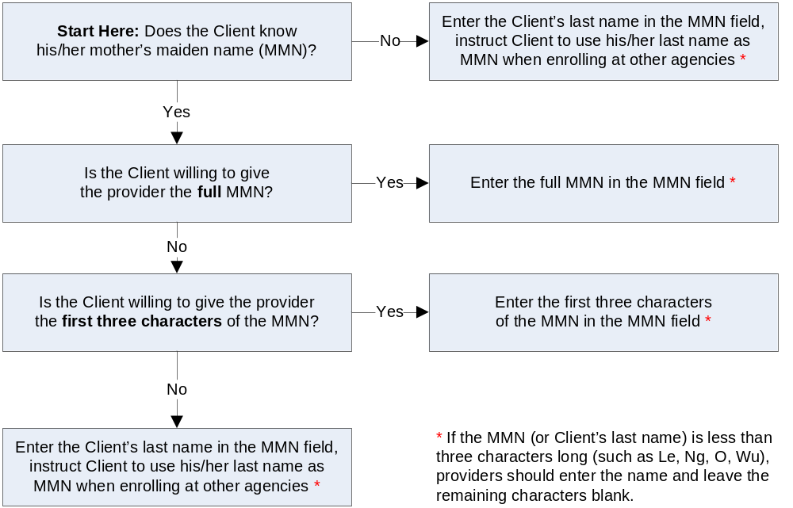
Collecting MMNs
Some clients may be reluctant to divulge their MMNs. This “decision tree” can help staff work through this process.

Slide 11

Entering MMNs
Even though it was previously entered and saved, the MMN does not appear on this screen for security reasons. If you leave this entry blank, ARIES maintains the previously entered MMN.
You only need to enter a MMN on this screen if you have reason to believe that the original information was incorrect.
We know Bart’s MMN is incorrect. We can tell by looking at the last two characters of his e-URN that a previous user entered “Unknown” as his MMN. Bart’s real MMN is Bouvier so you should enter “Bouvier.”

Slide 12
When entering MMNs, do not
Enter any numbers.
Type in “Unknown” or “UNK.”
Do not automatically use the client’s Last Name without first working through the “decision tree.”
Leave the field blank.

Slide 13
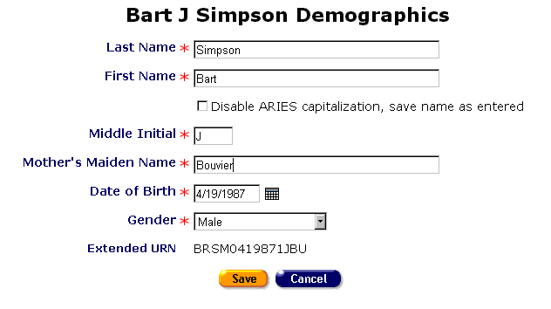
Date of Birth and Gender
If necessary, edit the client’s Date of Birth and Gender.
Type the Date of Birth carefully. It is easy to transpose the numbers.
When finished editing the Client Identifiers, click the Save button.

Slide 14
Editing Client Identifiers
When editing Client Identifiers, ARIES may display this error message: “Client URN Search Save: You cannot have two or more clients with the same URN. Please provide a different set of identifiers.”
If you encounter this message, please call the ARIES Help Desk (866-411-2743) for assistance before moving on.

Slide 15
Running the Fix-It Report
We hope these guidelines help improve data collection in the future.
However, some of your records may need attention now. To find records in your agency that need to be updated, go to Client Reports and select Fix-It: Client Identifiers. Then enter a date range for the last year and click the “Report >” button.

Slide 16
Running the Fix-It Report
What will appear is a report showing all records for clients served by your agency during the date range.
Error messages will indicate which records need attention and why.
The report will look something like this…

Slide 17
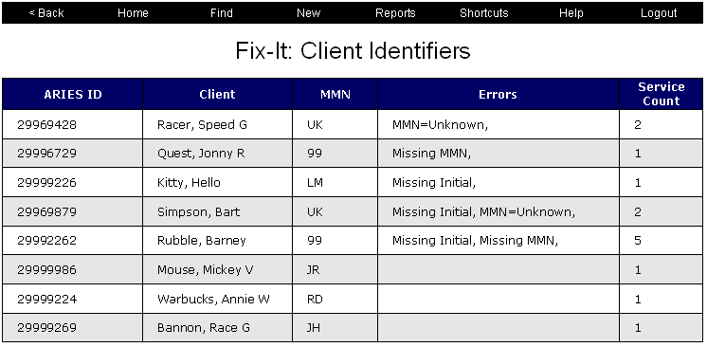
Running the Fix-It Report
This client has “Unknown”
entered as his MMN.
The MMN field for this client is blank.
The MI field for this client is blank.
A blank indicates a good record!

Slide 18
Running the Fix-It Report
Please look up the clients with error message using their ARIES ID.
Try to resolve the error by looking in client’s paper chart for the missing information or asking the client during the next visit.
It may be helpful to add a Client Alert to these client records. This will remind staff to collect this missing information during the client’s next appointment. You can create a Client Alert by going to the Agency Specific screen.

Slide 19
Questions & Answers
Do you have any questions?
Additional Resources:
  The Decision Tree for Middle Initial and Mother's Maiden Name is posted in the Resources/Supporting Documentation section of www.projectaries.org.
  The ARIES User Manual can be accessed by pressing the F1 button while in ARIES.
  The ARIES Help Desk can be reached at 866-411-ARIES.

Slide 20
Thank you!
Thank for participating! We hope that this has been a productive use of your time.
Together we can improved ARIES data quality!

