Slide 1
State of Washington
[Office of Financial Management]
Human Resource Management Report
This is the 10-20-06 email message from Dan Myers about this report:
Here's my "best" effort and I have to say, I'm not real happy with it.
As you both know, I've have some challenges with data. There is a large number of merit system 9 exempt employees in OFM. In addition there are 338 employees listed in OFM (105); however, only 270 employees are what I consider OFM "Proper." The other 68 employees are part of and report to the Governor's Office.
The information on hiring balance, turnover, and diversity is based on 338 employees. The information concerning position descriptions, individual development plans, performance expectations, performance evaluations and employee survey is based on 270 employees. I was not able to provide sick leave or overtime reports.
Finally, some of the labels on the charts did not update (see employee survey charts and diversity chart). The graphs updated but not the labels.
Please let me know if you need anything else from me.
October 16, 2006

Slide 2
Logic Model
Managers Accountability for Workforce Management
Plan & Align Workforce
Hire
Workforce
Deploy
Workforce
Develop Workforce
Reinforce Performance
Articulation of managers HRM accountabilities. HR policies. Workforce planning. Job classes & salaries assigned.
Qualified candidate pools, interviews & reference checks. Job offers. Appts & per-
formance monitoring.
Work assignments& requirements defined. Positive workplace environment created. Coaching, feedback, corrections.
Individual development plans. Time/ resources for training. Continuous learning environment created.
Clear performance expectations linked to orgn’al goals & measures. Regular performance appraisals. Recognition. Discipline.
Staffing levels & competencies aligned with agency priorities. Mgr’s HRM accountabilities are understood.
Best candidate hired & reviewed during appointment period. Successful performers retained.
Workplace is safe, gives capacity to perform, & fosters productive relations. Staff know job rqmts, how they’re doing, & are supported.
Learning environment created. Employees are engaged in develop-
ment opportunities & seek to learn.
Employees know how performance contributes to success of orgn. Strong performance rewarded; poor performance eliminated
Foundation is in place to build and sustain a productive, high performing workforce.
The right people are in the right job at the right time.
Time & talent is used effectively. Employees are motivated & productive.
Employees have competencies for present job & career advancement
Successful performance is differentiated & strengthened. Employees are held accountable.
State government has workforce depth & breadth needed for present and future success
Employees are committed to the work they do & the goals of the organization
Productive, successful employees are retained
Agencies are better enabled to successfully carry out their mission. The citizens receive efficient government services.

Slide 3
Human Resource Management Report
Standard Performance Measures
Plan & Align Workforce
Percent current position/competencies descriptions
Percent supervisors with current performance expectations for workforce management
Time-to-fill funded vacancies
Percent satisfaction with candidate quality New Hire-to-Promotional ratio
Percent turnover during review period
Percent employees with current performance expectations
Employee survey ratings on “productive workplace” questions
Leave usage (sick, LWOP, unscheduled leave)
Overtime usage
Number & type of non-disciplinary grievances
Percent employees with current annual individual development plans
Employee survey ratings on “learning/development” questions
Percent current performance evaluations
Employee survey ratings on “performance accountability” questions
Number/type of disciplinary issues, actions, appeals disposition
Turnover rates and types (e.g., retirement, resignation, etc.)
Turnover rate of key occupational categories and of workforce diversity
Employee survey ratings on “commitment” questions
Hire Workforce
Measures to add in the future:
Current workforce plans that align staff with business priorities
Safety and Workers Compensation measures
Competency gap analysis measure
Recognition/reward measure
Others to be determined
Deploy Workforce
Develop Workforce
Reinforce Performance
Ultimate Outcomes

Slide 4
Overall foundation & management accountability system to build & sustain a high performing workforce
Plan & Align Workforce |
HR Management Report category:
Performance Measures
Percent current position/competency descriptions
Percent supervisors with current performance expectations for workforce management
Agency-wide Percent Current Position & Competency Descriptions
68.5%
Analysis:
102 Classified Positions
102 CQ’s or PDF’s on File
168 Exempt Positions
84 CQ’s or PDF’s on File
All classified positions in OFM “proper” have position descriptions on file (CQ’s or PDF’s). Supervisors of exempt positions have always been required to conduct a thorough job analysis, identifying key job responsibilities and key competencies. Descriptions for exempt positions are in the form of either CQ’s, PDF’s, Workforce Plans or recruitment documents. OFM has made a concerted effort to implement the new Position Description Form. 32 exempt PDF’s were on file in January 2006 this number has increased to 84 as of October 15, 2006.
Action Steps:
Continue to require Position Description Forms be developed or updated when:
Establishing new positions
Recruiting to fill vancancies
Duties/responsibilities change
Conducting PDP/Performance Evaluations
Notes:
Notes:
Plan & Align Workforce is the foundation for the remaining four key HRM functions.
Ideally, each agency should have a comprehensive workforce plan that aligns staffing levels and competencies with business priorities, and identifies strategies to close workforce gaps. Most agencies do not have a workforce plan (a key reason WA did not get an A on Grading of the States). A future action step is to institute workforce planning in the state.
Right now, as a starting point, managers need to know what their HRM responsibilities and performance expectations are. This includes an understanding of the master agreement provisions and new HR policies. Of the XX agencies with represented employees that responded to our inquiry, XX had trained the majority of their managers on those provisions.
Next, a management accountability system needs to be in place. At this point, our best measure is whether managers are receiving performance evaluations. However, what needs to happen is implementation of the Managers HRM Report Card, so that those meaasures are incorporated in the evaluations.

Slide 5
Overall foundation & management accountability system to build & sustain a high performing workforce
Plan & Align Workforce |
HR Management Report category:
Performance Measures
Percent current position/competency descriptions
Percent supervisors with current performance expectations for workforce management
Percent supervisors with current performance expectations for workforce management
100%
Analysis:
All 50 supervisors in OFM “proper” have expectations to manage employee performance
7 supervisors are in the classified service
43 supervisors are in exempt positions
OFM supervisors have expectations for managing performance. Policies on performance, diversity, recruitment, and training are in place and being managed under the direction of senior leadership. A consultant recently conducted an organization review of the agency and concluded that performance management is being practiced by supervisors throughout the agency. A recent agency communication assessment, employee surveys as well as exit interview data confirm performance management is an expectation of and practiced by supervisors. OFM supervisors are expected to attend HELP, Harassment Prevention, Diversity Awareness/Management, Ethics, and DOP Supervisory Training.
Action Steps:
Continue to ensure supervisors are aware of expectations to manage performance.
Continue to monitor required supervisor training
Continue to provide HR assistance to supervisors in performance management (monitoring and reporting status of Performance Development Plans)
Strategic Plan Objectives in place
Notes:
Notes:
Plan & Align Workforce is the foundation for the remaining four key HRM functions.
Ideally, each agency should have a comprehensive workforce plan that aligns staffing levels and competencies with business priorities, and identifies strategies to close workforce gaps. Most agencies do not have a workforce plan (a key reason WA did not get an A on Grading of the States). A future action step is to institute workforce planning in the state.
Right now, as a starting point, managers need to know what their HRM responsibilities and performance expectations are. This includes an understanding of the master agreement provisions and new HR policies. Of the XX agencies with represented employees that responded to our inquiry, XX had trained the majority of their managers on those provisions.
Next, a management accountability system needs to be in place. At this point, our best measure is whether managers are receiving performance evaluations. However, what needs to happen is implementation of the Managers HRM Report Card, so that those meaasures are incorporated in the evaluations.

Slide 6
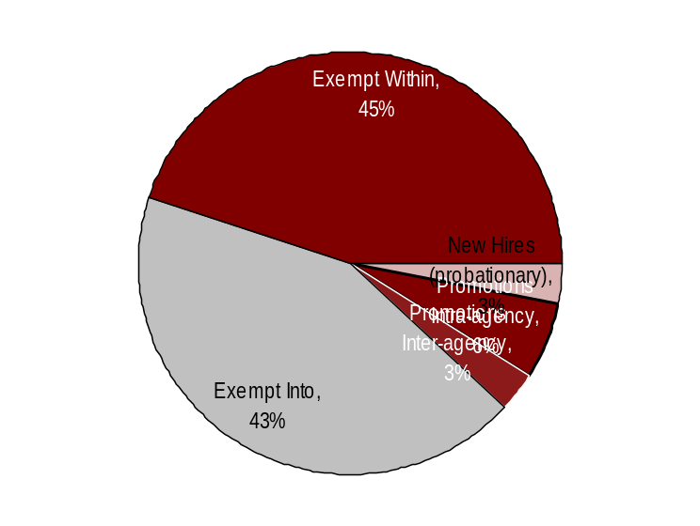
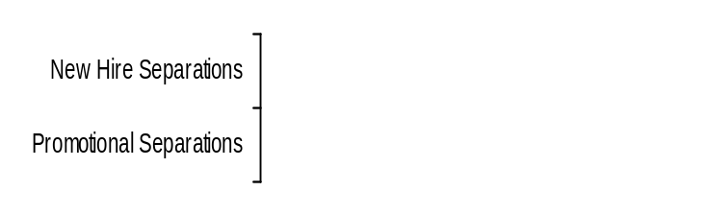
Hire Workforce |
HR Management Report category:
Right People in the Right Job at the Right Time
Performance Measures
Days to fill vacancies
% satisfaction with candidate quality
% new hires; % promotional hires
% separation during review period
Analysis:
2 Probationary Appointments
2 Trial Service Appointments into OFM
4 Trial Service Appointments with OFM
29 Exempt Appointments into OFM
30 Exempt Appointments within OFM
Total of 67 Appointments includes all appointments made in Agency 105
No Separations during Review Period to report
Hiring Balance - FY 2006
Total of 67 appointments (2/1/06 – 10/15-06)
Days to Fill Vacancies
Other (3,926)
This data will be reported by agencies to DOP in April 2007
Candidate Quality
(managers’ satisfaction rating)
Action Steps:
Hiring is Balanced no actions planned other than implementation of the HRMS E-Recruiting System
Separation during Review Period
This data will be reported by agencies to DOP in April 2007
*
* Released
** Voluntary
**
*
Double click on charts to add your agency’s data
Other = transfers, demotions, reassignments, movement in lieu of RIF, etc.
Notes:
Notes:

Slide 7
Deploy Workforce |
HR Management Report category:
Employee time and talent is used effectively. Employees motivated.
Performance Measures
Percent employees with current performance expectations
Employee survey ratings on “productive workplace” questions
Overtime usage
Sick leave usage Number & type of non-disciplinary grievances and disposition
Percent employees with current performance expectations
100%
Analysis:
58 classified employees with PDPs on file = 56.9%
55 exempt employees with PDPs on file = 41.9%
Data gathered through exit interviews, employee surveys, organizational unit reviews conducted by OFM's HR/Management Consulting group as well as the many agency accomplishments, indicated that OFM employees know what is expected of them. OFM revised its evaluation policy on July 1, 2005 and has been using the PDP tool. The number of employees with current PDP's has increased from 58 to 112. While not required by WAC, supervisors of exempt employees are expected to establish performance expectations and conduct annual assessments of performance. OFM leadership encourages supervisors of exempt employees to follow best practices in the management of performance of their staff.
Action Steps:
Continue to track and report PDP completion
Develop a method for use by agency leadership that ensures PDPs are developed in accordance with agency policy
Strategic Plan objectives in place

Slide 8
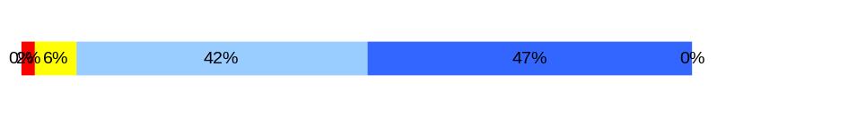
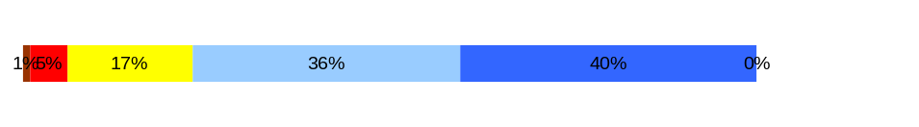
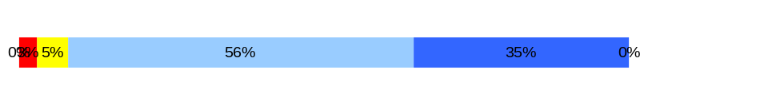
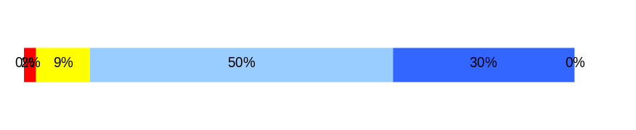
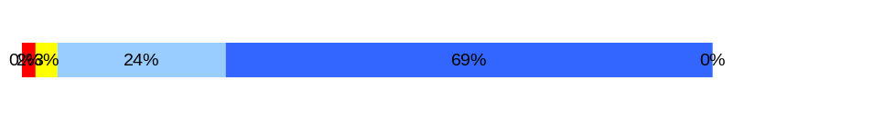
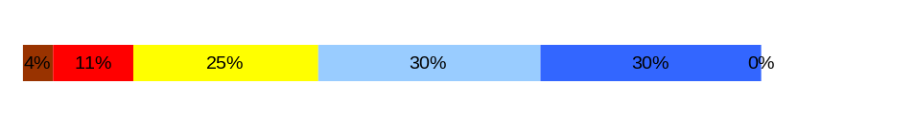
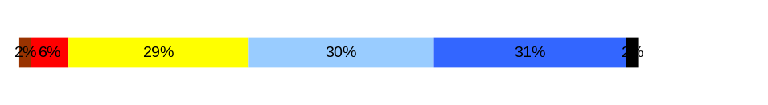
Deploy Workforce |
HR Management Report category:
Employee time and talent is used effectively. Employees motivated.
Performance Measures
Percent employees with current performance expectations
Employee survey ratings on “productive workplace” questions
Overtime usage
Sick leave usage Number & type of non-disciplinary grievances and disposition
Do employees have the day-to-day support
needed to enable successful job performance?
Analysis:
Q4 = 4.38
Q1 = 4.10
Q2 = 4.23
Q6 = 4.25
Q7 = 4.61
Q8 = 3.71
Q9 = 3.83
Q4. I know what is expected of me at work. (4.3)
Q1. I have opportunity to give input on decisions affecting my work. (3.5)
Q2. I receive the information I need to do my job effectively. (3.8)
Q6. I have the tools and resources I need to do my job effectively. (3.8)
Q7. My supervisor treats me with dignity and respect. (4.3)
Q8. My supervisor gives me ongoing feedback that helps me improve
my performance. (3.7)
Q9. I receive recognition for a job well done. (3.3)
Overall average score for “productive workplace” questions is “4.16”
Action Steps:
Senior Managers of divisions or major works group are looking for opportunities to improve
DOUBLE CLICK ON THE BAR CHARTS TO ENTER YOUR AGENCY’S DATA

Slide 9
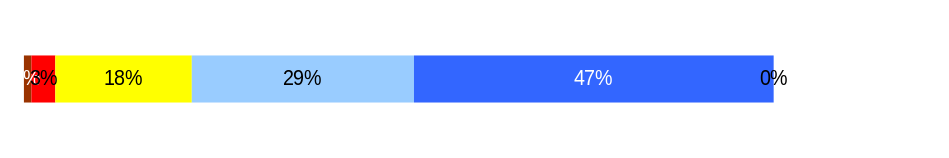
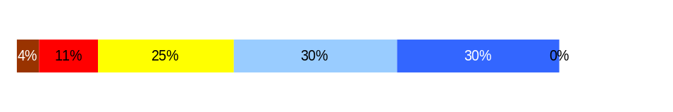
Employees have competencies for present job and future advancement
Develop Workforce |
HR Management Report category:
Performance Measures
Percent employees with current annual individual development plans
Employee survey ratings on “learning & development” questions
Analysis:
Q5 = 4.18
Q8 = 3.71
Percent employees with current Individual Development Plans
100%
Action Steps:
Continue to develop employee development plans as part of the new hire process and/or the PDP development process
Continue to sponsor agency training forum
Continue to support employee training and development
Overall average score for “Learning & Development” questions is “3.94”
Employee perceptions on
learning and development
Q5. I have opportunities at work to learn and grow. (3.6)
Q8. My supervisor gives me ongoing feedback that helps me improve
my performance. (3.7)
DOUBLE CLICK ON THE BAR CHARTS TO ENTER YOUR AGENCY’S DATA
Never
Seldom
Occasionally
Usually
Always
OFM has a strong employee development focus. Each year, OFM sponsors an agency-wide training forum where employees receive just in time training, attend required training and learn about the direction and needs of the agency. In addition, OFM regularly approves training and education requests in accordance with agency policy and budget constraints (this includes requests for training needed for the employee's current job, to improve general work performance, for career development and to meet mandatory training requirements.
94%
Notes:
Notes:

Slide 10
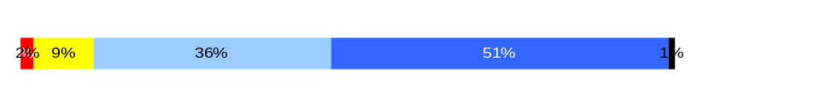
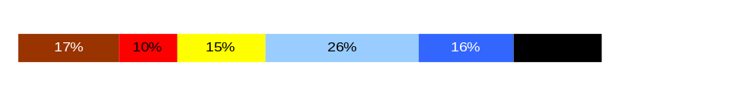
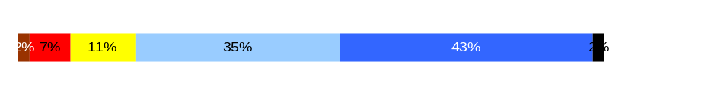
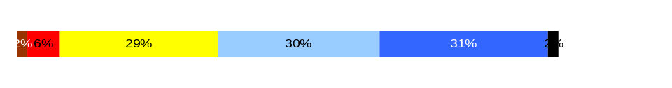
Successful performance is differentiated & strengthened. Employees are held accountable.
Reinforce Performance |
HR Management Report category:
Performance Measures
Percent employees and managers with current annual performance evaluations
Employee survey ratings on “performance and accountability” questions
Number and type of disciplinary issues, actions, appeals disposition
Percent employees with current performance evaluations
43.7%
Analysis:
74 of 102 classified employees with performance evaluations on file = 72.5% - 11 not due
44 of 168 exempt employees with evaluations on file = 26.2% - 33 not due
Q3 = 4.36
Q10 = 3.18
Q11 = 4.12
Q9 = 3.83
Do employees see a meaningful linkage between their performance and the success of the organization?
Q3. I know how my work contributes to the goals of my agency. (4.1)
Q10. My performance evaluation provides me with meaningful information about my performance. (3.4)
Q11. My supervisor holds me and my co-workers accountable for performance. (4.1)
Q9. I receive recognition for a job well done (3.3)
Overall average score for “performance & accountability” questions is “3.87”
Action Steps:
Continue to track and report PDP completion
Develop a method for use by agency leadership that ensures PDPs are developed in accordance with agency policy
Never
Seldom
Occasionally
Usually
Always
DOUBLE CLICK ON THE BAR CHARTS TO ENTER YOUR AGENCY’S DATA

Slide 11
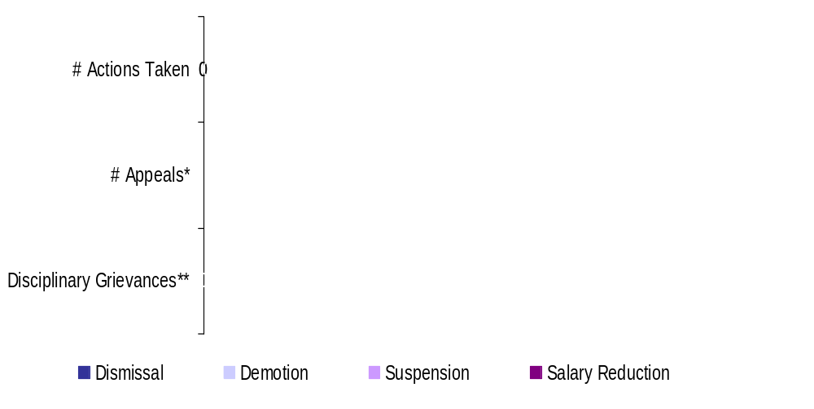
Successful performance is differentiated & strengthened. Employees are held accountable.
Reinforce Performance |
HR Management Report category:
Performance Measures
Percent employees and managers with current annual performance evaluations
Employee survey ratings on “performance and accountability” questions
Number and type of disciplinary issues, actions, appeals disposition
Formal Disciplinary Actions, Appeals, Grievances
FY 2006 to date (July 1, 2005- February 28, 2006)
Analysis:
No Disciplinary Actions, Appeals, or Grievances filed.
DOUBLE CLICK ON THE CHART TO ENTER YOUR AGENCY’S DATA
* Non-represented employees ** Represented employees
Action Steps:
Issues Leading to Disciplinary Action
[List of general categories of reasons that agency took disciplinary action for this time period]
Disposition of Disciplinary-related Grievances or Appeals
[List disposition of grievances/appeals for this time period.]

Slide 12
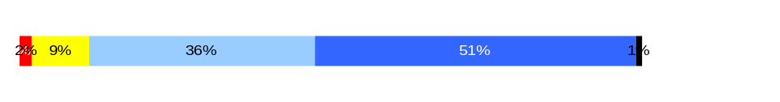
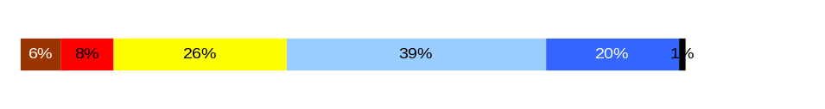

Ultimate Outcomes
HR Management Report category:
State has workforce breadth & depth for present & future success.
Employees are committed to the work they do and the goals of the organization.
Successful, productive employees are retained.
Performance Measures
Employee survey ratings on “commitment” questions
Turnover rates and types (e.g., retirement, resignation, etc.)
Turnover rate of key occupational categories - TBD
Diversity profile [& turnover TBD]
Indicators of Employee Commitment
Analysis:
Q3 = 4.36
Q12 = 3.60
Q9 = 3.83
Q3. I know how my job contributes to the goals of my agency. (4.1)
Q12. I know how my agency measures its success. (3.4)
Q9. I receive recognition for a job well done (3.3)
Overall average score for “performance & accountability” questions is “3.93”
Action Steps:
Strategic plan objectives in place
Never
Seldom
Occasionally
Usually
Always
DOUBLE CLICK ON THE BAR CHARTS TO ENTER YOUR AGENCY’S DATA
Notes:
Notes:

Slide 13
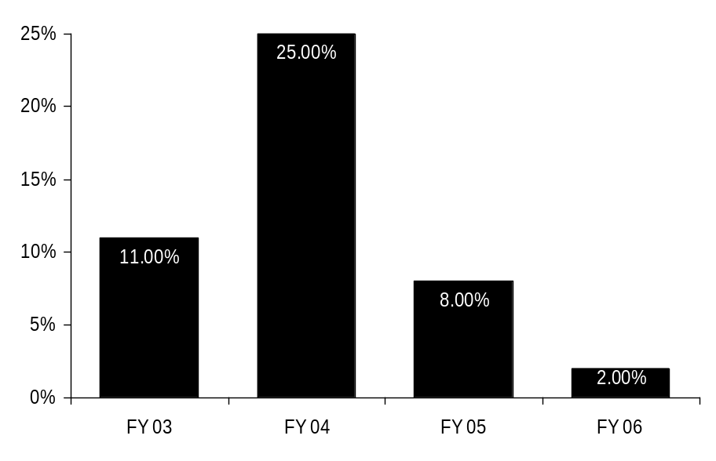
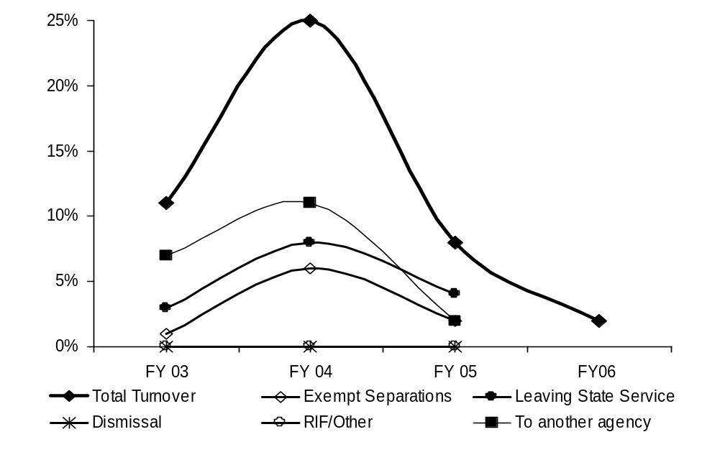
Ultimate Outcomes | continued
HR Management Report category:
Performance Measures
Employee survey ratings on “commitment” questions
Turnover rates and types (e.g., retirement, resignation, etc.)
Turnover rate of key occupational categories - TBD
Diversity profile [& turnover TBD]
Agency-wide Turnover
[leaving agency]
Analysis:
Data for FY05 and FY06 are approximate. HRMS does not provide detail for separations to other agencies
Data challenges due to Merit System 9 as well as HRMS
Action Steps:
No action contemplated at this time
DOUBLE CLICK ON THE CHARTS TO ENTER YOUR AGENCY’S DATA
Agency Workforce Turnover Breakdown
Notes:
Notes:
Trend Factors:
HRISD – Project ending – if current trend continues = 8% by end of FY06
DIR – Change in leadership – if current trend continues = 7% by end of FY06
CERS & PSD - Reorganized – if current trend continues = 4% by end of FY06
ASD Stable and low rate – if current trend continues = .33% by end of FY06
OEDS – Stable and low rate – if current trend continues = 1.5% by end of FY06

Slide 14
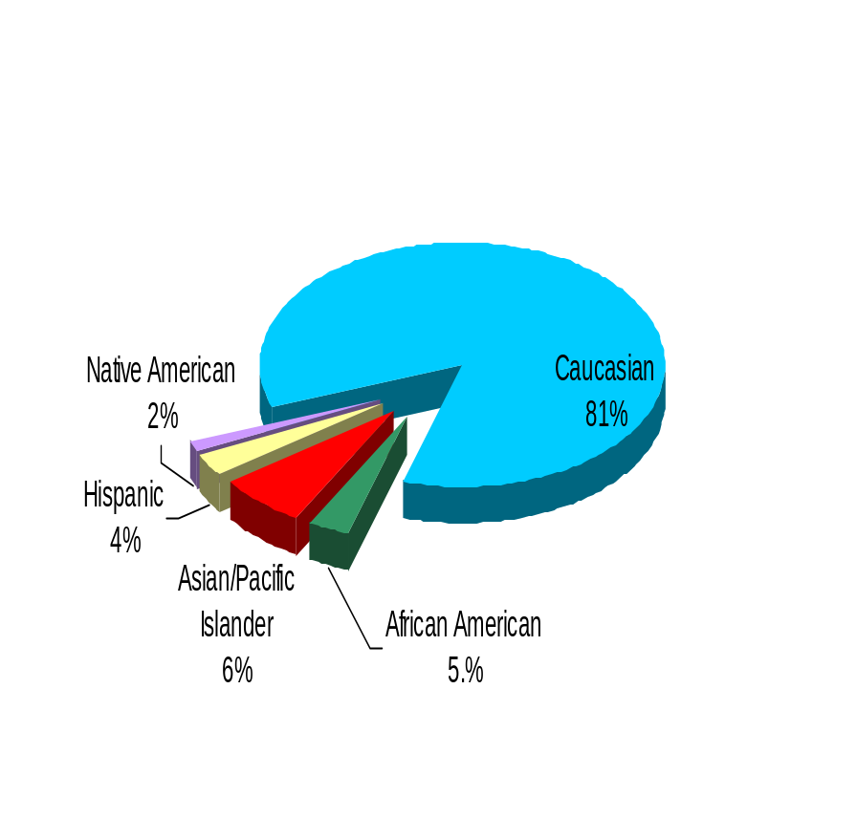
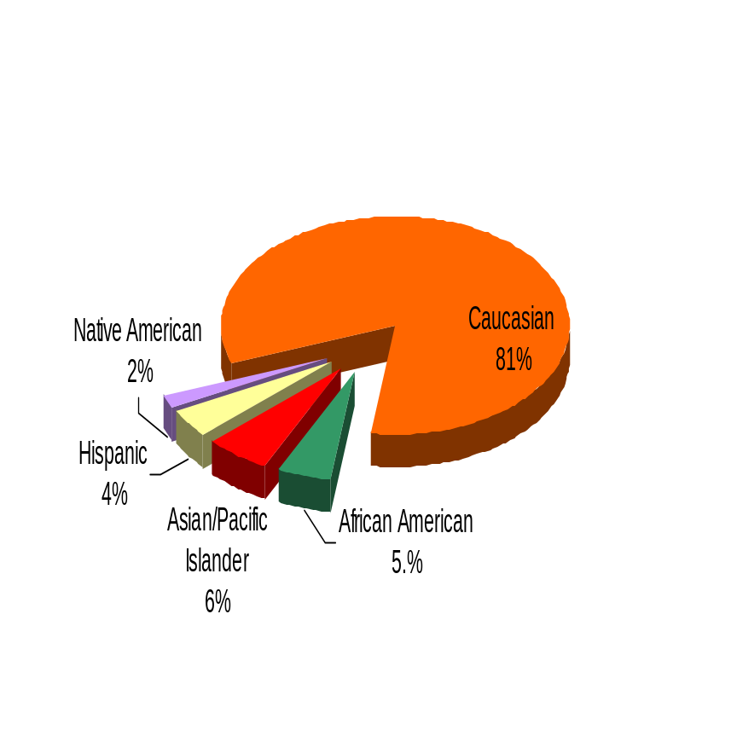
Ultimate Outcomes | continued
HR Management Report category:
Performance Measures
Employee survey ratings on “commitment” questions
Turnover rates and types (e.g., retirement, resignation, etc.)
Turnover rate of key occupational categories - TBD
Diversity profile [& turnover TBD]
Office of Financial Management
DOUBLE CLICK ON THE CHART TO ENTER YOUR AGENCY’S DATA
Diversity Profile [OFM] State
Women 59% 52%
Persons with disabilities 4.2% 5%
Vietnam Veterans 5.7% 7%
Disabled Veterans 1.5% 2%
People of color 14.8% 17.5%
WA State Government
Notes:
Chart labels did not update
Notes:
Notes:
Trend Factors:
HRISD – Project ending – if current trend continues = 8% by end of FY06
DIR – Change in leadership – if current trend continues = 7% by end of FY06
CERS & PSD - Reorganized – if current trend continues = 4% by end of FY06
ASD Stable and low rate – if current trend continues = .33% by end of FY06
OEDS – Stable and low rate – if current trend continues = 1.5% by end of FY06

