Slide 1
Information Management
Project Status Report
June 13, 2006

Slide 2
Introduction
Workflow
CST Applications
TAP
Remedy
Leave/Travel
DocDB
Conference/Meeting Management
Organization Maintenance
Completed Tasks
New Responsibilities
IM Project List in Plone

Slide 3
Workflow Tool
AlphaFlow selected.
  Plone plug-in
  Open source
  Supports all known workflow processes
  XML based rules
  Training
Pilot: Leave/Travel requests
Potential replacement for Matrix

Slide 4
CST Applications
FCIRT Ticket Tracking
  Remedy-based
  StrataCom Consulting
  Email tracking portion is being tested
Risk Analysis
  Maintenance screens in production
  Questionnaire progressing well

Slide 5
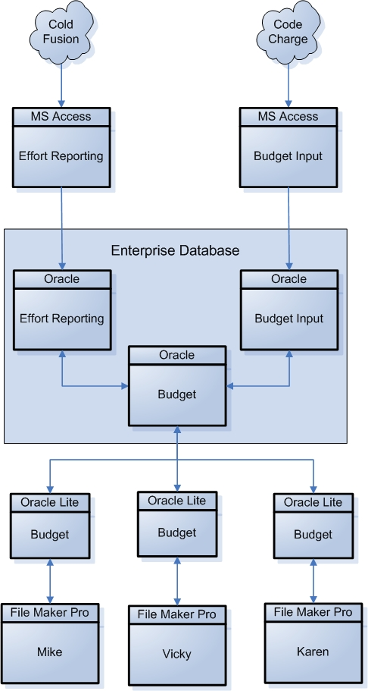
Task, Activities & Projects
Responsibility transferred to the IDS group
Effort Reporting and Budget Input data syncing (one-way) from MS Access to Oracle repository
Eliminate MS Access after the FY2007 budget input process
Redesign if sufficient resources are available
Oracle Workbench – a tool to convert non-Oracle databases to Oracle

Slide 6
Remedy
In sync with Footprints @ IU
  Many thanks to Stan
Rebuilding the HD form and CGI
  Reorganizing the PTIs for better metrics
  Automatic assignment based on PTI
  Automated email processing to ease workload on helpdesk personnel
  CGI to run on the central web server and it will not rely on any DB
May revive the Knowledgebase
Interface with MISJOB

Slide 7
Leave / Travel
First application to use AlphaFlow, which has slowed development while we traverse the learning curve
Phase I (simple leave requests) in user testing
Phase II (domestic travel) in beta testing
Use of Fermilab KCA Certificates is still an issue for some

Slide 8
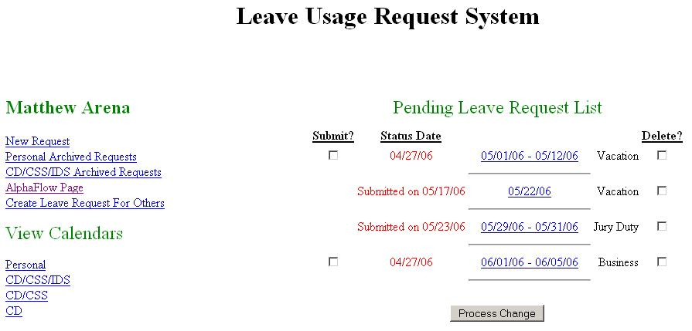
Leave/Travel Requests

Slide 9
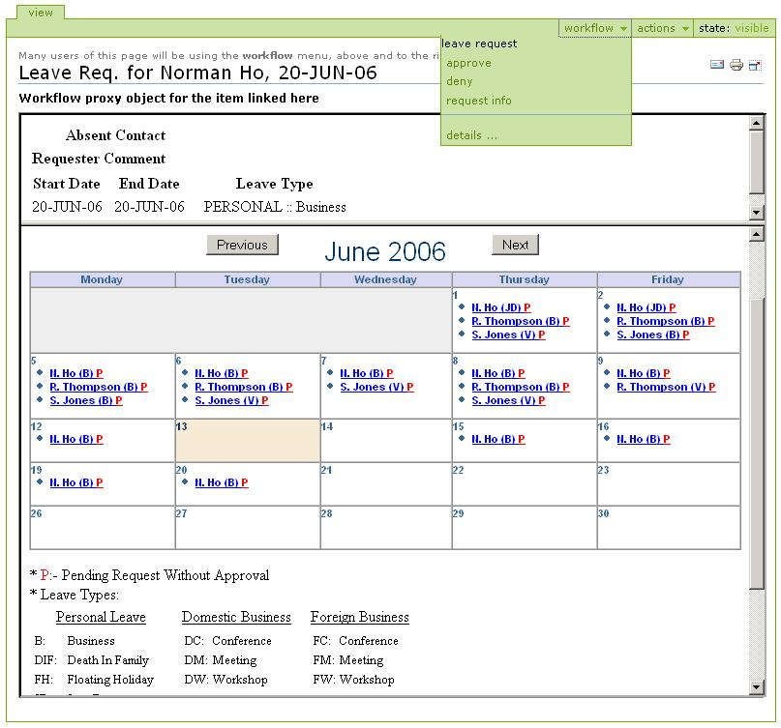

Slide 10
DocDB
Code moved to SourceForge – issue tracking, feature request tracking
8 New instances of DocDB
  CD, Dark Energy Survey, LArTPC, MINOS, MINERvA,, NFMCC, NOVA, Fermilab Projects
New Features
  cross-searching on other DocDB installations
  Google-like search function
  Calendar of events
  Many changes to meeting administration (as a result of feedback from Admin group)

Slide 11
DocDB
Issues
  Scalability
    each instance requires its own virtual host
    each instance has its own set of configuration files
  Long-term Support
  Certificate use
    many, particularly those from outside CD, are resistant to the possibility of requiring certificate authentication

Slide 12
DocDB
Future Plans
  Arbitrary topic hierarchies
  A DocDB Working Group has been formed to evaluate further needs

Slide 13
Conference/Meeting Management
SPMS
  Registration module completed and in use at EPAC06
  Still no good documentation
    CERN hopes to start this after EPAC06
    perhaps CDO can contribute
InDiCo
  CD is running an instance for Fermilab
  Investigating integration with DocDB
How do we interest the PPD Conference Office?

Slide 14
Organization Maintenance
Used by AlphaFlow to determine workflow and alternate approvers
  ESHTRK used to determine Organizational Roles
  MISCOMP used to determine Functional Roles
    Budget Officer, Safety Officer
ESHTRK
  Tracks deputy, associates and assistants
  Tracks organization type
  Tracks parenthetical membership
  Online org chart reflect new features
  Export to Org Chart Plus software
  Syncs to MISCOMP
  Example ESHTRK Organization Chart
Precursor for replacing Matrix

Slide 15
Miscellaneous
Capture and track Grid certificates for authentication in addition to Fermilab KCA certificates
EquipDB updates for CDF
Automation of User Accounts
  creation and termination of accounts
  CST SysAdminDB
  subscribe/unsubscribe to/from group level mailing lists based on Org Chart

Slide 16
Completed Tasks
Not a Complete List
Oracle iAS upgrade and migration
  iAS 10g
  New hardware, separated from DB
PL/SQL API wrapper
  Python, Java & Perl
Remote accounts
Support for multiple VOs (IU)
User DB conversion to Oracle

Slide 17
New Responsibilities
System Status Page framework
DocDB
  Administration still with CDO
  Integration with InDiCo
  Integration with SPMS
Budget Input Application
Effort Reporting

