Slide 1
Process-Based Cost Modeling
Christian Smart, Ph.D.
SAIC
March 9, 2004

Slide 2
Background
Cost analysts have used weight-based parametric cost models for 50 years*
Weight-based estimates have advantages, but also limitations
Recent focus has been placed on developing next-generation cost models**
*Joe Hamaker, “But What Will It Cost? The Evolution of NASA Cost Estimating” , Issues in NASA Program and Project Management, 1991.
**Andy Prince, ”Weight and the Future of Space Flight Hardware Cost Modeling,”, SCEA National Conference, 2003

Slide 3
Next Generation Cost Modeling
Traditional parametric approaches are very useful for cost estimating
But even the most sophisticated multivariate models have limitations
  One example is out-of-date samples and small sample sizes for some manned launched vehicle subsystems
    Crew Accommodations
    Crew Life Support
There is need for a tool to supplement existing parametric models

Slide 4
Overview
The objective is to improve state-of-the-art cost
modeling techniques using process-based estimation
Process-based models supplement traditional parametric tools
  they are not intended to replace parametric estimates
Traditional parametrics provide an early estimate of a project’s cost
These traditional weight-based statistical estimates can be greatly refined using a process-based model

Slide 5
Process-Based Modeling
Process-based cost modeling promises to provide a greater level of fidelity for cost estimating
  May be especially useful for large projects
Parametric analysis has tended to focus on the “what” of cost
Process-based modeling focuses on the “how”
Process-based modeling is a relatively new approach to cost estimation
  Process-based models are also being developed by Boeing and Galorath

Slide 6
Process-Based Modeling (cont.)
Process-based modeling provides cost estimates by
relating cost drivers to the processes that occur during design, development, test, evaluation, and production
Cost drivers affect cost by directly impacting the cost
of the processes
  Adding/removing some process,
  Changing the number of times some process occurs
  Changing the cost of a specific process
In addition to serving as an estimation tool, the process-based model will also be a communication tool between cost analysts and project personnel and management

Slide 7
Scope
Capture all processes that occur during Phase C/D, from ATP up to Operational Readiness Review
Focus on manned launch vehicles only
Reflect recent aerospace program development and experience
Model is top-down, with processes defined at an intermediate level (rather than the lowest level possible)

Slide 8
Outline of the Modeling Process
Document processes at the subsystem level – design, tooling, fabrication, assembly, etc., and account for interfaces
Collect detailed time-phased costs for several programs
Analyze historical data
Create calibrated models
Develop algorithms for relating complexity generators to cost

Slide 9
Cataloging Processes
Created detailed process flows (process catalogue) for all spacecraft-related subsystems
  Includes hardware and systems engineering/integration subsystems
Met with subject-matter experts for each subsystem to validate the process flows and revise as needed
Catalogued over 500 generic processes

Slide 10
Process Catalog - Example
Y
Detailed Design Process Flow - Structures
Re-design
Impacts
System?
Local
Re-design
N
N
Interface with Systems
Personnel, Discuss
Requirements,
Constraints, etc.
Determine
Sensitivities
& Margins
Perform
Detailed
Analyses
Meets
Requirements?
Y
Provide
Data
To Other
Disciplines
Detailed
Design
Complete?
N
Y
Produce
Drawings,
Etc.

Slide 11
Data Collection
Collected detailed cost data for several missions
  Apollo
  Cassini
  Chandra
  Shuttle
  Galileo
In the process of collecting data for other missions
  Gemini
  X-37

Slide 12
Data Analysis
Collected detailed, time-phased WBS level cost and data for Shuttle and Apollo
Allocated cost to the individual process level using schedules and other information

Slide 13
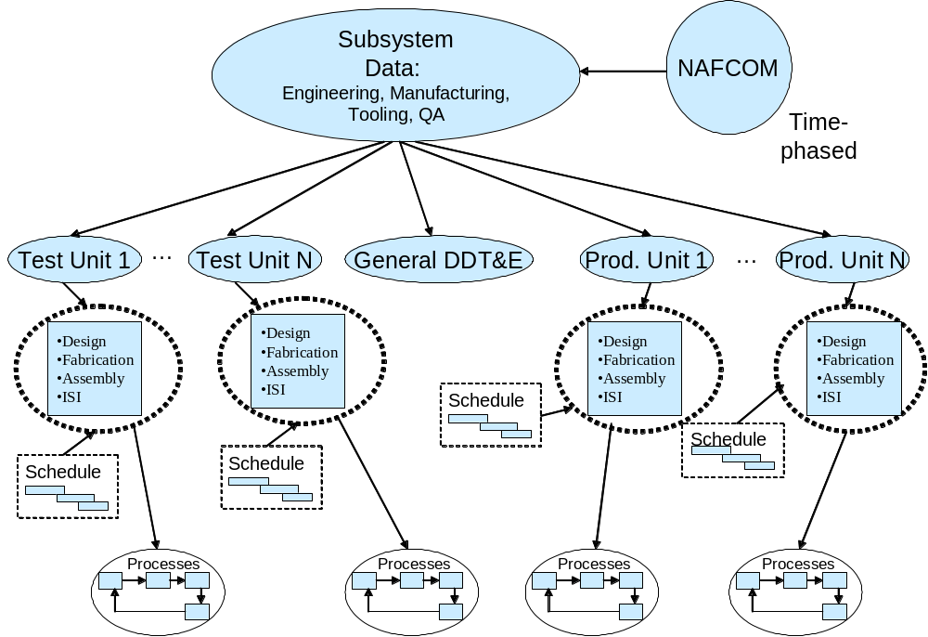
Data Analysis Flow

Slide 14
Model Development - Shuttle
Analyzed detailed, time-phased historical data for Shuttle Orbiter and modeled 22 subsystems and over 700 processes
Structures – 58 | Technical Mgt. and Support – 24
Thermal Protection – 43 | Provisioning – 9
EPD&C – 40 | Trainers and Mockups – 31
GN&C – 38 | Mechanical Systems – 38
CC&DH – 59 | Auxiliary Propulsion – 48
Avionics Dev. And Int. Labs – 19 | ECLS – 31
Approach and Landing Tests – 23 | IACO – 24
Crew Station – 33 | GSE – 37
Major Test and Support – 36 | Power Generation (APU) – 35
Flight Tech. Analysis – 11 | System Requirements – 11
Design and Project Control – 19 | Safety and Reliability - 24

Slide 15
Model Development - Apollo
Analyzed detailed, time-phased historical data for Apollo CSM and modeled 8 subsystems and over 250 processes
Crew Module Structures – 39 | Service Module Structures – 38
Crew Module Heat Shield - 37 | Crew Accommodations - 33
Crew Module Mechanisms - 37 | Launch Escape Structures - 38
Earth Landing System - 37 | Launch Escape SRMs - 38

Slide 16
Calibrated Models
Calibrating the models to specific historical programs is similar in its approach to using analogy-calibrated weight based CERs
Our efforts to date have been focused on calculating the “intercepts”
We have more “intercepts” to calculate, but we must also must calculate the “slope”
Cost
Apollo
Shuttle
Complexity Generator

Slide 17
Algorithms and Process Drivers
NAFCOM complexity generator inputs are used
Also, based on our research to date and the information gathered from subject matter experts and several key process drivers will be added, including
  Material type
  Hardware geometry
  Organizational structure

Slide 18
Process-Based Modeling and NAFCOM
Process-based model is at the subsystem level
  Structures
  Thermal Control
  Systems Engineering
  Etc.
Cost drivers include all the NAFCOM complexity generators, plus others:
  Material Type
  Organization Structure
  Etc.

Slide 19
Example – Detailed Structural Design
Cost Drivers
NAFCOM Cost Drivers for Structures Include:
  Weight
  New Design
  Engineering Management
  Manufacturing Methods
  Number of Deployed Structures
  Funding Availability
  Test Approach
  Integration Complexity
  Amount of Pre-Development Study
  Large Inert Structure (Yes/No)

Slide 20
Example – Relating % New Design and Engineering Management
To Cost
Engineering Management reflects the experience of the design team and the environment of the design effort
Both % New Design and Engineering Management can range from 0 to 100
Detailed Structural Design has three sets of loops
One of the projects (but not the only project) to which the model is calibrated is Shuttle - for Shuttle, the number of iterations was 5, 3, and 2

Slide 21
Example – Relating % New Design and Engineering Management
To Cost (cont’d)
Engineering Management
  0-12, Minimum Design Changes
  13-37, Few Design Changes
  38-62, Moderate Design Changes
  63-87, Dedicated Design Team, Experiences Sig. Reqmts. Changes
  88-100, Distributed Design Team, Dependent Upon Major Technological Advances
% New Design
  0-10, Reflight
  11-21, Minor Mods., No Requal.
  22-31, Minor Mods., Requal.
  32-55, Moderate Mods.
  56-73, Significant Mods.
  74-85, Based on Prev. Design
  86-96, Similar to Prev. Design
  97-100, New Design

Slide 22
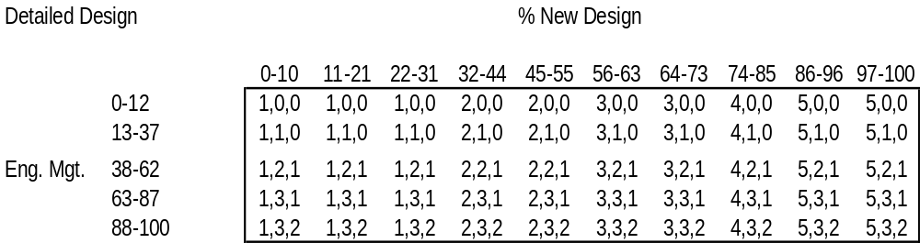
Example – Relating % New Design and Engineering Management
To Cost (cont’d)
Using the Shuttle values as a point of departure as an example, the definitions of levels of engineering management and % new design, we have the following table:

Slide 23
Additional Products
In addition to providing a modeling tool, an additional
product of the process-based model is the most
complete and detailed time-phased breakout of Shuttle
and Apollo costs known to exist

Slide 24
Future Plans
Incorporate recent advances in aerospace design and manufacturing
Make model applicable to generic launch vehicles
Test the model and compare results to NAFCOM
Deliver a stand-alone Excel-based prototype model in November for use in the evaluation of future launch vehicle architectures
Eventually incorporate model into NAFCOM

