Slide 1
Public Complaints
County Codes/ Procedures/ Tactics

Slide 2
Policy 106: Complaint Procedures
In incorporated areas
  Ordinance 650 (overflowing sewage)
    County Code 8.124
  Permitted facilities
  City contracts
    City Code Enforcement/ Building and Safety

Slide 3
Policy 106: Complaint Procedures
    In unincorporated areas
  Ordinance 650 (overflowing sewage)
    County Code 8.124
  Ordinance 657 (household trash & garbage)
    County Code 8.132

Slide 4
Policy 106: Complaint Procedures
In unincorporated areas
  Greywater or sewage complaints
  Permitted facilities
Notes:
Areas of the county that are not contained within a city boundary are considered unincorporated.
DES responds to sewage complaints or complaints involving permitted pool or food facilities.

Slide 5

Field Investigations
The Investigation
  Consent
  Other access
  Collecting evidence
Notes:
The alleged complaint can be viewed from any “public” areas (street, vacant lot, on the way to the door).
Consent must be from an adult. DO NOT enter private homes for any reason.
Take pictures if complaint is verified. These pictures will help you gauge progress.
a. They should be marked as evidence with appropriate labels.

Slide 6
County Code 8.124
Sewage discharge
  Owner/ tenant responsibility
  Fines
  Fee schedule (permits for modification)
  Enforcement procedures
Notes:
1.Any action taken on the owner (NOV, etc.) should taken with the tenant as well. Focus is on owner to correct problem.
2. Possible fines, fees for services, and procedures are also discussed in County Code 8.124

Slide 7
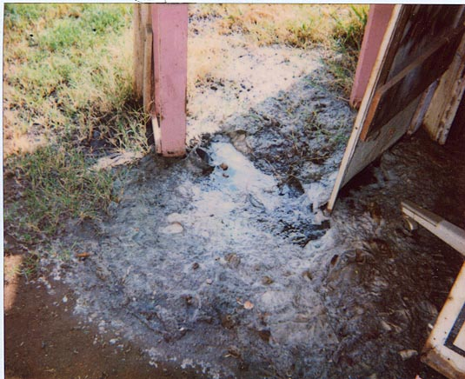
What is Sewage?
Recognition
    Dark colored liquid
    Toilet paper and …
    Lush vegetation
    Insect/ mosquito breeding
Dye tablets
Notes:
These are characteristics of an active sewage complaint.
Dye tablets are used to confirm the source of pooling effluent. If not used carefully, they can stain porcelain fixtures.
Soil samples are not usually collected for analysis. It is possible but very expensive.

Slide 8
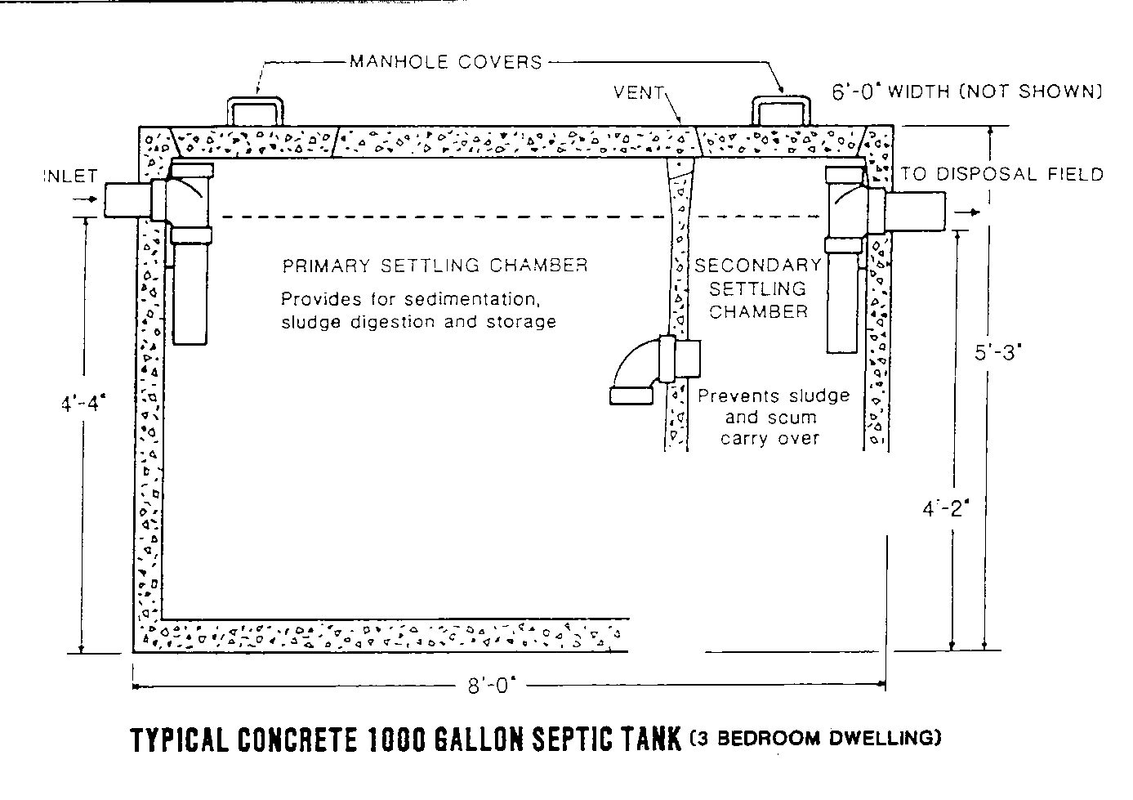
Septic Systems: Internal Structure

Slide 9
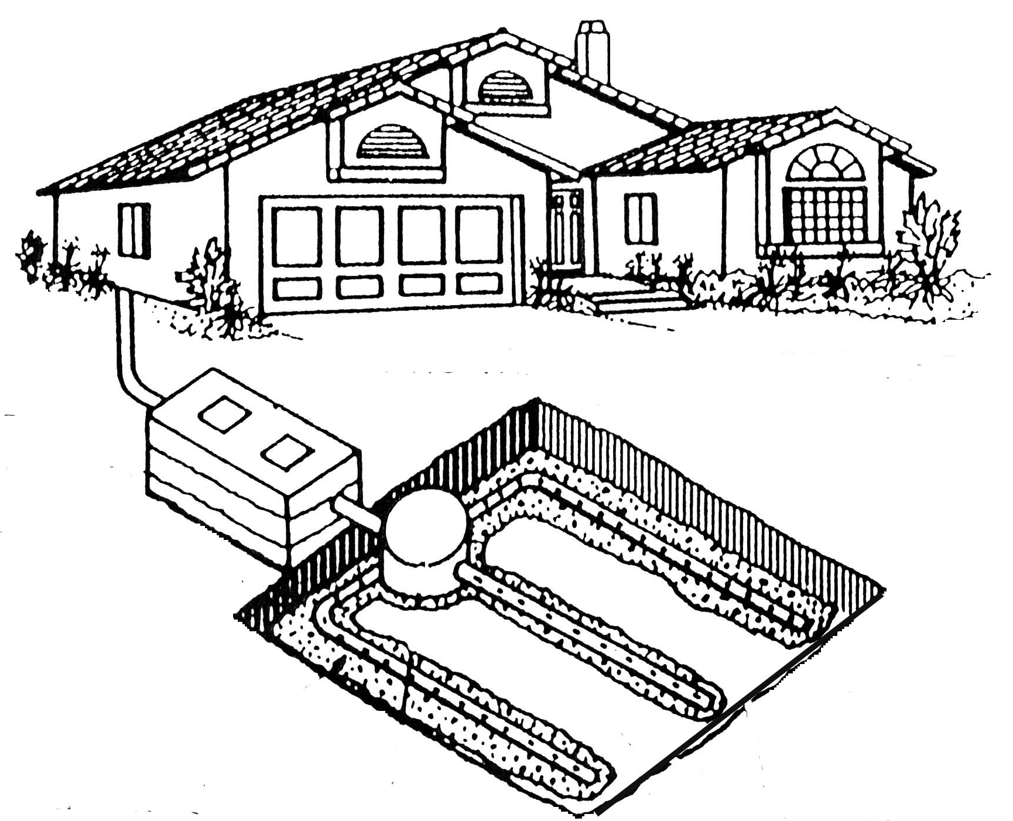
Septic Systems: Basic plan
SWITCH BOX
LEACH LINE
LIDS
SETTLING
CHAMBER
Notes:
This slide is a good place to discuss scenarios:
a. effluent is backing up into house - blockage at line to switchbox
b. effluent is pooling over lids – blockage between switchbox and settling chamber
c. effluent is pooling in field – blockage in leach line or switchbox

Slide 10
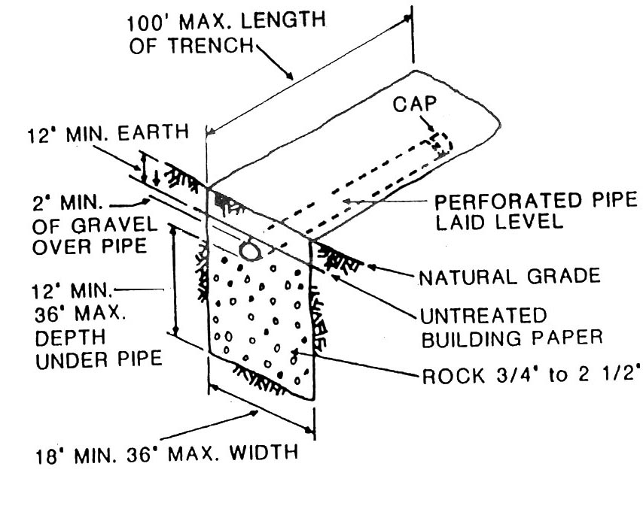
Septic Systems: Typical Trench

Slide 11
Septic Systems: Septic Tanks
Principle: Anaerobic degradation
Materials- concrete, steel, fiberglass
Pumping recommendations
  Residential (3 years)
  Commercial (1 year)

Slide 12
Septic Systems: Septic Tanks
Tank Capacity
  750-1500 gallons
  2BDR/4 people, 4BDR/ 8 people
Advantages and disadvantages
Notes:
Tank is sized based on the number of bedrooms.
Advantages to septic systems: Able to build without sewer hookup. Also do not pay city sewer fees. “natural” fertilizer and irrigation.
Disadvantages to septic systems: Require large amount of property for leach field- cannot use area for anything else. Must limit water input at all times. Many materials cannot be flushed (chemicals, objects, special tissue).

Slide 13
Septic Systems: Leach Lines
Length determined by capacity
Soil porosity
Materials
  Clay
  PVC
  High density plastics (Infiltrator system)

Slide 14

What is Sewage?
Other wastewater discharge
  Greywater
    Staining
    Above ground drainage pipes
    Insect/ mosquito breeding
    Lush vegetation
Notes:
1. Initial response may be by letter by Policy.

Slide 15
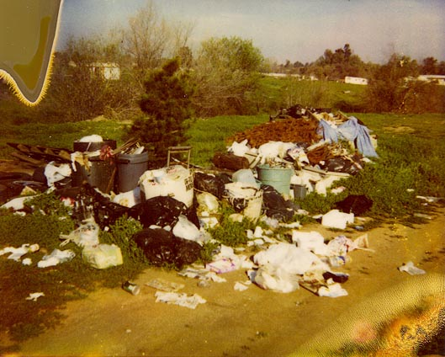
Ordinance 657- Household trash
Only household trash and garbage
Removal weekly
Leak-proof containers
“Acts of God”
Notes:
We respond to only residential or household trash.
Residential trash has to be removed weekly, either by service or private hauling.

Slide 16
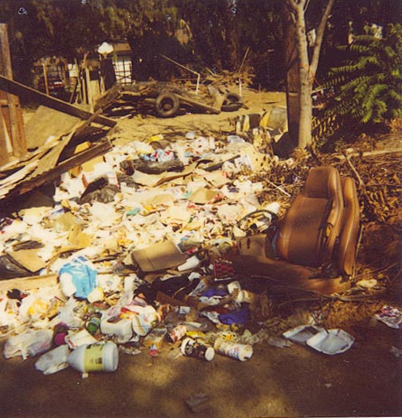
Ordinance 657- Household trash
“Trash letters”
Hold for 90 days
Second complaints
Notes:
Initial response may be by letter by Policy. Letters are not sent to BOS complaints.
Hold “trash letter” for 90 days in case of second complaint.
If a second complaint is received after 15 days, but before 90 days- a field investigation is required.

Slide 17
NPDES Waste Handling
Type of complaint |  |  | DES | ERM | HAZ | BS
Residential trash and garbage |  |  | ✓ |  |  | ✓
Building debris and brush |  |  |  | ✓ |  | ✓
Land filling- actual burial |  |  |  |   ✓
Junkyards/ vehicles |  |  |  |  |  | ✓
Medical waste |  |  |  | ✓
Sewage |  |  | ✓
Hazardous Materials |  |  |  |  | ✓
Notes:
This chart indicates the condition observed on the property and the responding agency.
DES responds to residential trash and garbage, as well as sewage.
National Pollution Discharge Elimination System reimburses our agency for trash.

