Slide 1
Design for a 2 MW graphite target for a neutrino beam
Jim Hylen
Accelerator Physics and Technology Workshop for Project X
November 12-13, 2007

Slide 2
Introduction
Two years ago, a preliminary design study was done for a target for proton driver beam parameters. No further work has been done since then. All numbers, graphs shown are for proton driver parameters ( about 10% different).
 | Proton Driver (this talk) | Project X
Protons / spill | 1.5e14 | 1.7e14
Repetition rate | 1.33 seconds | 1.40 seconds
This design is by Valeri Garkusha et. al, IHEP Protvino (NuMI note 1100)

Slide 3
Important issues for target design
Dynamic stress from short pulse
Getting the DC heat out
Radiation damage
Efficiency of neutrino production

Slide 4
Issues for dynamic stress
To reduce dynamic stress, want:
Fewer protons/pulse
  Neutrino production scales approximately with beam power
  so fewer protons at 120 GeV than eg 30 GeV helps
  Having more pulses of fewer protons each would help
Spread protons out in larger beam spot, use low density target
    Horn has ~ 1m long depth of field, few mm wide collection area
    so can use less dense target
High heat capacity, so dE/dx produces less temperature rise
Low coefficient of thermal expansion, so temperature rise produces less expansion
Low Youngs Modulus, so thermal expansion produces less stress
High yield strength
Beryllium has high yield strength, but high Youngs Modulus
Graphite has mediocre yield strength, but low Youngs Modulus

Slide 5
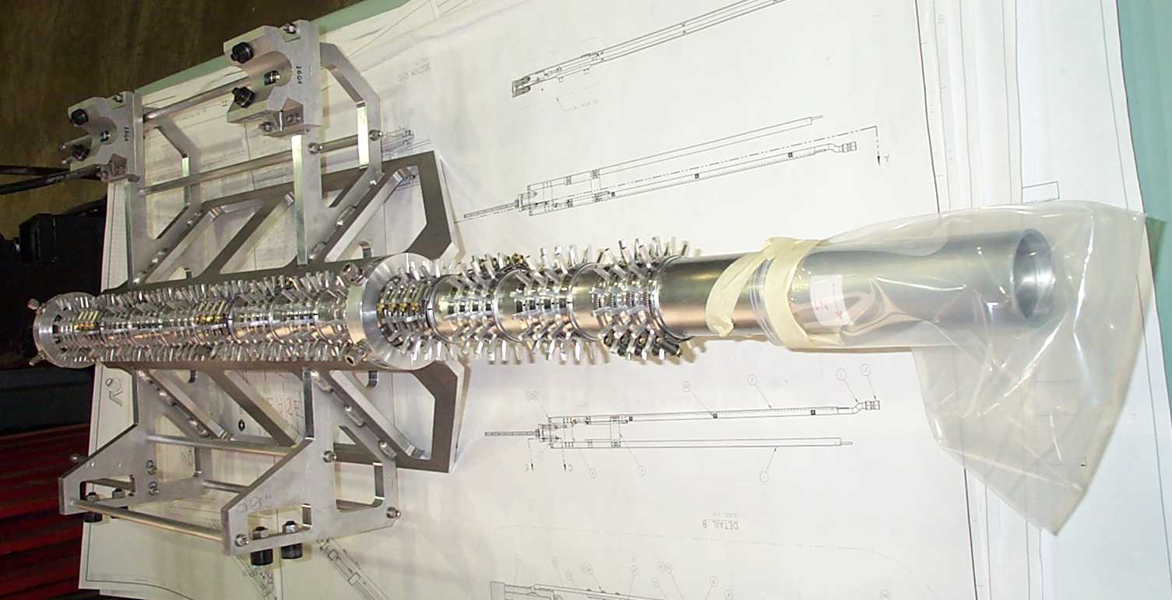
NuMI baffle as prototype of target
Graphite is good in compression, poor in tension,
so put pre-stress at outer radius by encapsulating in aluminum or steel
Existing NuMI baffle is 1.5 m long, 6 cm diameter graphite encapsulated in aluminum
Target would be 1 m long, 1.5 cm diameter – not too different from our baffle;
get rid of air cooling fins, add water cooling tubes

Slide 6
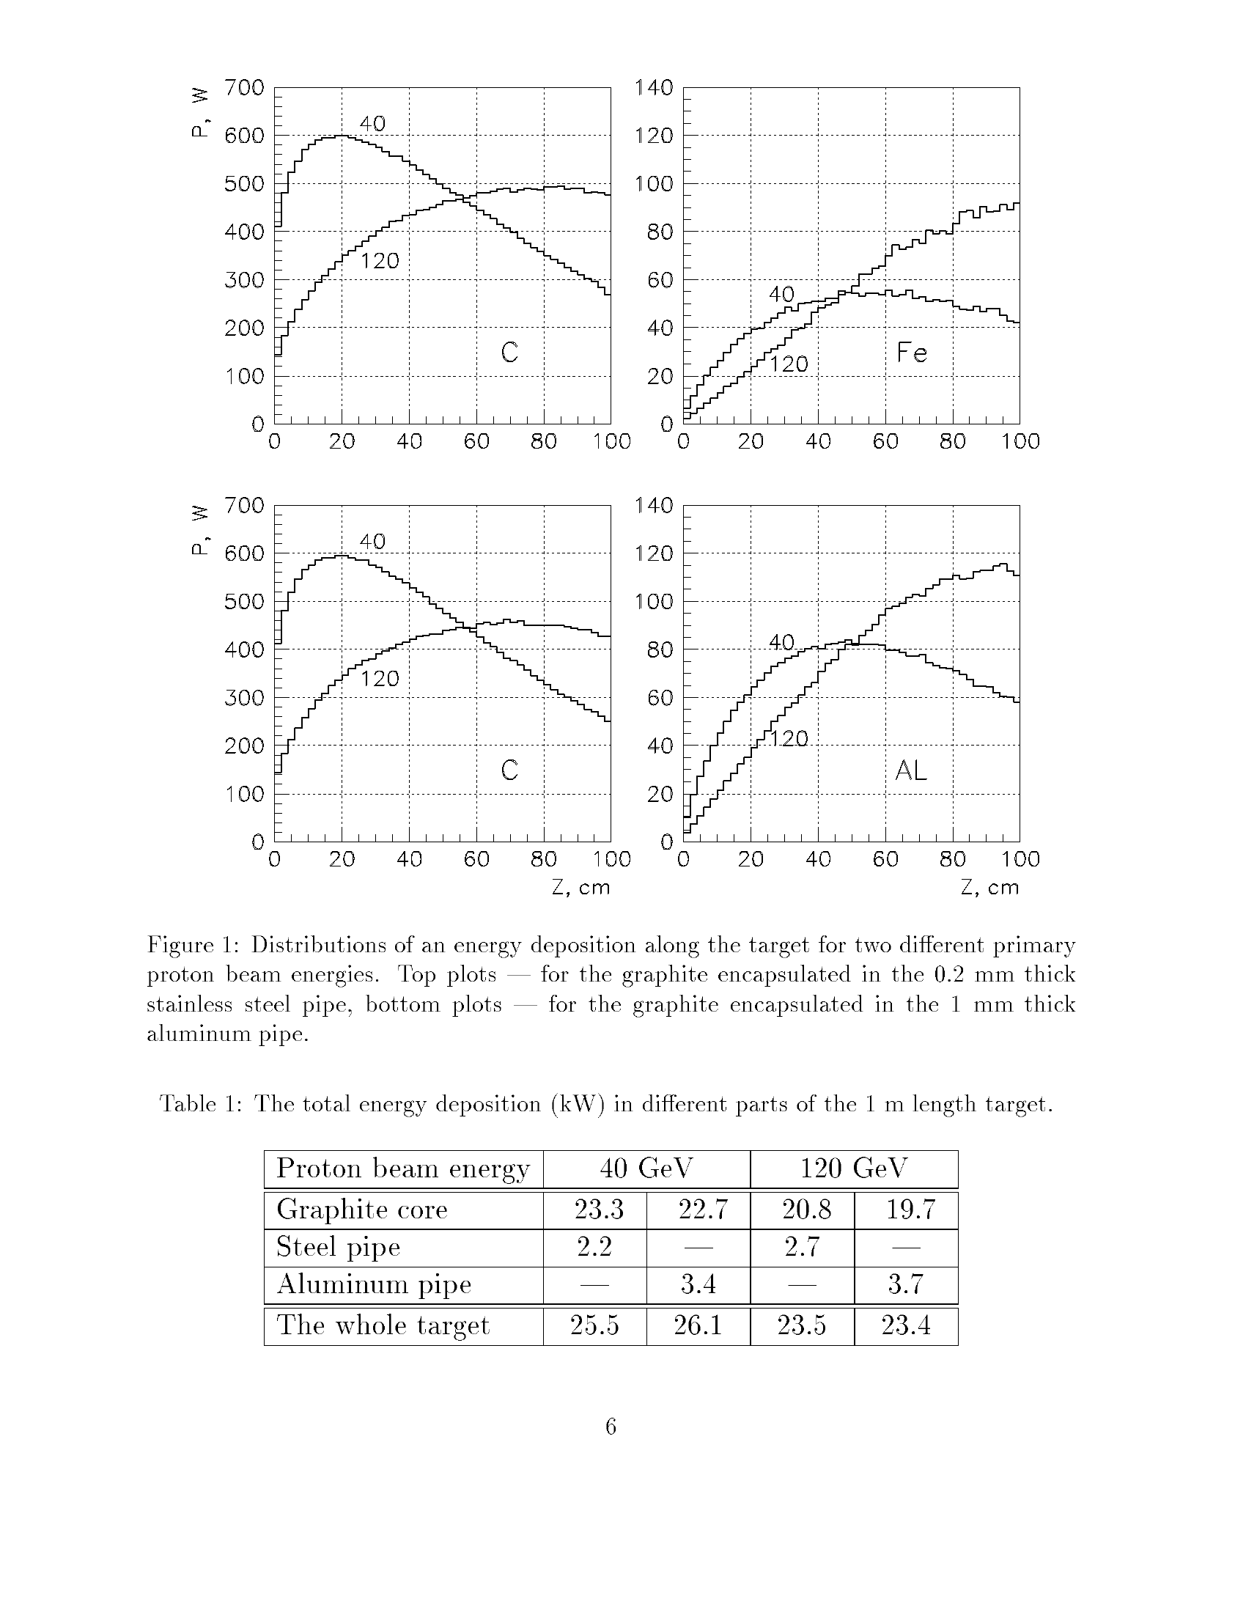
Other target details
Graphite in 3 cm long segments with 0.2mm gaps for thermal expansion
Helium atmosphere in target to prevent possibility of oxidation
Encapsulation also maintains integrity of the target core in case of thermo-mechanical or radiation damage of some segments
Encapsulation also prevents direct contact of the cooling water with the heated surface of graphite while providing a good thermal contact
Study was done with Poco ZXF-5Q graphite (what we have in the NuMI target),
although other graphites have up to 30% better Yield/Youngs-Modulus
Pre-stress: ~ 10 MPa if 0.2 mm steel casing, ~13 MPa if 1mm aluminum casing
Beam spot size: 1.5 mm RMS
Energy deposition (kW):

Slide 7
Energy deposition (MARS Monte Carlo)
Distance along target (cm)

Slide 8
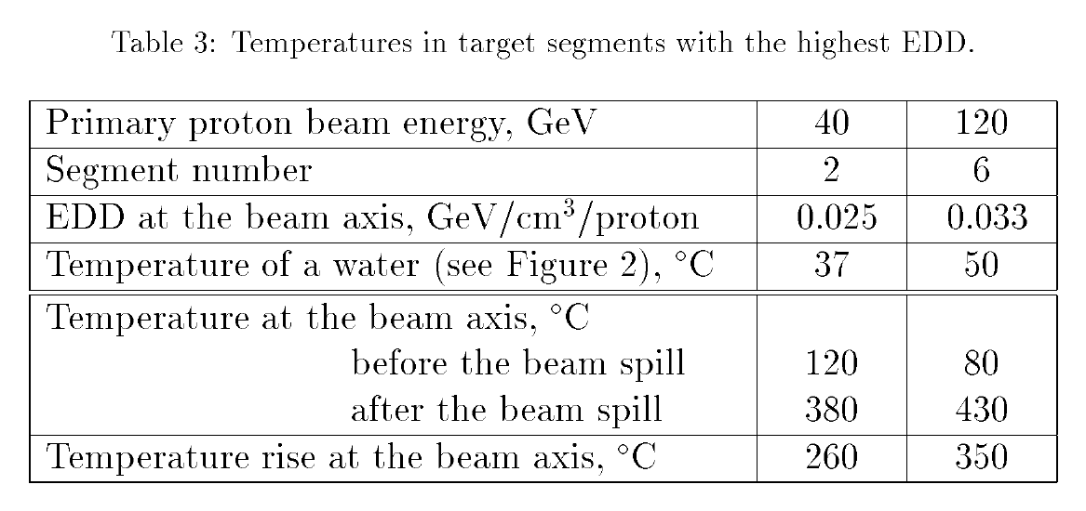
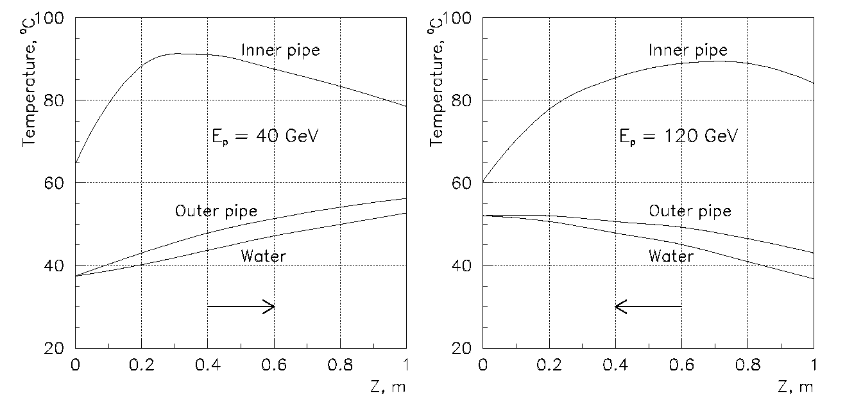
Target temperature and cooling water

Slide 9
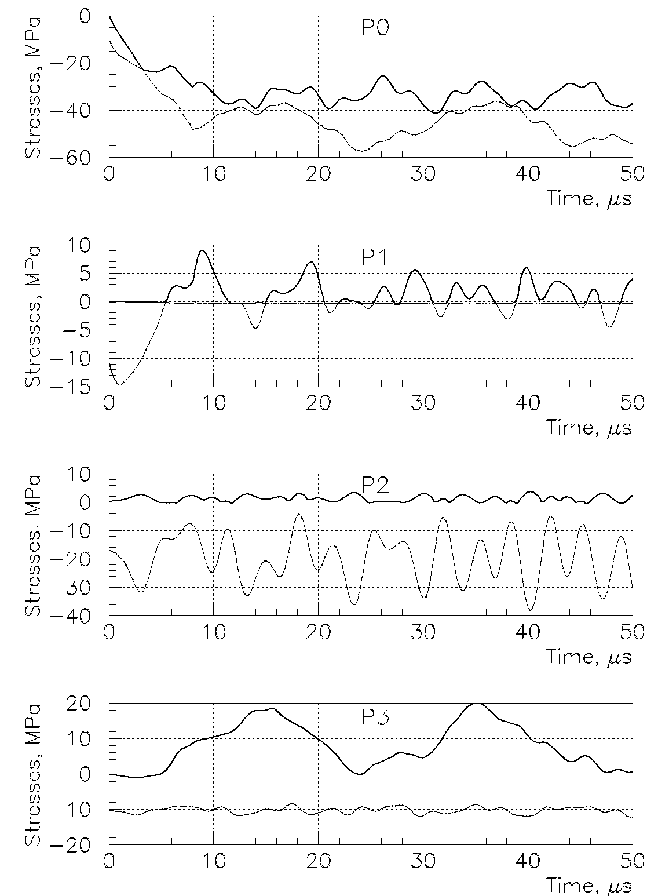
Time evolution of stresses (sigma1 and sigma3 shown)
Midpoint of segment
Center of end of segment
Outer radius end of segment
Outer radius center of segment

Slide 10
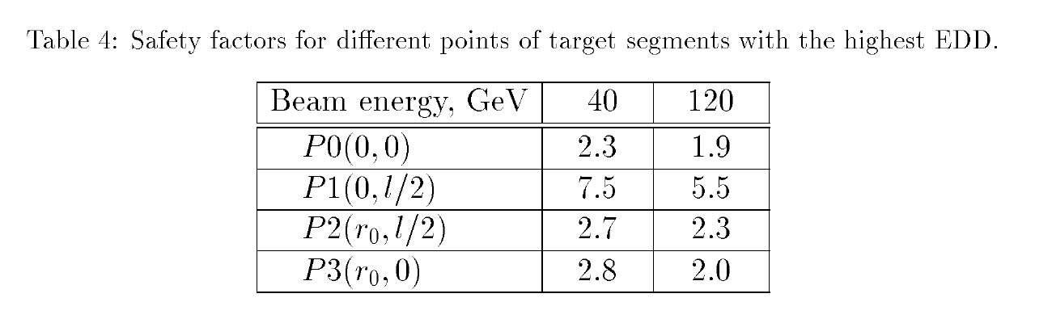
Compare stress to failure
Taking into account decrease of yield strength of 0.5 due to fatigue
and applying Mohr-Coulomb criteria, the safety factors
(failure stress divided by calculated stress) are:
Hence calculation says graphite should not fail.
(However, even if a segment fails, there is really no place for it to fall apart into?)

Slide 11
Target cooling design
Water in the cooling tube would experience 2 ksi hydraulic shock from heating
by the beam spill. Two ways have been suggested to reduce this:
Two phase flow – e.g. bubble helium through the water similar to
what we did when the 1st NuMI target developed a leak
Use “heat pipe” evaporative cooling
Work is needed to prototype and evaluate these and possibly other schemes
Further work is also needed on window design, although calculations for use of
graphite windows is encouraging.

Slide 12
Radiation damage
Although radiation damage data is not available for ZXF-5Q,
neutron damage data for AXFQ and AXZQ indicate that for one year operation
dimensional changes are not very large
two times decrease of the thermal expansion coefficient will compensate
approximately the same increase of the modulus of elasticity keeping
by this means stresses constant
the strength of graphite increases with irradiation over this period
(for a 40 GeV proton beam, radiation damage is about 3 times as fast)
So currently estimate radiation damage lifetime as 1 year.

Slide 13
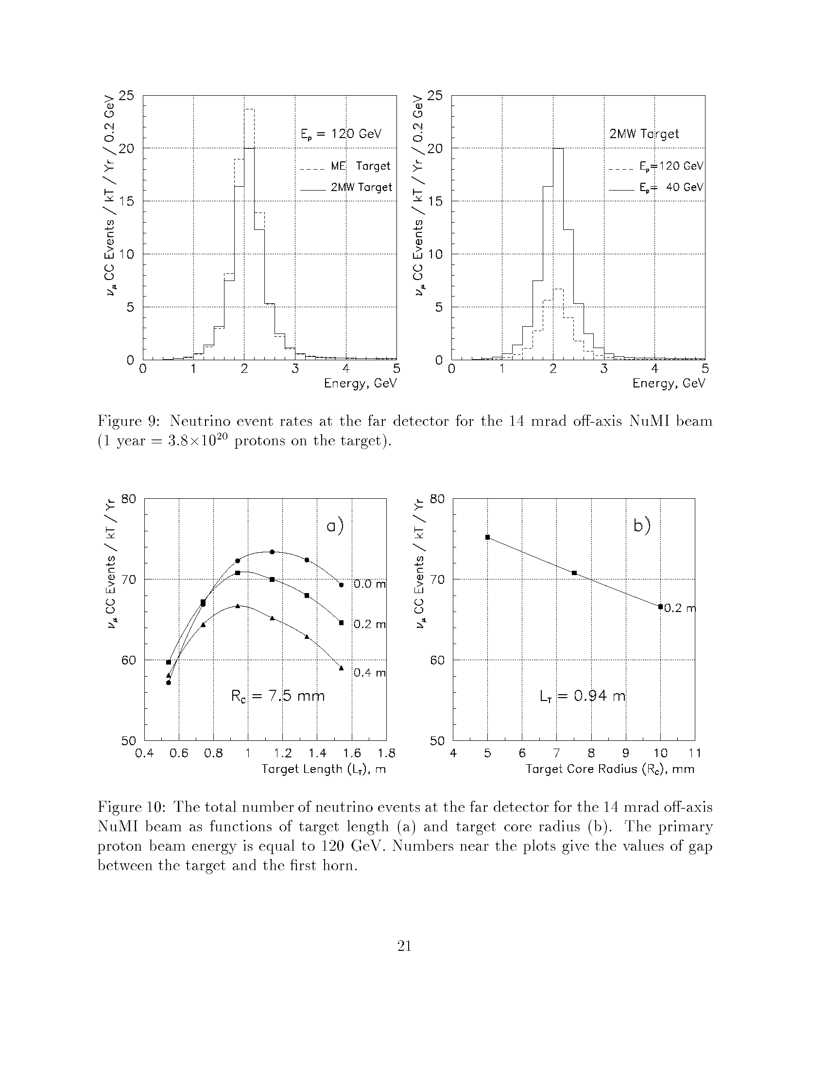
Efficiency of neutrino generation
The “2MW” target is about 10% less efficient at neutrino generation
than a 0.4 MW “Medium Energy” target
(ME target is more optimized to NoVA than the existing LE target)

Slide 14
Neutrinos vs. length and radius of target
Distance of Target from horn
Selected operating point

