Slide 1
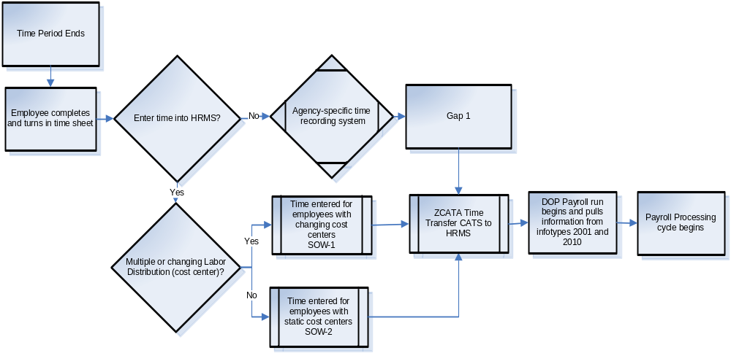
Personnel Time Recording Report
Time Report and Process
Report | Transaction Code | Use
Leave Activity Summary Report | ZHR_RPTTM398 | Displays leave accrual, leave balances, monetary value of leave, employees on Leave Without Pay, and percentages of leave usage
Attendance System Change Report | ZHR_RPTTM084 | Displays all employees who had attendance activity during the current reporting period. Monthly quota balance report per employee(s).
Display Working Time Report | CATS_DA | Displays all absence types and wages types that have been keyed into CATS.
March 2007

Slide 2

Personnel Time Recording
Which Profile Should I Use?
SOW-1: Use when entering multiple cost centers for an employee’s time entry.
SOW-2: Use when entering time for employees with one assigned cost center that does not need to be changed.
Error Message | Resolution
“Enter amount or number” | A wage type has been entered and a measurement unit must (example HR for hours) must also be entered.
“Unit not permitted” | A unit has been entered for an absence type. Delete the unit and save again.
“Attendance/absence XX/XX/XXXX during non-working period” | The absence has been entered on a non-working day according to the work schedule. The Time and Attendance Processor will need to first overwrite/maintain the work schedule then re-enter the absence or attendance.
“Not enough Quota for attendance type xxxx” | The employee does not have enough hours in the Absence Quota Bucket remaining to enter the absence.
“Enter relevant working time attributes” | Hours have been entered without entering a wage type or absence type.
“ Wage type XXXX not permitted for EE subgroup grouping X (from XX/XX/XXXX to XX/XX/XXXX)” | A wage type was assigned that is not permitted for an employee grouping or personnel subarea. Return to the transaction and enter a valid wage type.
Common Transactions
Action | Transaction Code | Menu Path
Enter Wage (i.e. Overtime) and Absence Types in CATS | CAT2 | Human Resources→ Time Management→ Time Sheet→ CATS Classic→ Record Working Times
Enter Labor Distribution in CATS | CAT2 | Human Resources→ Time Management→ Time Sheet→ CATS Classic→ Record Working Times
Overwrite an Employee’s Work Schedule | PA61 | Human Resources→ Time Management→ Administration→ Time Data → Maintain
March 2007

