Slide 1

State of Washington
Department of Veterans Affairs
Human Resource
Management Report
Plan & Align Workforce
Hire Workforce
Deploy Workforce
Reinforce Performance
Develop Workforce
Washington State Department of Veterans Affairs
October 15, 2007

Slide 2
Managers’ Logic Model for Workforce Management
Outputs
Initial Outcomes
Intermediate Outcomes
Plan & Align Workforce
Articulation of managers HRM accountabilities. HR policies. Workforce planning. Job classes & salaries assigned.
Managers understand HRM accountabilities. Jobs, staffing levels, & competencies aligned with agency priorities.
Foundation is in place to build and sustain a productive, high performing workforce.
Hire
Workforce
Qualified candidate pools, interviews & reference checks. Job offers. Appts & per-
formance monitoring.
Best candidate hired & reviewed during appointment period. Successful performers retained.
The right people are in the right job at the right time.
Ultimate Outcomes
Employees are committed to the work they do & the goals of the organization
Productive, successful employees are retained
State has workforce depth & breadth needed for present and future success
Deploy
Workforce
Work assignments& requirements defined. Positive workplace environment created. Coaching, feedback, corrections.
Workplace is safe, gives capacity to perform, & fosters productive relations. Staff know job rqmts, how they’re doing, & are supported.
Time & talent is used effectively. Employees are motivated & productive.
Develop Workforce
Individual development plans. Time/ resources for training. Continuous learning environment created.
Learning environment created. Employees are engaged in develop-
ment opportunities & seek to learn.
Employees have competencies for present job & career advancement
Agencies are better enabled to successfully carry out their mission. The citizens receive efficient government services.
Reinforce Performance
Clear performance expectations linked to orgn’al goals & measures. Regular performance appraisals. Recognition. Discipline.
Employees know how performance contributes to success of orgn. Strong performance rewarded; poor performance eliminated
Successful perf is differentiated & strengthened. Employees are held accountable.

Slide 3
Standard Performance Measures
Plan & Align Workforce
Percent supervisors with current performance expectations for workforce management
Management profile
Workforce planning measure (TBD)
Percent employees with current position/competencies descriptions
Time-to-fill funded vacancies
Candidate quality
Hiring Balance (Proportion of appointment types)
Separation during review period
Percent employees with current performance expectations
Employee survey ratings on “productive workplace” questions
Overtime usage
Sick leave usage
Non-disciplinary grievances/appeals filed and disposition (outcomes)
Worker safety
Percent employees with current individual development plans
Employee survey ratings on “learning & development” questions
Competency gap analysis (TBD)
Percent employees with current performance evaluations
Employee survey ratings on “performance & accountability” questions
Disciplinary actions and reasons, disciplinary grievances/appeals filed and disposition (outcomes)
Reward and recognition practices (TBD)
Ultimate Outcomes
Hire
Workforce
Employee survey ratings on “commitment” questions
Turnover rates and types
Turnover rate: key occupational categories
Workforce diversity profile
Retention measure (TBD)
Deploy
Workforce
Develop Workforce
Reinforce Performance

Slide 4
Plan & Align Workforce
Outcomes:
Managers understand workforce management accountabilities. Jobs and competencies are defined and aligned with business priorities. Overall foundation is in place to build & sustain a high performing workforce.
Performance Measures:
Percent supervisors with current performance expectations for workforce management
Management profile
Workforce Planning measure (TBD)
Percent employees with current position/ competency descriptions
Workforce Management Expectations
Percent supervisors with current performance expectations for workforce management = 100%*
Analysis:
The WDVA has received Performance Management Confirmation. As part of our commitment to providing clear expectations to all staff, including supervisors, the Director set a target of 100% completion on Performance and Development Plans (PDP).
Supervisors have been trained in writing effective PDPs.
Progress in achieving a 100% completion rate is monitored and reported in management team meetings and is a priority in the agency.
The Human Resources staff provided updates on the completion rate to the Director quarterly.
The Director affirmed his commitment to a 100% completion rate and monitored our progress regularly.
Action Steps:
Maintain 100% completion rate for performance expectations.
Complete quarterly reviews of Performance and Development Plans (PDP) at the same rate (100%).
Utilize the information gained from the PDPs in the Performance Management Confirmation awards process.
Continue reporting PDP completion rate to the Director on a quarterly basis.
*Based on 119 of 119 reported number of supervisors
The Washington State Department of Veterans Affairs was the first cabinet agency to receive Performance Management Confirmation. Setting clear expectations for staff is key.
Data as of October 12, 2007
Source: WDVA Human Resource Offices

Slide 5
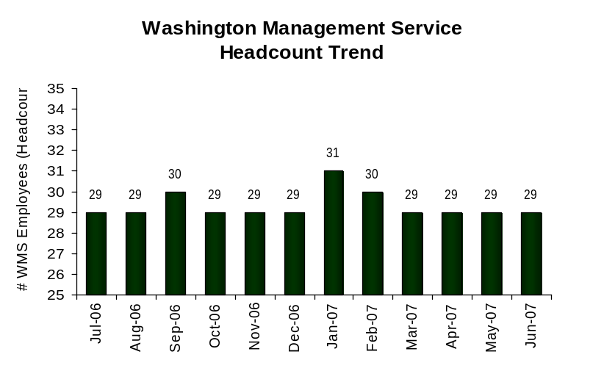
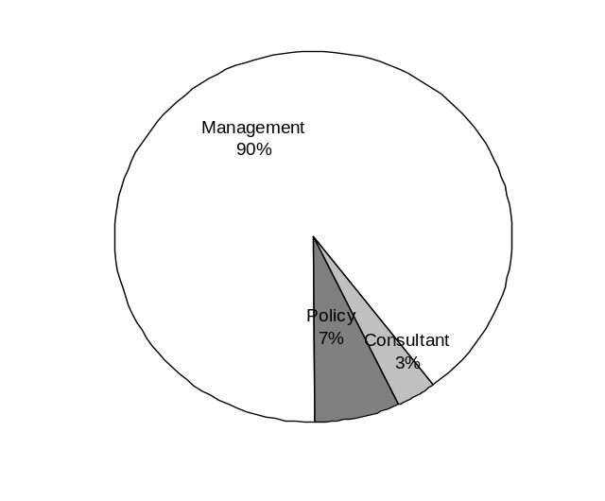
Plan & Align Workforce
Outcomes:
Managers understand workforce management accountabilities. Jobs and competencies are defined and aligned with business priorities. Overall foundation is in place to build & sustain a high performing workforce.
Performance Measures:
Percent supervisors with current performance expectations for workforce management
Management profile
Workforce Planning measure (TBD)
Percent employees with current position/ competency descriptions
Management Profile
WMS Employees Headcount = 29
Percent of agency workforce that is WMS = 4.3%
Managers* Headcount = 32
Percent of agency workforce that is Managers* = 4.7%
* In positions coded as “Manager” (includes EMS, WMS, and GS)
Analysis:
The WDVA appropriately utilizes management level positions to accomplish the agency’s mission and goals.
As a result of the required management cuts, WDVA has streamlined processes to ensure they are being performed in as an efficient manner as possible.
Action Steps:
The WDVA will continue to analyze the number of management positions it uses to ensure we are at an appropriate level to accomplish our mission and goals.
The WDVA will continue to assess processes for potential areas of improvement.
Management 26
Consultant 1
Policy 2
Data as of June 30, 2007
Source: HRMS BW

Slide 6
Plan & Align Workforce
Outcomes:
Managers understand workforce management accountabilities. Jobs and competencies are defined and aligned with business priorities. Overall foundation is in place to build & sustain a high performing workforce.
Performance Measures:
Percent supervisors with current performance expectations for workforce management
Management profile
Workforce Planning measure (TBD)
Percent employees with current position/ competency descriptions
Current Position/Competency Descriptions
Percent employees with current position/competency descriptions = 100%*
Analysis:
In preparing for performance management confirmation, the agency focused on ensuring each employee was aware of the requirements of his/her position.
This awareness includes ensuring position descriptions have been updated and those position descriptions are shared with the affected employee.
Employees are fully aware of the duties, essential functions and objectives of their positions.
These position descriptions are used in conjunction with the Performance and Development Plans in holding employees accountable.
Action Steps:
Supervisors will continue to update position descriptions as necessary.
Supervisors will review the position descriptions as requirements of the position change and at least annually, at the time of the Performance and Development Plan review, with each employee.
The position description will be used as a management tool in holding employees accountable for meeting the expectations of their position.
*Based on 585 of 585 reported employee count
Applies to employees in permanent positions, both WMS & GS
The Washington State Department of Veterans Affairs was the first cabinet agency to receive Performance Management Confirmation. Ensuring staff are aware of the duties and responsibilities to fulfill the requirements of their jobs is key to their overall success.
Data as of October 12, 2007
Source: WDVA Human Resource Offices

Slide 7
Hire Workforce
Outcomes:
Best candidates are hired and reviewed during appointment period. The right people are in the right job at the right time.
Performance Measures
Time-to-fill vacancies
Candidate quality
Hiring Balance (proportion of appointment types)
Separation during review period
Time-to-fill / Candidate Quality
Time-to-fill Funded Vacancies
Average number of days to fill*: 55.5
Number of vacancies filled: 19
*Equals # of days from creation of the requisition to job offer acceptance or actual start date, whichever is less
Time Period: April 25, 2007 –June 30, 2007
Analysis:
The WDVA uses e-Recruiting as a tool to recruit for candidates.
While staff have been learning to use this new recruitment tool, there has been a learning curve that may have affected the number of days it reportedly takes to fill a position.
Some appointments are not reported to the centralized data entry position until many days after the hiring decision has been made. This affects the “average number of days to fill” statistic.
The agency has not received any feedback from hiring managers through e-Recruiting. Instead, a survey was sent out to hiring managers to assess their satisfaction with candidate quality.
Candidate quality surveys were not submitted for three positions.
The ‘number of hires’ data for candidate quality does not match the ‘time to fill’ data because some recruitments were used to fill multiple positions.
Action Steps:
Once users are more comfortable with e-Recruiting, some data entry will be done at the local level. This will allow for more timely entry of hire information.
Provide hiring managers with the access to and training in e-Recruiting. This will allow for candidate satisfaction surveys to be completed and tracked through the system rather than manually.
Candidate Quality
Of the candidates interviewed for vacancies, how many had the competencies (knowledge, skills & abilities) needed to perform the job?
  Number = 45 Percentage = 70%
Of the candidates interviewed, were hiring managers able to hire the best candidate for the job?
  Hiring managers indicating “yes”:
  Number = 12 Percentage = 100%
  Hiring managers indicating “no”:
  Number = 0 Percentage = 0%
Time Period: April 25, 2007 – June 30, 2007
Data as of June 30, 2007
Source: HRMS BW and survey of agency hiring managers

Slide 8
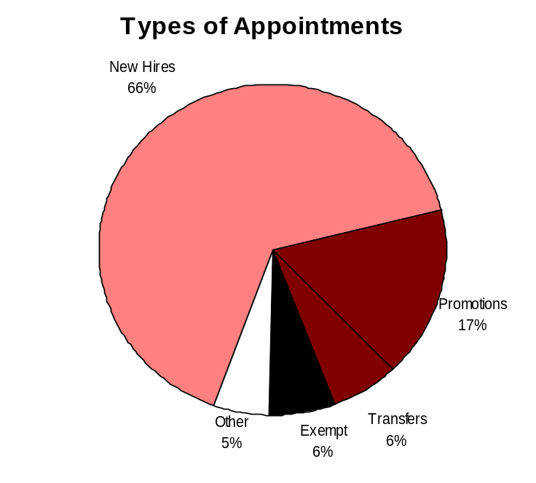
Hire Workforce
Outcomes:
Best candidates are hired and reviewed during appointment period. The right people are in the right job at the right time.
Performance Measures
Time-to-fill vacancies
Candidate quality
Hiring Balance (proportion of appointment types)
Separation during review period
Hiring Balance / Separations During Review Period
Analysis:
Prior to separation, employees are provided an opportunity to improve.
When appropriate, probationary periods are extended to provide an employee ample opportunity to improve and remain employed.
The employees who voluntarily separated during their review periods did so for a variety of reasons. Those reasons include:
  The job was not a “good fit”
  The work was too difficult
  “Issues” with co-workers
  Accept employment elsewhere
  Did not like the commute to work
Action Steps:
The WDVA will continue to work with employees on correcting deficiencies in an attempt to make the employee successful.
The WDVA will continue to terminate employee who are unable to improve their behavior and /or performance.
The WDVA will work towards hiring employees who understand the expectations of the position and can fulfill them. This will require training and support of our managers during the hiring and selection processes.
The WDVA will continue to address issues within workgroups to ensure employees do not feel the only way to resolve them is by resigning.
Total number of appointments = 113*
Time period = July 1, 2006 through June 30, 2007
Includes appointments to permanent vacant positions only; excludes reassignments
“Other” = Demotions, re-employment, reversion & RIF appointments
Separation During Review Period
Probationary separations - Voluntary 9
Probationary separations - Involuntary 4
  Total Probationary Separations 13
Trial Service separations - Voluntary 0
Trial Service separations - Involuntary 0
  Total Trial Service Separations 0
Total Separations During Review Period 13
Time period = July 2006 through June 2007
Data as of June 30, 2007
Source: HRMS, BW and WDVA Human Resource Offices

Slide 9
Deploy Workforce
Outcomes:
Staff know job expectations, how they’re doing, & are supported. Workplace is safe, gives capacity to perform, & fosters productive relations. Employee time and talent is used effectively. Employees are motivated.
Performance Measures
Percent employees with current performance expectations
Employee survey ratings on “productive workplace” questions
Overtime usage
Sick leave usage
Non-disciplinary grievances/appeals filed and disposition (outcomes)
Worker safety
Current Performance Expectations
Percent employees with current performance expectations = 100%*
Analysis:
The WDVA has received Performance Management Confirmation. As part of our commitment to providing clear expectations to all staff, including supervisors, the Director set a target of 100% completion on Performance and Development Plans (PDP).
Supervisors have been trained in writing effective PDPs.
Progress in achieving a 100% completion rate is monitored and reported in management team meetings and is a priority.
The Human Resources staff provided updates on the completion rate to the Director quarterly.
The Director affirmed his commitment to a 100% completion rate and monitored our progress regularly.
Action Steps:
Maintain 100% completion rate for performance expectations.
Complete quarterly reviews of Performance and Development Plans (PDP) at the same rate (100%).
Utilize the information gained from the PDPs in the Performance Management Confirmation awards process.
Continue reporting PDP completion rate to the Director on a quarterly basis.
*Based on 585 of 585 reported employee count
Applies to employees in permanent positions, both WMS & GS
The Washington State Department of Veterans Affairs was the first cabinet agency to receive Performance Management Confirmation. Setting clear expectations for staff is key.
Data as of October 12, 2007
Source: WDVA Human Resource Offices

Slide 10
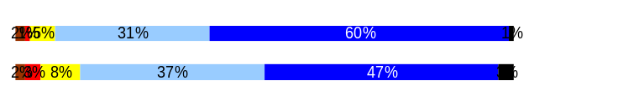
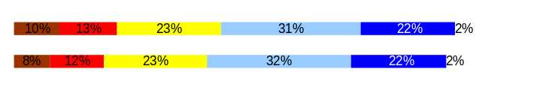
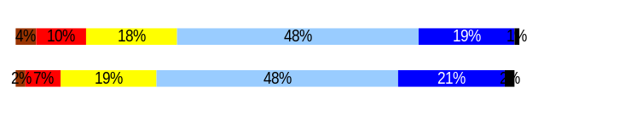
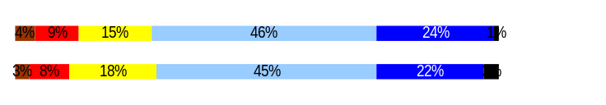
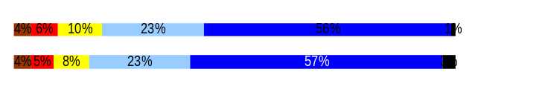
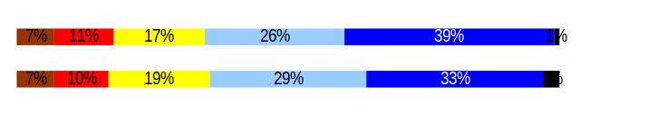
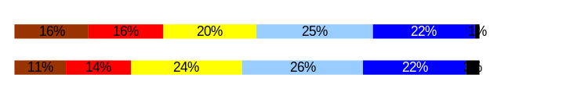
Deploy Workforce
Outcomes:
Staff know job expectations, how they’re doing, & are supported. Workplace is safe, gives capacity to perform, & fosters productive relations. Employee time and talent is used effectively. Employees are motivated.
Performance Measures
Percent employees with current performance expectations
Employee survey ratings on “productive workplace” questions
Overtime usage
Sick leave usage
Non-disciplinary grievances/appeals filed and disposition (outcomes)
Workers Safety
Employee Survey “Productive Workplace” Ratings
Avg
Q4. I know what is expected of me at work.
WDVA
State
Q1. I have opportunity to give input on decisions affecting my work.
WDVA
State
Q2. I receive the information I need to do my job effectively.
WDVA
State
Q6. I have the tools and resources I need to do my job effectively.
WDVA
State
Q7. My supervisor treats me with dignity and respect.
WDVA
State
Q8. My supervisor gives me ongoing feedback that helps me
improve my performance.
WDVA
State
Q9. I receive recognition for a job well done.
WDVA
State
Analysis:
The WDVA has worked diligently to update all position descriptions. All employees are aware of what is expected of them at work.
WDVA also has established a quarterly review process of Performance and Development Plans so employees know how they are doing in meeting the expectations of their positions.
The WDVA is performing at the statewide average in this category.
Action Steps:
At the Extended Leadership level, the WDVA will continue to address setting expectation and employee feedback.
WDVA will work with supervisors to encourage an environment where employees feel safe to discuss issues affecting their jobs, provide them with training and resources to effectively recognize their employees, and to ensure employees have the tools and resources to do their jobs.
We will continue to treat our employee with dignity and respect.
We will determine if our efforts are having a positive effect on employees when the next survey results are available in 2008.
4.46
4.28
3.44
3.50
3.71
3.80
3.78
3.76
4.21
4.29
3.80
3.72
3.23
3.34
Never
Seldom
Occasionally
Usually
Always
Productive Workplace Ratings
WDVA overall average score: 3.80
Statewide overall average score: 3.81
Data as of April, 2006
Source: Employee Survey conducted by DOP

Slide 11
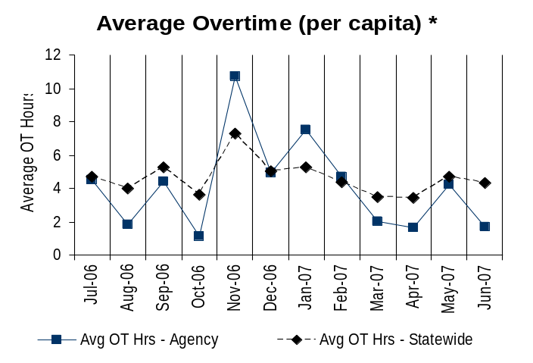
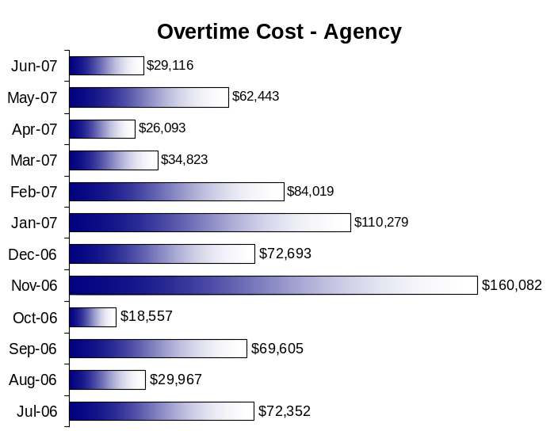
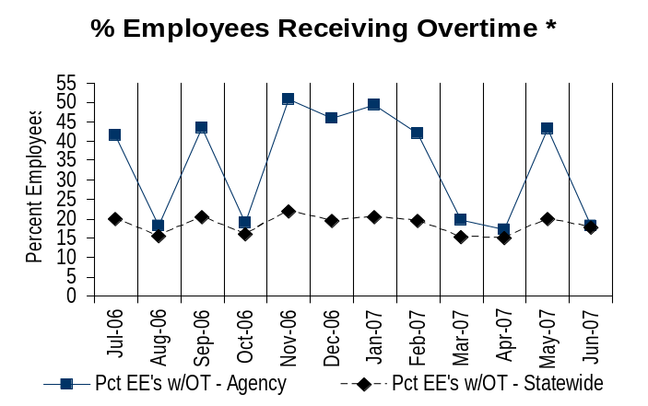
Deploy Workforce
Outcomes:
Staff know job expectations, how they’re doing, & are supported. Workplace is safe, gives capacity to perform, & fosters productive relations. Employee time and talent is used effectively. Employees are motivated.
Performance Measures
Percent employees with current performance expectations
Employee survey ratings on “productive workplace” questions
Overtime usage
Sick leave usage
Non-disciplinary grievances/appeals filed and disposition (outcomes)
Worker safety
Overtime Usage
Overall agency avg overtime usage – per capita, per month: 4.12**
*Statewide overtime values do not include DNR
**Overall agency avg overtime usage – per capita, per month = sum of monthly OT averages divided by number of months
Analysis:
Because our agency operates 3, 24-hour health care facilities, 60% of the cost of overtime in the agency is tied to holidays and is unavoidable.
Because we have tapped into the available on-call candidate pool of RNs and nurses assistants, we have fewer available to fill in for staff during holidays or other time off. This adversely affects our ability to minimize the overtime hours staff must work.
We have provided supervisors and managers at our largest facility with training and tools to assist them in managing staff issues including unexpected absences.
Action Steps:
We will continue to build the on-call pools for our nursing staff.
We will continue to provide supervisors and managers tools and training to minimize unexpected absences that can affect overtime. If we are successful in our trial, we will replicate in the other locations. If not, we will work on other tools that may work.
Overall agency avg employees receiving overtime per month: 34.0%**
*Statewide overtime values do not include DNR
**Overall agency avg employees receiving overtime per month = sum of monthly OT percentages divided by number of months
Data as of June 2007
Source: HRMS - BW

Slide 12
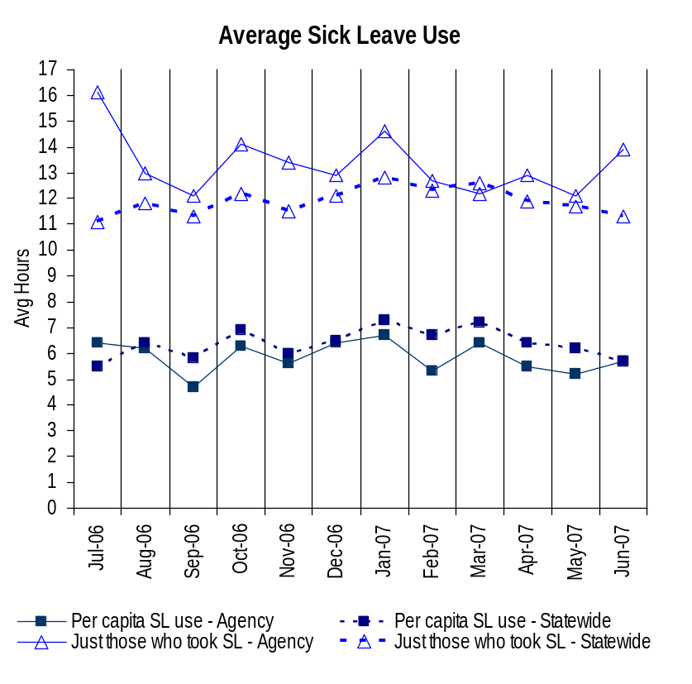
Deploy Workforce
Outcomes:
Staff know job expectations, how they’re doing, & are supported. Workplace is safe, gives capacity to perform, & fosters productive relations. Employee time and talent is used effectively. Employees are motivated.
Performance Measures
Percent employees with current performance expectations
Employee survey ratings on “productive workplace” questions
Overtime usage
Sick leave usage
Non-disciplinary grievances/appeals filed and disposition (outcomes)
Worker safety
Sick Leave Usage
Analysis:
Extended absences of several staff affect these numbers. This specifically impacts the number of hours used per capita for those that use sick leave.
Because of the nature of our work, it is necessary for staff to stay home when they are contagious so they to not compromise the fragile health of our residents or infect others.
In a pilot at our largest facility, WDVA has provided tools and training to our supervisor to assist them in identifying leave use and abuse issues and to deal with them appropriately.
Action Steps:
WDVA will ensure employees continue to use sick leave appropriately. If supervisors have reason to suspect sick leave abuse, they require documentation that the absence was medically necessary in order to approve the leave.
We will implement tools and training for supervisors in dealing with leave issues at all of our facilities in an effort to positively affect our unexpected sick leave use.
WDVA will explore other strategies to encourage a safe and healthful workplace.
Sick Leave Hrs Used / Earned (per capita)
Avg Hrs SL Used (per capita) - Agency | % of SL Hrs Earned (per capita) - Agency
5.9 Hrs | 77.0%
Avg Hrs SL Used (per capita) – Statewide* | % of SL Hrs Earned (per capita) – Statewide*
6.4 Hrs | 82.5%
Sick Leave Hrs Used / Earned (those who took SL)
Avg Hrs SL Used (those who took SL) - Agency | % SL Hrs Earned (those who took SL) - Agency
13.3 Hrs | 166.7%
Avg Hrs SL Used (those who took SL) – Statewide* | % SL Hrs Earned (those who took SL) – Statewide*
11.9 Hrs | 148.4%
Sick Leave time period = July 2006 through June 2007
* Statewide data does not include DOL, DOR, L&I, and LCB
Source: DOP

Slide 13
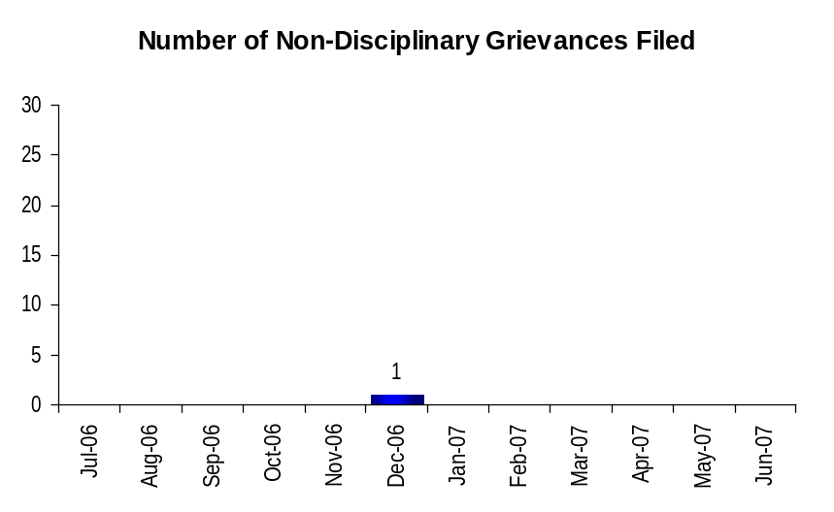
Deploy Workforce
Outcomes:
Staff know job expectations, how they’re doing, & are supported. Workplace is safe, gives capacity to perform, & fosters productive relations. Employee time and talent is used effectively. Employees are motivated.
Performance Measures
Percent employees with current performance expectations
Employee survey ratings on “productive workplace” questions
Overtime usage
Sick leave usage
Non-disciplinary grievances/appeals filed and disposition (outcomes)
Worker safety
Non-Disciplinary Grievances (represented employees)
Total Non-Disciplinary Grievances = 1
Analysis:
The WDVA will continue to communicate with staff and shop stewards to address areas of concern before they turn into grievances.
The low number of grievances indicates WDVA does a good job in labor relations and communications.
Action Steps:
The WDVA will continue to communicate with staff and shop stewards to address areas of concern before they become grievances.
The WDVA will continue to work towards satisfactory resolution of grievances at the lowest level possible.
Non-Disciplinary Grievance Disposition*
(Outcomes determined during 07/06 through 06/07)
This grievance was resolved at step 1 in the grievance process with the agreement there would be more cooperation and communication between labor and management.
Data as of June 30, 2007
Source: WDVA Human Resource Offices and HRMS, grievance tracking system

Slide 14
Deploy Workforce
Outcomes:
Staff know job expectations, how they’re doing, & are supported. Workplace is safe, gives capacity to perform, & fosters productive relations. Employee time and talent is used effectively. Employees are motivated.
Performance Measures
Percent employees with current performance expectations
Employee survey ratings on “productive workplace” questions
Overtime usage
Sick leave usage
Non-disciplinary grievances/appeals filed and disposition (outcomes)
Worker safety
Non-Disciplinary Appeals (mostly non-represented employees)
Filings for DOP Director’s Review
Time Period = July 2006 through June 2007
0 Job classification
0 Rule violation
0 Name removal from register
0 Rejection of job application
0 Remedial action
0 Total filings
Filings with Personnel Resources Board
Time Period = July 2006 through June 2007
0 Job classification
0 Other exceptions to Director Review
0 Layoff
0 Disability separation
0 Non-disciplinary separation
0 Total filings
Non-Disciplinary appeals only are shown above.
Total outcomes = 0
Time Period = 07/2006 through 6/2007
Total outcomes = 0
Time Period = 07/2006 through 06/2007
Source: Dept of Personnel

Slide 15
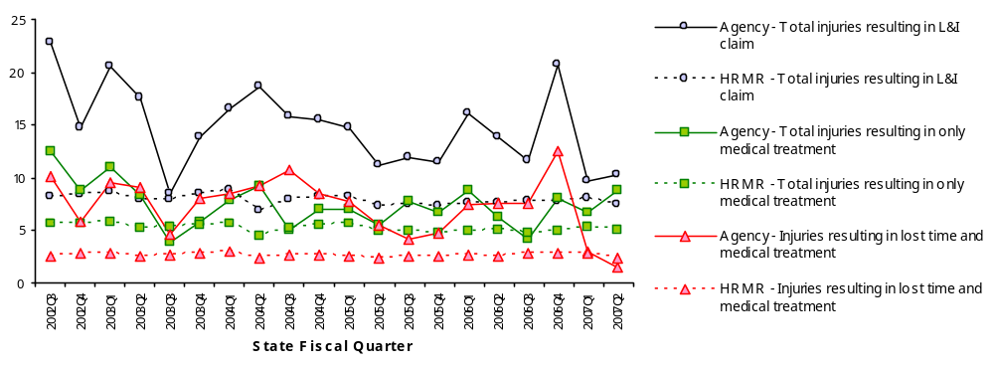
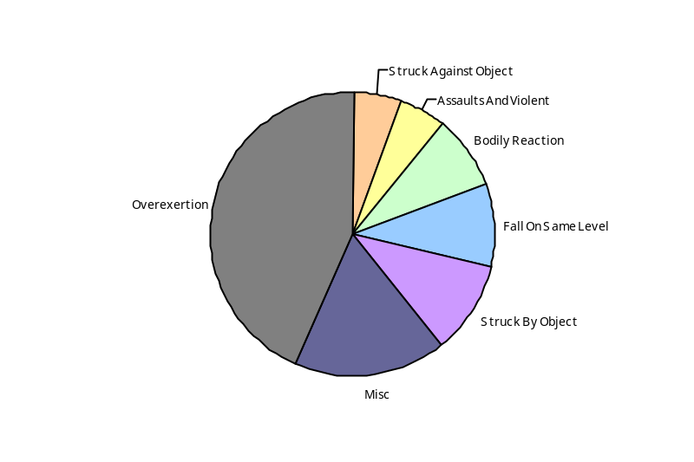
Deploy Workforce
Outcomes
Staff know job expectations, how they’re doing, & are supported. Workplace is safe, gives capacity to perform, & fosters productive relations. Employee time and talent is used effectively. Employees are motivated.
Performance Measures
Percent employees with current performance expectations
Employee survey ratings on 'productive workplace' questions
Overtime usage
Sick leave usage
Non-disciplinary grievances/appeals filed and disposition outcomes
Worker Safety
Worker Safety: Veterans Affairs, Department of
Analysis:
Claims filed by employees at the WDVA is higher than the statewide average.
Because the work at our Veterans’ Homes is physically demanding, the injury rate appears high.
Overexertion is our highest claim category.
Action Plan:
The WDVA will consider options for managing claims more efficiently.
The WDVA will consider tools and training to increase safe work habits at our facilities to decrease our injury rate.
The WDVA will analyze trends in our claim data to determine best approaches in minimizing and managing risk.
The WDVA will look at information for agencies with similar positions and duties to compare our numbers to. This will help us compare our claims rate to a similarly situated work group.
Allowed Annual
Claims Rate*^:
Agency vs. All HR
Management Report
(HRMR) agencies
*Annual claims rate
is # claims / 100 FTE
1 FTE = 2000 hours
^Due to natural lag
in claim filing, rates
are expected to
increase significantly
over time
Injuries by Occupational
Injury and Illness
Classification (OIICS)
event:
For fiscal period 2002Q3
through 2007Q2
(categories under 3% or not
adequately coded are grouped
into 'misc.')
Oiics Code | Oiics Description | Percent | Number
61 | Assaults And Violent | 5% | 22
21 | Bodily Reaction | 8% | 35
13 | Fall On Same Level | 9% | 39
- | Misc | 18% | 74
22 | Overexertion | 43% | 178
01 | Struck Against Object | 5% | 22
02 | Struck By Object | 11% | 44
Source: Labor & Industries, Research and Data Services (data as of 09/03/2007 )
Notes:
HRMR Safety Report Overview
The HRMR Safety Reports are:
- PowerPoint slides created by the Department of Labor and Industries
- Created for each state agency that is reporting their employee safety program results bi-
annually as part of their Human Resources Management Report (HRMR).
- Snapshots of five years of worker’s compensation claim data specific to that agency, as
well as a comparison to the combined data for agencies completing HRMR reports.
- There is a two quarter lag at the end of the five years.
This allows each agency’s payroll data to be entered into L&I’s computer system. This
payroll data is used to compute the number of workers per agency and quarter.
Definitions
Claim – When a covered worker sustains an occupational injury or illness, that worker files a
'claim’ for benefits. A 'claim number' is assigned, and all wage replacement payments, medical
provider bills, etc, for that worker and injury, are associated with that claim number.
Report Detail
'Allowed Annual Claim Rate'
This chart shows your agency's rate of injuries resulting in allowed
claims, by injury quarter, for on-the-job injuries and occupational illnesses. The rate for all
reporting agencies is shown for comparison.
- The rate is the number accepted claims per 200,000 annual worker hours (100 workers)
Three rates are included in this chart:
A)The total rate for all injuries resulting in a claim; the two groups listed below are
exclusive of each other.
B)The rate of injuries which required medical care, but no compensation for lost
time.
C)The rate of injuries which resulted in compensation for lost time in addition to
medical care.
'Injuries by Occupational Injury and Illness Classification (OIICS) Event’
This section contains a pie chart which shows your agency's injuries by type* and a table which
shows the percent and number of accepted claims by OIICS Event description and code.
This information is useful in identifying what causes injuries so prevention can occur. Prevention
might include root cause analysis, education, and hazard mitigation.
* Injury Type is based on the 2 digit Major Group code of the Event or Exposure section of the Occupational
Injury and Illness Classification System (OIICS). Groups with less than 3% of the
total injuries are combined into the 'Misc' category.
How to get this report for your agency:
All worker compensation reports will be available on the L&I website by the 20th of September or
the 20th of March of each year. The data will be provided in a PowerPoint slide to which you will
add your own analyses and action plans.

Slide 16
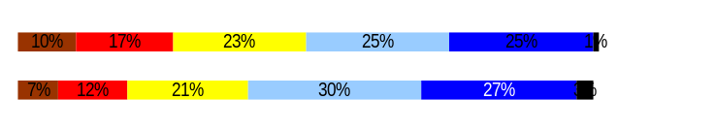
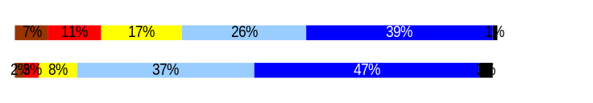
Develop Workforce
Outcomes:
A learning environment is created. Employees are engaged in professional development and seek to learn. Employees have competencies needed for present job and future advancement.
Performance Measures
Percent employees with current individual development plans
Employee survey ratings on “learning & development” questions
Competency gap analysis (TBD)
Individual Development Plans
Percent employees with current individual development plans = 100%
Analysis:
The WDVA has received Performance Management Confirmation. As part of our commitment to our providing clear expectations to all staff, including supervisors, the Director set a target of 100% completion on Performance and Development Plans (PDP).
Supervisors have been trained in writing effective PDPs, including completing the Training Development Needs and Opportunities section for each employee.
We are making strides in providing employees with opportunities for training.
The WDVA recognizes the importance of providing ongoing feedback about performance to employees.
The WDVA performs similarly to the statewide average in this category.
Action Steps:
The WDVA has established a process for supervisors to meet quarterly with employees on their Performance and Development Plan. This facilitates ongoing opportunities for feedback on performance.
These quarterly reviews provide an opportunity to review training opportunities and needs.
We will review our progress towards improvement after the current survey results are available in 2008.
Total # of employees with current IDPs* = 585
Total # of employees* = 585
*Applies to employees in permanent positions, both WMS & GS
Employee Survey “Learning & Development” Ratings
Q5. I have opportunities at work to learn and grow.
WDVA
State
Q8. My supervisor gives me ongoing feedback that helps me
improve my performance.
WDVA
State
Avg
3.38
3.59
3.80
3.72
Never
Seldom
Occasionally
Usually
Always
WDVA overall average score for Learning & Development Ratings: 3.59
Statewide overall average score for Learning & Development Ratings: 3.66
Data as of April 30, 2007
Source: WDVA Human Resource Offices

Slide 17
Reinforce Performance
Outcomes:
Employees know how their performance contributes to the goals of the organization. Strong performance is rewarded; poor performance is eliminated. Successful performance is differentiated and strengthened. Employees are held accountable.
Performance Measures
Percent employees with current performance evaluations
Employee survey ratings on “performance and accountability” questions
Disciplinary actions and reasons, disciplinary grievances/appeals filed and disposition (outcomes)
Reward and recognition practices (TBD)
Current Performance Evaluations
Percent employees with current performance evaluations = 100%*
Analysis:
The WDVA as received Performance Management Confirmation. As part of our commitment to providing specific feedback to our staff on their performance, we have set the expectation that 100% of performance evaluations be done in a timely manner.
The WDVA has instituted the same evaluation period for all staff. This has helped to facilitate easier tracking and reporting on our performance evaluation completion rate.
The Director has affirmed his commitment to a 100% completion rate for performance evaluations and has regularly monitored progress towards meeting that goal.
We have a few employees out on extended leave that are not included in these numbers. Upon their return, supervisors will work on setting expectations and evaluating these employees.
Action Steps:
The WDVA will continue to monitor timely completion of our performance evaluations.
The WDVA will continue to expect a 100% completion rate from all of our supervisors.
As part of “Supervisors Essentials” training, WDVA supervisors will continue to receive training in writing effective performance evaluations.
*Based on 585 of 585 reported employee count
Applies to employees in permanent positions, both WMS & GS
The Washington State Department of Veterans Affairs was the first cabinet agency to receive Performance Management Confirmation. Ensuring staff have received timely feedback on their job performance is key to their overall success.
Data as of October 12, 2007
Source: WDVA Human Resource Offices

Slide 18
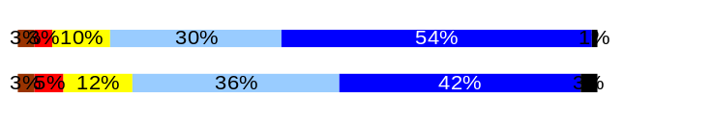
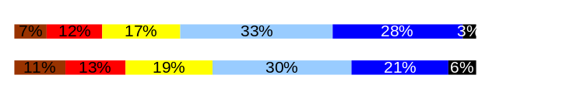
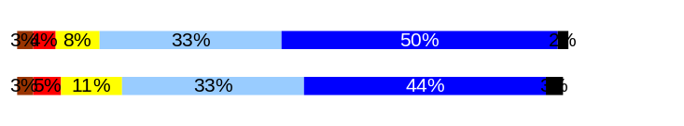

Reinforce Performance
Outcomes:
Employees know how their performance contributes to the goals of the organization. Strong performance is rewarded; poor performance is eliminated. Successful performance is differentiated and strengthened. Employees are held accountable.
Performance Measures
Percent employees with current performance evaluations
Employee survey ratings on “performance and accountability” questions
Disciplinary actions and reasons, disciplinary grievances/appeals filed and disposition (outcomes)
Reward and recognition practices (TBD)
Employee Survey “Performance & Accountability” Ratings
Analysis:
Supervisors may not have made a clear connection for employees to understand how they each impact and affect the agency mission.
The prior training supervisors received on completing Performance and Development Plans (PDPs) may not have clearly identified the need to communicate each position’s impact on the agency mission.
Supervisors do a good job of holding employees accountable and are supported by management in doing so.
Employee perception is they do not receive recognition when appropriate.
The WDVA performs slightly better than the statewide average in this category.
Action Steps:
Position alignment with the agency’s mission and goals is on every PDP. These plans are reviewed and discussed quarterly with employees so questions can be answered.
Supervisor training on completing effective PDPs will continue, as needed.
WDVA management will continue to provide support and guidance to supervisors in managing staff.
Tools and resources to recognize employees will be provided to supervisors and managers.
The WDVA will audit PDPs quarterly for content and completion.
Avg
Q3. I know how my work contributes to the goals of my agency.
WDVA
State
Q10. My performance evaluation provides me with meaningful information about my performance.
WDVA
State
Q11. My supervisor holds me and my co-workers accountable for performance.
WDVA
State
Q9. I receive recognition for a job well done.
WDVA
State
4.30
4.12
3.67
3.39
4.24
4.14
3.23
3.34
Never
Seldom
Occasionally
Usually
Always
Performance and Accountability Ratings
WDVA overall average score : 3.86
Statewide overall average score: 3.74
Data as of April, 2006
Source: Employee Survey conducted by DOP

Slide 19
Reinforce Performance
Outcomes:
Employees know how their performance contributes to the goals of the organization. Strong performance is rewarded; poor performance is eliminated. Successful performance is differentiated and strengthened. Employees are held accountable.
Performance Measures
Percent employees with current performance evaluations
Employee survey ratings on “performance and accountability” questions
Disciplinary actions and reasons, disciplinary grievances/appeals filed and disposition (outcomes)
Reward and recognition practices (TBD)
Formal Disciplinary Actions
Disciplinary Action Taken
Time period = July 2006 through June 2007
Issues Leading to Disciplinary Action
There was one dismissal for poor attendance.
The second dismissal was for an employee’s failure to abide by policies and procedures. This same employee failed to comply with supervisory directives.
The third dismissal was of an employee who purchased drugs from a resident.
A demotion was for an employee’s failure to provide proper care to residents and neglect of their rights.
One RIP was for an employee’s failure to respond to a resident’s request for nursing assistance.
Another RIP was for an employee’s repeated operation of a state motor vehicle in an unsafe manner, failing to consider the safety of the residents being transported, and for failing to report accidents involving resident injury and property damage in a timely manner. This same employee was later demoted for similar unsafe driving and another accident.
Two employees received RIPs for poor attendance.
Another RIP was for inappropriate contact with a co-worker.
One employee received a RIP for verbally abusing a resident.
The last RIP was for a supervisor who borrowed prescription drugs from a subordinate employee for whom it was prescribed.
Dismissals | 3
Demotions | 2
Suspensions | 0
Reduction in Pay (RIP)* | 7
Total Disciplinary Actions* | 12
* Reduction in Pay is not currently available in HRMS/BW.
Analysis:
Performance and behavior issues are addressed at as low a level as possible. Therefore, few problems rise to the level of formal discipline.
Supervisors receive support in dealing with personnel issues, as the need arises.
Employees are provided with opportunities to improve their performance and behaviors in an effort to avoid discipline, whenever possible.
Action Steps:
WDVA will continue to train supervisors in effective management of staff and dealing with personnel issues.
WDVA will continue to be proactive in dealing with HR issues in order to minimize the number of disciplinary actions taken against our employees.
If discipline is necessary, WDVA management will continue to support supervisors through the process.
Data as of June 30, 2007
Source: HRMS BW and WDVA Human Resource Offices

Slide 20
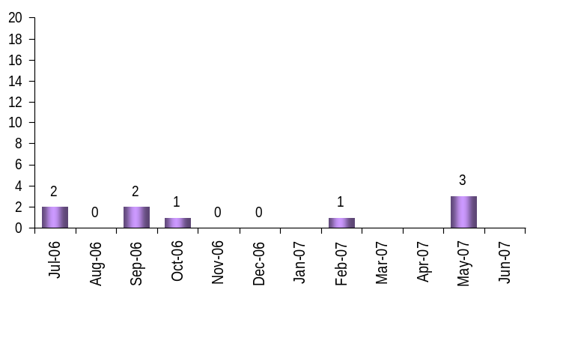
Reinforce Performance
Outcomes:
Employees know how their performance contributes to the goals of the organization. Strong performance is rewarded; poor performance is eliminated. Successful performance is differentiated and strengthened. Employees are held accountable.
Performance Measures
Percent employees with current performance evaluations
Employee survey ratings on “performance and accountability” questions
Disciplinary actions and reasons, disciplinary grievances/appeals filed and disposition (outcomes)
Reward and recognition practices (TBD)
Disciplinary Grievances and Appeals
Disciplinary Grievances
(Represented Employees)
Disciplinary Appeals
(Non-Represented Employees
filed with Personnel Resources Board)
Time Period = July 2006 through June 2007
0 Dismissal
0 Demotion
0 Suspension
0 Reduction in salary
0 Total Disciplinary Appeals Filed with PRB
Total # Disciplinary Grievances Filed: 9
There is no one-to-one correlation between the filings shown above and the outcomes displayed in the charts below. The time lag between filing date and when a decision is rendered can cross the time periods indicated.
Disposition (Outcomes) of Disciplinary Grievances
Time period = July 2006 through June 2007
WDVA had four disciplinary grievances withdrawn at various steps in the process.
One grievance is considered to have been resolved at the second level as it was neither moved forward to the third level, nor withdrawn.
One grievance that was scheduled to go to arbitrations was withdrawn.
One grievance was settled at the third step.
Two grievances are continuing through the process.
Disposition (Outcomes) of Disciplinary Appeals
Time period = July 2006 through June 2007
WDVA did not have any disciplinary appeals filed with the Personnel Resources Board during the reporting period.
*Outcomes issued by Personnel Resources Board
Data as of June 30, 2007
Source: WDVA Human Resource Offices and HRMS, grievance tracking system

Slide 21
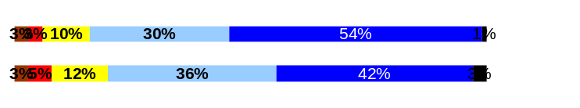
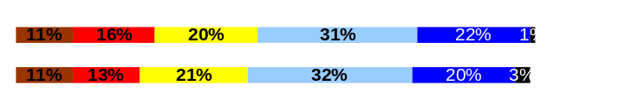

ULTIMATE OUTCOMES
Employees are committed to the work they do and the goals of the organization
Successful, productive employees are retained
The state has the workforce breadth and depth needed for present and future success
Performance Measures
Employee survey ratings on “commitment” questions
Turnover rates and types
Turnover rate: key occupational categories
Workforce diversity profile
Retention measure (TBD)
Employee Survey “Employee Commitment” Ratings
Analysis:
Employees did not appear to understand how their position impacts and supports the mission of the WDVA.
The WDVA has identified the need to advertise and verbalize metrics to determine success. Employees need to understand what success looks like and how will we know when we have achieved our goals.
The perception of our employees is that WDVA does not do a good job of recognizing them for a job well done. Though WDVA is committed to recognition, our staff does not see that.
The WDVA performs at the statewide average in this category.
Action Steps:
WDVA supervisors will continue to include position alignment with agency mission and goals on every Performance and Development Plan. Supervisors can use the quarterly review process to affirm the position’s alignment with the agency mission and goals.
WDVA management will clearly identify what success looks like and will communicate the metrics we will use to determine whether or not employees or the agency are successful.
The WDVA will continue to provide supervisors with the tools and resources to recognize staff.
We will review our progress towards improvement after the current survey results are available in 2008.
Avg
Q3. I know how my work contributes to the goals of my agency.
WDVA
State
Q12. I know how my agency measures its success.
WDVA
State
Q9. I receive recognition for a job well done.
WDVA
State
4.30
4.12
3.36
3.39
3.23
3.34
Never
Seldom
Occasionally
Usually
Always
WDVA overall average score for Employee Commitment Ratings: 3.63
Statewide overall average score for Employee Commitment Ratings: 3.62
Data as of April, 2006
Source: Employee Survey conducted by DOP

Slide 22
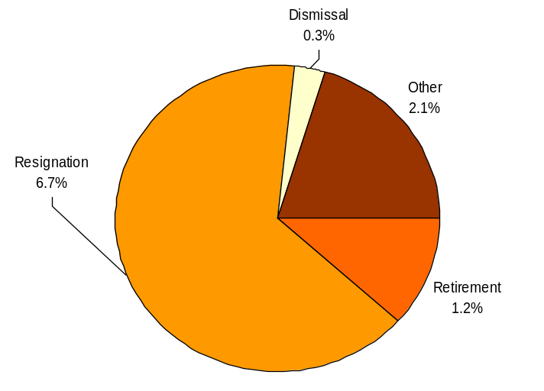
ULTIMATE OUTCOMES
Employees are committed to the work they do and the goals of the organization
Successful, productive employees are retained
The state has the workforce breadth and depth needed for present and future success
Performance Measures
Employee survey ratings on “commitment” questions
Turnover rates and types
Turnover rate: key occupational categories
Workforce diversity profile
Retention measure (TBD)
Turnover Rates
Total % Turnover (leaving state)
Time Period: July 2006 through June 2007
Analysis:
The largest percent of turnover at the WDVA is due to resignations.
Some staff have indicated they were not fully prepared for the pace of work in our Homes.
Some nursing staff are leaving for either more desirable shifts or days off.
Action Steps:
The WDVA will work towards hiring employees who understand the expectations of the position and can fulfill them. This will require training and support of our managers during the hiring and selection processes.
Supervisors will be provided training prior to, and support during, the hiring process to ensure candidates are aware of the environment at our homes.
WDVA will explore the effectiveness of changing our staff on-boarding process to include assigning a “buddy” to new hires.
Note: Movement to another agency is currently not available in HRMS/BW
Total Turnover Actions: 60
Total % Turnover: 10.3%
Data as of June 30, 2007
Source: HRMS BW

Slide 23
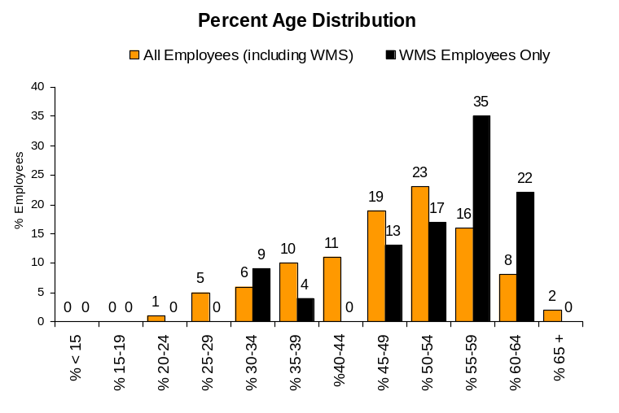
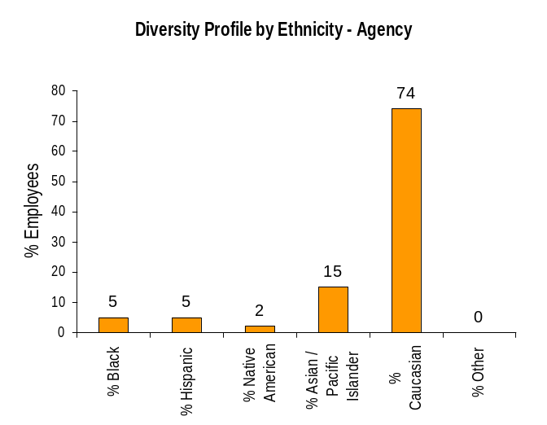
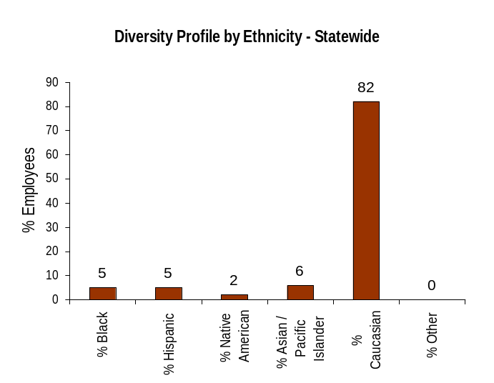
ULTIMATE OUTCOMES
Employees are committed to the work they do and the goals of the organization
Successful, productive employees are retained
The state has the workforce breadth and depth needed for present and future success
Performance Measures
Employee survey ratings on “commitment” questions
Turnover rates and types
Turnover rate: key occupational categories
Workforce diversity profile
Retention measure (TBD)
Workforce Diversity Profile
Agency State
Female 74% 53%
Disabled 4% 5%
Vietnam Vet 8% 7%
Disabled Vet 6% 2%
People of color 26% 18%
Persons over 40 79% 75%
Analysis:
The WDVA has been and continues to be committed to diversity.
The WDVA is consistently above state average in the diversity of our workforce.
Because of the nature of our work (long term care facilities), and the specific physical requirements of those jobs, many of our positions are limited in the candidates we can appoint to these positions.
Action Steps:
The WDVA will continue to make affirmative efforts to recruit a diverse workforce.
The WDVA will continue to participate in job fairs, information fairs, and other targeted recruitment events in an effort to continue to diversify our workforce.
Data as of June 2007
Source: HRMS BW

