Slide 1





MARIJUANA
“The Facts”
Click here to return to NHP Home:
www.nhp.nv.gov
Click to continue
Notes:
PRESENTATION CREATED BY:
Las Vegas Metropolitan Police Department
Special Operations Division – Narcotics

Slide 2
2 QUESTIONS
DO WE REALLY WANT TO CHANGE OUR STATE CONSTITUTION OF 140 YEARS FOR MARIJUANA?
DO WE WANT TO LEGALIZE A DRUG WHOSE ONLY PURPOSE IS TO GET THE USER HIGH?
Click here to return to NHP Home:
www.nhp.nv.gov
Click to continue

Slide 3
IMPORTANT!
THIS INITIATIVE HAS ABSOLUTELY NOTHING TO DO WITH THE ISSUE OF MEDICAL MARIJUANA.
THE PROPONENTS OF THE INITIATIVE HAVE ONCE AGAIN TRIED TO TIE THE ISSUE TO THE MEDICAL USE OF MARIJUANA, WHICH IS LEGAL IN NEVADA.
Click here to return to NHP Home:
www.nhp.nv.gov
Click to continue

Slide 4
CURRENT
NEVADA STATE LAW
1ST OFFENSE-MISDEMEANOR, MAXIMUM $600 FINE.
2ND OFFENSE-MISDEMEANOR, MAXIMUM $1,000 FINE AND TREATMENT.
THESE SUBJECTS ARE NOT BEING SENT TO JAIL/PRISON.
MINIMAL TIME SPENT BY OFFICERS.
Click here to return to NHP Home:
www.nhp.nv.gov
Click to continue

Slide 5
2002 CLARK COUNTY ARRESTEES
PERCENT TESTING POSITIVE FOR MARIJUANA – BY AGE:
TOTAL 41.8%
Under 21 60.5%
21-25 56.8%
26-30 37.7%
31-35 35.5%
Over 35 28.3%
Click here to return to NHP Home:
www.nhp.nv.gov
Click to continue

Slide 6
2002 CLARK COUNTY ARRESTEES
PERCENT TESTING POSITIVE FOR MARIJUANA BY OFFENSE:
VIOLENT - 36.2%
PROPERTY - 41.7%
DRUGS - 54.8%
DOMESTIC VIOLENCE - 36.6%
OTHER - 40.8%
MARIJUANA IS #1 IN EACH CATEGORY
Click here to return to NHP Home:
www.nhp.nv.gov
Click to continue

Slide 7
GATEWAY USE
A DIRECT CAUSE AND EFFECT RELATIONSHIP BETWEEN MARIJUANA USE AND SUBSEQUENT USE OF OTHER DRUGS IS HARD TO PROVE. STUDIES SHOW, HOWEVER, THAT MARIJUANA USERS WERE FOUND TO BE:
8X MORE LIKELY TO HAVE USED COCAINE,
15X MORE LIKELY TO HAVE USED HEROIN.
Click here to return to NHP Home:
www.nhp.nv.gov
Click to continue

Slide 8
INCREASED HEALTH RISKS
MARIJUANA SMOKE CONTAINS MORE THAN 400 CHEMICALS AND INCREASES THE RISK OF CANCER, LUNG DAMAGE AND POOR PREGNANCY OUTCOMES.
SMOKING MARIJUANA DELIVERS 3 TO 5 TIMES THE AMOUNT OF TARS AND CARBON MONOXIDE INTO THE BODY.
Click here to return to NHP Home:
www.nhp.nv.gov
Click to continue

Slide 9
INCREASED HEALTH RISKS
MENTION OF MARIJUANA USE IN EMERGENCY ROOM VISITS HAVE RISEN 176 PERCENT SINCE 1994, SURPASSING THOSE OF HEROIN.
IN 2001, MARIJUANA WAS A CONTRIBUTING FACTOR IN MORE THAN 110,000 EMERGENCY ROOM VISITS IN THE UNITED STATES.
Click here to return to NHP Home:
www.nhp.nv.gov
Click to continue

Slide 10
INCREASED HEALTH RISKS
MARIJUANA IS MUCH MORE POWERFUL TODAY THAN IT WAS 30 YEARS AGO, AND SO ARE ITS MIND-ALTERING EFFECTS.
AVERAGE THC LEVELS ROSE FROM LESS THAN 1 PERCENT IN THE MID-1970S TO MORE THAN 6 PERCENT IN 2002.
Click here to return to NHP Home:
www.nhp.nv.gov
Click to continue

Slide 11
CONSEQUENCES
IT WOULD BE POSSIBLE UNDER THE PROPOSED NEW LAW TO LEGALLY SMOKE MARIJUANA BEFORE GOING TO WORK OR PERFORMING DANGEROUS TASKS. MARIJUANA’S EFFECTS LASTS FOR SEVERAL HOURS.
Click here to return to NHP Home:
www.nhp.nv.gov
Click to continue

Slide 12
CONSEQUENCES
YOUR CHILDREN COULD BE EXPOSED TO MARIJUANA IN YOUR NEIGHBOR’S HOME AS IT WOULD BE LEGAL FOR YOUR NEIGHBOR TO SMOKE IT.
IT WOULD ALSO LEAD TO INCREASED ACCESS FOR CHILDREN TO MARIJUANA AS THEIR PARENTS COULD LEGALLY POSSESS IT IN THEIR HOME.
Click here to return to NHP Home:
www.nhp.nv.gov
Click to continue

Slide 13
“WE’VE GOT ENOUGH INTOXICANTS OUT THERE ALREADY, IT CERTAINLY WILL PUT OUR YOUNG PEOPLE AT RISK. IT’S MORE DRUGS, MORE STONED PEOPLE AND MORE PEOPLE DRIVING AROUND UNDER THE INFLUENCE.”
SHERIFF BILL YOUNG
LAS VEGAS METROPOLITAN POLICE
Click here to return to NHP Home:
www.nhp.nv.gov
Click to continue

Slide 14

MARIJUANA
*THE FACTS*
Click to continue
Presentation prepared by:
Special Operations Division
Narcotics
Click here to return to NHP Home:
www.nhp.nv.gov

Slide 15
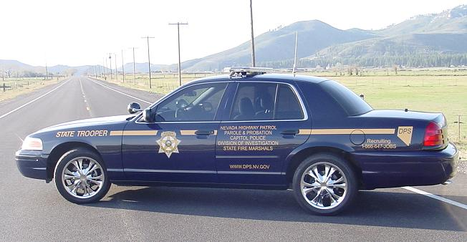
Dedicated employees committed to a
Drug Free Nevada.
Nevada Department of Public Safety
555 Wright Way
Carson City, NV 89711-0525
Click to return to NHP Home page

