Slide 1
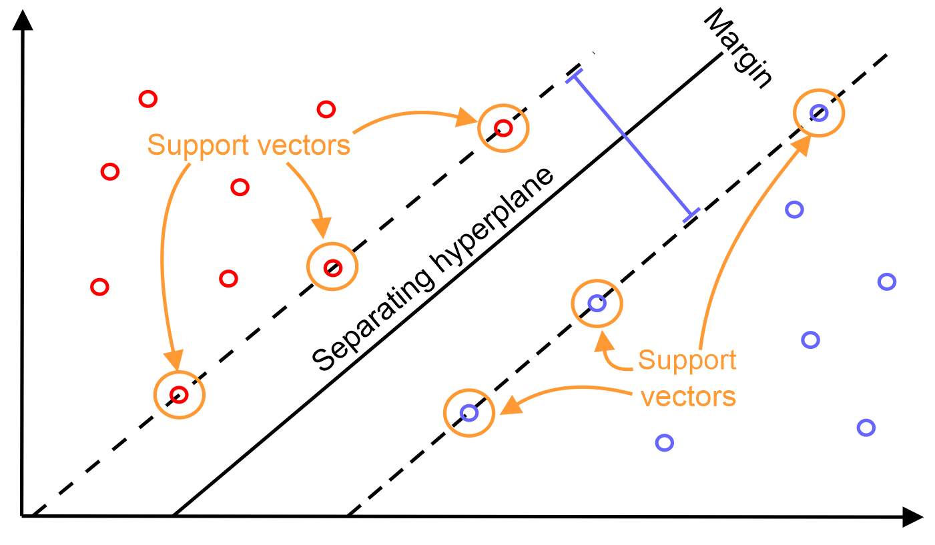
Support Vector Machines - SVMs
Group 1:
Nguyễn Lê Anh Quân
Nguyễn Khả Tiến
Nguyễn Trung Tuấn
Trịnh Nhật Tân

Slide 2
Content
Data source.
Test with imbalanced data.
Test with balanced data.
Visualize differences between 2 methods.
PCA.
Visualize differences between 3 methods.
ANN.
Result.

Slide 3
Data source
https://www.kaggle.com/lowecoryr/universalbank
Predict customers that are able to accept a loan.

Slide 4
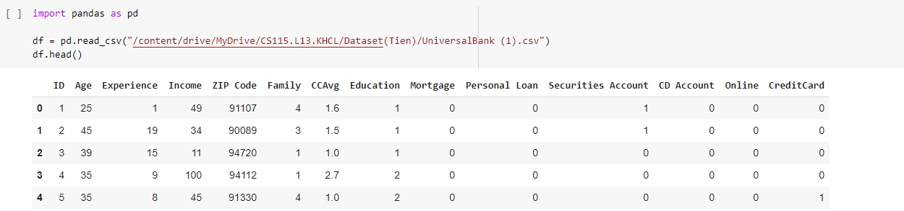
Data source
Analyze:

Slide 5
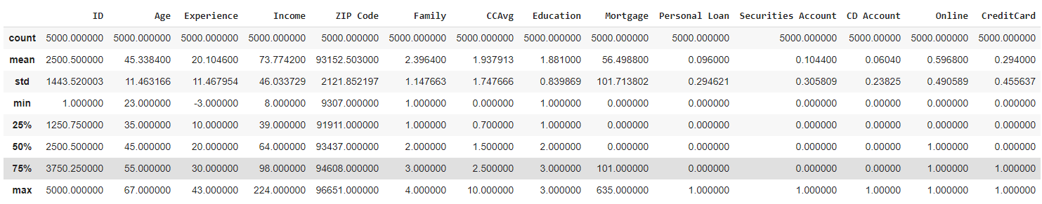
Data source
Analyze:

Slide 6
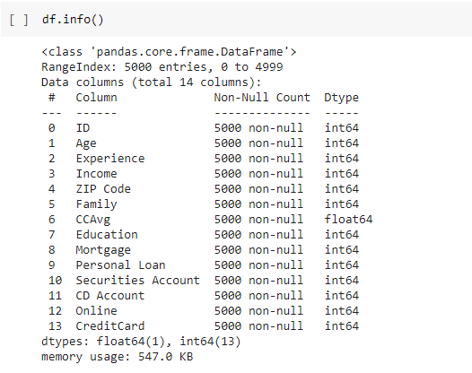
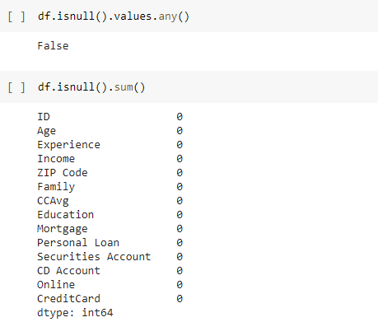
Data source
Analyze:

Slide 7
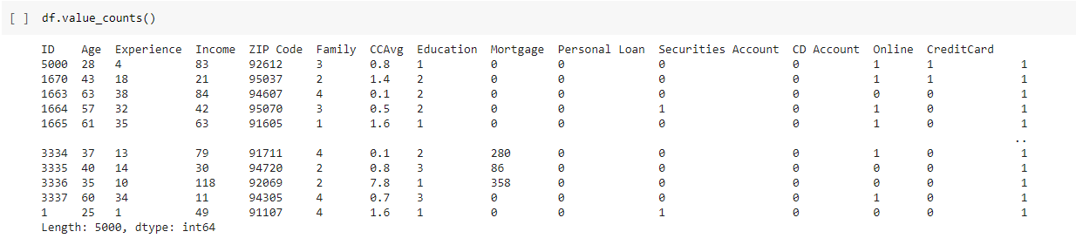
Data source
Analyze:

Slide 8
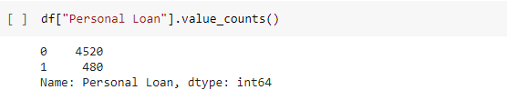
Data source
Analyze:

Slide 9
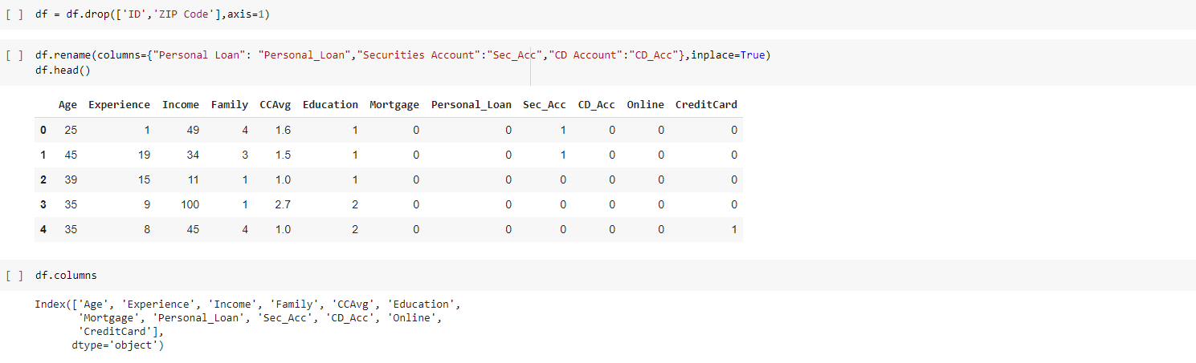
Data source
Analyze:

Slide 10
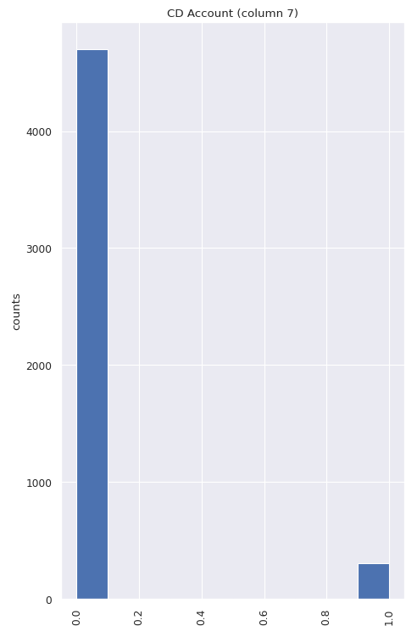
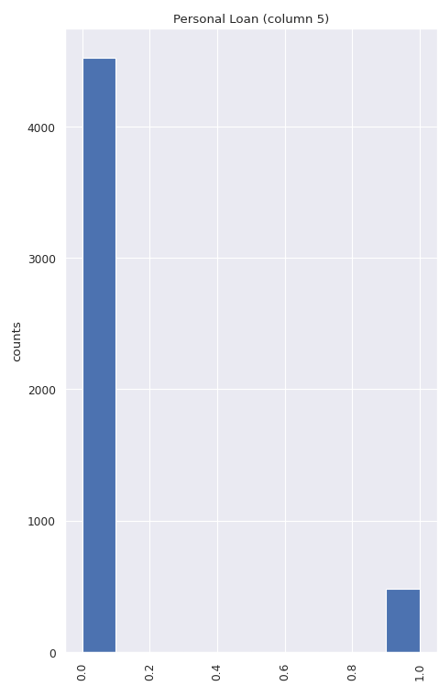
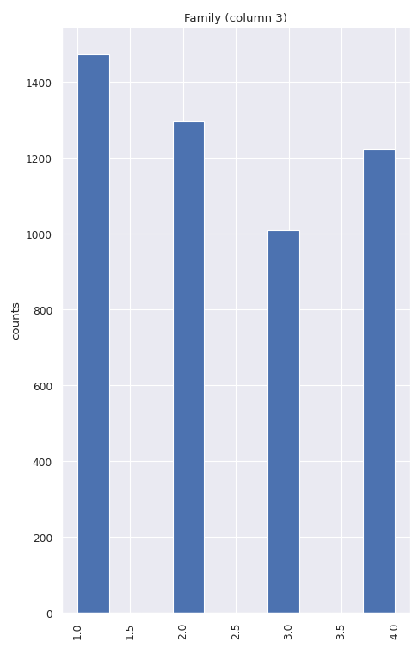
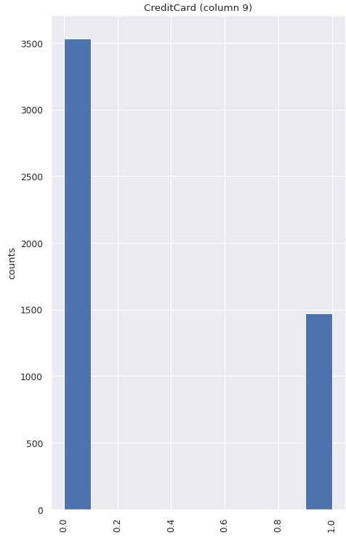
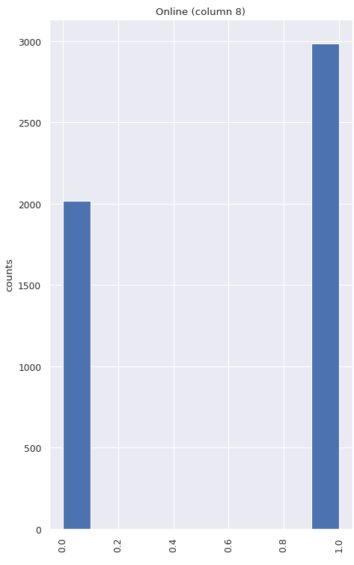
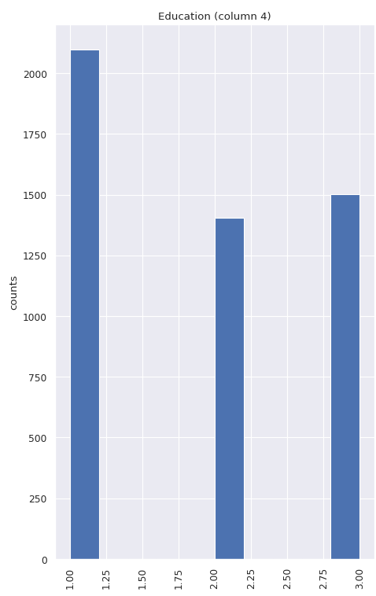
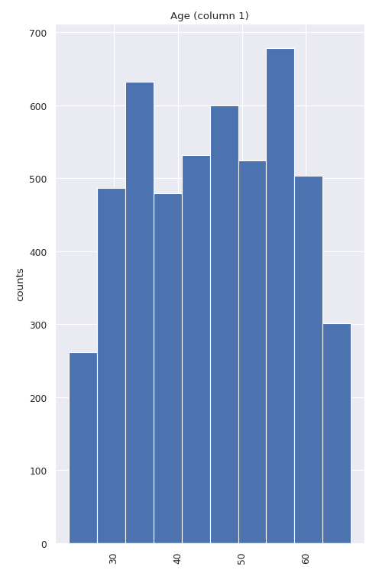
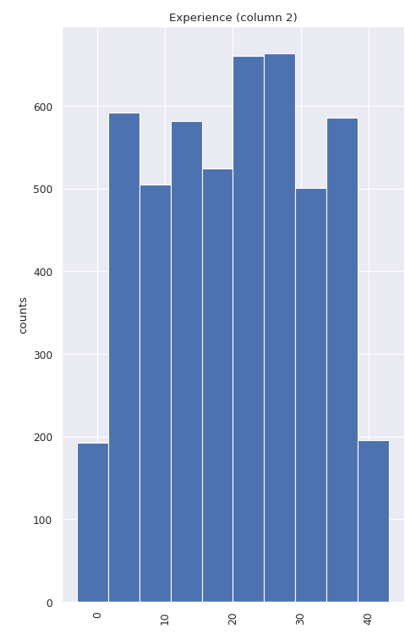
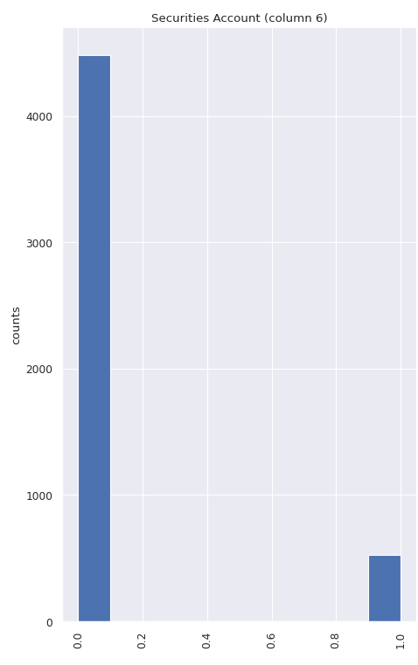
Data source
Visualize:

Slide 12
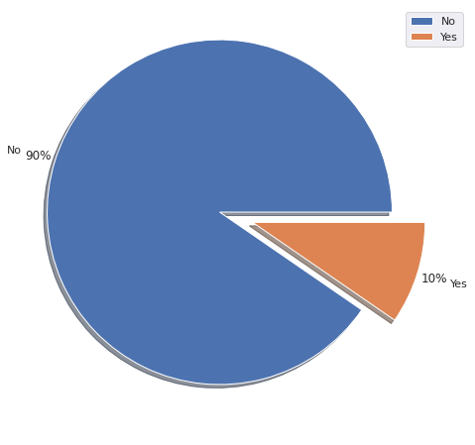
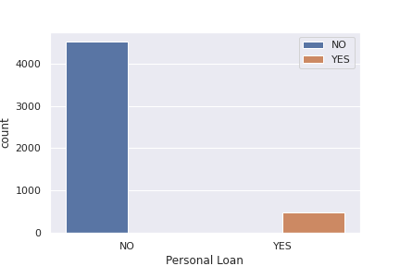
Notes:
Imbalanced data

Slide 13
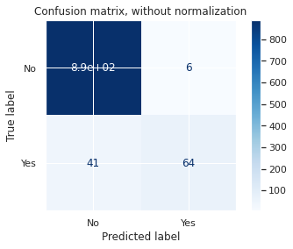
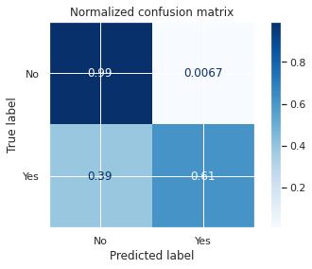
Test with imbalanced data
SVM Linear

Slide 14
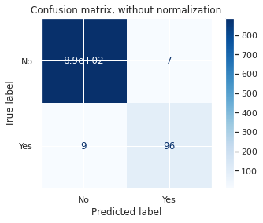
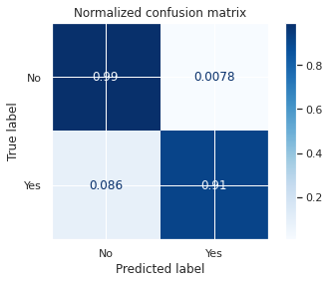
Test with imbalanced data
SVM Non-linear

Slide 15
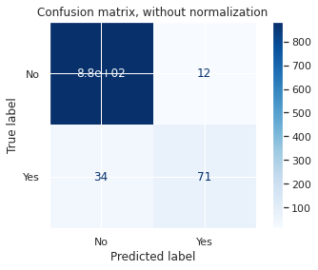
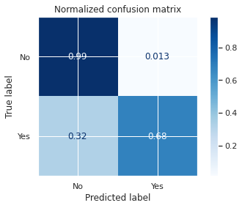
Test with imbalanced data
Logistic Regression

Slide 16
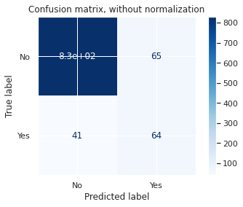
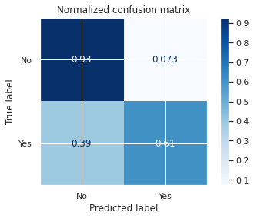
Test with imbalanced data
Naïve Bayes

Slide 17


Test with imbalanced data
Decision Tree

Slide 18
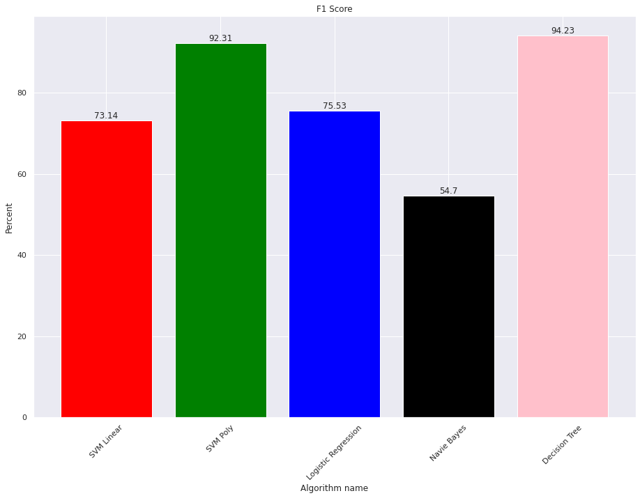
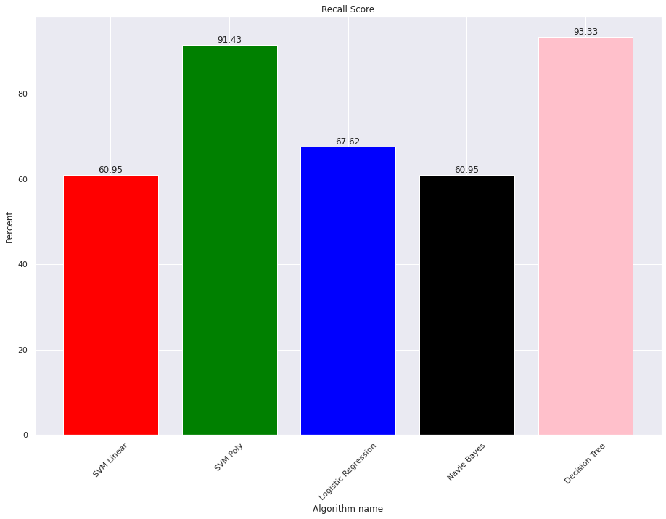
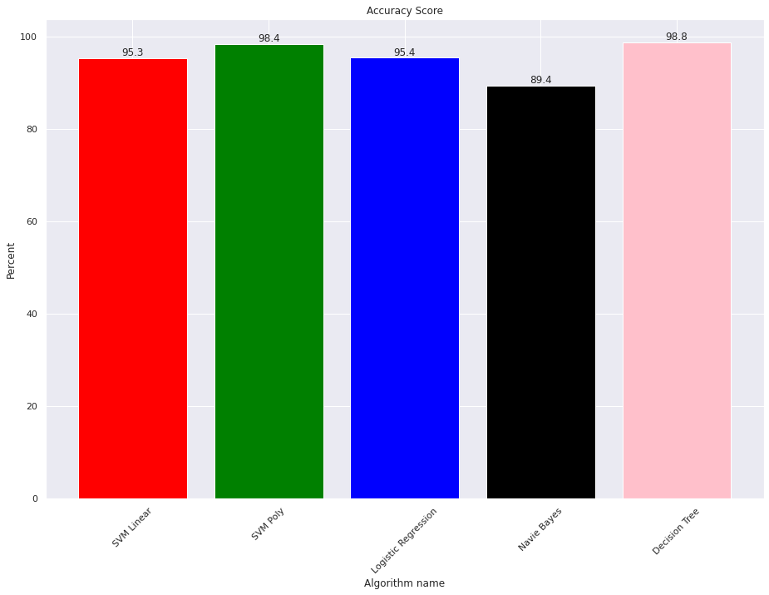
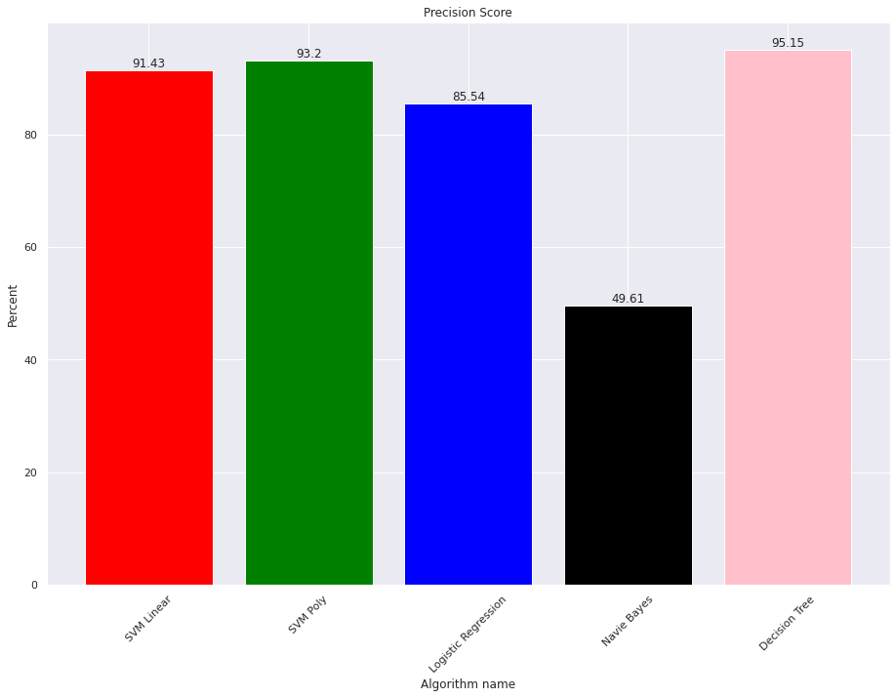
Test with imbalanced data
Result of imbalanced data:
Accuracy
Precision
Recall
F1 score

Slide 19
Test with imbalanced data
 | SVM Linear | SVM Non-linear | Logistic Regression | Naïve Bayes | Decision Tree
Accuracy | 95.3 | 98.4 | 95.4 | 89.4 | 98.8
Precision | 91.43 | 93.2 | 85.54 | 49.61 | 95.15
Recall | 60.95 | 91.43 | 67.62 | 60.95 | 93.33
F1 score | 73.14 | 92.31 | 75.53 | 54.7 | 94.23
Overall result with imbalanced data

Slide 20
Test with balanced data
 | SVM Linear | SVM Non-linear | Logistic Regression | Naïve Bayes | Decision Tree
Accuracy | 91.86 | 94.83 | 92.28 | 92.16 | 96.43
Precision | 87.89 | 93.16 | 88.91 | 89.44 | 95.23
Recall | 97.28 | 96.93 | 96.81 | 95.74 | 97.87
F1 score | 92.33 | 94.98 | 92.67 | 92.48 | 96.51
Overall result with balanced data

Slide 21
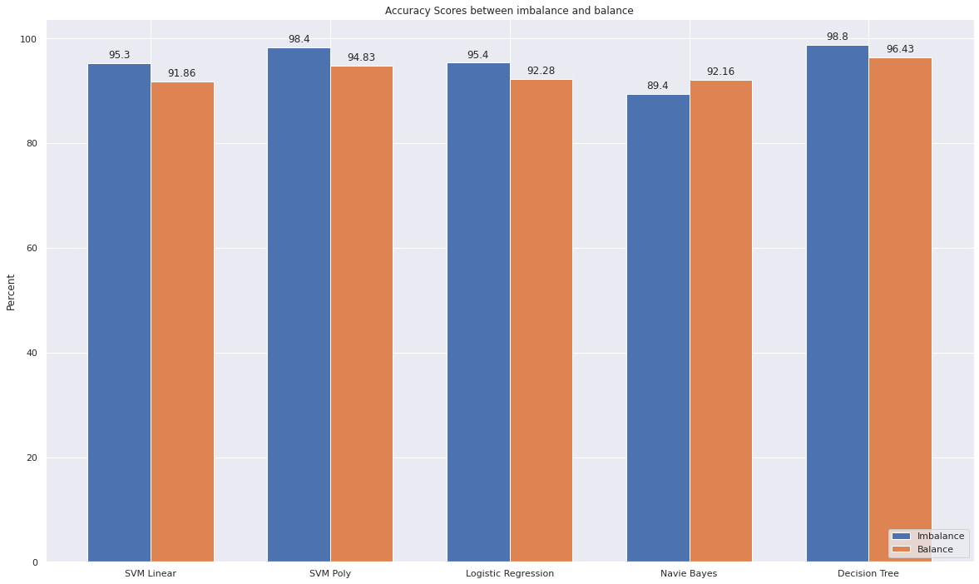
Visualize differences between 2 methods
Accuracy:

Slide 22
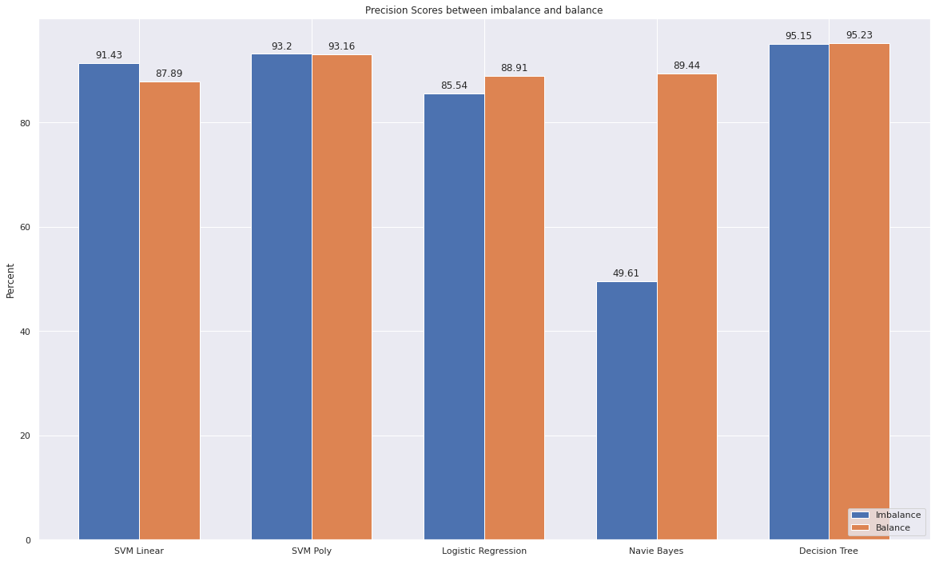
Visualize differences between 2 methods
Precision:

Slide 23
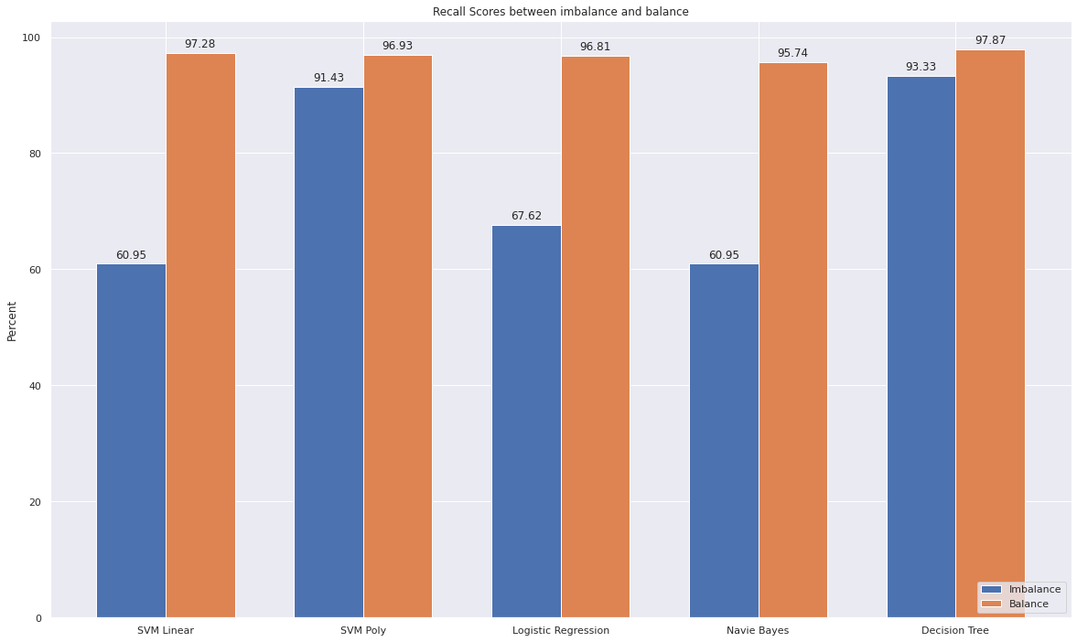
Visualize differences between 2 methods
Recall:

Slide 24
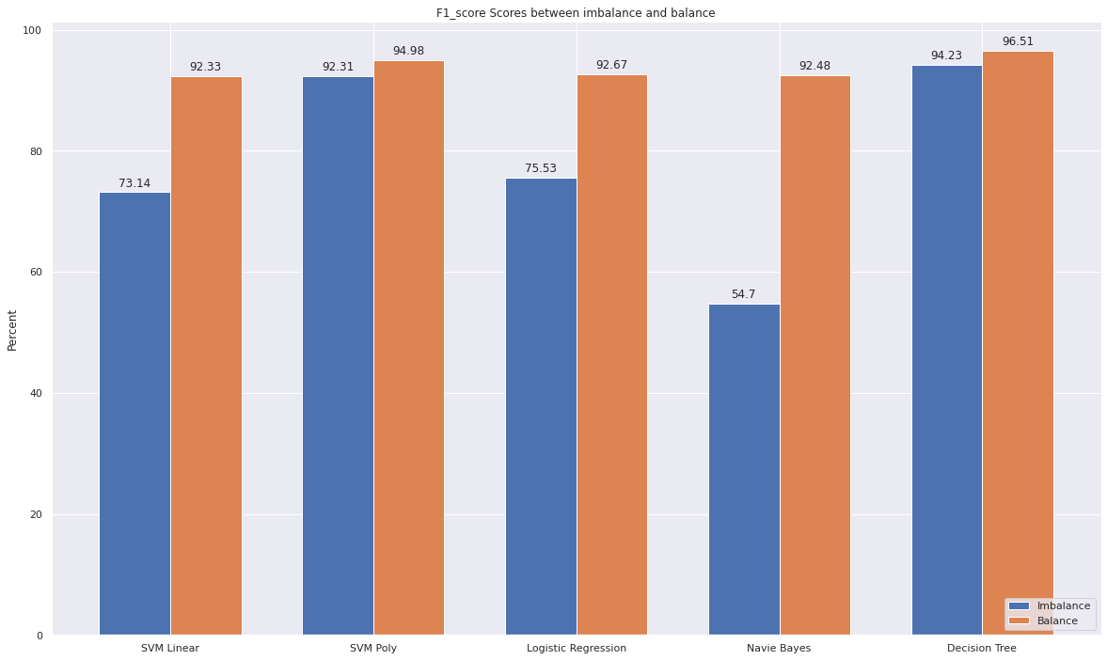
Visualize differences between 2 methods
F1 score:

Slide 25
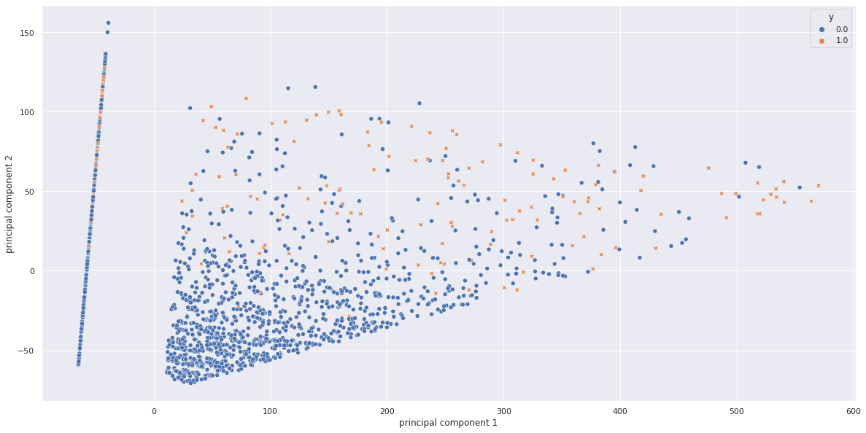
PCA
2D:

Slide 26
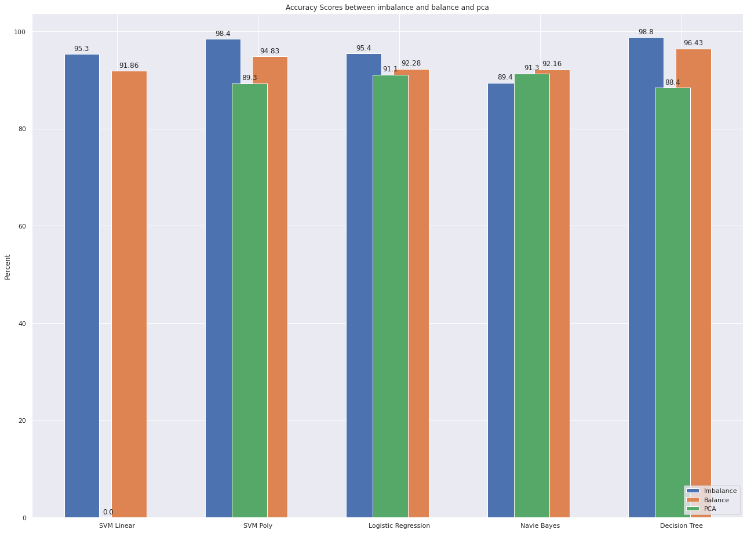
Visualize differences between 3 methods
Accuracy:

Slide 27
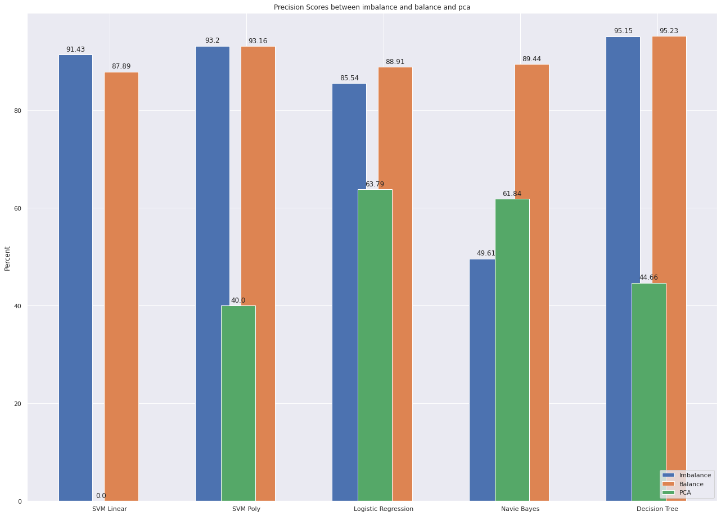
Visualize differences between 2 methods
Precision:

Slide 28
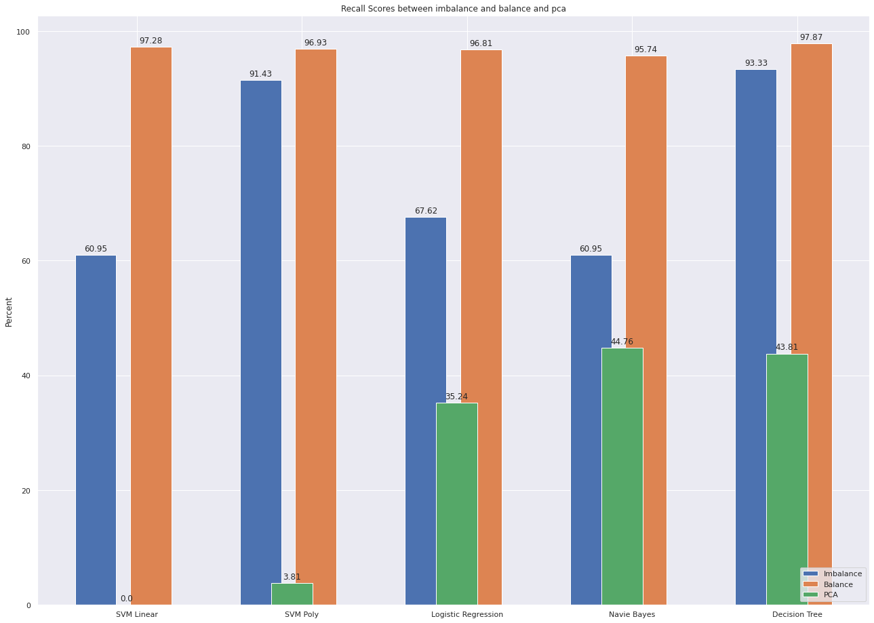
Visualize differences between 2 methods
Recall:

Slide 29
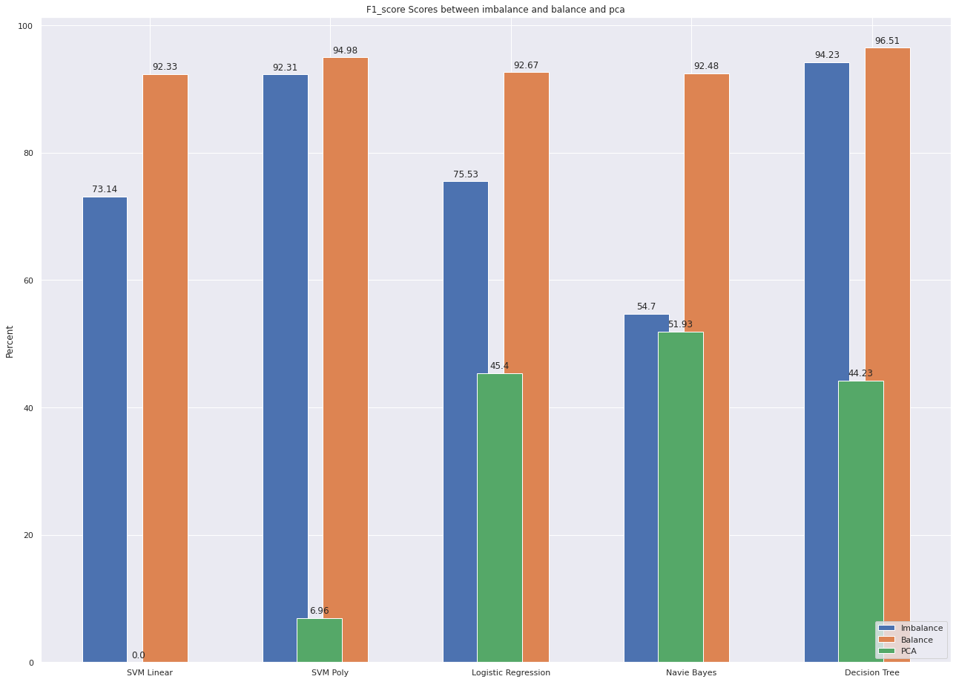
Visualize differences between 2 methods
F1 score:

Slide 30
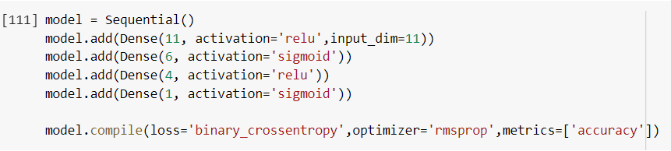
ANN

Slide 31
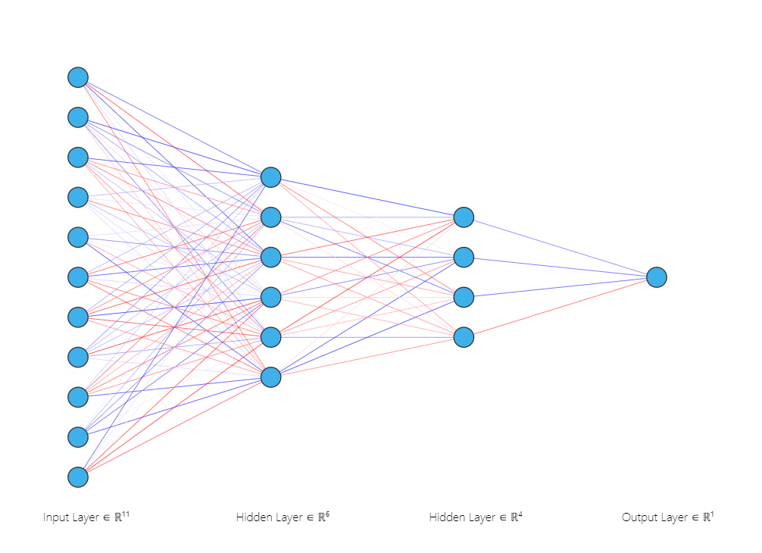
ANN

Slide 32
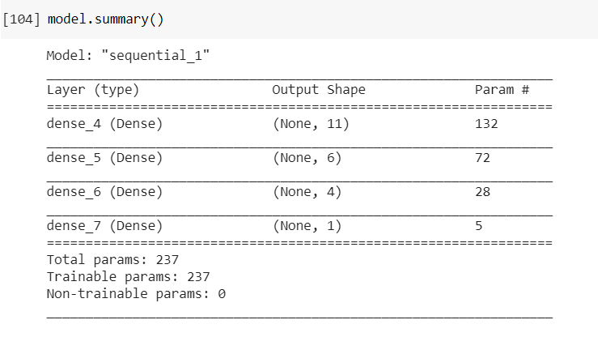
ANN

Slide 33
ANN
Performance:

Slide 34
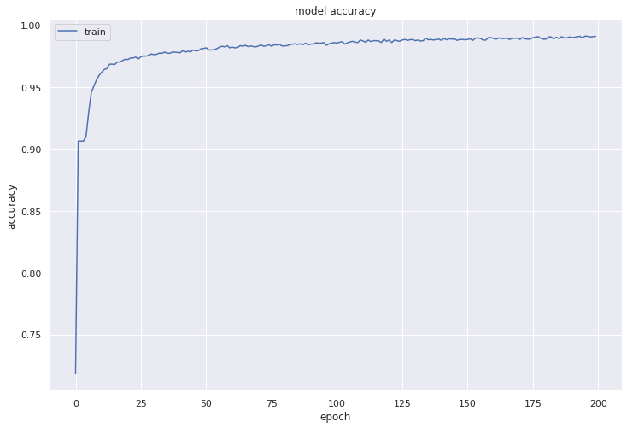
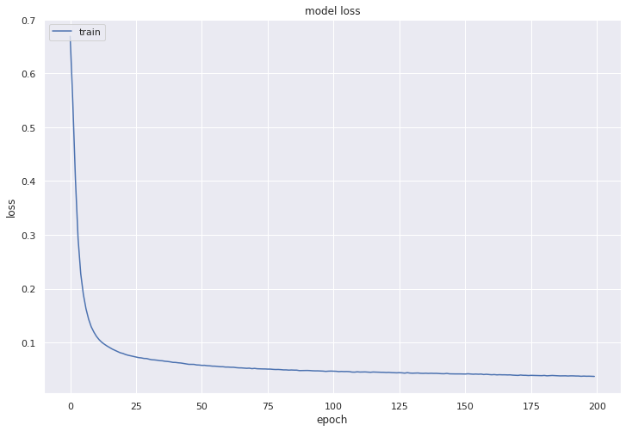
Accuracy
Loss

Slide 35
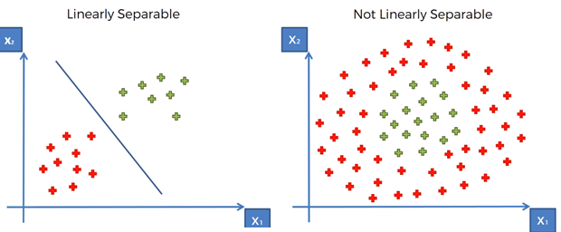
Overview
SVM:
Supervised learning
Find the points closest to the line from both the classes (support vectors).
Compute the distance between the line and the support vectors (margin).
Maximize the margin ⇒ optimal hyperplane.

Slide 36
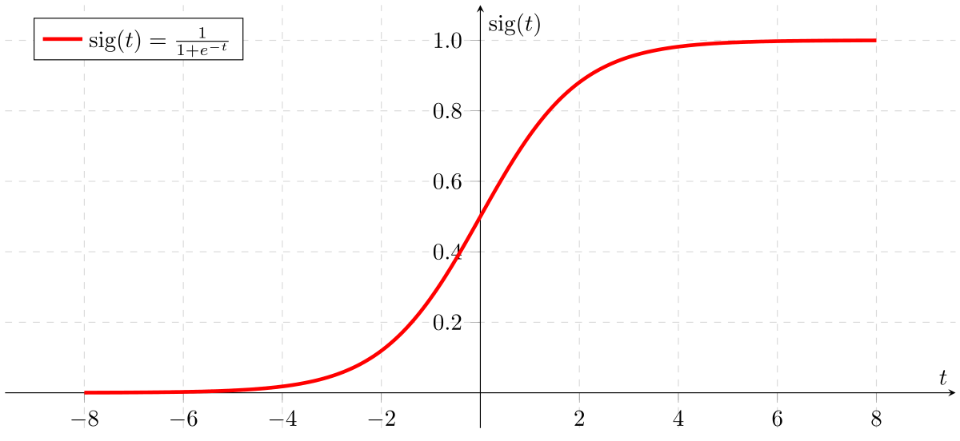

Overview
Logistic Regression:
Supervised learning.
Method for binary classification problems.
Sigmoid function: $σ\left(z\right)=\frac{1}{1+ⅇ^{−z}}$
Given output is based on probability.

Slide 37
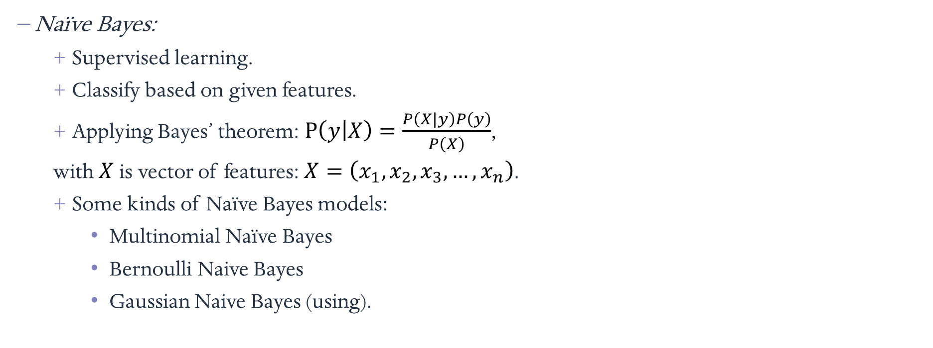
Overview
Naïve Bayes:
Supervised learning.
Classify based on given features.
Applying Bayes’ theorem: $P\left(\left.y\right|X\right)=\frac{P\left(\left.X\right|y\right)P\left(y\right)}{P\left(X\right)}$,
with $X$ is vector of features: $X=\left(x_{1},x_{2},x_{3},…,x_{n}\right)$.
Some kinds of Naïve Bayes models:
Multinomial Naïve Bayes
Bernoulli Naive Bayes
Gaussian Naive Bayes (using).

Slide 38
Overview
Decision Tree:
Supervised learning.
Used for classification and regression.
Predicts the value of a target variable by learning simple decision rules inferred from the data features.

Slide 39
Overview
Decision Tree:
Supervised learning.
Used for classification and regression.
Predicts the value of a target variable by learning simple decision rules inferred from the data features.

Slide 40
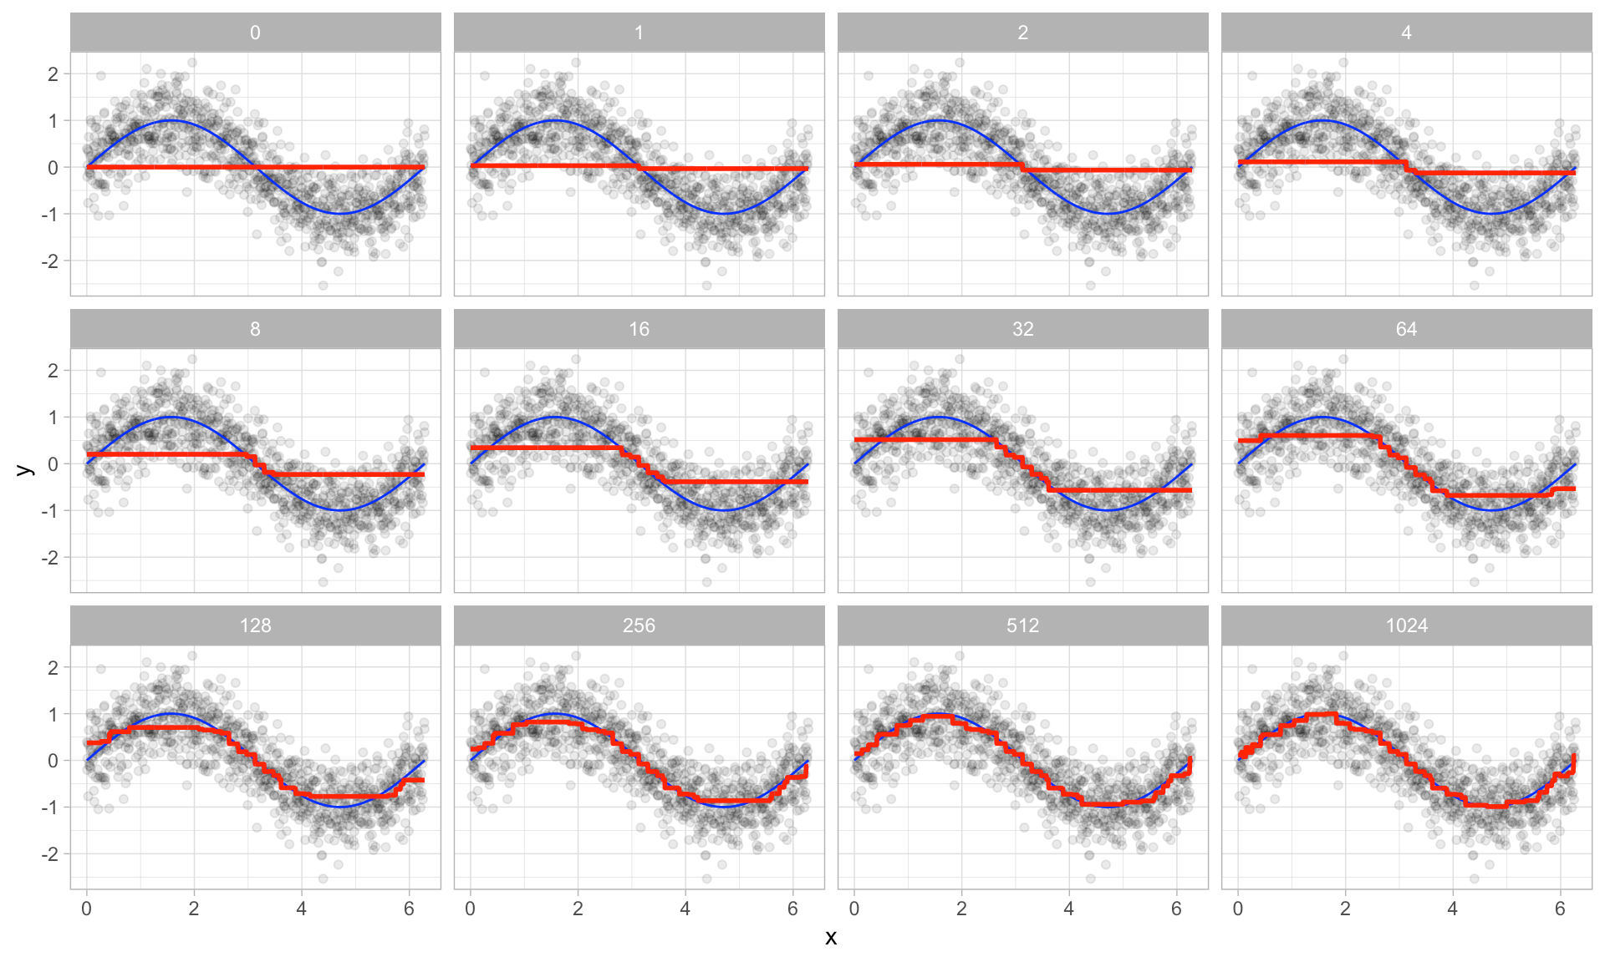
Overview
Gradient Boosting:
Supervised learning.
Used for classification and regression.
Converting weak learners into strong learners.

Slide 41

Result
Accuracy:

Slide 42

Result
Precision:

Slide 43

Result
Recall:

Slide 44

Result
F1 Score:

Slide 45
Result
 | SVM Linear | SVM Non-linear | Logistic Regression | Naïve Bayes | Decision Tree | Gradient Boosting | ANN
Accuracy | 95.3 | 98.4 | 95.4 | 89.4 | 98.8 | 98.9 | 98.2
Precision | 91.43 | 93.2 | 85.54 | 49.61 | 95.15 | 96.08 | 92.23
Recall | 60.95 | 91.43 | 67.62 | 60.95 | 93.33 | 93.33 | 90.48
F1 score | 73.14 | 92.31 | 75.53 | 54.7 | 94.23 | 94.69 | 91.35

