Slide 1
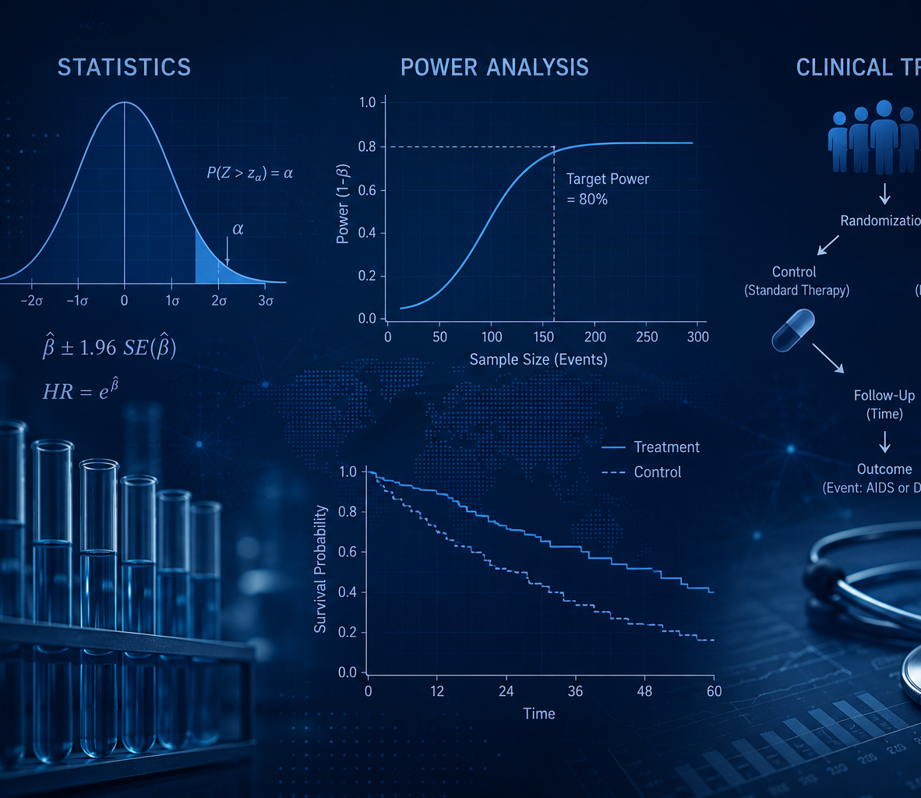
Represented but Underpowered: Subgroup Inference in the ACTG 320 Trial
Susan Peck, Jan Blackburn, Joseph Burks
Math 261B - Spring 2026

Slide 2
Today’s topics
Research Questions and Study Design
Participant Descriptive Statistics
Survival Analysis Methods
Full Group and Subgroup Results
Power Analysis and Sample Size Requirements
Conclusions

Slide 3
Research Questions
Were sex and race/ethnicity subgroups adequately powered to detect treatment effects?
Was indinavir’s benefit consistent across subgroups?
What enrollment would be required in a future study to achieve adequate power for all subgroups?
Key challenge:
In survival analyses, statistical power is driven by number of observed events, not sample size alone
Notes:
Represented but Underpowered: Subgroup Inference in the ACTG 320 Trial

Slide 4
ACTG 320 Study Design (Hammer et al. 1997)
Structure
Multi-center, randomized, double-blind, placebo-controlled trial
1,151 adults with advanced HIV (CD4 ≤ 200 cells/mm³)
Participants randomized within two CD4 count blocks
Treatment Groups
Control: standard two-drug regimen
Treatment: same regimen + protease inhibitor indinavir
Primary Outcome
Days to AIDS-defining illness or death (time-to-event)
Subgroups Analyzed
Sex: Female (83%), Male (17%)
Race/Ethnicity: White (52%), Black (28%), Hispanic (18%), Asian/PI (1%), Other (1%)
Other Covariates
Age, baseline CD4 count, Karnofsky score, prior ZDV use, CD4 stratum

Slide 5
Participant Group Descriptive Statistics
Treatment Group | n | %
Control (no indinavir) | 577 | 50.1
Treatment (indinavir) | 574 | 49.9
Subgroup | Observations | Events | % of Sample | Event Rate %
Female | 951 | 81 | 82.6 | 8.5
Male | 200 | 15 | 17.4 | 7.5
White | 596 | 51 | 51.8 | 8.6
Black | 327 | 21 | 28.4 | 6.4
Hispanic | 203 | 20 | 17.6 | 9.9
Asian/PI | 14 | 3 | 1.2 | 21.4
Other | 11 | 1 | 1.0 | 9.1
Total | 1151 | 96 | 100% | 8.3
Notes:
Study was well balanced between control and treatment groups
Female participants made up 83% of sample
Whites made up 52% of total participants
Low event rates in subgroups will have an impact on the statistical power of subgroup tests

Slide 6
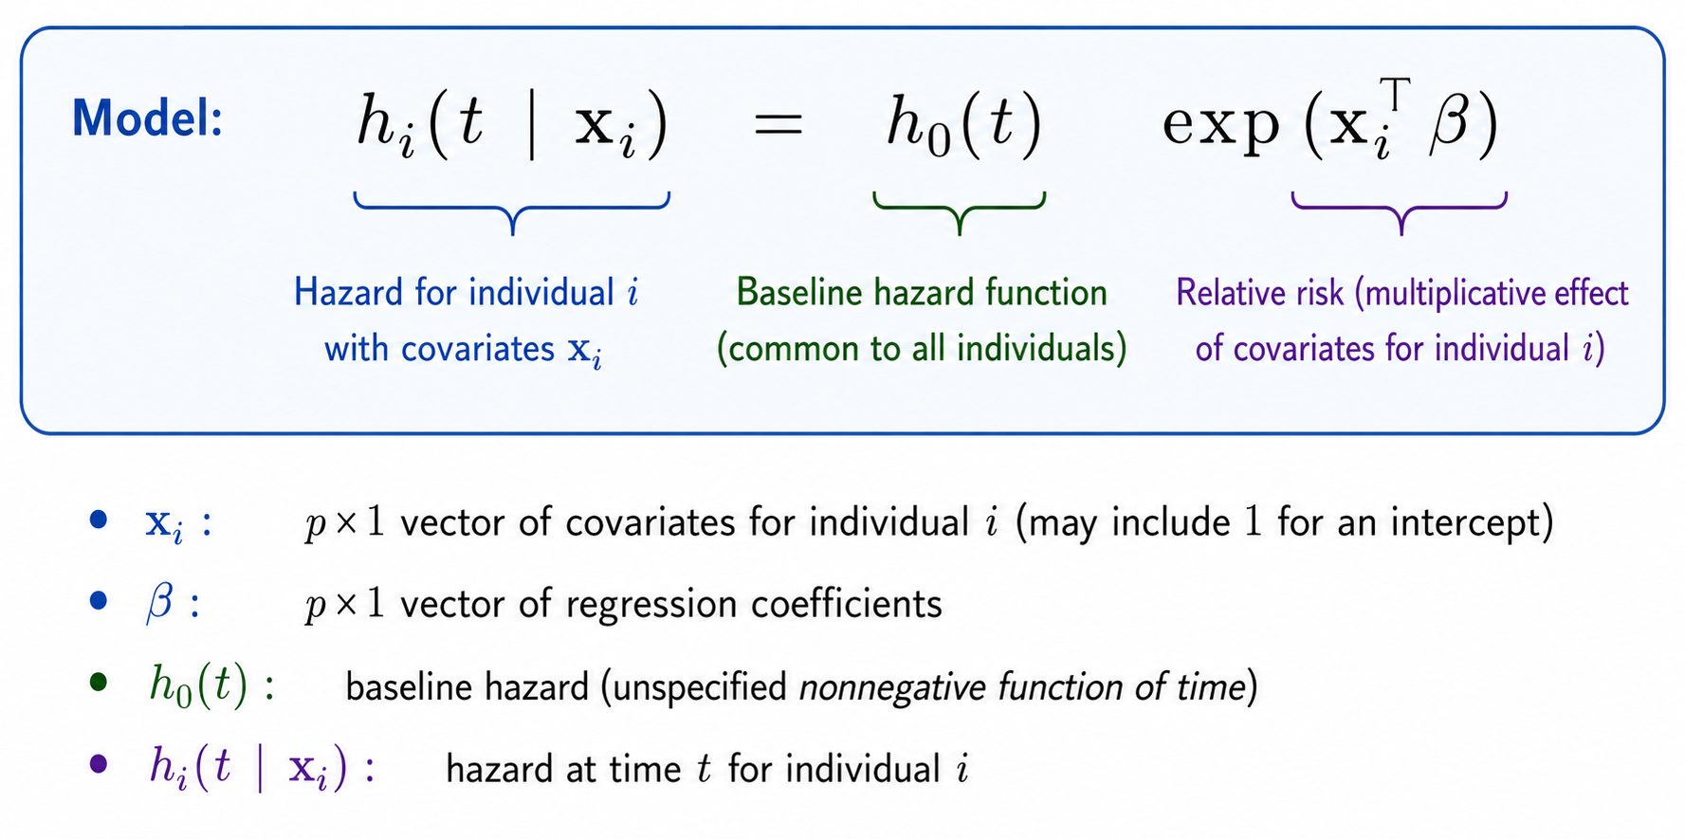
Survival Analysis Methods: Cox Proportional Hazard Models
Hazard Ratio (HR) compares the risk of an event occurring between two groups or individuals
Notes:
Two key functions:
Survival function S(t) = P(T > t) — probability of remaining event-free beyond time t
Hazard function h(t) — instantaneous rate of the event at time t, given survival up to t
Kaplan-Meier estimator: Non-parametric estimate of S(t). Drops at each observed event time, accounts for censored observations between events. Used for visualization and log-rank tests.
Cox proportional hazards model: Semi-parametric regression for time-to-event outcomes. Models the hazard as h₀(t)·exp(Xᵀβ) — the baseline hazard h₀(t) is left unspecified, so inference focuses entirely on the coefficient vector β. The key assumption: hazard ratios are constant over time.

Slide 7
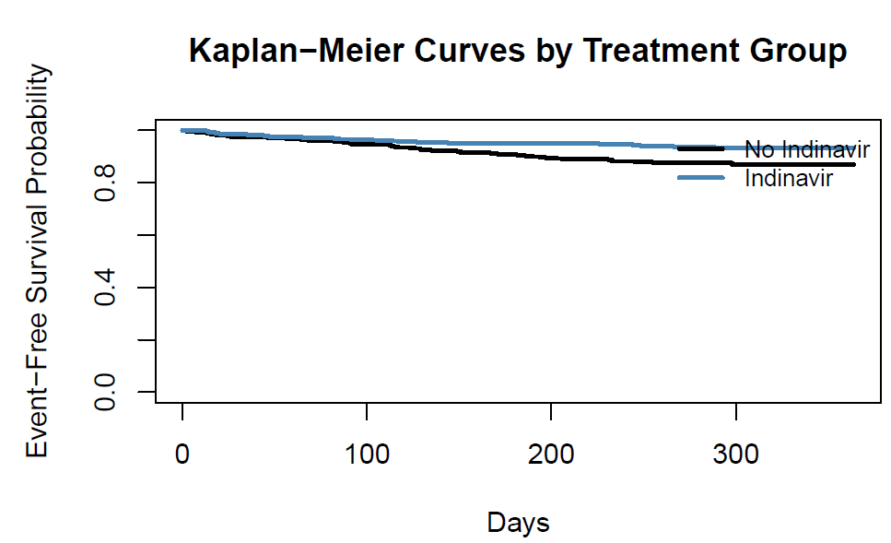
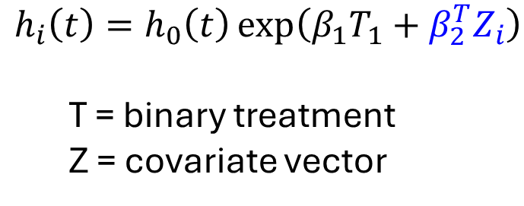
Full Group Treatment Effect Replication
Treatment HR = 0.517 [0.339, 0.788] (p-value = 0.002)
Indinavir therapy reduced hazard of AIDS or death by ~48%
Consistent with original finding Hammer et al. (1997)
$$h_{i}\left(t\right)=h_{0}\left(t\right)\exp\left(β_{1}T_{1}+β_{2}^{T}Z_{i}\right)$$
T = binary treatment
Z = covariate vector
7
Notes:
h_i(t) — the hazard for person i at time t. Think of it as: "what is person i's instantaneous risk of the event (AIDS or death) right now, given they've survived to time t?"
h_0(t) — the baseline hazard. This is the hazard for a person when all their covariates equal zero. It's the part Cox left unspecified — you never actually estimate it, which is what makes the model semi-parametric.
exp(...) — everything inside the exponent shifts the baseline hazard up or down multiplicatively based on the person's characteristics.
β_1 T_i — β_1 is the log hazard ratio for treatment. T_i is 1 if person i got indinavir, 0 if not. So exp(β_1) is the hazard ratio for treatment — in your paper, that comes out to 0.517, meaning indinavir cuts the hazard roughly in half.
β_2^T Z_i — the superscript T here means transpose, not treatment. Z_i is a vector of the other covariates (age, CD4 count, Karnofsky score, etc.), and β_2 is the corresponding vector of coefficients. This term adjusts for all those baseline characteristics simultaneously.
Other Baseline Covariates
Baseline CD4 cell count (cells/mm³) measured at enrollment
Participant age in years at enrollment
Karnofsky score: A clinical measure of functional status ranging from 0 to 100
Months of prior zidovudine (ZDV) use before enrollment
Indicator used for stratified randomization based on CD40 cell count
The two curves separate early and remain clearly apart throughout follow-up.
Indinavir group maintains substantially higher event-free survival probability.

Slide 8
Sex Subgroup Interaction Effects
$$h_{i}\left(t\right)=h_{0}\left(t\right)\exp\left(β_{1}T_{1}+β_{2}G_{i}+β_{3}{GiT}_{i}+β_{3}^{T}Z_{i}\right)$$
LR Test Results
p-value | 0.2187
Interpretation
Treatment effects do not appear to be different based on LRT p-value
Substantial overlap in CI intervals suggests high level of uncertainty whether treatment effects are truly different
M / F interaction is not significant
Treatment/Control HR Estimates
Variable | HR [95% CI] | Event Count
Female | 0.459 [0.288, 0.732] | 81
Male | 1.101 [0.393, 3.087] | 15
 | HR | p-value
M / F Interaction | 2.034 | 0.214
Since only 15 events occurred in the Male subgroup statistical tests are underpowered and treatment effect estimates are likely imprecise and unstable.
Notes:
Other Baseline Covariates
Baseline CD4 cell count (cells/mm³) measured at enrollment
Participant age in years at enrollment
Karnofsky score: A clinical measure of functional status ranging from 0 to 100
Months of prior zidovudine (ZDV) use before enrollment
Indicator used for stratified randomization based on CD40 cell count

Slide 9
Race Subgroup Interaction Effects
$$h_{i}\left(t\right)=h_{0}\left(t\right)exp⁡(β_{1}T_{1}+β_{2}{Black}_{i}+β_{3}Hispanic_{i}+β_{4}AsianPI_{i}+β_{5}Other_{i}$$
$$+ β_{6}T_{i}Black_{i}+β_{7}T_{i}Hispanic_{i}+β_{8}T_{i}Asian{PI}_{i}+β_{9}T_{i}Other_{i}+β_{10}^{T}Z_{i})$$
LR Test Results
p-value | 0.0803
Interpretation
Marginal significance at α = 0.10
Only Asian/PI interaction term (HR = 15.54) was significant but result unstable due to low event count
All groups underpowered according to Cox events-per-variable rule (EPV)
Treatment/Control HR Estimates
Variable | HR [95% CI] | Event Count
White | 0.539 [0.303, 0.960] | 51
Black | 0.287 [0.104, 0.794] | 21
Hispanic | 0.628 [0.246, 1.602] | 20
Asian/PI | 0.068 [0, Inf] | 3
Other | 237.3 [0, Inf] | 1
Notes:
Other Baseline Covariates
Baseline CD4 cell count (cells/mm³) measured at enrollment
Participant age in years at enrollment
Karnofsky score: A clinical measure of functional status ranging from 0 to 100
Months of prior zidovudine (ZDV) use before enrollment
Indicator used for stratified randomization based on CD40 cell count

Slide 10
Observed Statistical Power by Subgroup
Power is driven by events, not enrollment counts alone
Subgroup | Enrollment | Events | Observed HR | Event Rate | Observed Power
Overall | 1151 | 96 | 0.517 | 8.3% | 84.9%
Female | 951 | 81 | 0.459 | 8.5% | 89.7%
Male | 200 | 15 | 1.101 | 7.5% | 2.0%
White | 596 | 51 | 0.539 | 8.6% | 48.6%
Black | 327 | 21 | 0.287 | 6.4% | 73.2%
Hispanic | 203 | 20 | 0.628 | 9.9% | 11.5%
Asian/PI | 14 | 3 | 0.068 | 21.4% | 53.5%
Other | 11 | 1 | 237.311 | 9.1% | 68.9%
Notes:
Since clinical trials measure time-to-event, inference is based on number of events instead of sample size
The ACTG 320 study did not provide any explicit power analyses, so the power was estimated based on observed actuals
Only the Overall and Female groups were powered above 80%; all other groups were underpowered

Slide 11
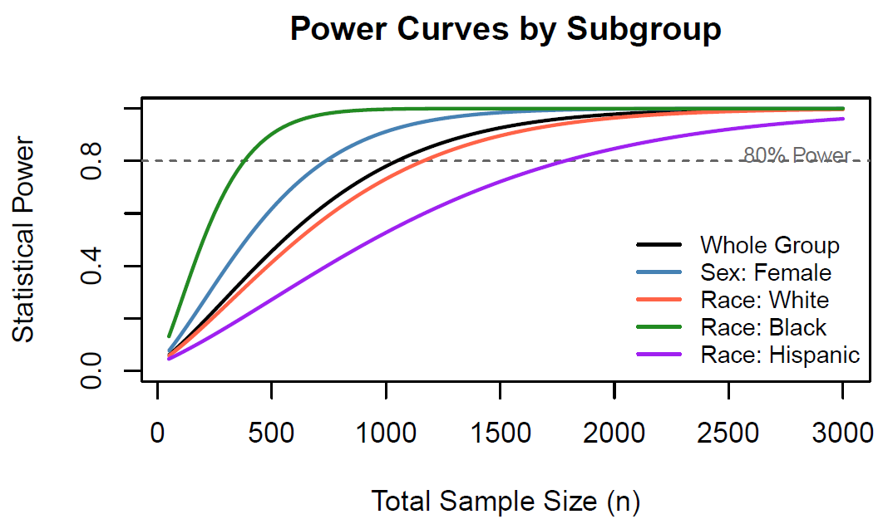
Statistical Power as a Function of Sample Size
Notes:
Preliminary simulation analysis shows that many of the subgroups were significantly under powered, undermining in the efficacy of the hypothesis tests for subgroup treatment effect analyses
A power simulation analysis was conducted to estimate sample size needed to generate power with 80%
Effect sizes were readily available for most subgroups but had to be estimated based on plausible HR ranges and observed event rates

Slide 12
Required Sample Sizes for 80%
Subgroup | Observations | Events | HR: Observed / (Assumed) | Sample Needed for 80% Power
Overall | 1151 | 96 | 0.517 | 264
Female | 951 | 81 | 0.459 | 188
Male | 200 | 15 | (0.5 – 0.9) | 267 – 11,427
White | 596 | 51 | 0.539 | 293
Black | 327 | 21 | 0.287 | 109
Hispanic | 203 | 20 | 0.628 | 447
Asian/PI | 14 | 3 | (0.5 – 0.9) | 94 – 4,000
Other | 11 | 1 | (0.5 – 0.9) | 220 – 9,427
Notes:
Due to extremely limited information, some subgroups would require prohibitively high sample rates
Extreme values highlight the instability of these estimates

Slide 13
Conclusions and Implications
ACTG 320 was adequately powered to measure Overall group and Female subgroup while other groups were underpowered
Absence of significant interaction effects does not prove the effects are the same across groups since there was insufficient statistical power due to low event counts
Simulated power analysis shows that with such little information available, sample sizes required to achieve 80% statistical power are impractical
Future clinical trials should design subgroup enrollment to achieve power requirements
Doing so will help ensure treatment effects can be detected to inform more accurate therapeutic recommendations where warranted

