Slide 1
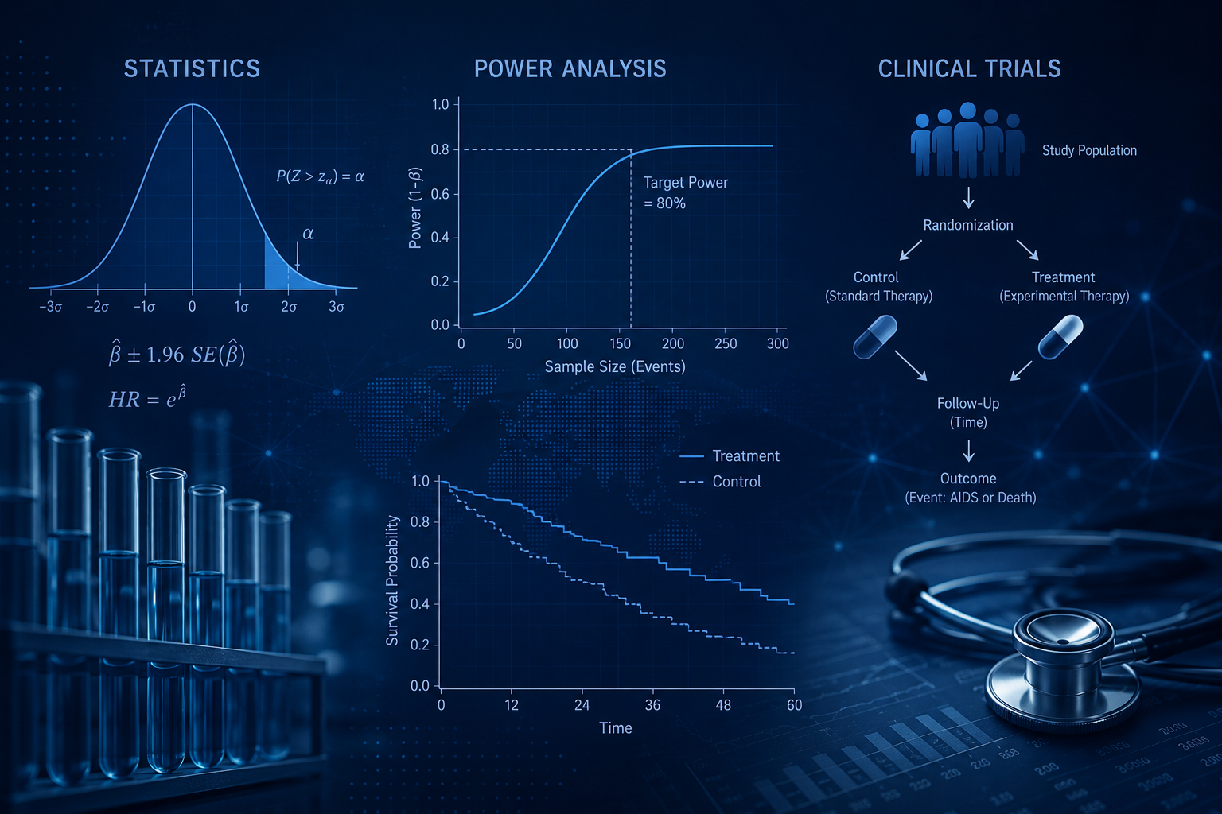
Dosage Inequity in Clinical Studies: A Power Analysis Replication and Reanalysis
Susan Peck, Jan Blackburn, Joseph Burks
Math 261B - Spring 2026

Slide 2
Today’s topics
Research Objective and Study Summary
Survival Analysis Overview
Reanalysis and Subgroup Interaction Analysis
Power Simulation Analysis
Results and Implications

Slide 3
Research Objective and Study Summary
Research Objective
Understand how clinical trial underrepresentation of gender and race/ethnic subgroups effect statistical power, its impact on detecting subgroup treatment effect differences and implications for therapeutic recommendations
Using ACTG 320 (Hammer et. al, 1997) as a case study
Purpose: Study impact on HIV by introducing indivir to existing baseline therapy
Structure: Multi-center, randomized, double blind, placebo- controlled study with 1,196 subjects enrolled
Response Variable: Time-to-event for participants to acquire AIDS related disease or death
Effect Variables: Treatment group + other covariates tracked by sex and race/ethnicity
Statistical analysis of Clinical Trial data requires used of tools found in Survival Analysis

Slide 4
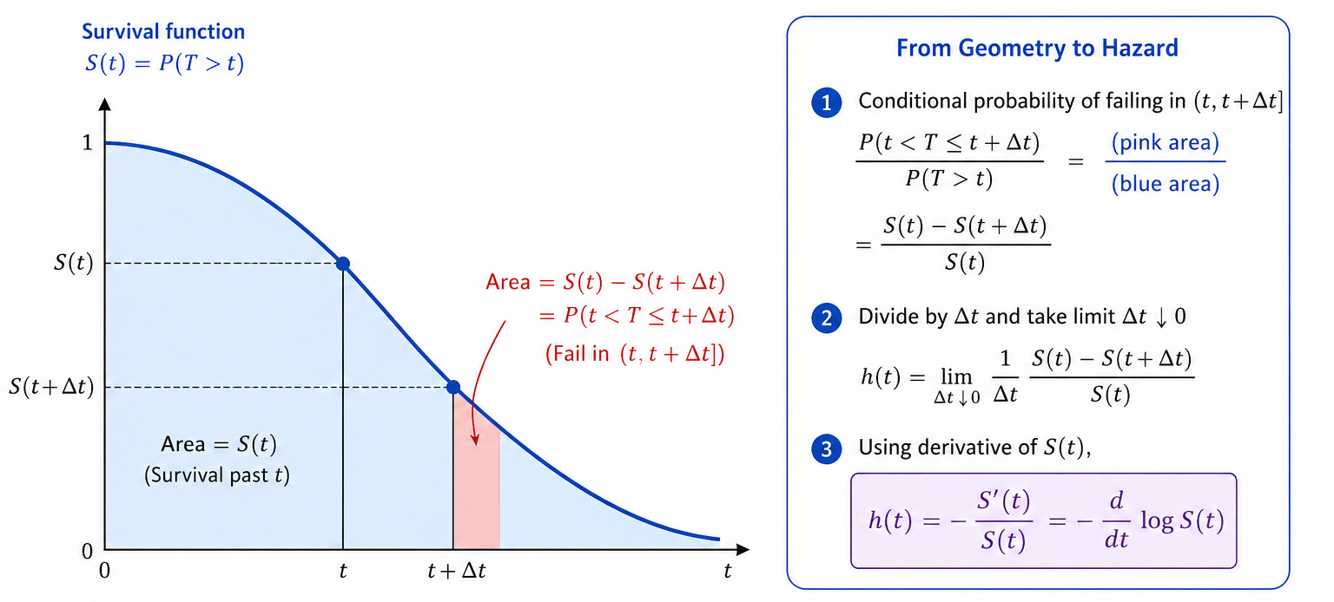
Survival Analysis Overview
Source: Image generated by ChatGPT

Slide 5
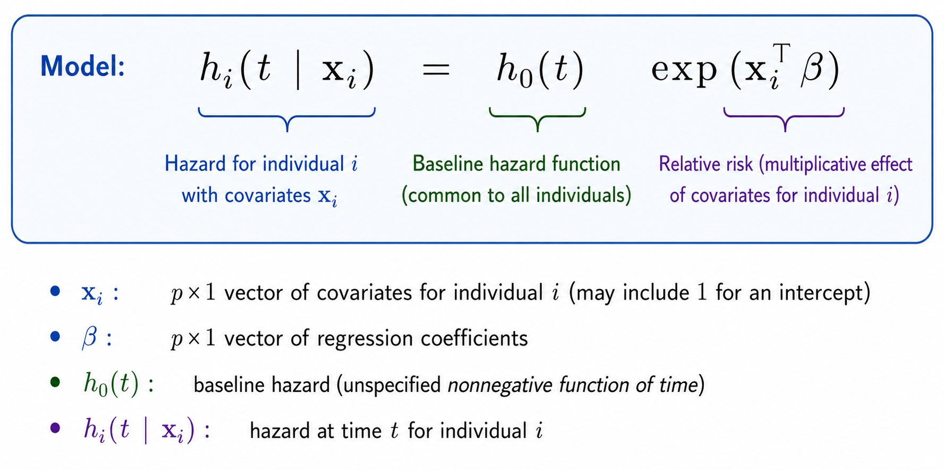
Cox Proportional Hazard Models
Source: Image generated by ChatGPT

Slide 6
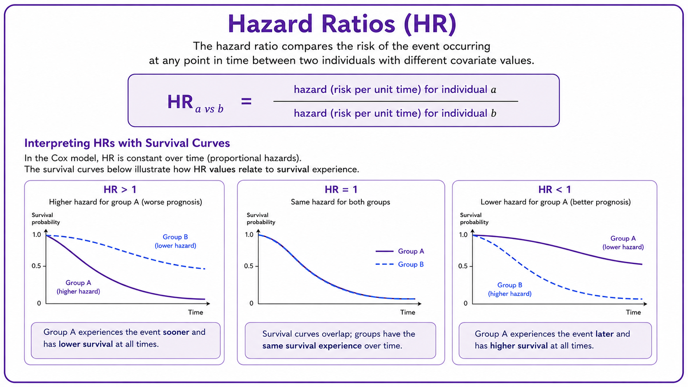
Hazard Ratios
Source: Image generated by ChatGPT

Slide 7
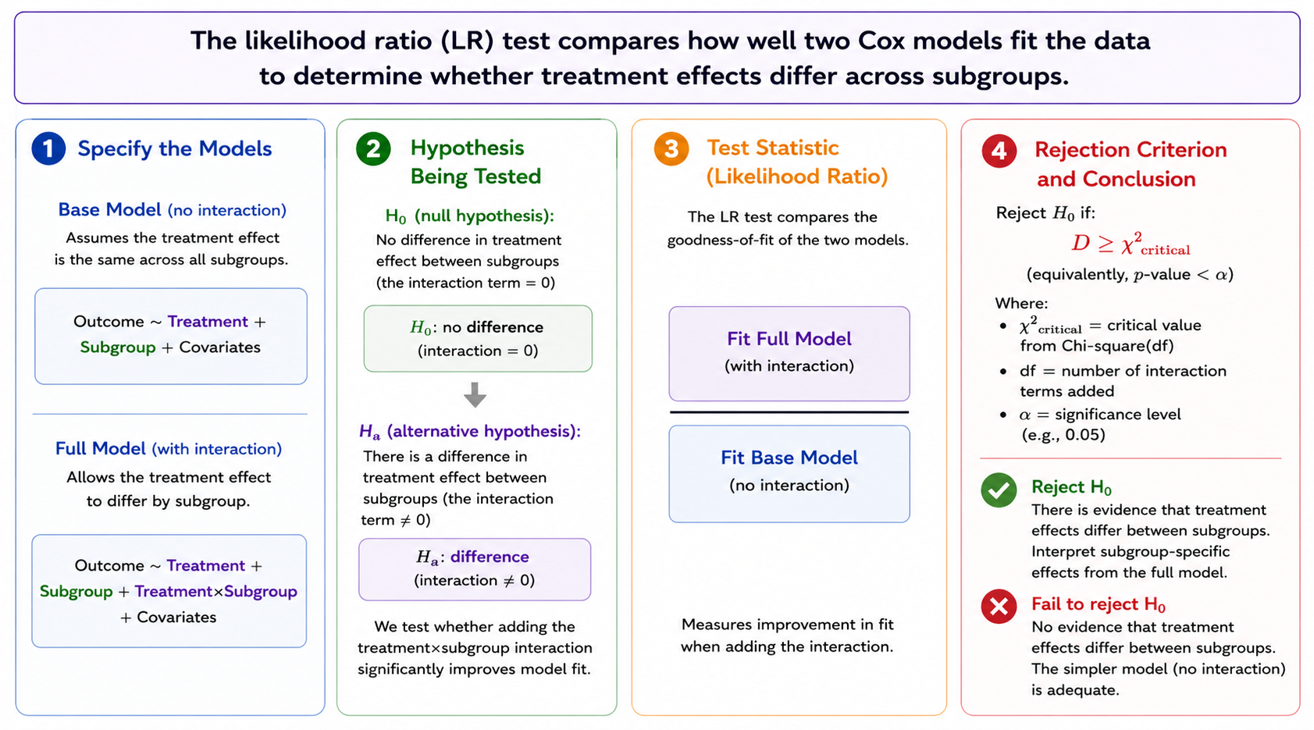
Modeling Subgroup Effects: Likelihood Ratio Test
Source: Image generated by ChatGPT

Slide 8
Participant Group Descriptive Statistics
Study was well balanced between control and treatment groups
Female participants made up 83% of sample
Whites made up 52% of total participants
Low event rates in subgroups will have an impact on the statistical power of subgroup tests
Treatment Group | n | %
Control (no indinavir) | 577 | 50.1
Treatment (indinavir) | 574 | 49.9
Subgroup | Observations | Events | % of Sample | Event Rate %
Female | 951 | 81 | 82.6 | 8.5
Male | 200 | 15 | 17.4 | 7.5
White | 596 | 51 | 51.8 | 8.6
Blck | 327 | 21 | 28.4 | 6.4
Hispanic | 203 | 20 | 17.6 | 9.9
Asian/PI | 14 | 3 | 1.2 | 21.4
Other | 11 | 1 | 1.0 | 9.1
Total | 1151 | 96 | 100% | 8.3

Slide 9

Modeling Full Group Treatment Effect
Replicated modeling of hazard using Cox Proportional hazard model for full group excluding any subgroup variables
Treatment HR = 0.517 (p-value = 0.002) indicating the treatment group hazard is nearly half of the control group and consistent with original study
Results for Full Group Cox Model
 |  | 95% CI
Covariate | HR | Lower | Upper | p-value
Treatment | 0.517 | 0.339 | 0.788 | 0.002
Age | 1.022 | 1.000 | 1.045 | 0.054
Baseline CD4 | 0.985 | 0.978 | 0.993 | 0.000
Karnofsky Score | 0.948 | 0.926 | 0.970 | 0.000
Prior ZDV Use | 1.000 | 0.992 | 1.007 | 0.925
CD4 Stratum | 1.012 | 0.517 | 1.984 | 0.871
Full Group Cox Model
$$h_{i}\left(t\right)=h_{0}\left(t\right)exp⁡(β_{1}T_{1}+β_{2}^{T}Z_{i})$$
Notes:
Other Baseline Covariates
Baseline CD4 cell count (cells/mm³) measured at enrollment
Participant age in years at enrollment
Karnofsky score: A clinical measure of functional status ranging from 0 to 100
Months of prior zidovudine (ZDV) use before enrollment
Indicator used for stratified randomization based on CD40 cell count

Slide 10
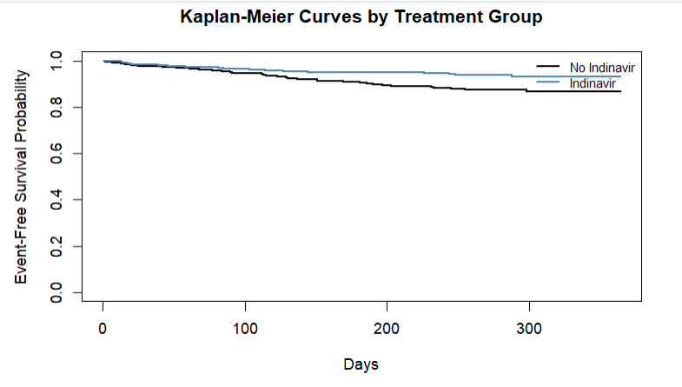
ACTG320 Kaplan-Meier Survival Curve
Primary effect survival curve shows slower progression and reduced risk due to indinavir treatment on the overall group
The HR = 0.517 reflects the ratio of the hazards between the treatment group and control group when considering other key covariates
Subsequent analysis will evaluate if this ratio is meaningfully different within the sex or race/ethnicity subgroups

Slide 11
Sex Subgroup Interaction Effects
Females are the reference group
Interaction hazard ratio is 2.034 suggests that treatment is less effective for male patients
p-value is 0.214 and so is not significant
The likelihood ratio test p-value = 0.2187 so the null hypothesis is not rejected and conclude interaction effects are the same for both female and male participants
Results for Sex Subgroup Model
 |  | 95% CI
Covariate | HR | Lower | Upper | p-value
Treatment | 0.460 | 0.288 | 0.734 | 0.001
Sex (Male v. Female) | 0.854 | 0.405 | 1.801 | 0.679
Treatment x Sex | 2.034 | 0.663 | 6.238 | 0.214
Age | 1.023 | 1.000 | 1.046 | 0.050
Baseline CD4 | 0.985 | 0.978 | 0.993 | 0.000*
Karnofsky Score | 0.947 | 0.925 | 0.969 | 0.000*
Prior ZDV Use | 0.999 | 0.992 | 1.007 | 0.865
CD4 Stratum | 1.011 | 0.516 | 1.978 | 0.975
* rounded
Sex Subgroup Cox Model
$$h_{i}\left(t\right)=h_{0}\left(t\right)exp⁡(β_{1}T_{1}+β_{2}G_{i}+β_{3}T_{i}+β_{3}^{T}Z_{i})$$
Notes:
Other Baseline Covariates
Baseline CD4 cell count (cells/mm³) measured at enrollment
Participant age in years at enrollment
Karnofsky score: A clinical measure of functional status ranging from 0 to 100
Months of prior zidovudine (ZDV) use before enrollment
Indicator used for stratified randomization based on CD40 cell count

Slide 12
Race Subgroup Interaction Effects
Asian/PI subgroup interaction term is significant but high HR = 15.514 and large CI bounds suggest this is an unstable result
The likelihood ratio test reports a p-value = 0.0803 which is marginally significant
This p-value would likely be higher if unstable results were removed
So the null hypothesis is not rejected and conclude that treatment effect does not vary by race subgroup
Results for Race Subgroup Model
 |  | 95% CI
Covariate | HR | Lower | Upper | p-value
Treatment | 0.534 | 0.302 | 0.946 | 0.032
Race: Black | 0.794 | 0.432 | 1.457 | 0.456
Race: Hispanic | 1.002 | 0.524 | 1.914 | 0.995
Race: Asian/PI | 0.860 | 0.117 | 6.317 | 0.882
Race: Other | 2.831 | 0.378 | 21.227 | 0.311
Treatment x Black | 0.591 | 0.185 | 1.883 | 0.373
Treatment x Hispanic | 1.249 | 0.422 | 3.698 | 0.687
Treatment x Asian/PI | 15.514 | 1.244 | 193.477 | 0.033
Treatment x Other | 0.000 | 0.000 | Inf | 0.983
Age | 1.024 | 1.001 | 1.048 | 0.038
Baseline CD4 | 0.985 | 0.978 | 0.993 | 0.000*
Karnofsky Score | 0.948 | 0.927 | 0.971 | 0.000*
Prior ZDV Use | 0.997 | 0.989 | 1.005 | 0.467
CD4 Stratum | 1.010 | 0.513 | 1.986 | 0.978
* rounded
Race Subgroup Cox Model
$$h_{i}\left(t\right)=h_{0}\left(t\right)exp⁡(β_{1}T_{1}+β_{2}{Black}_{i}+β_{3}Hispanic_{i}+β_{4}AsianPI_{i}+β_{5}Other_{i}$$
$$+β_{6}T_{i}Black_{i}+β_{7}T_{i}Hispanic_{i}+β_{8}T_{i}AsianP_{i}+β_{9}T_{i}Other_{i}+β_{10}^{T}Z_{i})$$
Notes:
Other Baseline Covariates
Baseline CD4 cell count (cells/mm³) measured at enrollment
Participant age in years at enrollment
Karnofsky score: A clinical measure of functional status ranging from 0 to 100
Months of prior zidovudine (ZDV) use before enrollment
Indicator used for stratified randomization based on CD40 cell count

Slide 13
Baseline Power Analysis
Since clinical trials measure time-to-event, inference is based on number of events instead of sample size
The ACTG 320 study did not provide any explicit power analyses, so the power was estimated based on observed actuals
Only the Overall and Female groups were powered above 80%; all other groups were underpowered
Subgroup | n | Events | Observed HR | Event Rate | Observed Power
Overall | 1151 | 96 | 0.517 | 0.083 | 0.839
Female | 951 | 81 | 0.459 | 0.085 | 0.897
Male | 200 | 15 | 1.101 | 0.075 | 0.020
White | 596 | 51 | 0.539 | 0.086 | 0.486
Black | 327 | 21 | 0.287 | 0.064 | 0.732
Hispanic | 203 | 20 | 0.628 | 0.099 | 0.115
Asian/PI | 14 | 3 | 0.068 | 0.214 | 0.535
Other | 11 | 1 | 237.311 | 0.091 | 0.689

Slide 14
Power Simulation Analysis
Preliminary simulation analysis shows that many of the subgroups were significantly under powered, undermining in the efficacy of the hypothesis tests for subgroup treatment effect analyses
A power simulation analysis was conducted to estimate sample size needed to generate power with 80%
Effect sizes were readily available for most subgroups but had to be estimated based on plausible HR ranges and observed event rates

Slide 15
Required Sample Sizes for 80%
Due to extremely limited information, some subgroups would require prohibitively high sample rates
Extreme values highlight the instability of these estimates
Subgroup | Observations | Events | HR: Observed / (Assumed) | Sample Needed for 80% Power
Overall | 1151 | 96 | 0.517 | 264
Female | 951 | 81 | 0.459 | 188
Male | 200 | 15 | (0.9 – 1.1) | 2,547 – 13,960
White | 596 | 51 | 0.539 | 293
Black | 327 | 21 | 0.287 | 109
Hispanic | 203 | 20 | 0.628 | 447
Asian/PI | 14 | 3 | (0.9 – 1.1) | 892 – 4,886
Other | 11 | 1 | (0.9 – 1.1) | 9,427 – 11,517

Slide 16
Conclusions and Implications
ACTG 320 was adequately powered to measure Overall group and Female subgroup while other groups were underpowered
Absence of significant interaction effects does not prove the effects are the same across groups since there was insufficient statistical power due to low event counts
Simulated power analysis shows that with such little information available, sample sizes required to achieve 80% statistical power are impractical
Future clinical trials should prospectively design subgroup enrollment to achieve primary event counts that reach subgroup specific power requirements
Doing so will help ensure treatment effects can be detected to inform more accurate therapeutic recommendations where warranted

