Slide 1
Build and Deploy Recommender System using Streamlit and Heroku
-by Qi Sun
Instructor: Andy Catlin
Yeshiva University
Spring 2021

Slide 2
Dataset:
Source: MovieLens dataset
This dataset is an ensemble of data collected from TMDB and GroupLens.
Movie data: 45,000 movies
Consists of movies released on or before July 2017
Features include posters, backdrops, budget, revenue, release dates, languages, production countries and companies.
Rating data:
Full dataset: 26 million ratings from 270,000 users for all 45,000 movies
Ratings are on a scale of 1-5
‘ratings_small.csv’: the subset of 100,000 ratings from 700 users on 9,000 movies.

Slide 3
Method:
Content-based filtering
Based on the overview of movie
Make text lowercase
Word tokenize and Remove stop words, punctuation, and words containing numbers
Text similarity: cosine similarity
CountVectorize
Collaborative-based filtering
Surprise package– SVD
Remove the rated movies

Slide 4
Streamlit:
https://streamlit.io/
Installation: pip install streamlit
Advantages:
The fastest way to build and share data apps.
Python, No HTML knowledge is needed
Open-source and free
Create application with only a few lines of code
Demo: local app

Slide 5
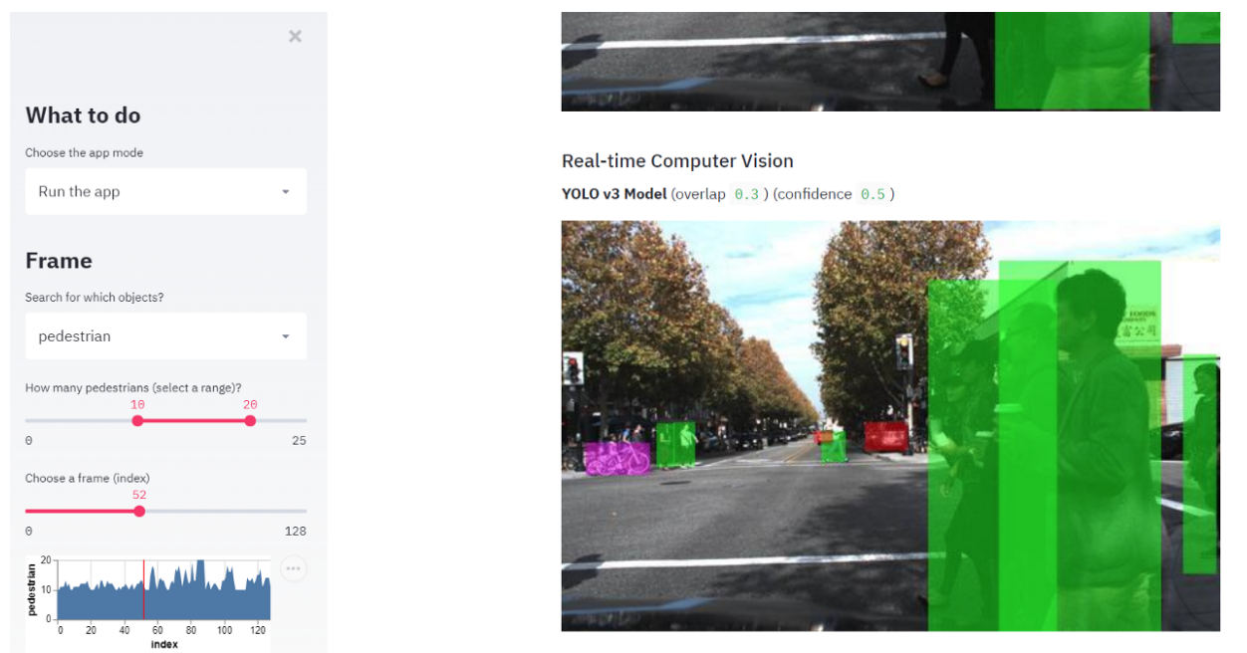
Example: The Self-driving Car Image Browser
Reference: https://towardsdatascience.com/quickly-build-and-deploy-an-application-with-streamlit-988ca08c7e83

Slide 6
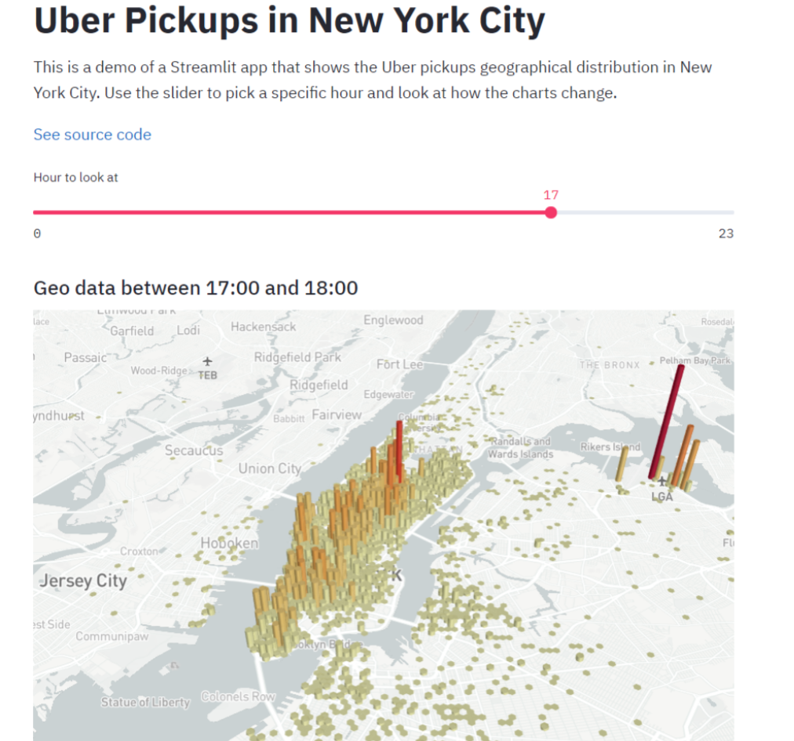

Slide 7
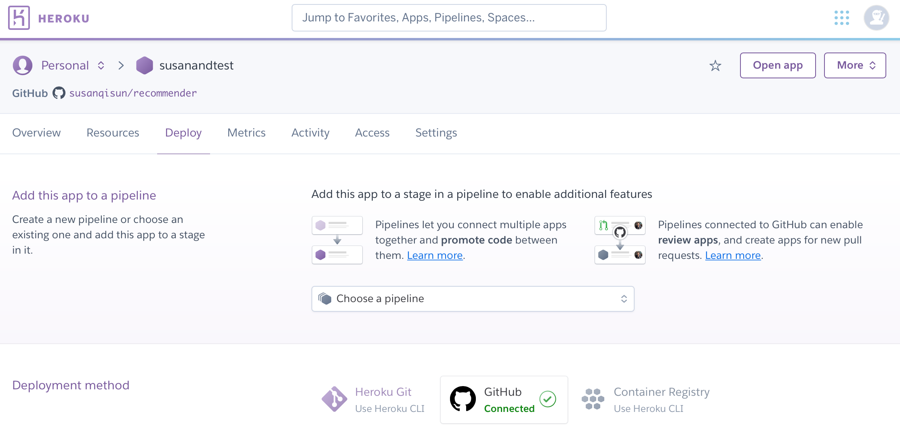
Heroku:
Deploy my Streamlit application to Heroku
Cloud service platform for app deployment and management
free tier

Slide 8
Application:
App address:
https://susanandtest.herokuapp.com
Github address:
https://github.com/susanqisun/recommender/tree/main

