Slide 1
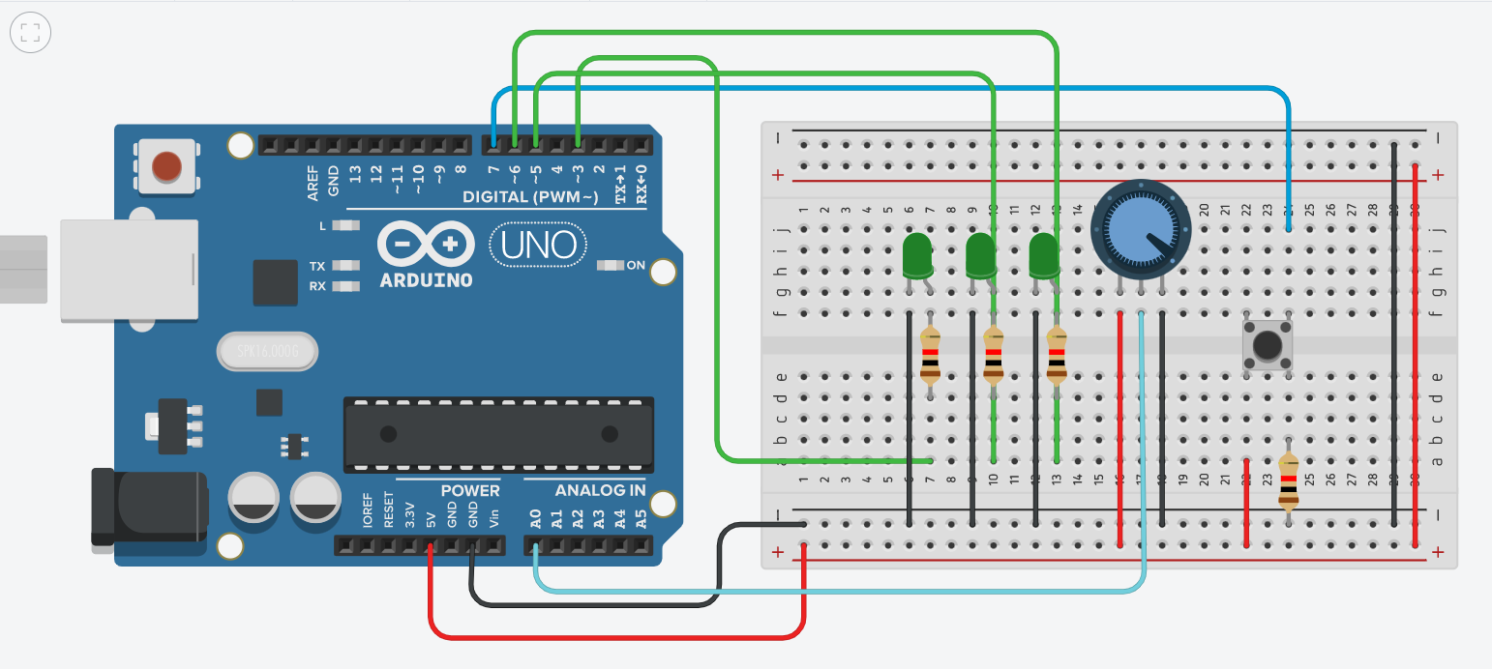
09/29 作業 – 410821204 杜昉紜
Tinkercad 連結：
https://www.tinkercad.com/things/5p0IYdnA1fP-fantastic-hango/editel?sharecode=lxq_HOaW14la0vLE610zp-eGW5RypMLiMOvtN3n4kp4

Slide 2
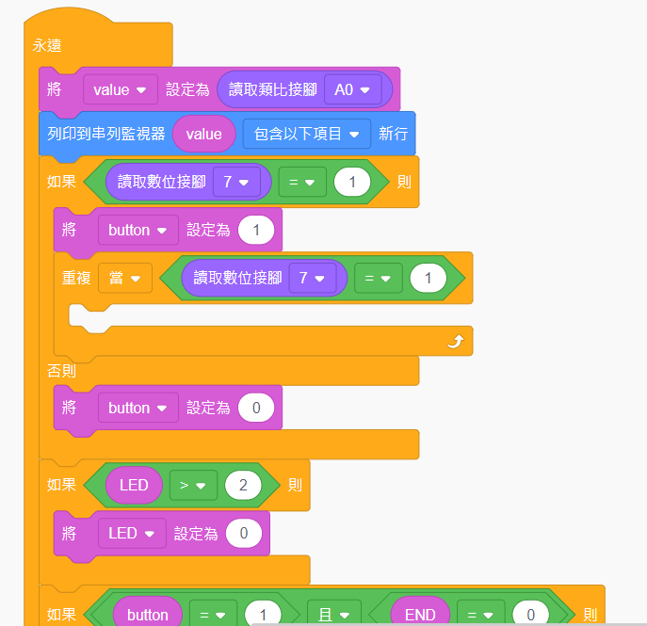
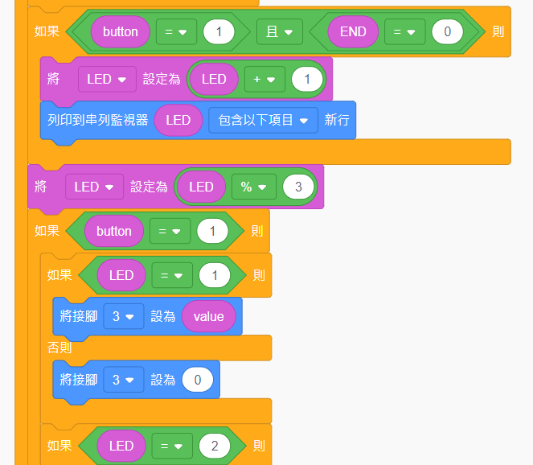
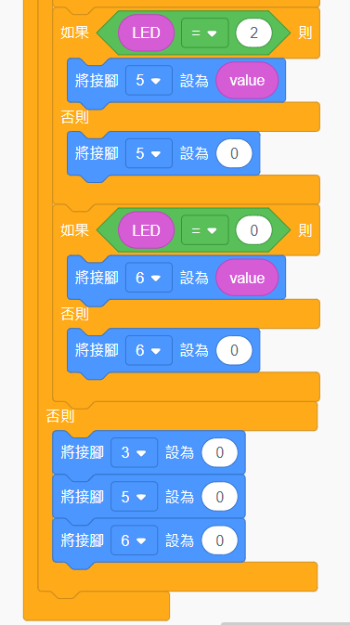
程式碼截3部分，程式碼在這張ppt底下備忘搞
Notes:
// C++ code
//
int button = 0;
int LED = 0;
int END = 0;
int value = 0;
void setup()
{
pinMode(A0, INPUT);
Serial.begin(9600);
pinMode(7, INPUT);
pinMode(3, OUTPUT);
pinMode(5, OUTPUT);
pinMode(6, OUTPUT);
}
void loop()
{
value = analogRead(A0);
Serial.println(value);
if (digitalRead(7) == 1) {
button = 1;
while (digitalRead(7) == 1) {
}
} else {
button = 0;
}
if (LED > 2) {
LED = 0;
}
if (button == 1 && END == 0) {
LED = (LED + 1);
Serial.println(LED);
}
LED = (LED % 3);
if (button == 1) {
if (LED == 1) {
analogWrite(3, value);
} else {
analogWrite(3, 0);
}
if (LED == 2) {
analogWrite(5, value);
} else {
analogWrite(5, 0);
}
if (LED == 0) {
analogWrite(6, value);
} else {
analogWrite(6, 0);
}
} else {
analogWrite(3, 0);
analogWrite(5, 0);
analogWrite(6, 0);
}
delay(10); // Delay a little bit to improve simulation performance
}

