Slide 1
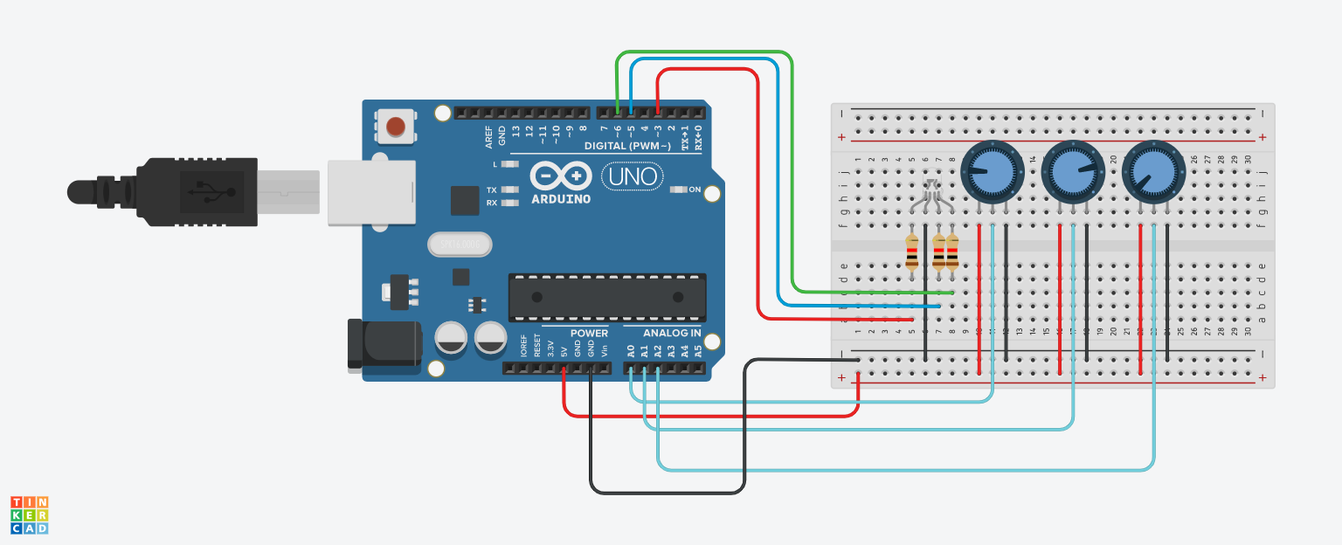
410821204_HW4 作業1：用三顆可變電阻分別控制RGB LED燈的三種顏色
https://www.tinkercad.com/things/7g3Y4yQMvRy

Slide 2

程式碼附在下方備忘搞
Notes:
// C++ code
//
int value1 = 0;
int value2 = 0;
int value3 = 0;
void setup()
{
pinMode(A0, INPUT);
Serial.begin(9600);
pinMode(A1, INPUT);
pinMode(A2, INPUT);
pinMode(3, OUTPUT);
pinMode(5, OUTPUT);
pinMode(6, OUTPUT);
}
void loop()
{
value1 = analogRead(A0);
Serial.println(value1);
value2 = analogRead(A1);
Serial.println(value2);
value3 = analogRead(A2);
Serial.println(value3);
analogWrite(3, value1);
analogWrite(5, value2);
analogWrite(6, value3);
delay(10); // Delay a little bit to improve simulation performance
}

