Slide 1
Evaluating Recommender System

Slide 2
Evaluation Paradigms
There are three primary types of evaluation of recommender systems, corresponding to user studies, online evaluations, and offline evaluations with historical data sets.
The first two types involve users, although they are conducted in slightly different ways.

Slide 3
User studies
Test subjects are actively recruited, and they are asked to interact with the recommender system to perform specific tasks
For example
users could be asked to interact with the recommendations at a product site and give their feedback about the quality of the recommendations
users could be asked to listen to several songs, and then provide their feedback on these songs in the form of ratings

Slide 4
User studies
Adv.
Various scenarios can be tested about the effect of changing the recommender system on the user interaction
Disadv.
It is also difficult and expensive to recruit large cohorts of users for evaluation purposes.
In many cases, the recruited users are not representative of the general population because the recruitment process is itself a bias-centric filter, which cannot be fully controlled

Slide 5

Online Evaluation
Online evaluations also leverage user studies except that the users are often real users in a fully deployed or commercial system.
Typically, users can be sampled randomly, and the various algorithms can be tested with each sample of users.
A typical example of a metric, which is used to measure the effectiveness of the recommender system on the users, is the conversion rate.

Slide 6
A/B testing
Sec. 8.6.3
Purpose: Test a single innovation
Prerequisite: You have a large search engine up and running.
Have most users use old system
Divert a small proportion of traffic (e.g., 1%) to the new system that includes the innovation
Evaluate with an “automatic” measure like clickthrough on first result
Probably the evaluation methodology that large search engines trust most

Slide 7
Online Evaluation
The main disadvantage is that such systems cannot be realistically deployed unless a large number of users are already enrolled.
Therefore, it is hard to use this method during the start up phase.

Slide 8
Offline Evaluation with Historical Data Sets
In offline testing, historical data, such as ratings, are used.
The main advantage of the use of historical data sets is that they do not require access to a large user base.
Once a data set has been collected, it can be used as a standardized benchmark to compare various algorithms across a variety of settings.

Slide 9
General goals of evaluation design
Accuracy
Accuracy of estimating rating
Accuracy of estimating rankings
Novelty
The novelty of a recommender system evaluates the likelihood of a recommender system to give recommendations to the user that they are not aware of, or that they have not seen before.
The most natural way of measuring novelty is through online experimentation in which users are explicitly asked whether they were aware of an item previously.

Slide 10
General goals of evaluation design
Serendipity
Online methods:
The recommender system collects user feedback both on the usefulness of a recommendation and its obviousness.
Offline methods:
One can also use a primitive recommender to generate the information about the obviousness of a recommendation in an automated way. The primitive recommender is typically selected as a content-based recommender.
Then, the fraction of the recommended items in the top-k lists that are correct (i.e., high values of hidden ratings), and are also not recommended by the primitive recommender are determined.

Slide 11
General goals of evaluation design
Serendipity
The word “serendipity” literally means “lucky discovery.” Therefore, serendipity is a measure of the level of surprise in successful recommendations.
In contrast, novelty only requires that the user was not aware of the recommendation earlier. Serendipity is a stronger condition than novelty.

Slide 12
General goals of evaluation design
Diversity
The notion of diversity implies that the set of proposed recommendations within a single recommended list should be as diverse as possible.
Diversity can be measured in terms of the content-centric similarity between pairs of items.
For example, if a set of k items are recommended to the user, then the pairwise similarity is computed between every pair of items in the list.
The average similarity between all pairs can be reported as the diversity.
Lower values of the average similarity indicate greater diversity.

Slide 13
General goals of evaluation design
Scalability
Training time: Most recommender systems require a training phase, which is separate from the testing phase.
Prediction time: Once a model has been trained, it is used to determine the top recommendations for a particular customer.
Memory requirements: When the ratings matrices are large, it is sometimes a challenge to hold the entire matrix in the main memory. In such cases, it is essential to design the algorithm to minimize memory requirements.

Slide 14

Design Issues in Offline Recommender Evaluation
The data are often divided into three parts:
Training data: This part of the data is used to build the training model.
Validation data: This part of the data is used for model selection and parameter tuning.
Testing data: This part of the data is used to test the accuracy of the final (tuned) model.

Slide 15

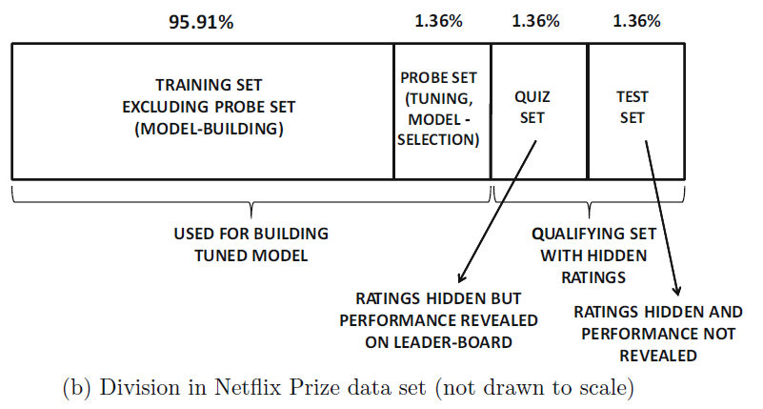
Design Issues in Offline Recommender Evaluation
https://en.wikipedia.org/wiki/Netflix_Prize

Slide 16
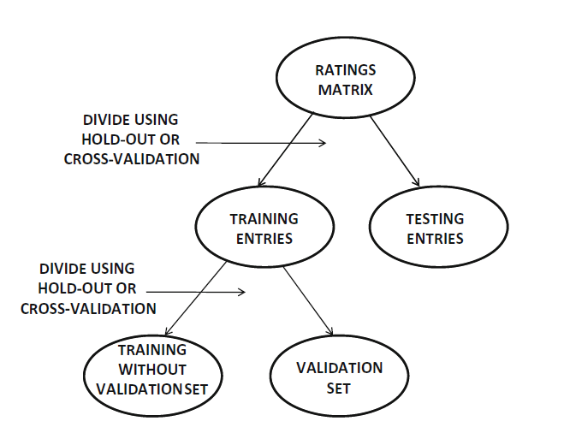
Segmenting the ratings for training and testing
Holdout method
Cross validation
16

Slide 17
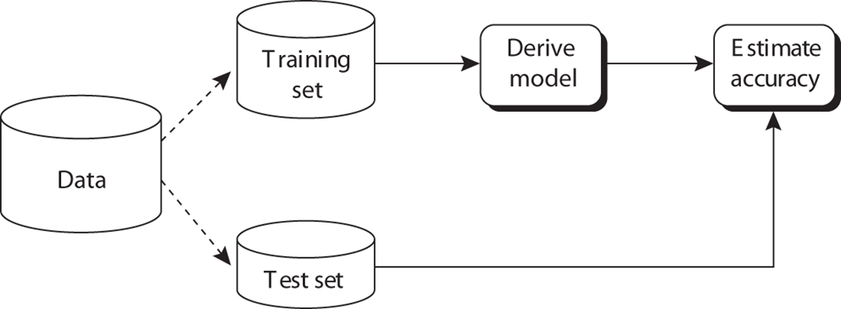
Segmenting the ratings for training and testing
Holdout method
Given data is randomly partitioned into two independent sets
Training set for model construction
Test set for accuracy estimation
This approach ensures that the reported accuracy is not a result of overfitting to the specific data set. However, it underestimates the true accuracy.
17

Slide 18
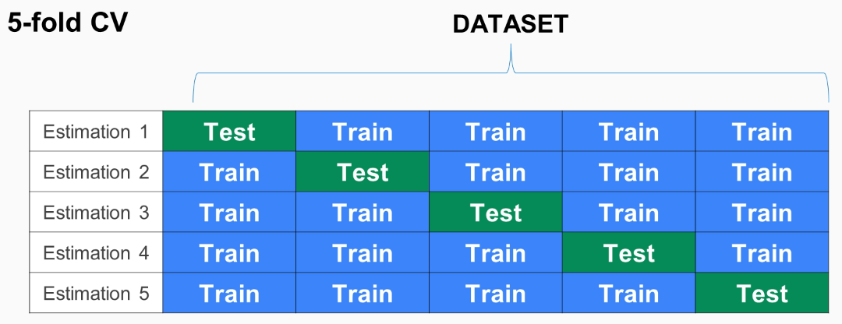
Segmenting the ratings for training and testing
Cross-validation (k-fold, where k = 10 is most popular)
Randomly partition the data into k mutually exclusive subsets, each approximately equal size
At i-th iteration, use D_{i} as test set and others as training set
Leave-one-out: k folds where k = # of tuples
This approach can closely estimate the true accuracy when the value of q is large.
18

Slide 19
Accuracy Metrics in Offline Evaluation
Measuring the Accuracy of Ratings Prediction
Evaluating Ranking via Correlation
Evaluating Ranking via Utility
Evaluating Ranking via Receiver Operating Characteristic

Slide 20
Measuring the Accuracy of Ratings Prediction
Mean squared error (MSE)
Predicted rating | True rating | Error (e)
5 | 4 | 1
4 | 3 | 1
3 | 2 | 1
2 | 5 | -3
smaller values of the MSE are indicative of superior performance

Slide 21
Measuring the Accuracy of Ratings Prediction
Root Mean squared error (RMSE)
it is often used instead of the MSE
Predicted rating | True rating | Error (e)
5 | 4 | 1
4 | 3 | 1
3 | 2 | 1
2 | 5 | -3
The RMSE was used as the standard metric for the Netflix Prize contest.
One characteristic of the RMSE is that it tends to disproportionately penalize large errors because of the squared term within the summation.

Slide 22
Measuring the Accuracy of Ratings Prediction
Mean Absolute Error (MAE)
it does not disproportionately penalize larger errors
Predicted rating | True rating | Error (e)
5 | 4 | 1
4 | 3 | 1
3 | 2 | 1
2 | 5 | -3
it does not disproportionately penalize larger errors

Slide 23
Measuring the Accuracy of Ratings Prediction
normalized RMSE (NRMSE) and normalized MAE(NMAE)
each of them is divided by the range r_{max} − r_{min} of the ratings:
Predicted rating | True rating | Error (e)
5 | 4 | 1
4 | 3 | 1
3 | 2 | 1
2 | 5 | -3
The normalized values of the RMSE and MAE always lie in the range (0, 1)
It is also possible to use these values to compare the performance of a particular algorithm over different data sets with varying scales of ratings

Slide 24
Evaluating Ranking via Correlation
In practice, the recommender system creates a ranking of items for a user, and the top-k items are recommended. The value of k may vary with the system, item, and user at hand.
In general, it is desirable for highly rated items to be ranked above items which are not highly rated.
Consider a user u, for which the ratings of the set I_{u} of items have been hidden by a hold-out or cross-validation strategy.
For example, if the ratings of the first, third, and fifth items (columns) of user (row) u are hidden for evaluation purposes, then we have I_{u} = {1, 3, 5}.
We would like to measure how well the ground-truth orderings of the ratings in I_{u} are related to the ordering predicted by the recommender system for the set I_{u}.

Slide 25
Evaluating Ranking via Correlation
Spearman rank correlation coefficient:
The first step is to rank all items from 1 to |I_{u}|, both for the recommender system prediction and for the ground-truth.
The Spearman correlation coefficient is simply equal to the Pearson correlation coefficient applied on these ranks.
The ground truth will contain many ties!
Tie-corrected Spearman
use the average rank of all the ties.
For example, if the ground-truth rating of the top-2 ratings is identical in a list of four items, then instead of using the ranks {1, 2, 3, 4}, one might use the ranks {1.5, 1.5, 3, 4}.
Predicted rating | Predicted ranking | True rating | True raking
5 | 1 | 4 | 2
4 | 2 | 3 | 3
3 | 3 | 2 | 4
2 | 4 | 5 | 1

Slide 26
Practice
Spearman rank correlation coefficient:
Predicted rating | Predicted ranking | True rating | True raking
5 |  | 4
4 |  | 2
3 |  | 3
2 |  | 1

Slide 27

Evaluating Ranking via Correlation
Kendall rank correlation coefficient:
For each pair of items j, k ∈ Ii, the followingcredit C(j, k) is computed by comparing the predicted ranking with the ground-truth ranking of these items:
Kendall rank correlation coefficient τ_{u} (specific to user u)

Slide 28
Example
Kendall rank correlation coefficient
Pairs of items
{a,b}, {a,c}, {a,d}, {b,c}, {b,d}, {c,d}
Predicted rating | Predicted ranking | True rating | True raking
5 | 1 | 4 | 2
4 | 2 | 3 | 3
3 | 3 | 2 | 4
2 | 4 | 5 | 1
a
b
c
d
1 1 -1 1 -1 -1

Slide 29
Practice
Kendall rank correlation coefficient
Predicted rating | Predicted ranking | True rating | True raking
5 |  | 4
4 |  | 2
3 |  | 3
2 |  | 1
a
b
c
d

Slide 30

Evaluating Ranking via Utility
NDCG (normalized discounted cumulative gain)
Designed for situations of nonbinary notions of relevance.
Example
good :3 fair :2 bad:1
1 | Good (3)
2 | Bad (1)
3 | Fair (2)
4 | Good (3)
5 | Fair (2)
CG: cumulative gain
3+1+2+3+2=11
Do not consider the rank!!

Slide 31

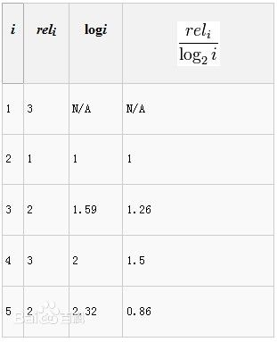
Example
Discounted cumulative gain
Consider the rank
1 | Good (3)
2 | Bad (1)
3 | Fair (2)
4 | Good (3)
5 | Fair (2)
DCG_{p}
=3+1+1.26+1.5+0.86
=7.62

Slide 32
Example
NDCG => normalize DCG
For each query, compute its ideal DCG (IDCG).
Normalized DCG by IDCG
1 | Good (3)
2 | Bad (1)
3 | Fair (2)
4 | Good (3)
5 | Fair (2)
1 | Good (3)
2 | Good (3)
3 | Fair (2)
4 | Fair (2)
5 | Bad (1)
IDCG_{p}
=3+3+1.26+1+0.43
=8.69
Best rank
NDCG_{p}
= 7.62/8.69 = 0.88

Slide 33
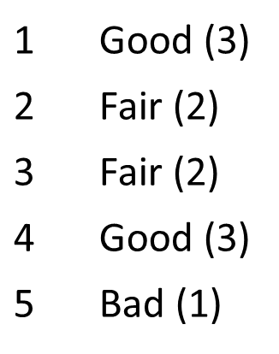
Practice

Slide 34
Practice
DCG_{p}
=3+2+1.26+1.5+0.43
=8.19
2
2
1
0.43

Slide 35
Practice
DCG_{p}
=3+2+1.26+1.5+0.43
=8.19
NDCG => normalize DCG
For each query, compute its ideal DCG (IDCG).
Normalized DCG by IDCG
1 | Good (3)
2 | Bad (1)
3 | Fair (2)
4 | Good (3)
5 | Fair (2)
1 | Good (3)
2 | Good (3)
3 | Fair (2)
4 | Fair (2)
5 | Bad (1)
IDCG_{p}
=3+3+1.26+1+0.43
=8.69
Best rank
NDCG_{p}
= 8.19/8.69 = 0.94

Slide 36
Evaluating Ranking via Receiver Operating Characteristic
Ranking methods are used frequently in the evaluation of the actual consumption of items.
For example, Netflix might recommend a set of ranked items for a user, and the user might eventually consume only a subset of these items.
These methods are well suited to implicit feedback data sets, such as sales, click-throughs, or movie views.

Slide 37
Evaluating Ranking via Receiver Operating Characteristic
The items that are eventually consumed are also referred to as the ground-truth positives or true positives.
The recommendation algorithm can provide a ranked list of any number of items.
What percentage of these items is relevant?
The answer to this question depends on the size of the recommended list.

Slide 38
Evaluating Ranking via Receiver Operating Characteristic
Sec. 8.3
Precision: fraction of retrieved docs that are relevant = P(relevant|retrieved)
Recall: fraction of relevant docs that are retrieved
= P(retrieved|relevant)
Precision P = tp/(tp + fp)
Recall R = tp/(tp + fn)
 | Relevant | Nonrelevant
Retrieved | tp (true positives) | fp
Not Retrieved | fn (false negative) | tn

Slide 39
Example
Sec. 8.3
Precision P = tp/(tp + fp)
Recall R = tp/(tp + fn)
 | Relevant | Nonrelevant
Retrieved | 18 (tp) | 2 (fp)
Not Retrieved | 82 (fn) | 100,000,000 (tn)
Precision = 18/20 = 0.9
Recall = 18/100 = 0.18

Slide 40
Precision/Recall
Sec. 8.3
You can get high recall (but low precision) by retrieving all docs for all queries!
Recall is a non-decreasing function of the number of docs retrieved
In a good system, precision decreases as either the number of docs retrieved or recall increases
This is not a theorem, but a result with strong empirical confirmation

Slide 41
A combined measure: F
Sec. 8.3
Combined measure that assesses precision/recall tradeoff is F measure (weighted harmonic mean):
People usually use balanced F₁ measure
i.e., with β = 1 or α = ½
Harmonic mean is a conservative average
See CJ van Rijsbergen, Information Retrieval

Slide 42
Example
Sec. 8.3
 | Relevant | Nonrelevant
Retrieved | 18 | 2
Not Retrieved | 82 | 100,000,000
Precision = 18/20 = 0.9
Recall = 18/100 = 0.18
F₁ = 1/(0.5*1.111+0.5*5.556)
=0.3

Slide 43
F₁ and other averages
Sec. 8.3

Slide 44
Precision-at-k
Example
D_{q}={d₁, d₅, d₇, d₁₀}
Retrieved documents: (d₁, d₁₀, d₁₅, d₅, d₄, d₇, d₂₂, d₂)
Precision-at-1= 100%
Precision-at-2= 100%
Precision-at-3= 67%
Precision-at-4= 75%
Perhaps appropriate for most of web search:
all people want are good matches on the first one or two results pages
Parameter k
Affect the evaluation results

Slide 45
Summary
The evaluation of recommender systems is crucial in order to obtain a clear idea about the quality of different algorithms

