Slide 1
Hybrid recommendation approaches

Slide 2



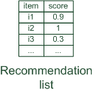
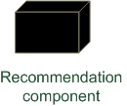



Hybrid recommender systems
Hybrid: combinations of various inputs and/or composition of different mechanism
Collaborative: "Tell me what's popular among my peers"
Content-based: "Show me more of the same what I've liked"
Knowledge-based: "Tell me what fits based on my needs"

Slide 3
Hybrid recommender systems
All three base techniques are naturally incorporated by a good sales assistant (at different stages of the sales act) but have their shortcomings
For instance, cold start problems
Idea of crossing two (or more) species/implementations
hybrida [lat.]: denotes an object made by combining two different elements
Avoid some of the shortcomings
Reach desirable properties not (or only inconsistently) present in parent individuals

Slide 4
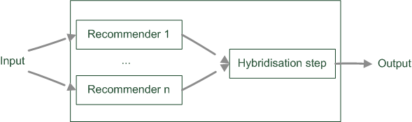
Parallelized hybridization design
Output of several existing implementations combined
Least invasive design
Some weighting or voting scheme
Weights can be learned dynamically
Extreme case of dynamic weighting is switching

Slide 5

Parallelized hybridization design: Weighted
Compute weighted sum:
Recommender 1
Item1 | 0.5 | 1
Item2 | 0
Item3 | 0.3 | 2
Item4 | 0.1 | 3
Item5 | 0
Recommender 2
Item1 | 0.8 | 2
Item2 | 0.9 | 1
Item3 | 0.4 | 3
Item4 | 0
Item5 | 0
Recommender weighted(0.5:0.5)
Item1 | 0.65 | 1
Item2 | 0.45 | 2
Item3 | 0.35 | 3
Item4 | 0.05 | 4
Item5 | 0.00

Slide 6
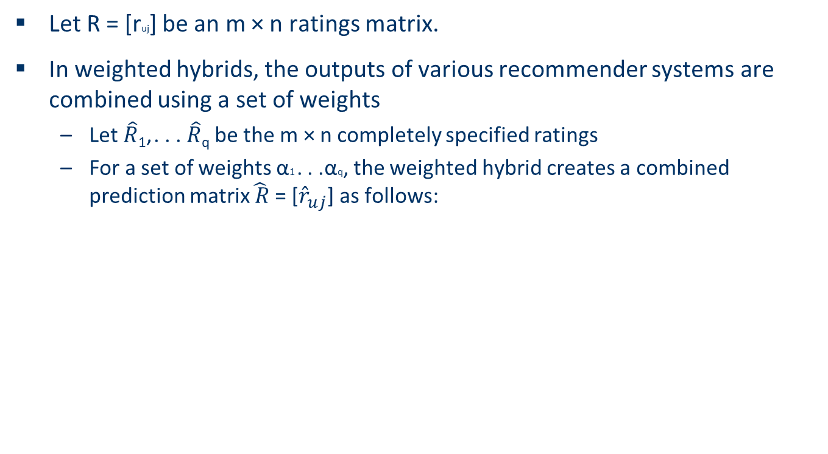
Parallelized hybridization design: Weighted

Slide 7
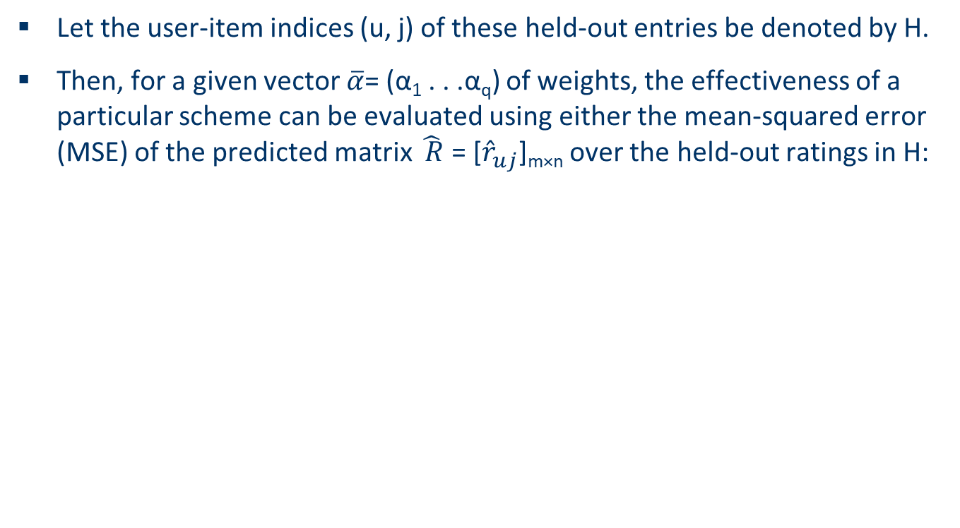
Parallelized hybridization design: Weighted

Slide 8





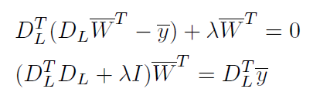

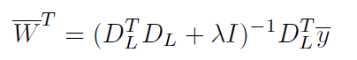
q (number of recommender)
D_{L}
Ratings (H)
|H|
q

Slide 9
Parallelized hybridization design: Switching
Switching hybrids are used most commonly in recommender systems in the context of the problem of model selection, but they are often not formally recognized as hybrid systems.
Example:
Ordering on recommenders and switch based on some quality criteria
E.g. if too few ratings in the system use knowledge-based, else collaborative
More complex conditions based on contextual parameters, apply classification techniques

Slide 10
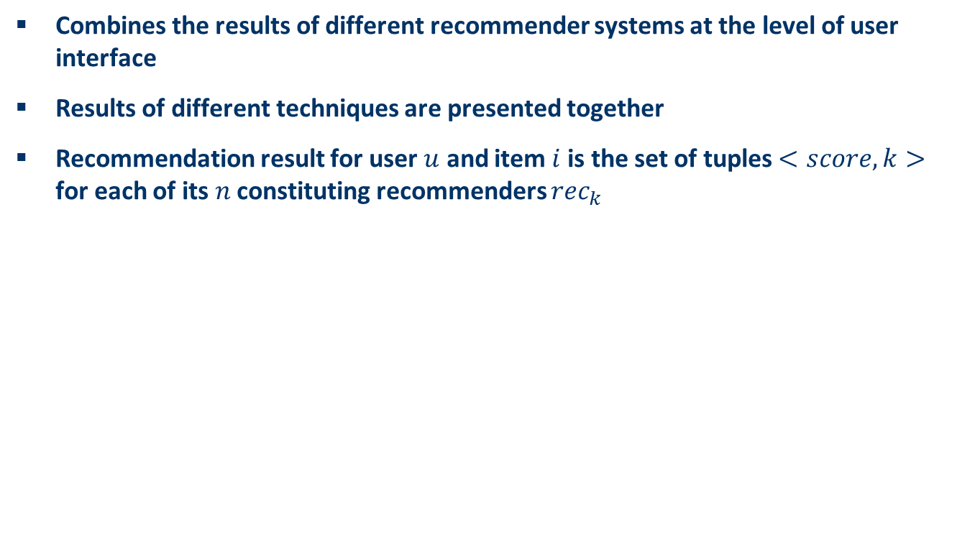


Parallelized hybridization design: Mixed

Slide 11
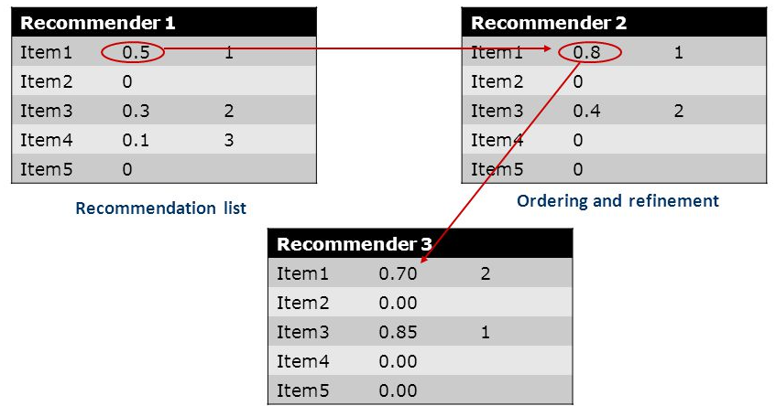
Pipelined hybridization designs
One recommender system pre-processes some input for the subsequent one
Refinement of recommendation lists (cascade)
Recommendation list is continually reduced
First recommender excludes items
Remove absolute no-go items (e.g. knowledge-based)
Second recommender assigns score
Ordering and refinement (e.g. collaborative)

Slide 12
Summary
Hybrid recommender systems are used either to leverage the power of multiple data sources or to improve the performance of existing recommender systems within a particular data modality.
Hybrid recommender systems attempt to leverage the complementary strengths of these systems to create a system with greater overall robustness.

