Slide 1
Knowledge-based recommendation

Slide 2


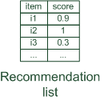




Basic I/O Relationship
Knowledge-based: "Tell me what fits based on my needs"

Slide 3

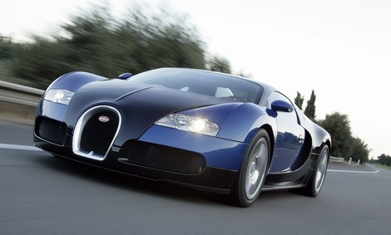
Why do we need knowledge-based recommendation?
Products with low number of available ratings
Time span plays an important role
five-year-old ratings for computers
user lifestyle or family situation changes
Customers want to define their requirements explicitly
"the color of the car should be black"

Slide 4
Knowledge-based recommender systems
Constraint-based
based on explicitly defined set of recommendation rules
fulfill recommendation rules
Case-based
based on different types of similarity measures
retrieve items that are similar to specified requirements
Both approaches are similar in their conversational recommendation process
users specify the requirements
systems try to identify solutions
if no solution can be found, users change requirements

Slide 5
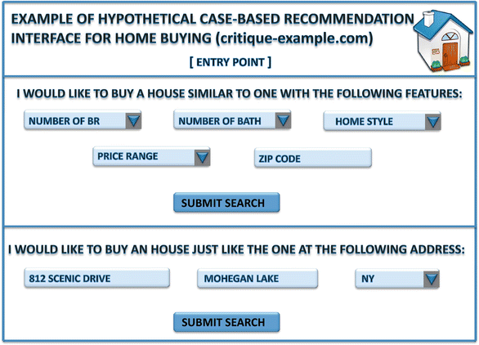
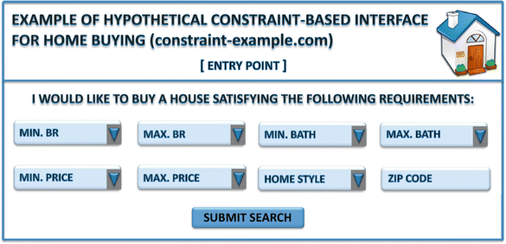
Knowledge-based recommender systems

Slide 6
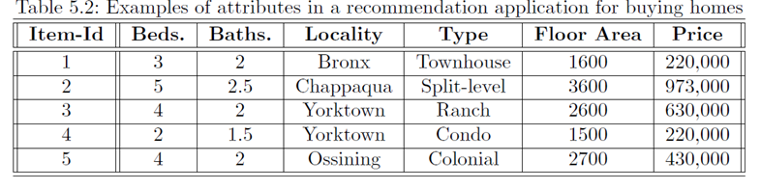
Knowledge-based recommender systems
It is noteworthy that most forms of knowledge-based recommender systems depend heavily on the descriptions of the items in the form of relational attributes.

Slide 7
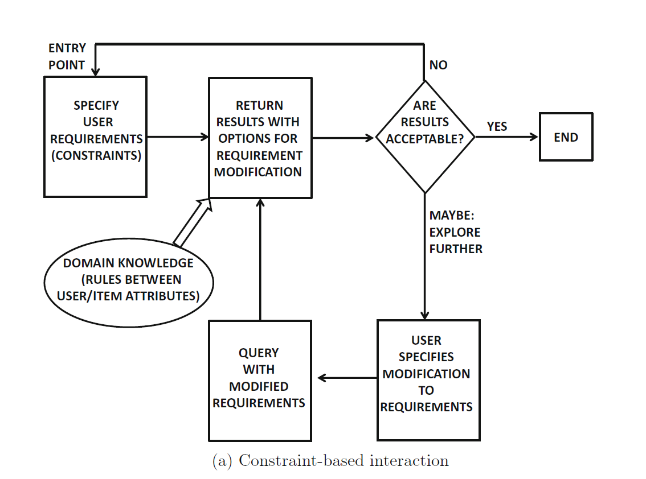
Constraint-based recommender systems

Slide 8
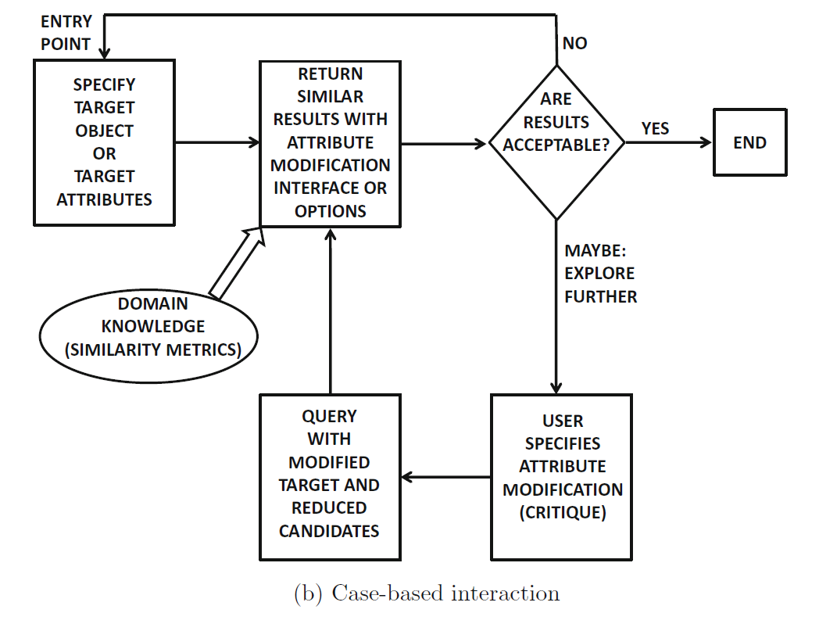

Case-based recommender systems

Slide 9
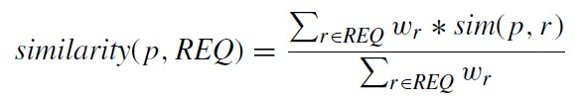

Case-based recommender systems
Items are retrieved using similarity measures
Similarity
Def.
sim (p, r) expresses for each item attribute value φ_{r} (p) its similarity to the customer requirement r ∈ REQ.
wr is the importance weight for requirement r

Slide 10



Attributes
 | name | Dep. | gender | title | salary
1 | Alice | CSIE | Female | Prof. | 90k
2 | John | EE | Male | Assistant Prof. | 67k
3 | Bob | BM | Male | Associate Prof. | 75.8k
Attribute (or dimensions, features, variables): a data field, representing a characteristic or feature of a data object.
Types:
Nominal
Binary
Ordinal
Numeric: quantitative

Slide 11
Attribute Types
Nominal: categories, states, or “names of things”
Hair_color = {auburn, black, blond, brown, grey, red, white}
Binary
Nominal attribute with only 2 states (0 and 1)
Symmetric binary: both outcomes equally important
e.g., gender
Asymmetric binary: outcomes not equally important.
e.g., medical test (positive vs. negative)
Convention: assign 1 to most important outcome (e.g., HIV positive)
Ordinal
Values have a meaningful order (ranking) but magnitude between successive values is not known.
Size = {small, medium, large}, grades, army rankings

Slide 12
Similarity and Dissimilarity
Similarity
Numerical measure of how alike two data objects are
Value is higher when objects are more alike
Often falls in the range [0,1]

Slide 13
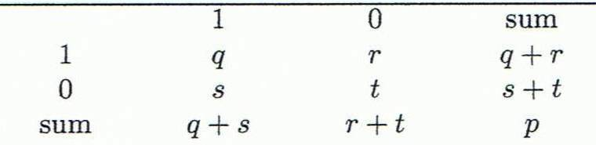

Object i | 1 | 0 | 0 | 1 | …. | 0
Object j | 1 | 1 | 0 | 0 | …. | 0
Object j
A contingency table for binary data
similarity measure for symmetric binary variables:
Sim(i,j)=(q+t)/(q+r+s+t)
Jaccard coefficient (similarity measure for asymmetric binary variables):
Object i

Slide 14
Similarity between Binary Variables
Example
Gender is a symmetric attribute
The remaining attributes are asymmetric binary
Let the values Y and P be 1, and the value N be 0

Slide 15
Numeric Attribute
price
min=15, max=215, σ=10
t_{i}=100 x_{i}=150
Symmetric

Slide 16
price
min=15, max=215, α=0.5
t_{i}=100 x_{i}=120
Larger values are better
asymmetric
Asymmetric reward
The values of α_{i} are chosen in a highly domain-specific way.
For values of α_{i} > 1, the “similarity” actually increases with greater distance to the target. (you can think Sim(t_{i}, x_{i}) as a utility function rather than as a similarity function)
smaller values are better

Slide 17
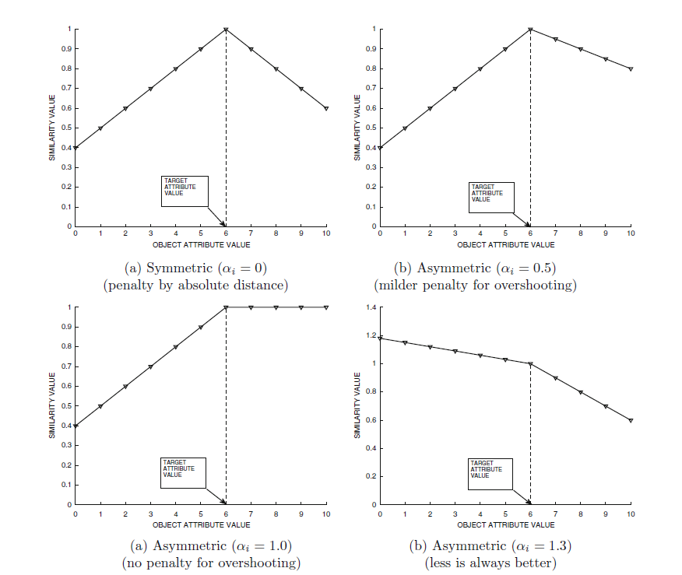

Larger values are better

Slide 18
Ordinal Variables
Order is important, e.g., rank
Can be treated like interval-scaled
replace x_{if} by their rank
compute the similarity using methods for interval-scaled variables

Slide 19
Example
M_{f}=3
fair->1, good->2, excellent->3
Sim(fair,good)=1-(|1-2|/(3-1))=1-1/2

Slide 20
Case-based recommender systems
Items are retrieved using similarity measures
similarity
Min=10, max=110,
w₁=0.3, w₂=0.2,w₃=0.4,w₄=0.1
 | A_{１}(Sym) | A₂(Sym) | A₃(Asym, the larger the beter, α₃=0.5) | A₄(sym)
T |  | 50 | 70 | 40
X | 30 | 60 | 80 | 100
1-(10/100)
=0.9
1-(10/100)+0.5*(10/100)
=0.95
1-(60/100)
=0.4
(0.2*0.9+0.4*0.95+0.1*0.4)/(0.2+0.4+0.1)

Slide 21
Practice
Items are retrieved using similarity measures
similarity
Min=10, max=210,
w₁=0.3, w₂=0.1,w₃=0.4,w₄=0.2
 | A_{１}(Sym) | A₂(Sym) | A₃(Asym, the larger the beter, α₃=0.5) | A₄(Asym, The smaller the better,α₄=0.4)
T | 50 |  | 70 | 40
X | 30 | 60 | 80 | 100

Slide 22
Case-based recommender systems
The design of similarity functions is the determination of the relative importance of various attributes.
The relative importance of the ith attributes is regulated by the parameter w_{i}
Define by domain experts
To learn the values of w_{i} with user feedback.
Pairs of target objects could be presented to users, and users might be asked to rate how similar these target objects are.
This feedback can be used in conjunction with a linear regression model to determine the value of w_{i}.

Slide 23




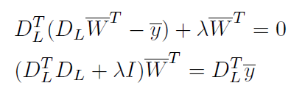

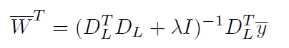
d dimensions
D_{L}
N pairs of similarity
n
d

Slide 24
Incorporating Diversity in Similarity Computation
As case-based systems use item attributes to retrieve similar products, they face many of the same challenges as content-based systems in returning diverse results.
In many cases, the results returned by case-based systems are all very similar.
The problem with the lack of diversity is that if a user does not like the top-ranked result, she will often not like the other results, which are all very similar.

Slide 25
Incorporating Diversity in Similarity Computation
Bounded random selection
Consider a scenario where it is desired to retrieve the top-k results matching a particular case.
One possibility is to retrieve the top b · k results (for b > 1) and then randomly select k items from this list.
However, such a strategy does not seem to work very well in practice.

Slide 26
Incorporating Diversity in Similarity Computation
Bounded greedy selection strategy
we start with the empty set R and incrementally build it by adding instances from the base set of b · k cases.
The first step is to create a quality metric that combines similarity and diversity.
Assume without loss of generality that the similarity function f(X, Y ) always maps to a value in (0, 1).

Slide 27
Example
T
Assume k=3, b=2
sim
D
 | X₁ | X₂ | X₃ | X₄ | X₅ | X₆
X₁ | 0 | 0.3 | 0.2 | 0.3 | 0.3 | 0.2
X₂ | 0.3 | 0 | 0.2 | 0.3 | 0.4 | 0.3
X₃ | 0.2 | 0.2 | 0 | 0.4 | 0.3 | 0.2
X₄ | 0.3 | 0.3 | 0.4 | 0 | 0.1 | 0.2
X₅ | 0.3 | 0.4 | 0.3 | 0.1 | 0 | 0.3
X₆ | 0.2 | 0.3 | 0.2 | 0.2 | 0.3 | 0
X₁ | 0.8
X₂ | 0.7
X₃ | 0.7
X₄ | 0.6
X₅ | 0.6
X₆ | 0.6

Slide 28
Example
sim
D
X₁ | 0.8
X₂ | 0.7
X₃ | 0.7
X₄ | 0.6
X₅ | 0.6
X₆ | 0.6
 | X₁ | X₂ | X₃ | X₄ | X₅ | X₆
X₁ | 0 | 0.3 | 0.2 | 0.3 | 0.3 | 0.2
X₂ | 0.3 | 0 | 0.2 | 0.3 | 0.4 | 0.3
X₃ | 0.2 | 0.2 | 0 | 0.4 | 0.3 | 0.2
X₄ | 0.3 | 0.3 | 0.4 | 0 | 0.1 | 0.2
X₅ | 0.3 | 0.4 | 0.3 | 0.1 | 0 | 0.3
X₆ | 0.2 | 0.3 | 0.2 | 0.2 | 0.3 | 0
R={X₁}

Slide 29
Example
sim
D
X₁ | 0.8
X₂ | 0.7
X₃ | 0.7
X₄ | 0.6
X₅ | 0.6
X₆ | 0.6
 | X₁ | X₂ | X₃ | X₄ | X₅ | X₆
X₁ | 0 | 0.3 | 0.2 | 0.3 | 0.3 | 0.2
X₂ | 0.3 | 0 | 0.2 | 0.3 | 0.4 | 0.3
X₃ | 0.2 | 0.2 | 0 | 0.4 | 0.3 | 0.2
X₄ | 0.3 | 0.3 | 0.4 | 0 | 0.1 | 0.2
X₅ | 0.3 | 0.5 | 0.3 | 0.1 | 0 | 0.3
X₆ | 0.2 | 0.3 | 0.2 | 0.2 | 0.3 | 0
R={X₁, X₂}

Slide 30
Example
sim
D
X₁ | 0.8
X₂ | 0.7
X₃ | 0.7
X₄ | 0.6
X₅ | 0.6
X₆ | 0.6
 | X₁ | X₂ | X₃ | X₄ | X₅ | X₆
X₁ | 0 | 0.3 | 0.2 | 0.3 | 0.3 | 0.2
X₂ | 0.3 | 0 | 0.2 | 0.3 | 0.4 | 0.3
X₃ | 0.2 | 0.2 | 0 | 0.4 | 0.3 | 0.2
X₄ | 0.3 | 0.3 | 0.4 | 0 | 0.1 | 0.2
X₅ | 0.3 | 0.5 | 0.3 | 0.1 | 0 | 0.3
X₆ | 0.2 | 0.3 | 0.2 | 0.2 | 0.3 | 0
R={X₁, X₂, X₅}

Slide 31
Summary
Knowledge-based recommender systems are generally designed for domains in which the items are highly customized, and it is difficult for rating information to directly reflect greater preferences.
constraint-based
Users specify their requirements, which are combined with domain-specific rules to provide recommendations.
Users can add constraints or relax constraints depending on the size of the results
case-based
They are usually effective at handling cold-start issues.

