Slide 1
Bayesian Theorem
Given training data X, posteriori probability of a hypothesis H, P(H|X), follows the Bayes theorem
Informally, this can be written as
posteriori = likelihood x prior/evidence
Predicts X belongs to C_{i} iff the probability P(C_{i}|X) is the highest among all the P(C_{k}|X) for all the k classes
Practical difficulty: require initial knowledge of many probabilities, significant computational cost

Slide 2
Towards Naïve Bayesian Classifier
Let D be a training set of tuples and their associated class labels, and each tuple is represented by an n-D attribute vector X = (x₁, x₂, …, x_{n})
Suppose there are m classes C₁, C₂, …, C_{m}.
Classification is to derive the maximum posteriori, i.e., the maximal P(C_{i}|X)
This can be derived from Bayes’ theorem
Since P(X) is constant for all classes, only
needs to be maximized

Slide 3

Derivation of Naïve Bayes Classifier
A simplified assumption: attributes are conditionally independent (i.e., no dependence relation between attributes):
MLE

Slide 4
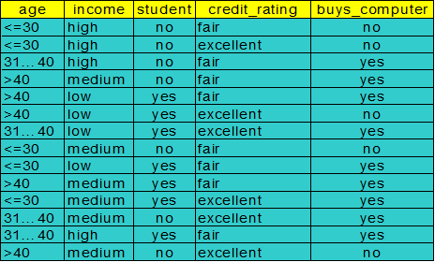
Naïve Bayesian Classifier: Training Dataset
Class:
C1:buys_computer = ‘yes’
C2:buys_computer = ‘no’
Data sample
X = (age <=30,
Income = medium,
Student = yes
Credit_rating = Fair)
( 9/14)*(2/9)*(4/9)*(6/9)*(6/9)

Slide 5

Example of the Bayes Method with Binary Ratings
P(r₃₁=1|r₃₂,r₃₃,r₃₄,r₃₅)
P(r₃₁=1)*P(r₃₂=1|r₃₁=1) *P(r₃₃=1|r₃₁=1)* P(r₃₄=-1|r₃₁=1) P(r₃₅=-1|r₃₁=1)
P(r₃₁=-1|r₃₂,r₃₃,r₃₄,r₃₅)
0.5*0.5*1*1*0.5=0.125

Slide 6
Example of the Bayes Method with Binary Ratings
P(r₃₁=1|r₃₂,r₃₃,r₃₄,r₃₅)
P(r₃₁=-1|r₃₂,r₃₃,r₃₄,r₃₅)
0.5*0.5*1*1*0.5=0.125
P(r31=-1)*P(r32=1|r31=-1) *P(r33=1|r31=-1)* P(r34=-1|r31=1) P(r35=-1|r31=-1)
0.5*(0/1)*(0/2)*(0/2)(0/2)=0
r₃₁=1

Slide 7
Practice
 | I1 | I2 | I3 | I4 | I5 | I6
u1 | 1 | ? | 1 | 1 | 3 | 1
u2 | 1 | 1 | -1 | 1 | 3 | 2
u3 | 1 | -1 | ? | -1 | 1 | 3
u4 | -1 | -1 | -1 | 1 | 2 | 2
u5 | ? | -1 | -1 | ? | 1 | 2
u6 | -1 | ? | 1 | -1 | 1 | 2
Possible rating (1,-1)

Slide 8
Practice
 | I1 | I2 | I3 | I4 | I5 | I6
u1 | 1 | ? | 1 | 1 | 3 | 1
u2 | 1 | 1 | -1 | 1 | 3 | 2
u3 | 1 | -1 | ? | -1 | 1 | 3
u4 | -1 | -1 | -1 | 1 | 2 | 2
u5 | ? | -1 | -1 | ? | 1 | 2
u6 | -1 | ? | 1 | -1 | 1 | 2
1
(3/5)*(1/2)*(1/2)=0.15
-1
(2/5)*(1/1)*(1/2)=0.2

Slide 9
Smoothing to Avoid Overfitting
A problem arises when the underlying ratings matrix is sparse and the number of observed ratings is small.
Laplace smoothing
For example, let q₁ . . . q_{l} be the number of users that have respectively specified the ratings, v₁ . . .v_{l} for the jth item.
Laplacian smoothing (parameter α):
The value of α controls the level of smoothing.
Larger value α will lead to more smoothing, but the results will become insensitive to the underlying data.

Slide 10
Example of the Bayes Method with Binary Ratings
P(r₃₁=1|r₃₂,r₃₃,r₃₄,r₃₅)
P(r₃₁=-1|r₃₂,r₃₃,r₃₄,r₃₅)
0.5*0.5*1*1*0.5=0.125
P(r31=-1)*P(r32=1|r31=-1) *P(r33=1|r31=-1)* P(r34=-1|r31=1) P(r35=-1|r31=-1)
0.5*(0/1)*(0/2)*(0/2)(0/2)=0
r₃₁=1

Slide 11
Smoothing to Avoid Overfitting
A problem arises when the underlying ratings matrix is sparse and the number of observed ratings is small.
Laplace smoothing
For example, let q₁ . . . q_{l} be the number of users that have respectively specified the ratings, v₁ . . .v_{l} for the jth item.
Laplacian smoothing (parameter α):
The value of α controls the level of smoothing.
Larger value α will lead to more smoothing, but the results will become insensitive to the underlying data.

Slide 12
Example of the Bayes Method with Binary Ratings
P(r₃₁=1|r₃₂,r₃₃,r₃₄,r₃₅)
P(r₃₁=1)*P(r₃₂=1|r₃₁=1) *P(r₃₃=1|r₃₁=1)* P(r₃₄=-1|r₃₁=1) P(r₃₅=-1|r₃₁=1)
(2/4) *((1+1)/(2+2))* ((1+1)/(1+2)* ((2+1)/(2+2))* ((2+1)/(2+2))
P(r₃₁=-1|r₃₂,r₃₃,r₃₄,r₃₅)

Slide 13

Practice
 | I1 | I2 | I3 | I4 | I5 | I6
u1 | 1 | ? | 2 | 1 | 3 | 1
u2 | 2 | 3 | 2 | ? | 3 | 2
u3 | 1 | 3 | ? | 3 | 1 | 3
u4 | 3 | 2 | 1 | 3 | 2 | 2
u5 | ? | 3 | 2 | ? | 1 | 2
u6 | 3 | ? | 2 | 2 | 1 | 2
Possible rating (1,2,3)

Slide 14
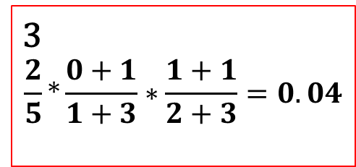

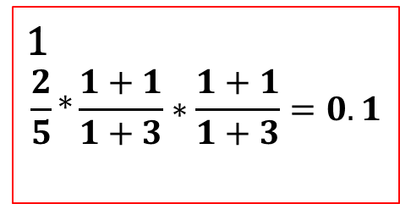
Practice
 | I1 | I2 | I3 | I4 | I5 | I6
u1 | 1 | ? | 2 | 1 | 3 | 1
u2 | 2 | 3 | 2 | ? | 3 | 2
u3 | 1 | 3 | ? | 3 | 1 | 3
u4 | 3 | 2 | 1 | 3 | 2 | 2
u5 | ? | 3 | 2 | ? | 1 | 2
u6 | 3 | ? | 2 | 2 | 1 | 2
Possible rating (1,2,3)
1
$$\frac{2}{5}∗\frac{1+1}{1+3}∗\frac{1+1}{1+3}=0.1$$
2
$$\frac{1}{5}∗\frac{1+1}{1+3}∗\frac{1+1}{1+3}=0.05$$
3
$$\frac{2}{5}∗\frac{0+1}{1+3}∗\frac{1+1}{2+3}=0.04$$

Slide 15
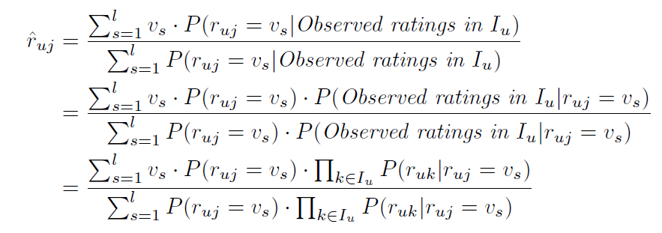
Rather than determining the rating that takes on the maximum probability, one can estimate the predicted value as the weighted average of all the ratings, where the weight of a rating is its probability.
This approach is preferable when the granularity of the ratings distribution is greater.

Slide 16




Example
1
$$\frac{2}{5}∗\frac{1+1}{1+3}∗\frac{1+1}{1+3}=0.1$$
 | I1 | I2 | I3 | I4 | I5 | I6
u1 | 1 | ? | 2 | 1 | 3 | 1
u2 | 2 | 3 | 2 | ? | 3 | 2
u3 | 1 | 3 | ? | 3 | 1 | 3
u4 | 3 | 2 | 1 | 3 | 2 | 2
u5 | ? | 3 | 2 | ? | 1 | 2
u6 | 3 | ? | 2 | 2 | 1 | 2
2
$$\frac{1}{5}∗\frac{1+1}{1+3}∗\frac{1+1}{1+3}=0.05$$
3
$$\frac{2}{5}∗\frac{0+1}{1+3}∗\frac{1+1}{2+3}=0.04$$
Possible rating (1,2,3)
(1*0.1 + 2*0.05 +3*0.04)/(0.1+0.05+0.04) = 1.68

