Slide 1
Collaborative Filtering

Slide 2

Collaborative Filtering (CF)
The most prominent approach to generate recommendations
used by large, commercial e-commerce sites
well-understood, various algorithms and variations exist
applicable in many domains (book, movies, DVDs, ..)
Approach
use the "wisdom of the crowd" to recommend items
Basic assumption and idea
Customers who had similar tastes in the past, will have similar tastes in the future
Users give ratings to catalog items (implicitly or explicitly)

Slide 3
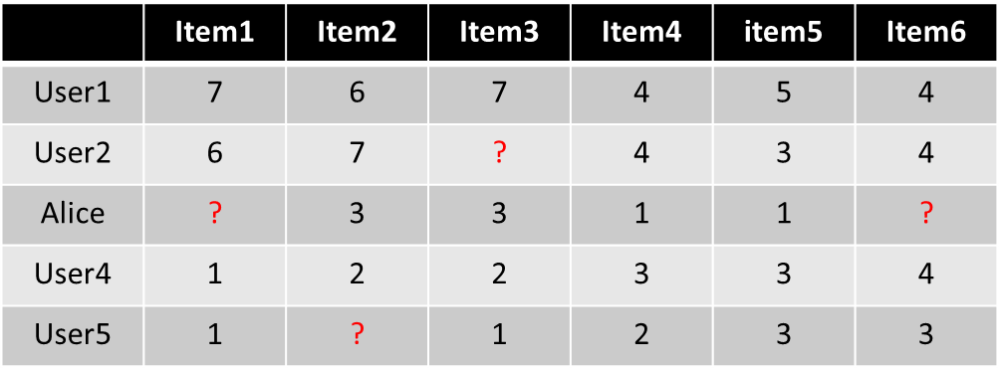
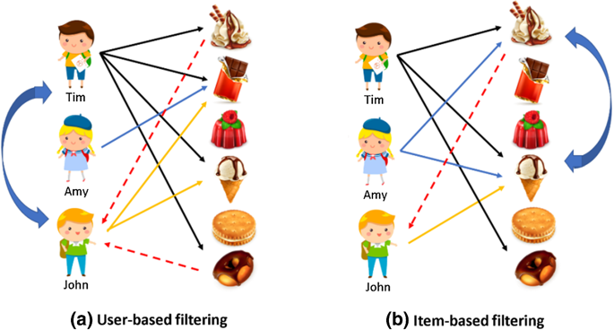
Neighborhood-based CF Approaches
Memory-based algorithms
The earliest algorithms developed for CF
Input
Only a matrix of given user–item ratings
Basic models
User-based models
Similar users have similar ratings on the same item.
Item-based models
Similar items are rated in a similar way by the same user

Slide 4
Neighborhood-based CF Approaches
Memory-based algorithms
The earliest algorithms developed for CF
Input
Only a matrix of given user–item ratings
Basic models
User-based models
Similar users have similar ratings on the same item.
Item-based models
Similar items are rated in a similar way by the same user
Output types
A (numerical) prediction indicating to what degree the current user will like or dislike a certain item
A top-N list of recommended items

Slide 5
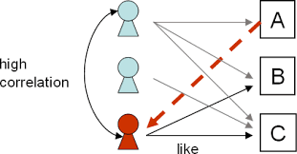
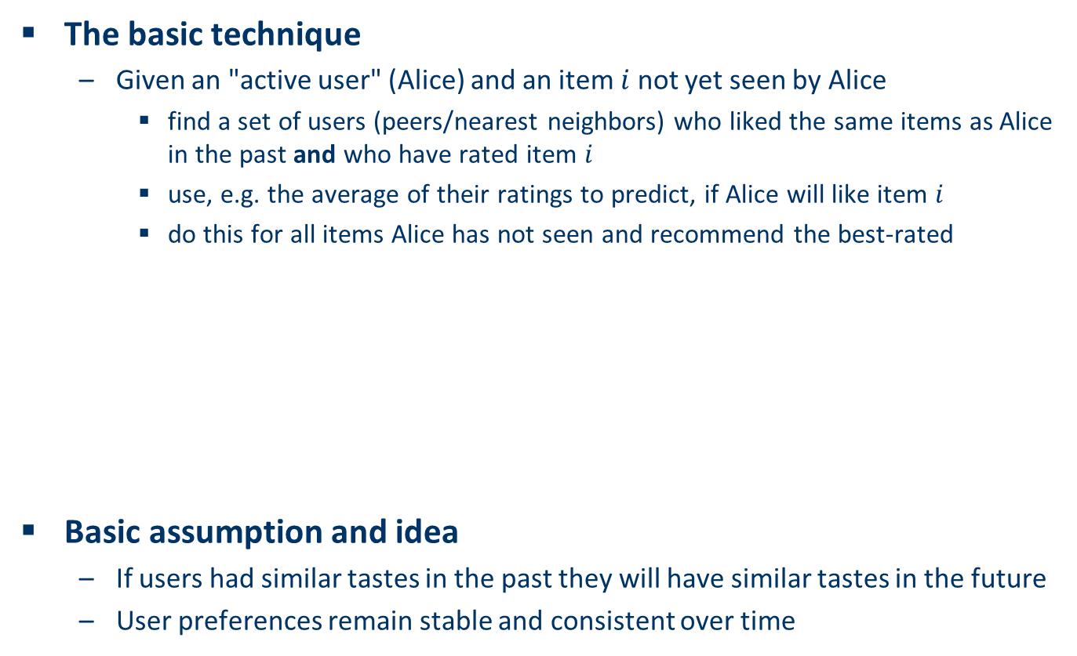
User-based nearest-neighbor collaborative filtering (1)
The basic technique
Given an "active user" (Alice) and an item $i$ not yet seen by Alice
find a set of users (peers/nearest neighbors) who liked the same items as Alice in the past and who have rated item $i$
use, e.g. the average of their ratings to predict, if Alice will like item $i$
do this for all items Alice has not seen and recommend the best-rated
Basic assumption and idea
If users had similar tastes in the past they will have similar tastes in the future
User preferences remain stable and consistent over time
Active user

Slide 6
User-based nearest-neighbor collaborative filtering (2)
Example
A database of ratings of the current user, Alice, and some other users is given:
Determine whether Alice will like or dislike Item1, which Alice has not yet rated or seen
 | Item1 | Item2 | Item3 | Item4 | item5 | Item6
User1 | 7 | 6 | 7 | 4 | 5 | 4
User2 | 6 | 7 | ? | 4 | 3 | 4
Alice | ? | 3 | 3 | 1 | 1 | ?
User4 | 1 | 2 | 2 | 3 | 3 | 4
User5 | 1 | ? | 1 | 2 | 3 | 3

Slide 7
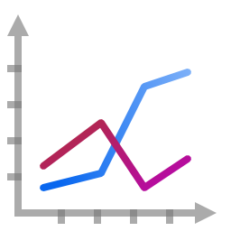
User-based nearest-neighbor collaborative filtering (3)
Some first questions
How do we measure similarity?
How many neighbors should we consider?
How do we generate a prediction from the neighbors' ratings?
 | Item1 | Item2 | Item3 | Item4 | item5 | Item6
User1 | 7 | 6 | 7 | 4 | 5 | 4
User2 | 6 | 7 | ? | 4 | 3 | 4
Alice | ? | 3 | 3 | 1 | 1 | ?
User4 | 1 | 2 | 2 | 3 | 3 | 4
User5 | 1 | ? | 1 | 2 | 3 | 3

Slide 8
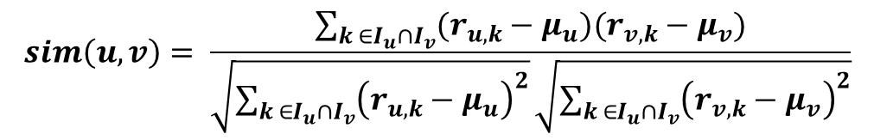

Measuring user similarity (1)
A popular similarity measure in user-based CF: Pearson correlation
u, v : users
$r_{u,i}$ : rating of user $u$ for item $i$
$I_{u}$ : set of items, rated by u
Possible similarity values between $−1$ and $1$
$$sim\left(u,v\right)= \frac{\sum_{k ∈I_{u}∩I_{v}}{(r_{u,k}−μ_{u})(r_{v,k}−μ_{v})}}{\sqrt{\sum_{k ∈I_{u}∩I_{v}}{{\left(r_{u,k}−μ_{u}\right)}^{2}}}\sqrt{\sum_{k ∈I_{u}∩I_{v}}{{\left(r_{v,k}−μ_{v}\right)}^{2}}}}$$

Slide 9
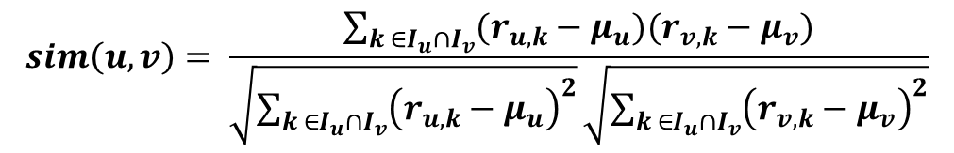
Measuring user similarity (2)
Example
A database of ratings of the current user, Alice, and some other users is given:
 | Item1 | Item2 | Item3 | Item4 | item5 | Item6 | Mean rating | Pearson (i, Alice)
User1 | 7 | 6 | 7 | 4 | 5 | 4 | 5.5 | 0.894
User2 | 6 | 7 | ? | 4 | 3 | 4 | 4.8 | 0.939
Alice | ? | 3 | 3 | 1 | 1 | ? | 2 | 1
User4 | 1 | 2 | 2 | 3 | 3 | 4 | 2.5 | -1.0
User5 | 1 | ? | 1 | 2 | 3 | 3 | 2 | -0.817
$$sim\left(u,v\right)= \frac{\sum_{k ∈I_{u}∩I_{v}}{(r_{u,k}−μ_{u})(r_{v,k}−μ_{v})}}{\sqrt{\sum_{k ∈I_{u}∩I_{v}}{{\left(r_{u,k}−μ_{u}\right)}^{2}}}\sqrt{\sum_{k ∈I_{u}∩I_{v}}{{\left(r_{v,k}−μ_{v}\right)}^{2}}}}$$

Slide 10

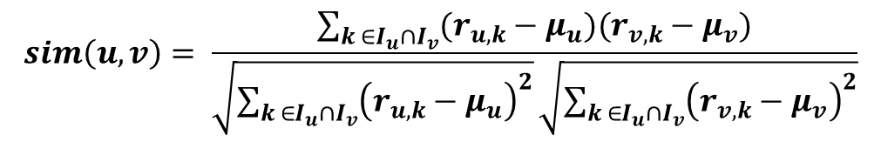
Measuring user similarity (2)
Many implementations of user-based methods compute μ_{u} and μ_{v} in pairwise fashion during the pearson computation
Example
A database of ratings of the current user, Alice, and some other users is given:
 | Item1 | Item2 | Item3 | Item4 | item5 | Item6
User1 | 7 | 6 | 7 | 4 | 5 | 4
User2 | 6 | 7 | ? | 4 | 3 | 4
Alice | ? | 3 | 3 | 1 | 1 | ?
User4 | 1 | 2 | 2 | 3 | 3 | 4
User5 | 1 | ? | 1 | 2 | 3 | 3
(7+4+3)/3
(3+1+1)/3
$$sim\left(u,v\right)= \frac{\sum_{k ∈I_{u}∩I_{v}}{(r_{u,k}−μ_{u})(r_{v,k}−μ_{v})}}{\sqrt{\sum_{k ∈I_{u}∩I_{v}}{{\left(r_{u,k}−μ_{u}\right)}^{2}}}\sqrt{\sum_{k ∈I_{u}∩I_{v}}{{\left(r_{v,k}−μ_{v}\right)}^{2}}}}$$

Slide 11
Measuring user similarity (2)
Many implementations of user-based methods compute μ_{u} and μ_{v} in pairwise fashion during the pearson computation
Example
A database of ratings of the current user, Alice, and some other users is given:
 | Item1 | Item2 | Item3 | Item4 | item5 | Item6
User1 | 7 | 6 | 7 | 4 | 5 | 4
User2 | 6 | 7 | ? | 4 | 3 | 4
Alice | ? | 3 | 3 | 1 | 1 | ?
User4 | 1 | 2 | 2 | 3 | 3 | 4
User5 | 1 | ? | 1 | 2 | 3 | 3
(6+7+4+5)/4
(3+3+1+1)/4
$$sim\left(u,v\right)= \frac{\sum_{k ∈I_{u}∩I_{v}}{(r_{u,k}−μ_{u})(r_{v,k}−μ_{v})}}{\sqrt{\sum_{k ∈I_{u}∩I_{v}}{{\left(r_{u,k}−μ_{u}\right)}^{2}}}\sqrt{\sum_{k ∈I_{u}∩I_{v}}{{\left(r_{v,k}−μ_{v}\right)}^{2}}}}$$

Slide 12
Pearson correlation
Takes differences in rating behavior into account
Works well in usual domains, compared with alternative measures
such as cosine similarity

Slide 13
Neighborhood selection
If we included all users in the neighborhood
negatively influence the performance with respect to the required calculation time.
negatively effect on the accuracy of the recommendation, as the ratings of other users who are not really comparable would be taken into account.
For the calculation of the predictions, we included only those that had a positive correlation with the active user
Common techniques for reducing the size of the neighborhood
define a specific minimum threshold of user similarity
limit the size to a fixed number and to take only the k nearest neighbors into account
An analysis of the MovieLens dataset indicates that “in most real-world situations, a neighborhood of 20 to 50 neighbors seems reasonable”

Slide 14
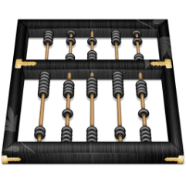
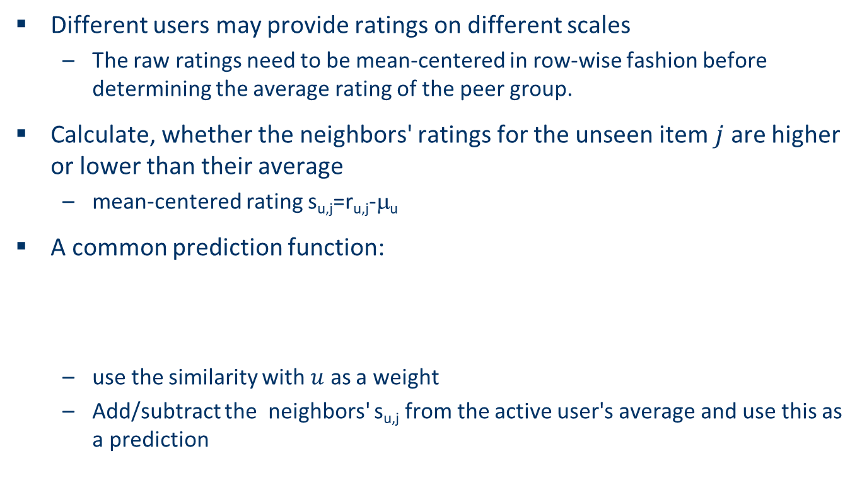
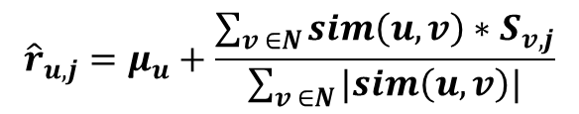
Making predictions
Different users may provide ratings on different scales
The raw ratings need to be mean-centered in row-wise fashion before determining the average rating of the peer group.
Calculate, whether the neighbors' ratings for the unseen item $j$ are higher or lower than their average
mean-centered rating s_{u,j}=r_{u,j}-μ_{u}
A common prediction function:
use the similarity with $u$ as a weight
Add/subtract the neighbors' s_{u,j} from the active user's average and use this as a prediction
$${\hat{r}}_{u,j}=μ_{u}+\frac{\sum_{v ∈N}{sim\left(u,v\right)∗S_{v,j}}}{\sum_{v ∈N}{|sim\left(u,v\right)|}}$$

Slide 15
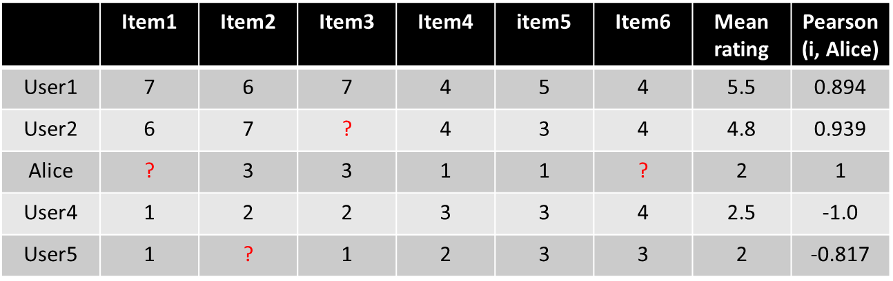
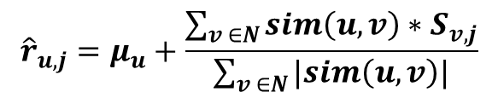
Making predictions
$${\hat{r}}_{u,j}=μ_{u}+\frac{\sum_{v ∈N}{sim\left(u,v\right)∗S_{v,j}}}{\sum_{v ∈N}{|sim\left(u,v\right)|}}$$
Assume the number of neighbors is 2
Pre(a,p)=4 + [0.85*(3-2.25)+0.70*(4-3)]/(0.85+0.70)=4.86
${\hat{r}}_{alice,1}=2+\frac{0.894∗\left(1.5\right)+0.939∗1.2}{0.894+0.939}$=3.35

Slide 16
Making predictions
$${\hat{r}}_{u,j}=μ_{u}+\frac{\sum_{v ∈N}{sim\left(u,v\right)∗S_{v,j}}}{\sum_{v ∈N}{|sim\left(u,v\right)|}}$$
Assume the number of neighbors is 2
Pre(a,p)=4 + [0.85*(3-2.25)+0.70*(4-3)]/(0.85+0.70)=4.86
${\hat{r}}_{alice,1}=2+\frac{0.894∗\left(1.5\right)+0.939∗1.2}{0.894+0.939}$=3.35
${\hat{r}}_{alice,6}=2+\frac{0.894∗\left(−1.5\right)+0.939∗(−0.8)}{0.894+0.939}$=0.86

Slide 17
Practice
Assume k=2
 | Item1 | Item2 | Item3 | Item4 | Item5
Alice | 5 | 3 | 4 | 4 | ?
User1 | 4 | ? | 2 | 3 | 3
User2 | 1 | 5 | 5 | 1 | 3
User3 | 5 | 3 | ? | 5 | 3

Slide 18
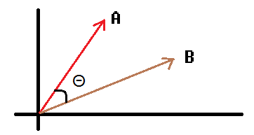

Similarity function variants : cosine similarity measure
Produces better results in item-to-item filtering
Ratings are seen as vector in n-dimensional space
Similarity is calculated based on the angle between the vectors
$$sim\left(\vec{a},\vec{b}\right)=\frac{\vec{a}∙\vec{b}}{\left|\vec{a}\right|∗|\vec{b}|}$$

Slide 19

Measuring user similarity (2)
Example
$$Cosine\left(1,Alice\right)=\frac{6∗3+7∗3+4∗1+5∗1}{\sqrt{6^{2}+7^{2}+4^{2}+5^{2}}∗\sqrt{3^{2}+3^{2}+1^{2}+1^{2}}}$$
Pearson correlation coefficient is much more discriminative and the sign of the coefficient provides information about similarity and dissimilarity
 | Item1 | Item2 | Item3 | Item4 | item5 | Item6 | Cosine (i, Alice) | Pearson (i, Alice)
User1 | 7 | 6 | 7 | 4 | 5 | 4 | 0.956 | 0.894
User2 | 6 | 7 | ? | 4 | 3 | 4 | 0.981 | 0.939
Alice | ? | 3 | 3 | 1 | 1 | ? | 1 | 1
User4 | 1 | 2 | 2 | 3 | 3 | 4 | 0.789 | -1.0
User5 | 1 | ? | 1 | 2 | 3 | 3 | 0.645 | -0.817

Slide 20
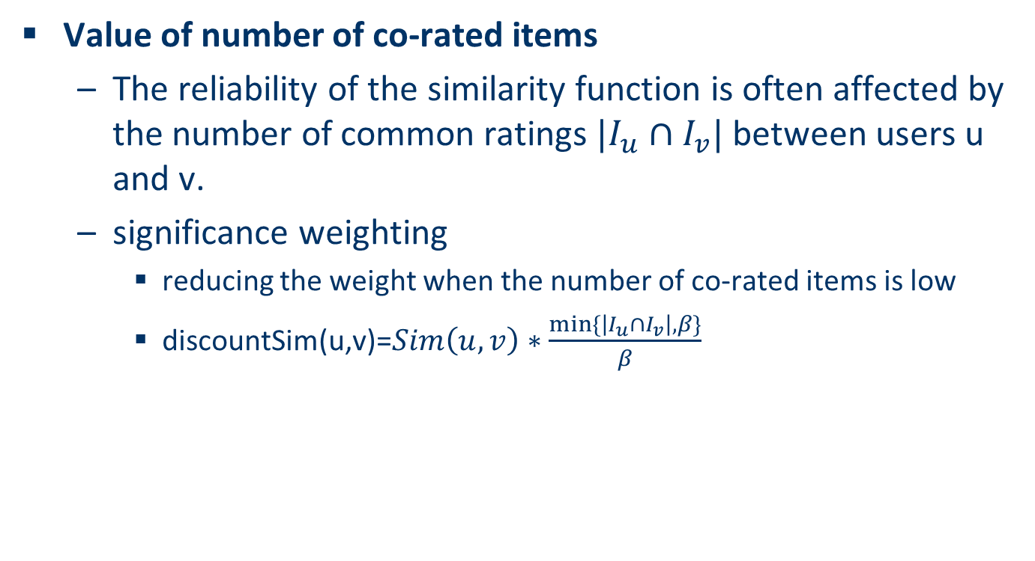
Improving the metrics / prediction function
Value of number of co-rated items
The reliability of the similarity function is often affected by the number of common ratings $|I_{u}∩I_{v}|$ between users u and v.
significance weighting
reducing the weight when the number of co-rated items is low
discountSim(u,v)=$Sim\left(u,v\right)∗\frac{min⁡\{\left|I_{u}∩I_{v}\right|,β\}}{β}$
Discount Sim when the number of common ratings between the two users is less than a particular threshold β

Slide 21

Example
discountSim(u,v)=$Sim\left(u,v\right)∗\frac{min⁡\{\left|I_{u}∩I_{v}\right|,β\}}{β}$
Assume β=5
$0.939∗\frac{min⁡\{3,5\}}{5}$=0.563

Slide 22
Improving the metrics / prediction function
Case amplification
Intuition: Give more weight to "very similar" neighbors, i.e., where the similarity value is close to 1.
Sim(u,v)=Pearson(u,v)^{α}
By choosing α >1, it is possible to amplify the importance of the similarity

Slide 23


Example
Sim(u,v)=Pearson(u,v)^{α}
Assume α=2
$0.939$²=0.7512=0.882
Sim(u,v)=Pearson(u,v)^{α}
Assume α=2
$0.939$²=0.7512=0.882
0.894²=0.799
Before 0.939/(0.939+0.894)=0.512
After 0.882/(0.882+0.799)=0.525

Slide 24
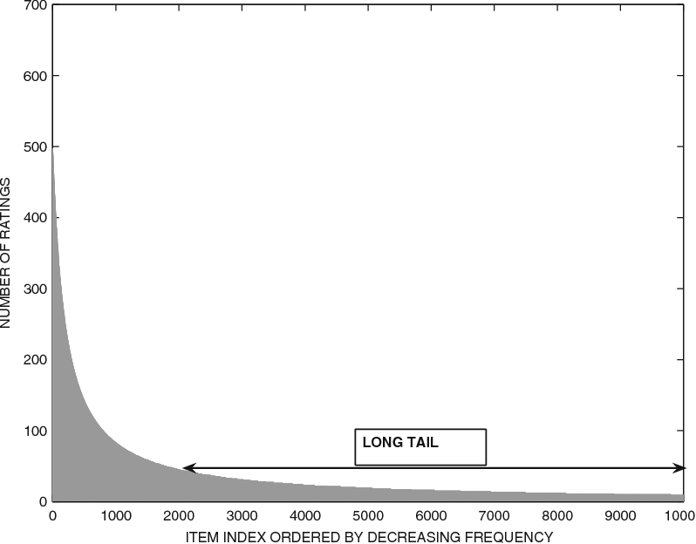
Long tail property
The distribution of ratings among items often satisfies a property in real-world settings : long-tail property
Only a small fraction of the items are rated frequently
This distribution has important implications for the recommendation process
Because of the rarity of observed ratings in the long tail it is generally more difficult to provide robust rating predictions in the long tail
The long tailed distribution implies that the items, which are frequently rated by users, are fewer in number. This fact has important implications for neighborhood based collaborative filtering algorithms because the neighborhoods are often defined on the basis of these frequently rated items.

Slide 25
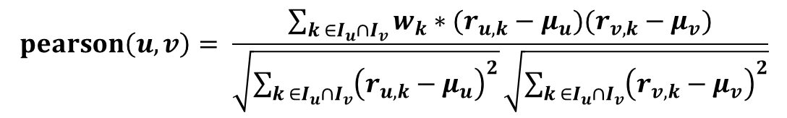
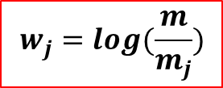
Impact of the long tail
Some movies may be very popular and they may repeatedly occur as commonly rated items by different users. Such ratings can sometimes worsen the quality of the recommendations because they tend to be less discriminative across different users.
This notion is similar in principle to the deterioration in retrieval quality caused by popular and noninformative words (e.g., “a,” “an,” “the”) in document retrieval applications.
Number of users
$$w_{j}=log(\frac{m}{m_{j}})$$
Inverse User Frequency
Number of rating ratings of item j
$$pearson\left(u,v\right)= \frac{\sum_{k ∈I_{u}∩I_{v}}{w_{k}∗(r_{u,k}−μ_{u})(r_{v,k}−μ_{v})}}{\sqrt{\sum_{k ∈I_{u}∩I_{v}}{{\left(r_{u,k}−μ_{u}\right)}^{2}}}\sqrt{\sum_{k ∈I_{u}∩I_{v}}{{\left(r_{v,k}−μ_{v}\right)}^{2}}}}$$

Slide 26
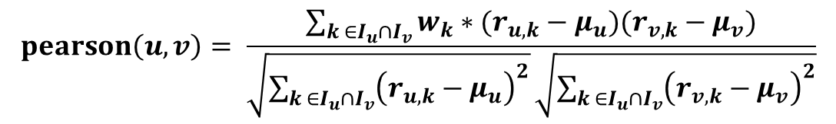

Example
$$w_{j}=log(\frac{m}{m_{j}})$$
$$pearson\left(u,v\right)= \frac{\sum_{k ∈I_{u}∩I_{v}}{w_{k}∗(r_{u,k}−μ_{u})(r_{v,k}−μ_{v})}}{\sqrt{\sum_{k ∈I_{u}∩I_{v}}{{\left(r_{u,k}−μ_{u}\right)}^{2}}}\sqrt{\sum_{k ∈I_{u}∩I_{v}}{{\left(r_{v,k}−μ_{v}\right)}^{2}}}}$$
$$pearson\left(Alice,2\right)= \frac{0.097\left(7−4.8\right)\left(3−2\right)+0\left(4−4.8\right)\left(1−2\right)+0(3−4.8)(1−2) }{\sqrt{3}\sqrt{8.72}}$$
Log(5/4)
=0.097
Log(5/5)
=0
0.097
0.097
0
0.097

Slide 27
Item-based Neighborhood Models
Basic idea:
Use the similarity between items (and not users) to make predictions
Example:
Look for items that are similar to Item5
Take Alice's ratings for these items to predict the rating for Item5
 | Item1 | Item2 | Item3 | Item4 | Item5
Alice | 5 | 3 | 4 | 4 | ?
User1 | 3 | 1 | 2 | 3 | 3
User2 | 4 | 3 | 4 | 3 | 5
User3 | 3 | 3 | 1 | 5 | 4
User4 | 1 | 5 | 5 | 2 | 1

Slide 28

The cosine similarity measure
Produces better results in item-to-item filtering
Ratings are seen as vector in n-dimensional space
Similarity is calculated based on the angle between the vectors
$$sim\left(\vec{a},\vec{b}\right)=\frac{\vec{a}∙\vec{b}}{\left|\vec{a}\right|∗|\vec{b}|}$$

Slide 29
Item-based Neighborhood Models
Adjusted cosine similarity
take average user ratings into account, transform the original ratings
 | Item1 | Item2 | Item3 | Item4 | item5 | Item6 | Mean rating
User1 | 7 | 6 | 7 | 4 | 5 | 4 | 5.5
User2 | 6 | 7 | ? | 4 | 3 | 4 | 4.8
Alice | ? | 3 | 3 | 1 | 1 | ? | 2
User4 | 1 | 2 | 2 | 3 | 3 | 4 | 2.5
User5 | 1 | ? | 1 | 2 | 3 | 3 | 2

Slide 30
Item-based Neighborhood Models
Adjusted cosine similarity
take average user ratings into account, transform the original ratings
 | Item1 | Item2 | Item3 | Item4 | item5 | Item6
User1 | 1.5 | 0.5 | 1.5 | -1.5 | -0.5 | -1.5
User2 | 1.2 | 2.2 | ? | -0.8 | -1.8 | -0.8
Alice | ? | 1 | 1 | -1 | -1 | ?
User4 | -1.5 | -0.5 | -0.5 | 0.5 | 0.5 | 1.5
User5 | -1 | ? | -1 | 0 | 1 | 1

Slide 31

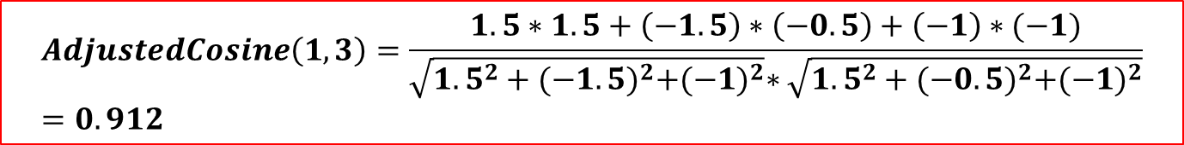
Item-based Neighborhood Models
 | Item1 | Item2 | Item3 | Item4 | item5 | Item6
User1 | 1.5 | 0.5 | 1.5 | -1.5 | -0.5 | -1.5
User2 | 1.2 | 2.2 | ? | -0.8 | -1.8 | -0.8
Alice | ? | 1 | 1 | -1 | -1 | ?
User4 | -1.5 | -0.5 | -0.5 | 0.5 | 0.5 | 1.5
User5 | -1 | ? | -1 | 0 | 1 | 1
$AdjustedCosine\left(i,j\right)=\frac{\sum_{u∈U_{i}∩U_{j}}{S_{ui}∗S_{uj}}}{\sqrt{\sum_{u∈U_{i}∩U_{j}}{s_{ui}^{2}}}∗\sqrt{\sum_{u∈U_{i}∩U_{j}}{s_{uj}^{2}}}}$
U_{i} :the set of users who have specified ratings for item i
$$AdjustedCosine\left(1,3\right)=\frac{1.5∗1.5+\left(−1.5\right)∗\left(−0.5\right)+\left(−1\right)∗(−1)}{\sqrt{{1.5}^{2}+{(−1.5)}^{2}+{(−1)}^{2}}∗\sqrt{{1.5}^{2}+{(−0.5)}^{2}+{(−1)}^{2}}}=0.912$$

Slide 32

Item-based Neighborhood Models
${\hat{r}}_{ut}=\frac{\sum{AdjustedCosine(j,t)}∗r_{ut}}{\sum{|AdjustedCosine\left(j,t\right)|}}$
 | Item1 | Item2 | Item3 | Item4 | item5 | Item6
User1 | 1.5 | 0.5 | 1.5 | -1.5 | -0.5 | -1.5
User2 | 1.2 | 2.2 | ? | -0.8 | -1.8 | -0.8
Alice | ? | 1 | 1 | -1 | -1 | ?
User4 | -1.5 | -0.5 | -0.5 | 0.5 | 0.5 | 1.5
User5 | -1 | ? | -1 | 0 | 1 | 1
Cosine(1,j) | 1 | 0.735 | 0.912 | -0.848 | -0.813 | -0.990
Cosine(6,j) | -0.990 | -0.622 | -0.912 | 0.829 | 0.730 | 1

Slide 33
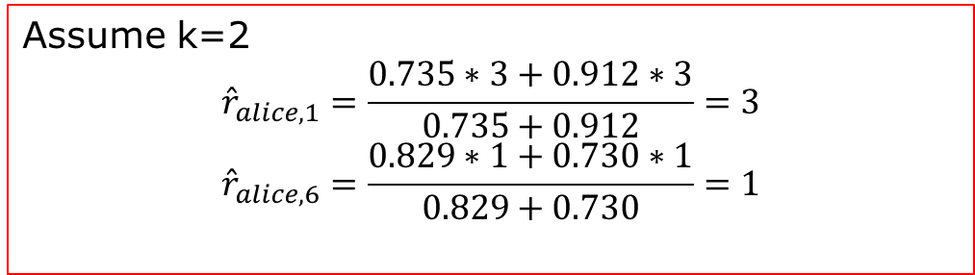
Item-based Neighborhood Models
 | Item1 | Item2 | Item3 | Item4 | item5 | Item6 | Mean rating
Alice | ? | 3 | 3 | 1 | 1 | ? | 2
${\hat{r}}_{ut}=\frac{\sum{AdjustedCosine(j,t)}∗r_{ut}}{\sum{|AdjustedCosine\left(j,t\right)|}}$
 | Item1 | Item2 | Item3 | Item4 | item5 | Item6
User1 | 1.5 | 0.5 | 1.5 | -1.5 | -0.5 | -1.5
User2 | 1.2 | 2.2 | ? | -0.8 | -1.8 | -0.8
Alice | ? | 1 | 1 | -1 | -1 | ?
User4 | -1.5 | -0.5 | -0.5 | 0.5 | 0.5 | 1.5
User5 | -1 | ? | -1 | 0 | 1 | 1
Cosine(1,j) | 1 | 0.735 | 0.912 | -0.848 | -0.813 | -0.990
Cosine(6,j) | -0.990 | -0.622 | -0.912 | 0.829 | 0.730 | 1
Assume k=2
$${\hat{r}}_{alice,1}=\frac{0.735∗3+0.912∗3}{0.735+0.912}=3$$
$${\hat{r}}_{alice,6}=\frac{0.829∗1+0.730∗1}{0.829+0.730}=1$$

Slide 34
Practice
Assume k=2
 | Item1 | Item2 | Item3 | Item4 | Item5
Alice | 5 | 3 | 4 | 4 | ?
User1 | 3 | ? | 2 | 4 | 3
User2 | 1 | 4 | 4 | 2 | 4
User3 | 5 | 3 | 4 | 5 | 3

Slide 35
Efficient Implementation and computational complexity
Neighborhood-based methods are always used to determine the best item recommendations for a target user or the best user recommendations for a target item.
A straightforward approach is to compute all possible rating predictions for the relevant user-item pairs (e.g., all items for a particular user) and then rank them.
It is important to observe that the prediction process for many user-item combinations reuses many intermediate quantities.
have an offline phase to store these intermediate computations and then leverage them in the ranking process.

Slide 36
Pre-processing for item-based filtering
Item-based filtering does not solve the scalability problem itself
Pre-processing approach by Amazon.com (in 2003)
Calculate all pair-wise item similarities in advance
The neighborhood to be used at run-time is typically rather small, because only items are taken into account which the user has rated
Item similarities are supposed to be more stable than user similarities

Slide 37
Efficient Implementation and computational complexity
Neighborhood-based methods are always partitioned into an offline phase and an online phase. In the offline phase, the user-user (or item-item) similarity values and peer groups of the users (or items) are computed.
n items
Let n′ ≪ n be the maximum number of specified ratings of a user (row)
m′ ≪ m be the maximum number of specified ratings of an item (column).
*
*
*
* * * * *
n’
m users
m’
Compute two users’ similarity : O(n’)
Compute two items’ similarity : O(m’)

Slide 38
Efficient Implementation and computational complexity
Compute two users’ similarity : O(n’)
Compute two items’ similarity : O(m’)
n items
*
*
*
* * * * *
n’
m users
user-based methods
compute the peer group of a target user : O(m·n′)
the offline running time for computing the peer groups of all users is given by O(m² · n′).
item-based methods
the corresponding offline running time is given by O(n² · m′).
m’

Slide 39
Efficient Implementation and computational complexity
user-based methods
compute the peer group of a target user : O(m·n′)
the offline running time for computing the peer groups of all users is given by O(m² · n′).
item-based methods
the corresponding offline running time is given by O(n² · m′).
n items
*
*
*
* * * * *
n’
m users
m’
The space requirements
user-based methods :O(m²)
item-based methods :O(n²)
Because the number of users is typically greater than the number of items (m > n), the space requirements of user-based methods are generally greater than
those of item-based methods.

Slide 40
Comparing User-Based and Item-Based Methods
Item-based methods often provide more relevant recommendations
because of the fact that a user’s own ratings are used to perform the recommendation
item-based methods are more stable with changes to the ratings
the number of users is generally much larger than the number of items. In such cases, two users may have a very small number of mutually rated items, but two items are more likely to have a larger number of users who have co-rated them.
new users are likely to be added more frequently in commercial systems than new items. In such cases, the computation of neighborhood items can be done only occasionally because item neighborhoods are unlikely to change drastically with the addition of new users.

Slide 41
Strengths and Weaknesses of Neighborhood-Based Methods
Adv
easy to implement and debug.
easy to justify why a specific item is recommended
the recommendations are relatively stable
Disadv
offline phase can sometimes be impractical in large-scale settings
user-based method requires at least O(m²) time and space. This might sometimes be too slow or space-intensive with desktop hardware, when m is of the order of tens of millions
Their limited coverage because of sparsity.
For example, if none of John’s nearest neighbors have rated Terminator, it is not possible to provide a rating prediction of Terminator for John.

