Slide 1

B.TECH. · BCSE497J — PROJECT-I · COMPUTER SCIENCE AND ENGINEERING
System and Method for Counterfactual-Driven Adaptive Security Control and Verified Model Updating in Edge-Deployed Digital Twins for Consumer Internet of Things Networks
TEAM MEMBERS
ATRIK (23BAI0136)
T V SAI SUSANTH (23BCI0231)
PUSHPAK (23BCT0129)
FACULTY GUIDE
Dr. JIM SOLOMON RAJA
Employee ID: 22533 — SCOPE
School of Computer Science and Engineering
Vellore Institute of Technology, Vellore
Review-3 · 28 October 2026 · Fall Semester 2026–2027

Slide 2
REVIEW-3
Approval Mail From Guide
Approval for the following aspects was obtained from the project guide by e-mail before 21-10-2026. All points raised have been addressed and updated by the project team.
● Project title — Retained as filed in the patent application; no change requested.
● Problem statement and objectives — Seven objectives, O1–O6 complete, O7 delivered in Phase II.
● Architecture and modules — Eleven-module pipeline and the edge-node block diagram approved.
● Results and validation — 13 of 13 validation decisions verified in a live demonstration.
● Outcome — Patent route confirmed in place of conference or journal publication.
Approval mail — screenshot
Paste the guide's approval e-mail here before the review. Keep the sender address, subject line and date visible in the capture.
Status
Approved · all review points closed
2
28/10/26 SCOPE

Slide 3
OBJECTIVE OF THE WORK
Aim
To decide whether a retraining update for an edge-deployed IoT threat detector is safe to accept before it is accepted — by testing what the update would do to futures the system committed to in advance, rather than by testing what the update looks like.
Predict
Mirror every device with a holographic digital twin and commit 20 counterfactual futures before the observation that will judge them exists.
Validate
Graft each update onto a trusted core, train a shadow model, and score it on six weighted components against the committed futures.
Immunize
Synthesise vaccine rows from those same futures so resistance to a poisoning strategy exists before the strategy is ever attempted.
Self-heal
Restore the last trusted model and purge the offending contributor's rows if degradation occurs despite the gate.
Deliverable: a working edge-gateway console in which all twelve stages of this cycle are operator-driven, inspectable and reproducible, on simulated devices and on live USB hardware alike.
3
28/10/26 SCOPE

Slide 4
SUMMARY
Abstract
Consumer IoT networks are increasingly defended by AI models that run on a local edge gateway and retrain continuously on the telemetry they collect. That retraining keeps the detector current — and is also its most exposed surface: an adversary who can introduce falsified or mislabelled training data can steer the model into accepting hostile behaviour as ordinary.
Existing poisoning defences are reactive. Anomaly filtering, trust and reputation scoring and robust aggregation each inspect a contribution only after submission, and judge it only against present or historical observations — so a contribution engineered to resemble ordinary traffic passes unchallenged.
This project develops a proactive alternative. Every device is mirrored by a holographic digital twin that models it as five behavioural planes and commits in advance to twenty counterfactual futures. An incoming update is grafted onto a trusted core, a shadow model is trained, and its behaviour on that audit bank yields a Counterfactual Consistency Score judged against a threshold calibrated from honest traffic on that specific fleet.
The framework is implemented end to end and evaluated on a simulated eight-device network and on live USB hardware against five poisoning strategies, including clean-label poisoning that carries no label shift and is therefore invisible to distributional defences.
The core idea
Judge an update by its consequence on committed futures, not by its resemblance to the present.
0.9565
Detection accuracy
13 / 13
Correct decisions
0.9736
Poison resistance
Keywords — Digital Twin · Counterfactual Validation · Model Poisoning · Edge AI · Consumer IoT Security · Predictive Immunization · Self-Healing Systems
4
28/10/26 SCOPE

Slide 5
PRIOR WORK
Literature Review
Work | Contribution | Limitation for this problem
Alcaraz & Lopez, 2022 IEEE COMST | Comprehensive survey of digital-twin security threats. | Treats the twin as an asset to protect, never as a validator.
Tian et al., 2022 ACM Comput. Surv. | Taxonomy of poisoning attacks and countermeasures. | Every countermeasure surveyed acts after submission.
Nguyen et al., 2019 ICDCS — DÏoT | Federated self-learning anomaly detection for IoT. | Aggregation assumes most contributors are honest.
Shafahi et al., 2018 NeurIPS — Poison Frogs | Clean-label poisoning with no label shift at all. | Defeats the whole family of distributional defences.
Fung et al., 2020 RAID | Limits of federated learning under Sybil pressure. | Identifies the failure; proposes no forward-looking gate.
Sulem et al., 2022 arXiv:2203.11103 | Counterfactual explanations for time-series anomalies. | Explains a past decision; does not gate a future one.
Reading across the field: digital twins are used for monitoring, counterfactuals for explanation, and poisoning defences for filtering — but no work joins them into a decision mechanism that validates a model update against futures committed before the update existed.
5
28/10/26 SCOPE

Slide 6
WHAT IS MISSING
Research Gap
● G1 Validation against the current state only. Trust, reputation and robust aggregation compare an update with the present or the past. None tests it against where the device is expected to go next.
● G2 Twins and counterfactuals are never combined. Each has been applied separately; neither has been joined into a gate on model updates.
● G3 Attack simulation does not close the loop. Simulation measures accuracy, then stops. It is rarely carried on to synthesise training rows and retrain.
● G4 Twins monitor rather than immunize. Twin research targets visualisation and fault prediction, not active prediction of behaviour under attack.
● G5 Detection remains reactive. Attack → collect → detect → alert. Prediction is seldom tied to proactive adaptation at the edge.
● G6 Clean-label poisoning passes everything. Defences that filter on label distribution cannot see an attack that alters no label.
● G7 Retraining forces a security trade-off. Frequent retraining adapts but widens exposure; infrequent is safer but stale. Choosing a frequency resolves neither.
● G8 Recovery is manual and total. Restoring a clean model is an operator task, and the usual remedy discards the entire training pool.
Stated as one gap: there is no integrated framework that uses counterfactual twin states to validate machine-learning updates against multiple plausible future behaviours, quarantines the inconsistent ones, and proactively immunizes the edge model against threats it has not yet met.
6
28/10/26 SCOPE

Slide 7
SEVEN, EACH WITH A GATE
Objectives
# | Objective | Gap | Measurable criterion | Status
O1 | Simulate a heterogeneous consumer IoT fleet and an on-demand edge gateway. | G4 | Six device types separable on baseline | Complete
O2 | Build a holographic twin per device across five behavioural planes. | G4 | Zero false flags on healthy traffic | Complete
O3 | Commit counterfactual futures before the observation they judge exists. | G1 | 20 futures × 5-tick horizon, in advance | Complete
O4 | Design a Counterfactual Consistency Score gating every retraining update. | G2 | Separation of honest from poisoned scores | Complete
O5 | Detect clean-label poisoning carrying no label shift. | G6 | Quarantined at label shift below 0.10 | Complete
O6 | Immunize the detector against synthesised poisoning before real attacks. | G3 | Resistance measured across five strategies | Complete
O7 | Benchmark against reactive baselines across poisoning rates. | G1 | Attack success rate vs. each baseline | Phase II
Sustainable Development Goals
SDG 9 — Industry, Innovation and Infrastructure · SDG 11 — Sustainable Cities and Communities · SDG 16 — Peace, Justice and Strong Institutions
Outcome identified
PATENT — Indian Patent Application filed for the counterfactual-driven adaptive security control method.
7
28/10/26 SCOPE

Slide 8
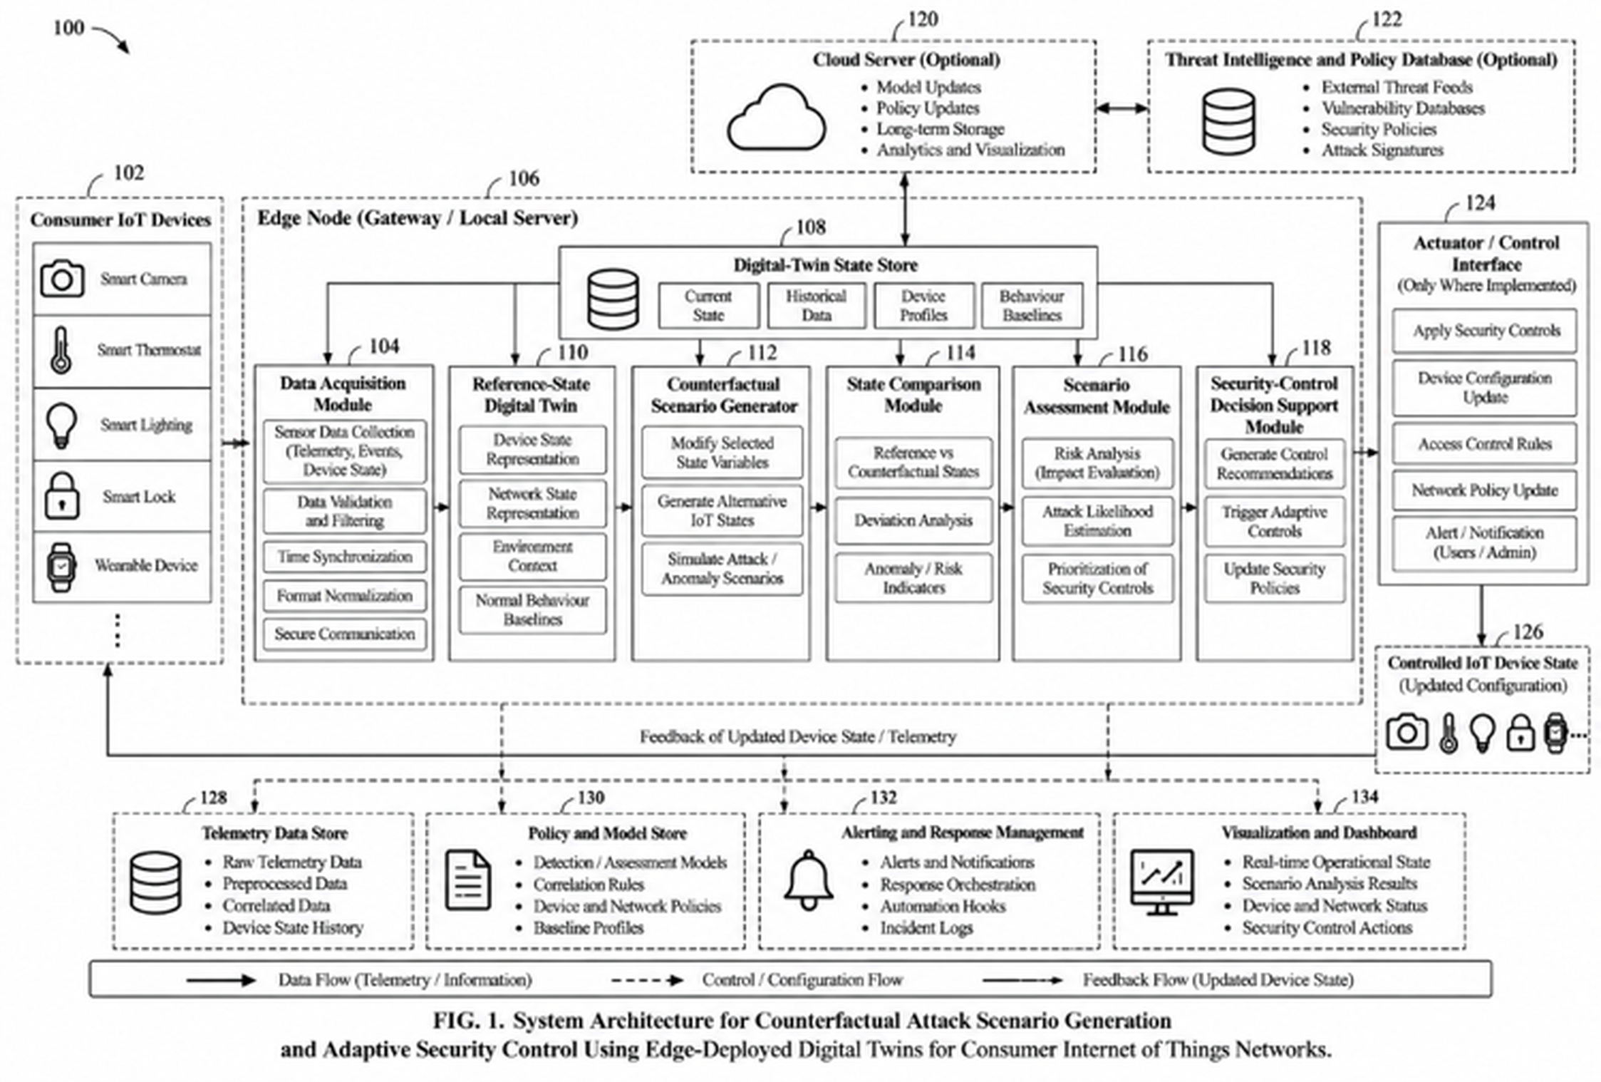
SYSTEM ARCHITECTURE
Framework / Architecture / Block Diagram
102 Consumer IoT devices — camera, thermostat, lighting, lock, wearable.
106 Edge node: the gateway where every decision is taken.
108 Digital-twin state store — current, historical, profiles, baselines.
112 Counterfactual scenario generator: the committed futures.
116 Scenario assessment — risk, likelihood, prioritisation.
118 Security-control decision support and policy update.
8
28/10/26 SCOPE

Slide 9
FR-01 TO FR-10
Functional Requirements
● FR-01 Device simulation. Continuous sixteen-feature telemetry for six device types, deformable by a named attack class on demand.
● FR-02 On-demand ingestion. The gateway collects, timestamps and buffers telemetry only when an operator requests a tick.
● FR-03 Twin synchronisation. Each twin updates its five-plane state from trusted telemetry and refuses any observation judged hostile.
● FR-04 Future commitment. Every ready twin commits twenty trajectories over a five-tick horizon before the judging observation exists.
● FR-05 Threat detection. Classify normal traffic and six attack classes, returning class, confidence and an operator-facing risk level.
● FR-06 Counterfactual validation. Score every update on six weighted components against the audit bank, versus a fleet-calibrated threshold.
● FR-07 Operator control. Apply accept or quarantine only on explicit instruction; allow override in either direction and record it.
● FR-08 Quarantine ledger. Retain quarantined updates intact with id, source, strategy, score and timestamp, and allow rescoring.
● FR-09 Predictive immunization. Synthesise vaccine rows from committed futures and measure poison resistance across five strategies.
● FR-10 Guarded promotion. Promote a candidate only if accuracy, resistance, false-positive rate and pool size all pass; else roll back.
9
28/10/26 SCOPE

Slide 10
ELEVEN PACKAGES, ONE STAGE EACH
Modules
Module | Responsibility | Key artefact
simulator | Six device profiles, per-attack deformations and the labelled corpus generator. | SimulatedDevice
live | Real USB peripherals via Windows PnP; host telemetry via psutil. | UsbMonitor, HostSampler
twin | Five planes, a ridge vector-autoregressive forward model and committed futures. | HolographicTwin
detection | Feature engineering and the edge threat classifier. | ThreatDetector
counterfactual | The audit bank and the Counterfactual Consistency Score. | CounterfactualValidator
poisoning | Five poisoning strategies used to test the defence. | PoisonForge
immunization | Predictive vaccines and poison-resistance measurement. | ImmunizationEngine
quarantine | Holding, dissecting, releasing and rescoring updates. | QuarantineZone
retraining | Validated safe pool, promotion gates and versioned registry. | SecureRetrainer
selfheal | Model/twin agreement monitoring, rollback and purge. | SelfHealingMonitor
server | Operator console, JSON API, accounts, sessions and the audit database. | pages.py, auth.py, db.py
Why the boundaries matter: no module reaches across more than one boundary, which is what lets the simulated fleet and the live USB sampler be swapped for one another without any stage above Step 1 being aware of the change.
10
28/10/26 SCOPE

Slide 11
EIGHT-DEVICE FLEET, SEED 1337
Experiments and Results
0.9565
Detection accuracy
0.0307
False-negative rate
0.8568
Calibrated accept gate
13 / 13
Correct decisions
0.9736
Poison resistance
VALIDATION DECISIONS — 13 SUBMITTED, 1 HONEST
LIVE USB HARDWARE vs. SIMULATED FLEET
Crafted as | CCS | Gate | Decision
Honest contribution | 0.910 | 0.857 | ACCEPTED
Label flipping | 0.629 | 0.857 | QUARANTINED
Gradual poisoning | 0.801 | 0.857 | QUARANTINED
Backdoor trigger | 0.659 | 0.857 | QUARANTINED
Sybil flood (8 shards) | 0.677–0.730 | 0.907 | QUARANTINED
Clean-label poisoning | 0.735 | 0.907 | QUARANTINED
Metric | Live USB | Simulated
Accuracy | 0.9962 | 0.9565
Macro F1 | 0.9961 | 0.9564
False-positive rate | 0.0000 | 0.0488
False-negative rate | 0.0029 | 0.0307
Validation decisions | 13 of 13 | 13 of 13
Clean-label is the decisive row. Its label mix barely moves, so every distributional check admits it; it is caught only by cross-checking its labels against the trusted model's own reading of its rows. Sybil shards face a 0.907 gate rather than 0.857 because the burst of unseen contributor identities triggers the novelty penalty.
Read the live column carefully: it reflects an easier problem, not a better model — USB peripherals all sample one host, so their baselines nearly coincide and the class overlap of the mixed fleet disappears.
11
28/10/26 SCOPE

Slide 12
WHERE IT LANDS
Conclusion and Future Work
Existing defences judge an incoming contribution by how closely it resembles the others — a question about the present and the past, which an attacker answers by staying close to the crowd. This framework asks instead what accepting the update would cost the system's ability to detect tomorrow's attack.
FUTURE WORK
● Deployment against genuine networked IoT hardware with its own address, removing the host-attribution assumption.
● Extension of the poisoning taxonomy, and an adaptive adversary that knows the Consistency Score itself.
● A learned strategy attributor in place of the rule-based one.
● Evaluation across cooperating gateways, sharing the counterfactual bank without sharing telemetry.
CONTRIBUTIONS
● A validation mechanism that judges an update by its effect on futures committed before the update existed.
● A six-component Consistency Score in which each term closes a hole the others leave open.
● Run-time threshold calibration that adapts the gate to the deployed fleet rather than to a fixed constant.
● A predictive immunization engine that inoculates the edge model against poisoning it has not yet met.
● An operator console in which every stage is a deliberate, inspectable action with declared prerequisites.
Independent of its data source
Real USB peripherals were enrolled through the identical twelve stages, with the provenance of all sixteen features declared and the two unobtainable ones reported missing rather than fabricated.
The framework establishes that counterfactual consequence is a usable and discriminating basis for deciding whether to accept a model update at the edge — and that the decision can be taken on hardware a household already owns.
12
28/10/26 SCOPE

Slide 13
REVIEW-3 DELIVERABLE
Outcome Achieved
PATENT
Indian Patent Application — “System and Method for Counterfactual-Driven Adaptive Security Control and Verified Model Updating in Edge-Deployed Digital Twins for Consumer Internet of Things Networks”
Application
Indian Patent Application
filed at the Indian Patent Office
Status
FILED
awaiting publication
Inventors
Three student inventors
with the project guide
Artefact
Complete specification,
claims and Fig. 1
WHY THE PATENT ROUTE
● The contribution is a method, not a measurement — a decision mechanism that can be claimed.
● The committed-futures invariant is implementable on any edge gateway, independent of the model family.
● A filed application secures priority on the mechanism while Phase II benchmarking continues.
Proof of outcome — to upload
Patent filing receipt / acknowledgement screenshot to be uploaded on or before 27 Oct 2026 at the link circulated with the Review-3 template.
13
28/10/26 SCOPE

Slide 14
IEEE FORMAT
References
[1] C. Alcaraz and J. Lopez, “Digital twin: A comprehensive survey of security threats,” IEEE Commun. Surveys Tuts., vol. 24, no. 3, pp. 1475–1503, 2022.
[2] Z. Tian, L. Cui, J. Liang, and S. Yu, “A comprehensive survey on poisoning attacks and countermeasures in machine learning,” ACM Comput. Surv., vol. 55, no. 8, pp. 1–35, 2022.
[3] R. Yang, H. He, Y. Wang, Y. Qu, and W. Zhang, “Dependable federated learning for IoT intrusion detection against poisoning attacks,” Computers & Security, vol. 132, art. 103381, 2023.
[4] T. D. Nguyen et al., “DÏoT: A federated self-learning anomaly detection system for IoT,” in Proc. IEEE ICDCS, Dallas, TX, USA, 2019, pp. 756–767.
[5] D. Sulem et al., “Diverse counterfactual explanations for anomaly detection in time series,” arXiv:2203.11103, 2022.
[6] A. Shafahi et al., “Poison frogs! Targeted clean-label poisoning attacks on neural networks,” in Adv. Neural Inf. Process. Syst. (NeurIPS), 2018.
[7] E. Bagdasaryan, A. Veit, Y. Hua, D. Estrin, and V. Shmatikov, “How to backdoor federated learning,” in Proc. AISTATS, 2020, pp. 2938–2948.
[8] V. Tolpegin, S. Truex, M. E. Gursoy, and L. Liu, “Data poisoning attacks against federated learning systems,” in Proc. ESORICS, 2020, pp. 480–501.
[9] C. Fung, C. J. M. Yoon, and I. Beschastnikh, “The limitations of federated learning in Sybil settings,” in Proc. RAID, 2020, pp. 301–316.
[10] M. Antonakakis et al., “Understanding the Mirai botnet,” in Proc. 26th USENIX Security Symp., 2017, pp. 1093–1110.
14
28/10/26 SCOPE

