Slide 1
Feature Engineering - Questions? Comments?
Time to Hack.
S. Charlie Dey Texas Advanced Computing Center charlie@tacc.utexas.edu | Susan Lindsey Texas Advanced Computing Center slindsey@tacc.utexas.edu

Slide 2
What is it
🔹 Definition
Feature engineering is the process of transforming raw data into meaningful inputs (features) that machine learning models can understand.

Slide 3
What is it
🔹 Why it matters
The quality of your features often matters more than the choice of algorithm.
A well-chosen feature can reveal hidden patterns, making the model smarter and more accurate.

Slide 4
What is it
🔹 Analogy
Imagine you’re predicting whether a football - uhem soccer - player will score.
Raw data might be: player’s speed, accuracy, team name, jersey number, last game date.
After feature engineering, useful features might be: average points per game, shooting percentage in the last 5 games, fatigue level, opponent’s defense rating.
Same raw data, but better structured information.

Slide 5
Key Types of Feature Engineering
Cleaning – Fixing missing values, removing duplicates, converting data types.
Transformation – Scaling numbers, normalizing values, encoding categorical data.
Creation – Making new features from old ones.
Example: from “Published Date” you can create “Hour of Day,” “Day of Week,” “ "Is Weekend.”
Selection – Choosing the most important features to avoid noise.

Slide 6
In a nutshell
Feature engineering is how we turn messy real-world data into the smart signals that help AI make better predictions. It’s less about magic algorithms and more about asking the right questions of your data.

Slide 7
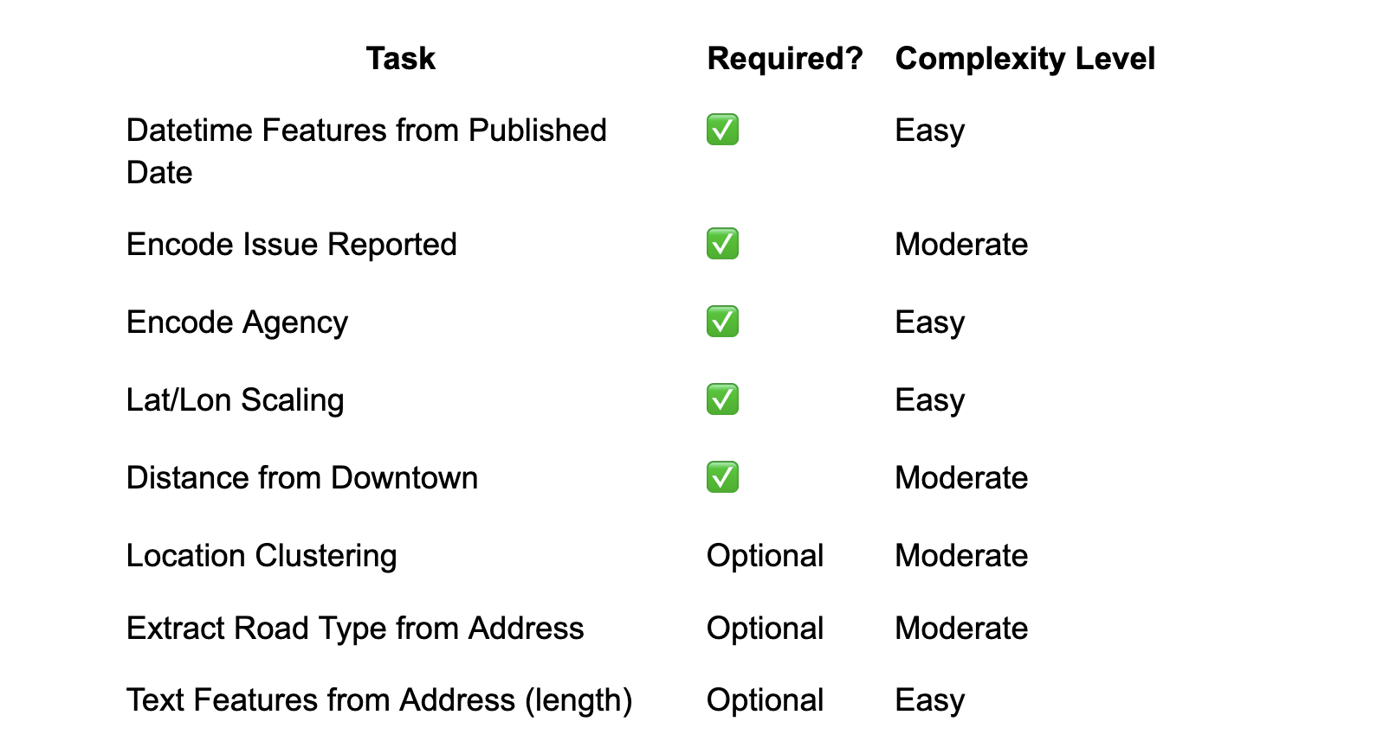
Useful Engineering Features

Slide 8
🎯 Why Engineer Datetime Features from Published Date?
Raw Column:
Column Name | Example Value | Problem with Raw Form
Published Date | 2025-08-03 14:30:00 | A raw timestamp is meaningless to ML models

Slide 9
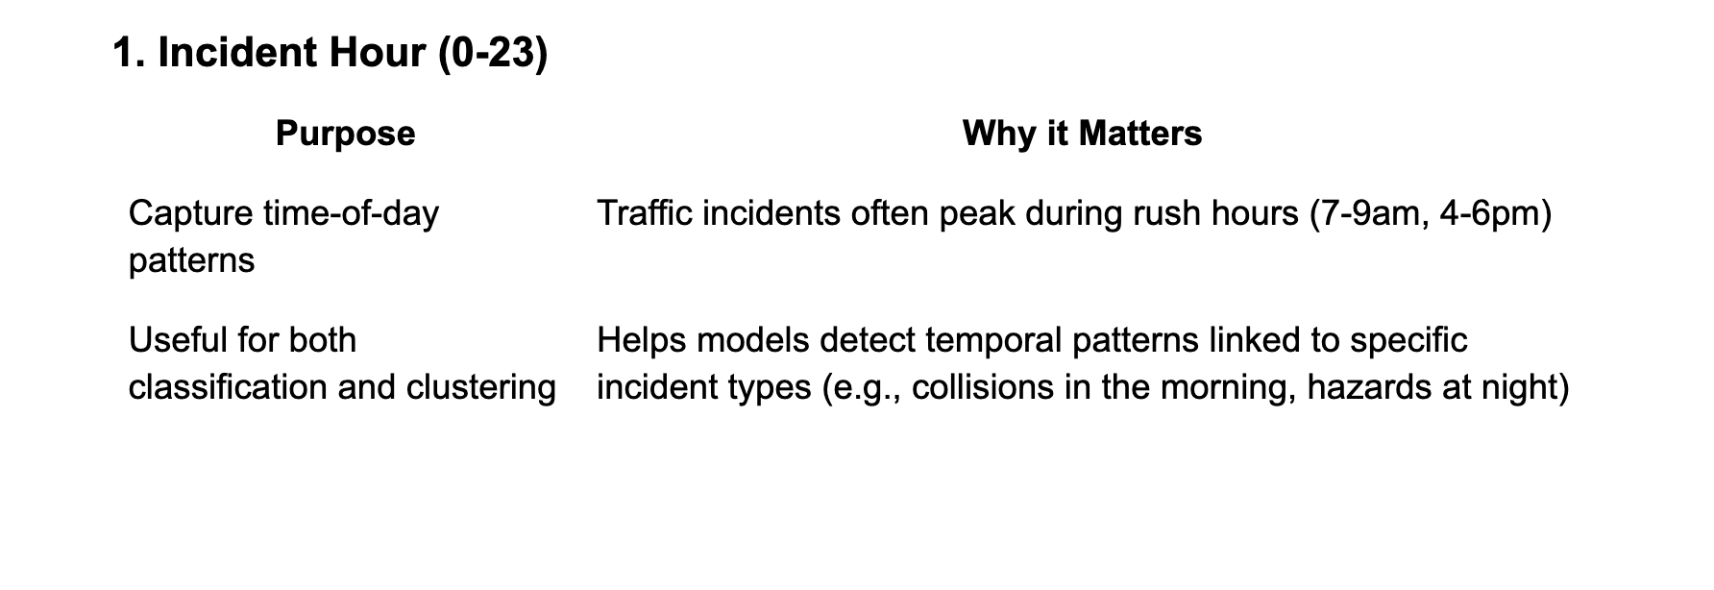
🌟 Transformations & Their Purpose:

Slide 10
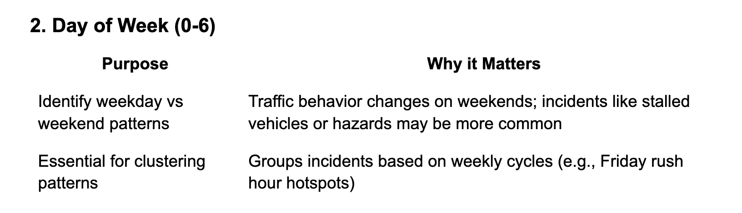
🌟 Transformations & Their Purpose:

Slide 11
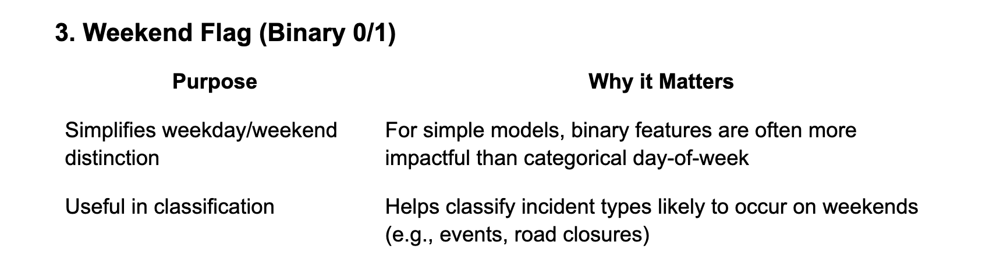
🌟 Transformations & Their Purpose:

Slide 12
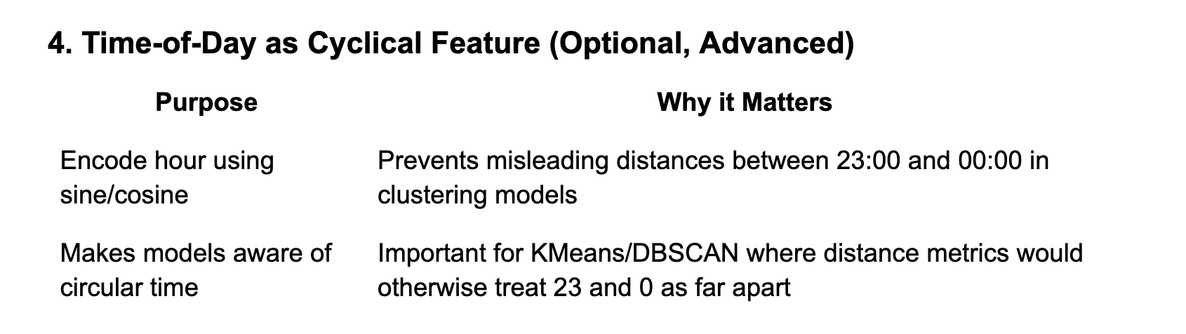
🌟 Transformations & Their Purpose:

Slide 13
🧠 High-Level Why:
Traffic incidents are inherently temporal. Patterns in collisions, hazards, and stalled vehicles follow time-of-day and day-of-week rhythms.
Machine Learning models don't understand timestamps. They need explicit numerical or categorical features representing patterns (e.g., rush hours, weekends).
For Clustering, time-of-day and day-of-week help reveal "incident patterns" that are spatial-temporal:
Where and when do collisions spike?
Are stalled vehicles more common on weekends?
For Classification, datetime-derived features add valuable predictive signals:
If it’s Friday 5 PM, there’s a higher chance it’s a collision.
If it’s Sunday afternoon, it might be a hazard or road closure.

Slide 14
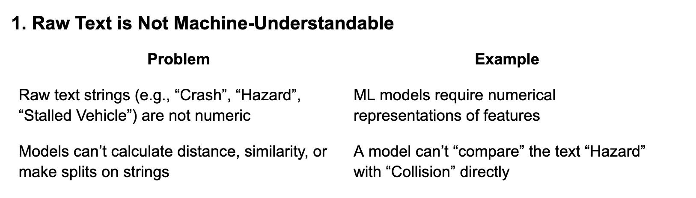
📝 Why We Need to Encode Issue Reported

Slide 15
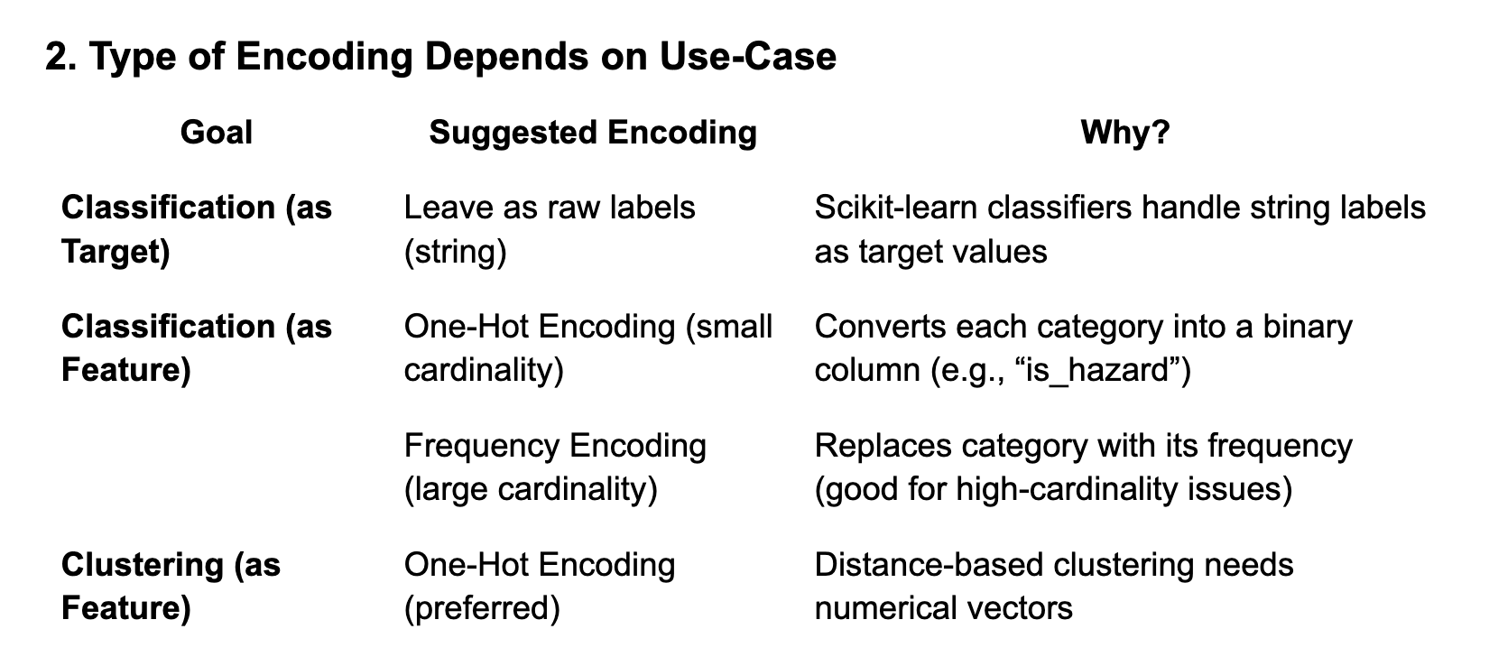
📝 Why We Need to Encode Issue Reported

Slide 16
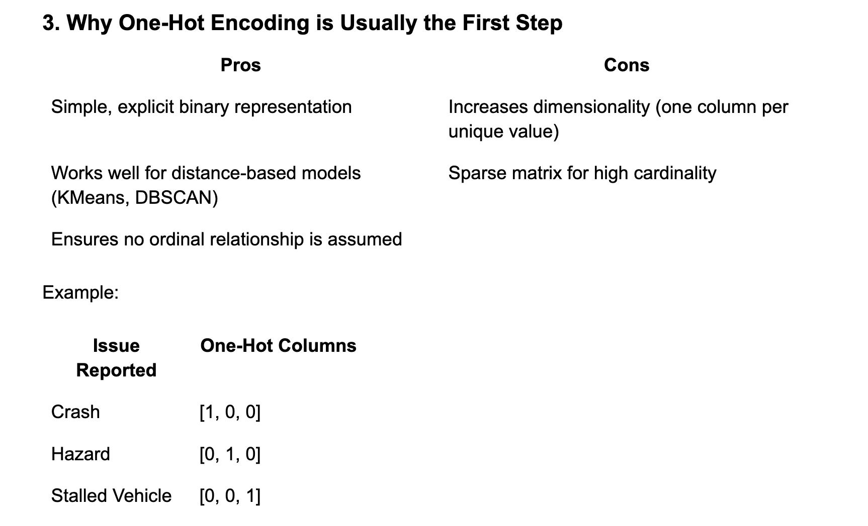
📝 Why We Need to Encode Issue Reported

Slide 17
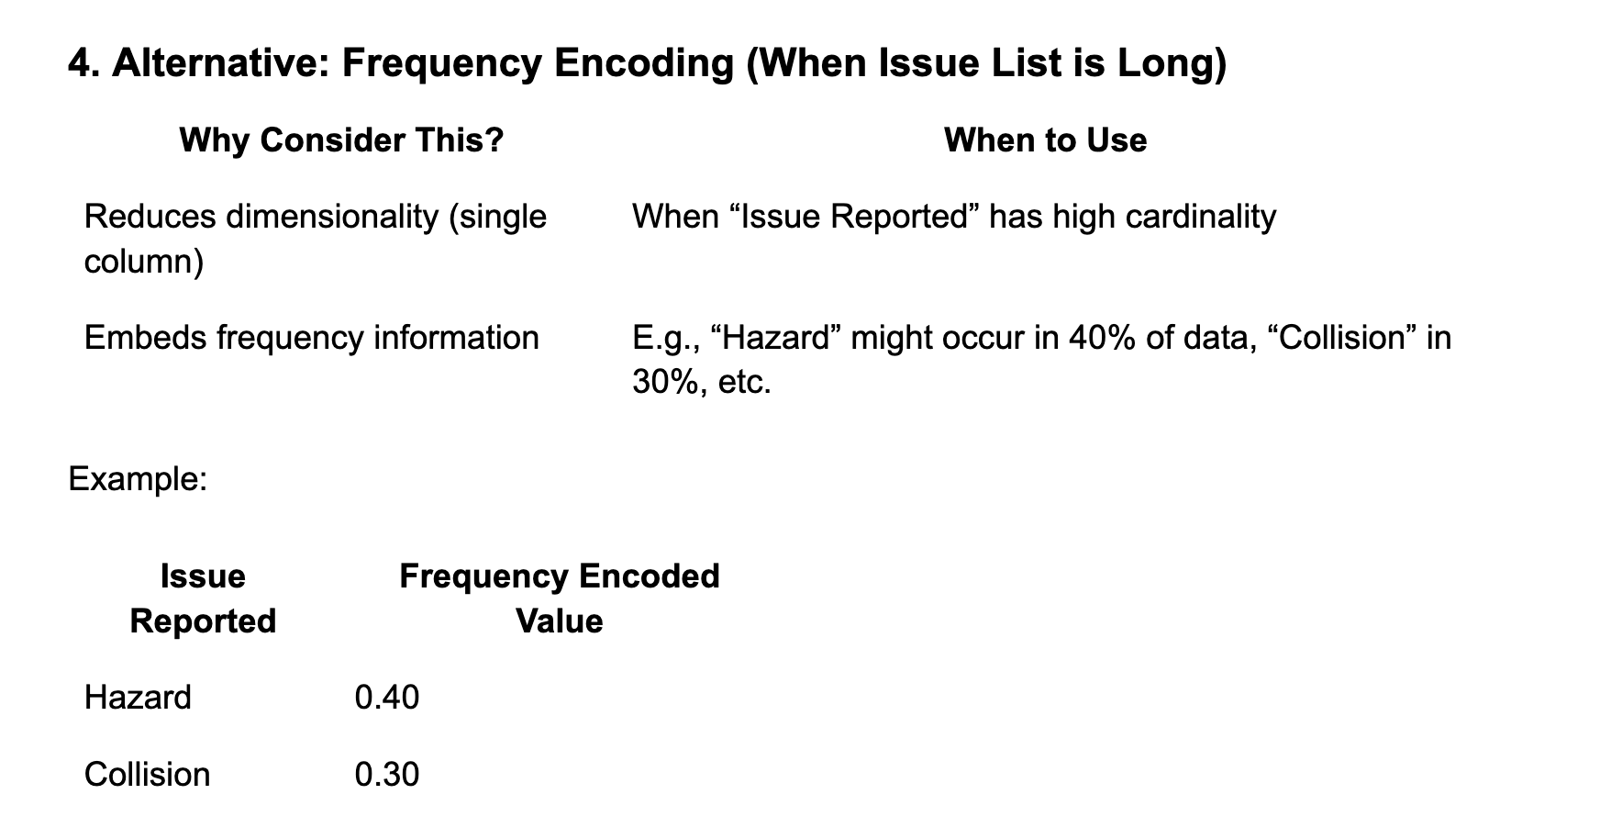
📝 Why We Need to Encode Issue Reported

Slide 18
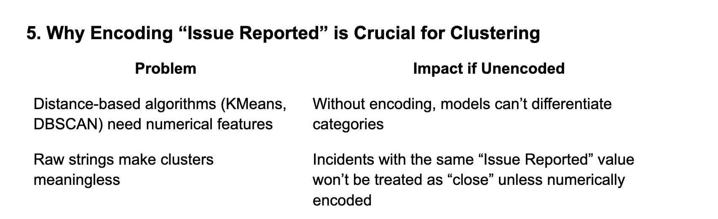
📝 Why We Need to Encode Issue Reported

Slide 19
🧠 High-Level Why:
ML models don’t understand text labels as categorical concepts unless we explicitly transform them.
Encoding ‘Issue Reported’ injects semantic meaning into a format ML models can process—allowing them to group similar incidents or predict categories effectively.
Choosing One-Hot vs Frequency Encoding depends on cardinality and model sensitivity to dimensionality.

Slide 20
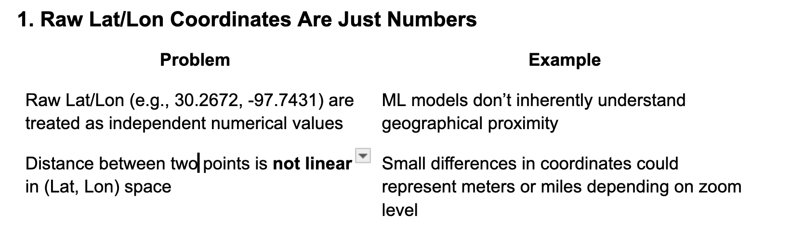
🗺️ Why We Need to Engineer Spatial Features (Latitude, Longitude)

Slide 21
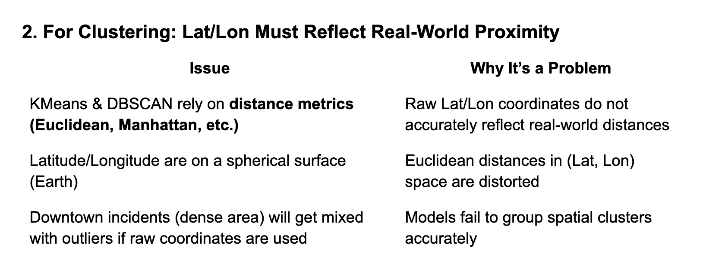
🗺️ Why We Need to Engineer Spatial Features (Latitude, Longitude)

Slide 22
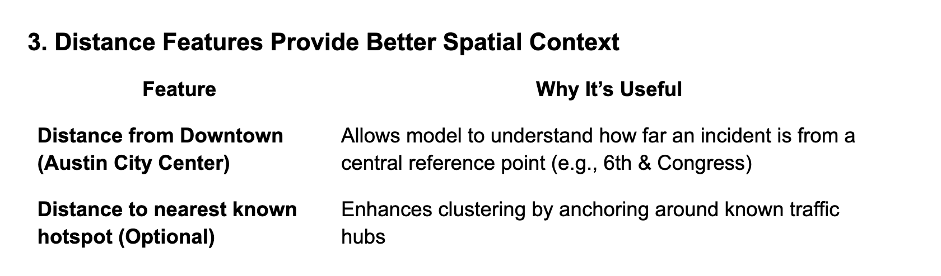
🗺️ Why We Need to Engineer Spatial Features (Latitude, Longitude)

Slide 23
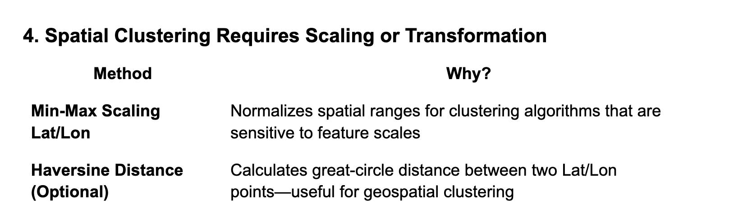
🗺️ Why We Need to Engineer Spatial Features (Latitude, Longitude)

Slide 24
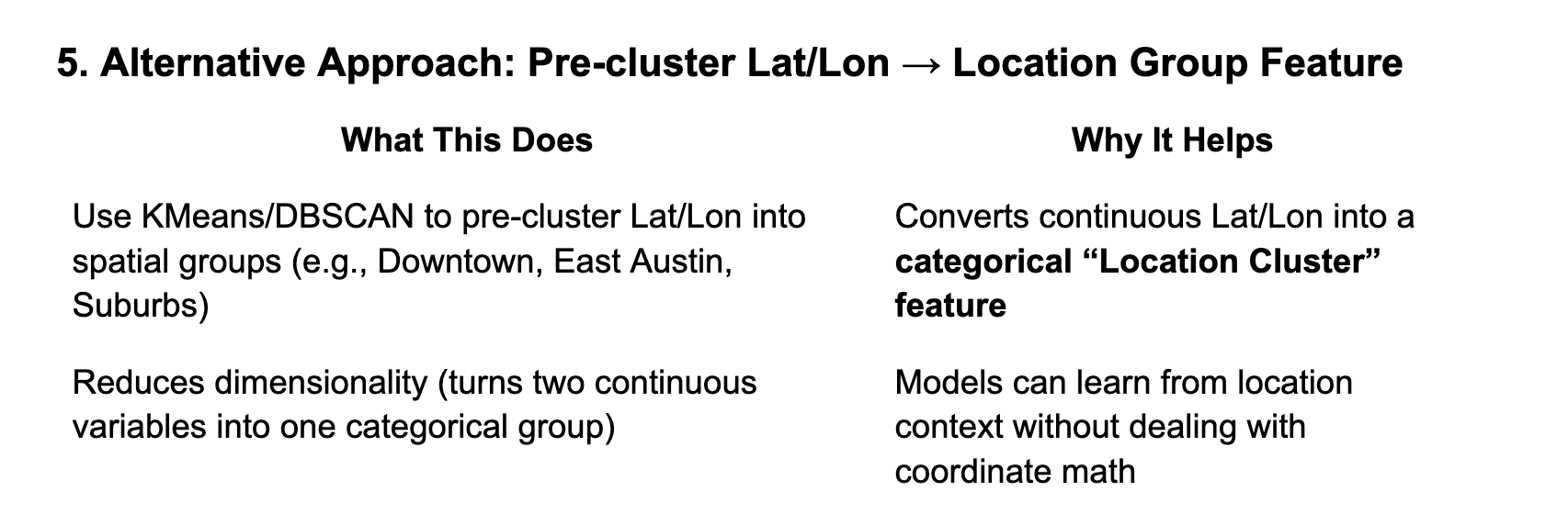
🗺️ Why We Need to Engineer Spatial Features (Latitude, Longitude)

Slide 25
🧠 High-Level Why:
Raw Latitude/Longitude values lack context. The model doesn’t understand that (30.27, -97.74) is “Downtown” and (30.30, -97.70) is “East Austin.”
Distance metrics on Lat/Lon are misleading unless scaled or converted to real-world distances.
For Clustering, spatial features often need:
Scaling (Min-Max, Standard)
Distance from central reference points (Downtown)
Optional: Pre-clustered into categorical “zones”

Slide 26
Coding through Storytelling: Narrative Reasoning and Software Engineering Education
S. Charlie Dey Texas Advanced Computing Center charlie@tacc.utexas.edu | Jeaime H. Powell Omnibond Systems jeaime@omnibond.com | Victor Eijkhout Texas Advanced Computing Center eijkhout@tacc.utexas.edu | Joshua Freeze Texas Advanced Computing Center jfreeze@tacc.utexas.edu | Susan Lindsey Texas Advanced Computing Center slindsey@tacc.utexas.edu

Slide 27


THANK YOU FOR ATTENDING.
For more information and news about the TACC visit:
tacc.utexas.edu
Connect with us: /taccutexas

