Slide 1
What Is Data Science, and Why Does It Matter?
“From Caveman Art to Spotify Streams”
Goal:
Introduce students to the concepts, history, tools, and relevance of Data Science, preparing them to explore it hands-on.

Slide 2
The Oldest Profession You’ve Never Heard Of Data Science Isn’t New—We’ve Been Doing It for Thousands of Years
Cave paintings were early data logs—recording what was hunted or important
Ancient civilizations used census data to allocate resources
Humans are natural data collectors, always looking for patterns
Like tracking scores in a game or keeping a diary, we’ve always collected data to understand the world better.

Slide 3
Data Science 101
What is Data?

Slide 4
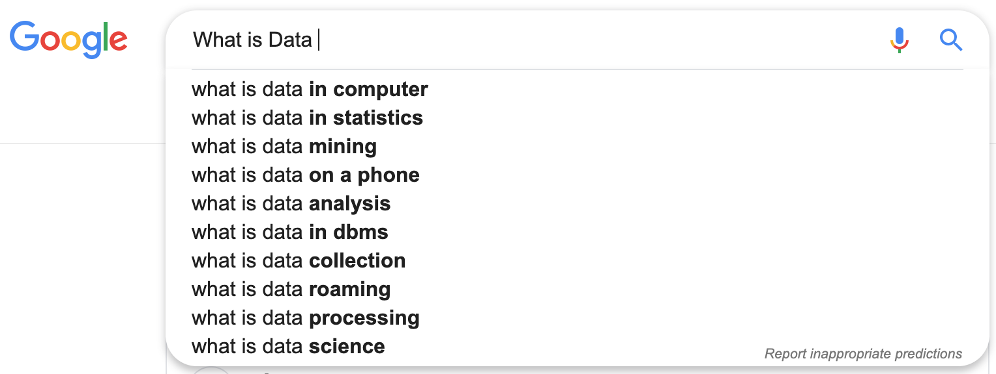
Data Science 101

Slide 5
Data Science 101
Data is a set of values of subjects with respect to qualitative or quantitative variables. Data and information or knowledge are often used interchangeably; however data becomes information when it is viewed in context or in post-analysis. Wikipedia

Slide 6
Data Science 101
What makes data important?

Slide 7
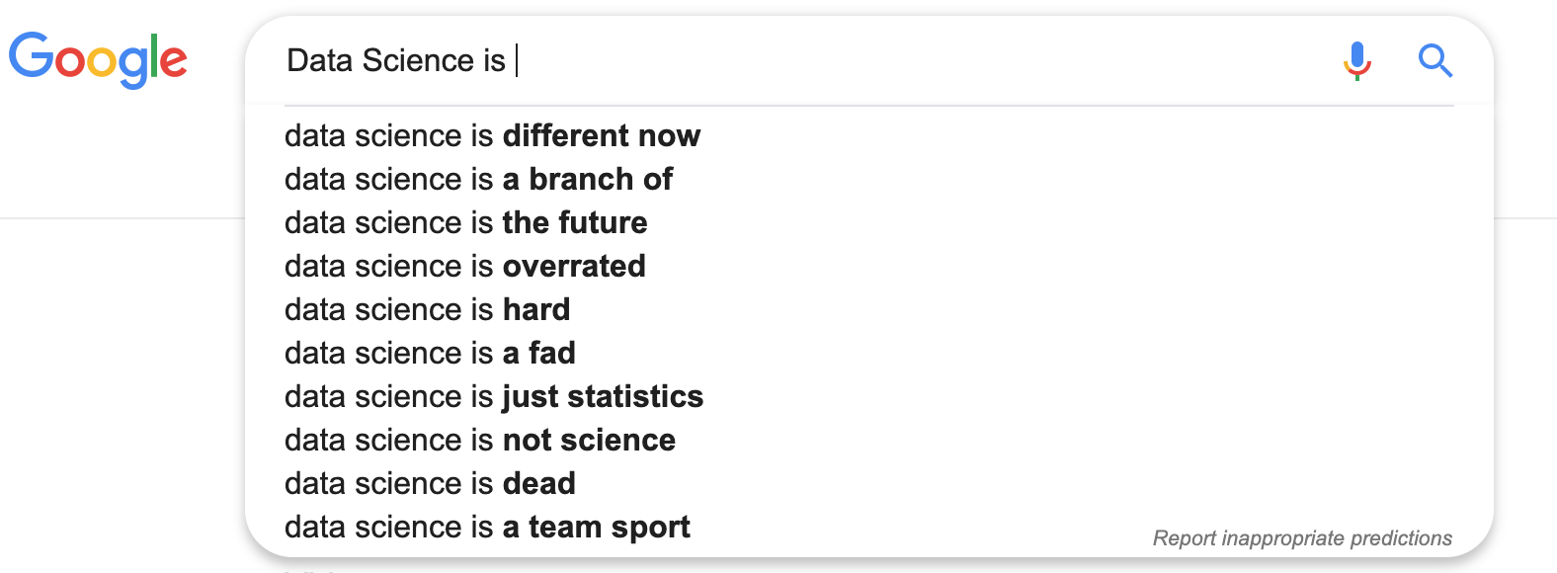
Data Science 101

Slide 8
Data Science 101
Data science is a multi-disciplinary field that uses scientific methods, processes, algorithms and systems to extract knowledge and insights from structured and unstructured data. Wikipedia

Slide 9
Data Science 101
Data Science is the ability to understand that there is a story hidden in the data.

Slide 10
What Is Data Science? - A Deeper Dive
Turning Raw Data into Insight and Action
Data Science is the process of using math, coding, and knowledge to extract meaning from data - finding the story!
It blends:
Math & Stats to analyze
Programming to process
Domain knowledge to understand context
data alone is just numbers

Slide 11
The Three Cornerstones of Modern Data Science
Scale, Speed, Ubiquity
Scale: We create 2.5 quintillion bytes of data daily (that’s 2.5 million terabytes!)
Speed: Real-time fraud detection, instant recommendations, live traffic updates
Ubiquity: Data is everywhere—from your phone to city cameras
Data is like oxygen—unseen but everywhere and essential.

Slide 12
Three Cornerstones: SCALE
Massive amounts of data being generated
Netflix processes hundreds of millions of viewing sessions per day to recommend shows.
Every second of your binge-watch is analyzed to find patterns.
Walmart collects over 2.5 petabytes of customer data per hour—from scanners, inventory, and purchases.
NASA satellites generate terabytes of climate data daily, monitoring everything from hurricanes to ice caps.

Slide 13
Three Cornerstones: SPEED
Real-time or near real-time processing
Spotify adapts your “Daily Mix” while you're still listening to music.
Skip a song, and it starts reshaping your playlist immediately.
Delta Airlines uses real-time data to reroute flights and reschedule crews to minimize delays.
Uber Eats tracks both driver location and restaurant prep time to adjust delivery estimates on the fly.
Amazon’s dynamic pricing engine changes product prices millions of times a day based on demand, stock, and competition.

Slide 14
Three Cornerstones: UBIQUITY
Data is everywhere
Your Smart Watch tracks your steps, sleep, and heart rate—generating health data 24/7.
Smart thermostats like Nest learn your habits and adjust temperature automatically.
Traffic lights in smart cities adapt timing based on real-time congestion data.
Grocery stores use loyalty card data to understand customer behavior and send you personalized coupons.

Slide 15
Why Does Data Science Matter?
It Helps Us Understand, Predict, and Decide
Understand behavior: What songs do you like?
Predict outcomes: When will traffic be heaviest?
Make smarter choices: When to restock a store or launch a new product
TikTok uses your viewing time to customize your “For You” page, tailoring content just for you.

Slide 16
Data Science in Action
Real World Applications
Company | Use Case
Amazon | Product recommendations based on your browsing and purchase history
Spotify | Creates “Discover Weekly” playlists just for you
Uber | Predicts demand to match drivers and riders
CDC | Tracks and predicts disease outbreaks using data
City of Austin | Monitors traffic incidents to improve safety and flow***

Slide 17
The Data Science Pipeline
How Do We Work with Data?
Steps:
Ask a question (e.g., When is traffic worst in Austin?)
Collect data (files, sensors, APIs)
Clean data (fix errors, remove duplicates)
Explore data (summarize, visualize)
Model data (make predictions)
Share insights (dashboards, reports)

Slide 18
The Tools of the Trade
Meet Pandas and Matplotlib
Pandas: Like Excel but much more powerful for data wrangling
Matplotlib: A way to create charts and graphs from data
Pandas = your data chef’s knife
Matplotlib = your data artist’s paintbrush

Slide 19
What Can You Do With Data Science?
The Possibilities Are Endless
Analyze cafeteria usage to reduce waste
Build an app to find best driving times
Study climate impacts on neighborhoods
Discover trends in music or social media
Data science lets you tell stories with data and influence change

Slide 20
Jobs You Could Have
There’s a wide range of careers—no one path
Role | What You Do
Data Analyst | Look for trends and summaries
Data Scientist | Build models and automate decisions
Machine Learning Engineer | Deploy AI-powered systems
Public Policy Analyst | Use data to influence fair laws
Entrepreneur | Create data-driven apps and products

Slide 21
Data Justice: Why Ethics Matter
Data Isn’t Neutral
Algorithms can reinforce bias if not designed carefully
Ethical data science is about fairness, transparency, and inclusion
The quiet part out loud: “How can data be biased?”

Slide 22
How to Get Started
Let's do this thing
Start with curiosity and ask questions
Learn Python and explore data projects
Use free resources like DataCamp, Kaggle, HPC-ED, or ScienceGateways.org

Slide 23
Final Thoughts
The Future Belongs to Data-Literate People
“Data Science is a superpower. With it, you can discover patterns, solve problems, and shape the world… But there's a catch.”
- Anonymous TACCster

Slide 24
The Catch
The Future Belongs to Data-Literate People
"Data without context is just noise."
Data is powerful, but only if we understand:
How it was collected
Why it was collected
Who collected it
What was left out

Slide 25
The Catch
The Future Belongs to Data-Literate People
Real-World Examples:
1. Salary Data Misinterpretation
“The average salary is $100K” But: Does that include the CEO? Interns? Is it median or mean?
2. Facial Recognition Bias
AI performed poorly on darker-skinned individuals Why? The training dataset had mostly lighter-skinned faces.
3. Austin Traffic Spike at 5 PM
Are drivers more reckless then? Or is it rush hour + bad weather + school zones?

Slide 26
The Catch
The Future Belongs to Data-Literate People
Data Science isn’t just about crunching numbers. It’s about asking thoughtful questions and understanding the story behind the data.

Slide 27
What's Next?
The Future Belongs to Data-Literate People
Your Questions & Ideas
What data projects interest you?
Anything surprise you today?

