Slide 1
Intro to Pandas
The Chef's Knife
Charlie Dey
Susan Lindsey

Slide 2
Intro to Pandas + Lambda Functions + Advanced Techniques
🎯 Learning Goals:
Ultimate Goal: Understand what Pandas is and why it’s useful.
Load and inspect real-world data (Austin Traffic).
Perform basic data exploration and statistics.
Query and filter data (using conditions and lambda functions).
Connect lambda functions to their broader use in Machine Learning.
Explore advanced Pandas techniques like groupby, sorting, and aggregation.

Slide 3
Let's Do This!
Fire up Jupyter! Download Austin Real-Time Traffic Incident Reports from:
https://data.austintexas.gov/Transportation-and-Mobility/Real-Time-Traffic-Incident-Reports/dx9v-zd7x/about_data
(or GOOGLE: Austin Real-Time Traffic Incidents)

Slide 4
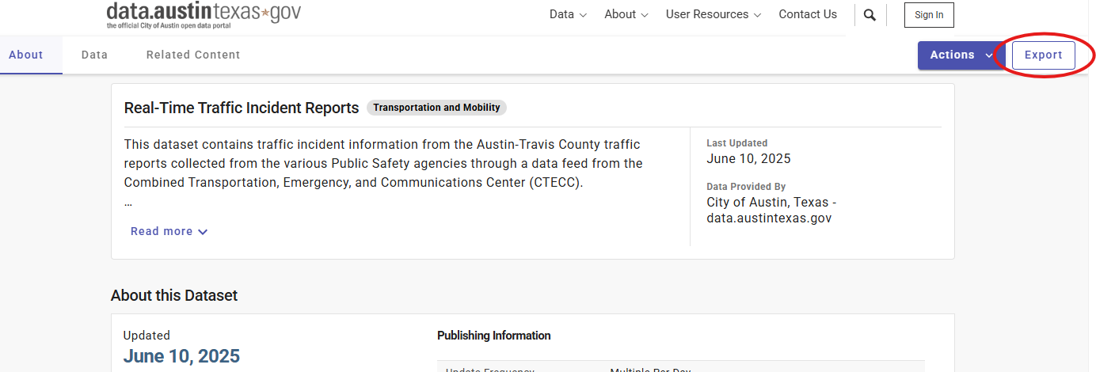
Get The Data

Slide 5
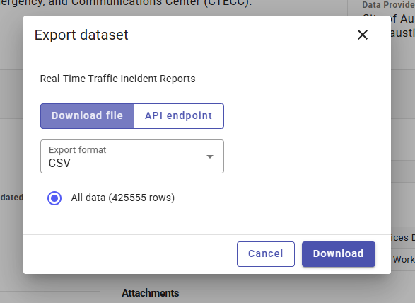
Get The Data
Notes:
CSV = Comma Separated Values

Slide 6
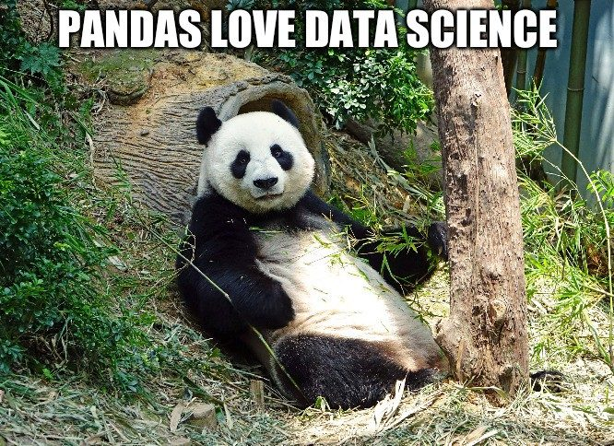
🧭 Part 1: Introduction to Pandas
What Is Pandas?
Python library for working with tabular data.
Like Excel, but way more powerful and programmable.

Slide 7
✅ Hands-on Steps:
import pandas as pd
# Load the dataset
df = pd.read_csv("Austin_traffic_data.csv")
# Preview
df.head()

Slide 8
🔍 Inspecting the Data: What do these commands do
df.shape # (rows, columns)
df.columns
df.info()
df.describe()

Slide 9
🔍 Inspecting the Data:
# Shape of the data (rows, columns)
df.shape
# Column names
df.columns
# Quick summary of the dataframe
df.info()
# Summary statistics (only numerical columns)
df.describe()

Slide 10
💬 Mini Challenge:
You may have to Google or ask ChatGPT
Print how many unique values are in the 'Issue Reported' column.

Slide 11
💬 Mini Challenge: A solution
# How many unique types of issues are reported?
df['Issue Reported'].nunique()
# Optional: list the top 10 most frequent issues
df['Issue Reported'].value_counts().head(10)

Slide 12
🧭 Part 2: Querying and Filtering Data
How Do We Ask Questions of Our Data?
# Simple query
df[df['Issue Reported'] == 'Crash Urgent']
# Incidents on a specific street
df[df['Address'].str.contains('IH 35', na=False)]
# Multiple conditions
df[(df['Issue Reported'] == 'Crash Urgent') & (df['Address'].str.contains('IH 35', na=False))]

Slide 13
💬 Mini Challenge:
You may have to Google or ask ChatGPT
How many “Traffic Hazard” incidents occurred in 2023?
How about in 2024?

Slide 14
💬 Mini Challenge:
You may have to Google or ask ChatGPT
# Convert date column to datetime
df['Published Date'] = pd.to_datetime(df['Published Date'])
# Filter for year 2023 and "Traffic Hazard"
hazards_2023 = df[
(df['Published Date'].dt.year == 2023) &
(df['Issue Reported'] == 'Traffic Hazard')
]
# Count
len(hazards_2023)

Slide 15
🧭 Part 3: Lambda Functions + Side Quest
What Is a Lambda Function?
Anonymous one-line function: lambda x: x + 1
Useful for short operations in data transformations
# Clean up issue descriptions
df['Issue Lower'] = df['Issue Reported'].apply (lambda x: x.lower() if pd.notnull(x) else x)
# Extract year from date
df['Year'] = pd.to_datetime (df['Published Date']).apply(lambda x: x.year)

Slide 16
⚔️ 🧭 Side Quest: Lambda in Machine Learning
What Is a Lambda Function?
lambda functions are often used for quick feature engineering or inside pipelines
from sklearn.preprocessing import FunctionTransformer
# Use lambda inside a pipeline step (optional preview)
transformer = FunctionTransformer(lambda x: x**2)

Slide 17
💬 Macro Challenge:
You may have to Google or ask ChatGPT
Create a new column that returns True if the incident occurred in rush hour (e.g., 7–9am or 4–6pm).
Hint - Just like we scraped out the year, we have to scrape out the hour part. (Python might change our AM/PM into 24 time. 7 through 9 or 16 through 18) put this in a new column called 'hour'
Analyze that new column (if it's between 7-9 or 16-18, value=True, else Value = False)

Slide 18
💬 Macro Challenge:
You may have to Google or ask ChatGPT
# Extract hour from datetime
df['Hour'] = df['Published Date'].dt.hour
# Define rush hour times (7–9am and 4–6pm)
def is_rush_hour(hour):
return (7 <= hour <= 9) or (16 <= hour <= 18)
df['Rush Hour'] = df['Hour'].apply(is_rush_hour)
# Preview
df[['Published Date', 'Hour', 'Rush Hour']].head()

Slide 19
🧭 Part 4: Advanced Pandas Techniques
Level Up with Pandas
# Grouping
df.groupby('Issue Reported').size().sort_values(ascending=False).head(10)
# Time-based grouping
df['Date'] = pd.to_datetime(df['Published Date'])
df['Month'] = df['Date'].dt.month
monthly_counts = df.groupby('Month').size()
# Aggregations
df.groupby('Issue Reported')['Traffic Report ID'].count()
# Sorting
df.sort_values(by='Published Date', ascending=False).head()

Slide 20
💬 Mini Challenge:
You may have to Google or ask ChatGPT
Which month has the highest number of “Crash Urgent” reports?
Which month has the highest number of “LOOSE LIVESTOCK” reports?

Slide 21
💬 Mini Challenge:
You may have to Google or ask ChatGPT
crash_urgent = df[df['Issue Reported'] == 'Crash Urgent']
crash_urgent.groupby('Month').size().sort_values(ascending=False)

Slide 22

Question? Comments?

