Slide 1
Classification and Clustering
Charlie Dey Texas Advanced Computing Center
charlie@tacc.utexas.edu
Susan Lindsey Texas Advanced Computing Center
slndsey@tacc.utexas.edu

Slide 2
First up: Classification
Charlie Dey Texas Advanced Computing Center
charlie@tacc.utexas.edu
Susan Lindsey Texas Advanced Computing Center
slndsey@tacc.utexas.edu

Slide 3
🎯 Learning Objectives
Understand the difference between supervised and unsupervised learning
Implement and explain basic classification (e.g., decision trees) and clustering (e.g., K-means) algorithms
Use real-world traffic incident data to solve classification and clustering problems
Interpret model outputs and performance metrics

Slide 4
Classification
🔍 What is Classification?
Classification is the task of predicting a label or category for input data. In our case, we might classify an incident based on its description as a "Crash", "Traffic Hazard", or "Loose Livestock".

Slide 5
Classification
💡 Real-Life Analogies
Spam filter: Given the contents of an email, predict whether it's "Spam" or "Not Spam".
Doctor’s diagnosis: Based on symptoms, classify a disease.
Campus security: Given an incident report, predict if it’s high priority.

Slide 6
🧰 Algorithm Focus: Decision Trees
🛠️ How It Works
A decision tree splits the data based on the features to reduce uncertainty.
Each split is a "yes/no" question (e.g., Does the incident description contain 'crash'?)
It continues splitting until it can confidently assign a label.

Slide 7
🧰 Algorithm Focus: Decision Trees
🛠️ How It Works
Think of playing 20 Questions, where you narrow down the object by asking binary questions. A decision tree is doing exactly that—asking a series of smart questions to guess the right label.

Slide 8
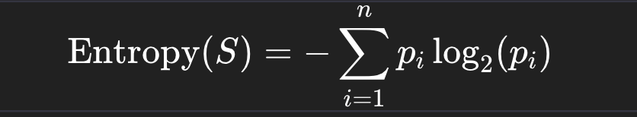
📐 Math Behind It
Entropy formula from Information Theory, which is also used inside Decision Trees (like ID3, C4.5, CART) to decide where to split the data.

Slide 9
📐 Math Behind It
What it means:
S = a dataset (or subset) at a node in the tree.
n = the number of possible classes (e.g., "Highway" vs "Local" → 2 classes).
p_{i}​ = the proportion (probability) of examples in class i within dataset S.
log₂ = base-2 logarithm, which measures information in "bits."

Slide 10
Example with Highway vs Local:
Say at some node:
8 incidents are Highway
2 incidents are Local

Slide 11
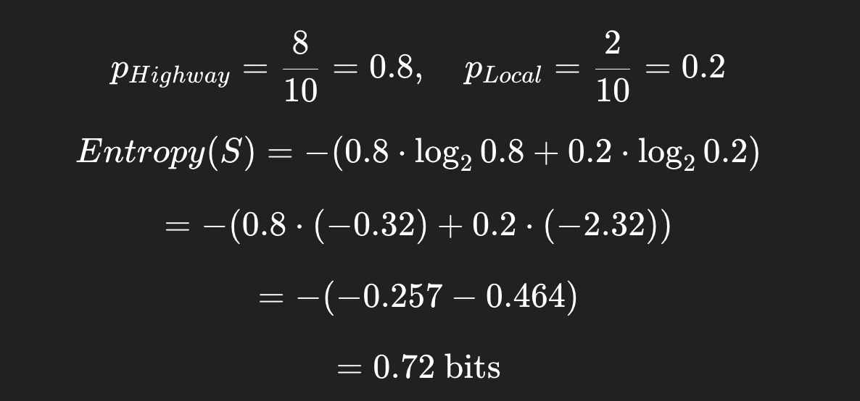
Example with Highway vs Local:
So this node has some uncertainty (not perfectly pure), but leaning strongly toward "Highway."

Slide 12
Information Gain
🔹 Step 1: Entropy
If a node is perfectly pure (all "Highway"), entropy = 0. If it’s a 50/50 split (max uncertainty), entropy = 1 (for binary classification).

Slide 13
Information Gain
🔹 Step 2: Splitting the Data
Suppose we’re trying to classify Highway vs Local. We pick a feature (say, "Street Name starts with 'I-' → interstate).
Splitting on this feature divides the dataset into subsets.
Subset A: incidents where Street starts with I-
Subset B: incidents where Street does not start with I-
Each subset will have its own entropy.

Slide 14

Information Gain
🔹 Step 3: Weighted Average Entropy After Split
After the split, the expected entropy is:
The algorithm chooses the feature/split that maximizes information gain.
Sj = subset j
∣Sj∣/∣S∣ = proportion of samples in that subset

Slide 15
Information Gain
🔹 Step 4: Information Gain
The information gain tells us how much uncertainty was reduced:
IG(S,feature)=Entropy(S)−Entropysplit
If IG is high, that feature is a great split (makes subsets purer).
If IG is low, the feature doesn’t help much.

Slide 16
🔹 Example with Numbers
Say we have 10 traffic reports:
6 Highway, 4 Local

Slide 17
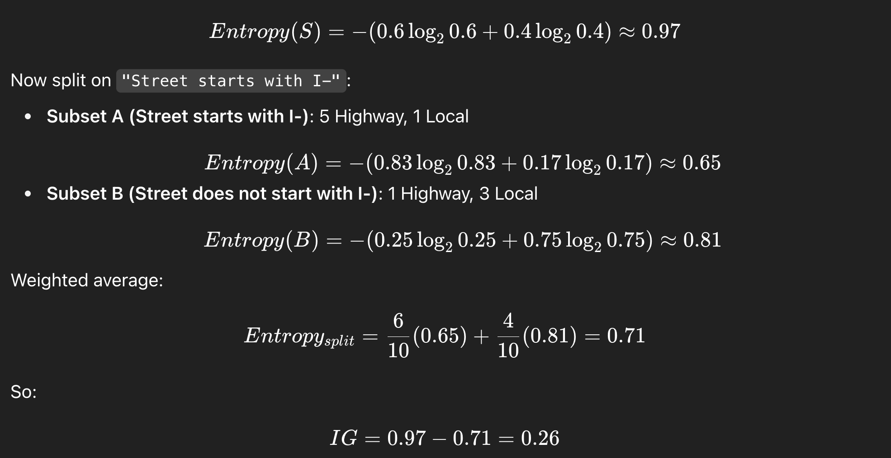
🔹 Example with Numbers

Slide 18
🔹 Example with Numbers
✅ Interpretation: Splitting on "Street starts with I-" reduces uncertainty (good feature). The decision tree will prefer this feature if no other feature has higher information gain.

Slide 19
🧠 Classification: Highway vs Local

Slide 20
🧠 Classification Lecture: Highway vs Local
🌟 Learning Objectives
By the end of this lesson:
Understand the difference between simple queries, logistic regression, and decision trees for classification.
Be able to classify incidents as Highway vs Local using location or address.
Visualize and interpret a Decision Tree.
Critically think about feature engineering and model limitations.

Slide 21
🧠 Classification Lecture: Highway vs Local
1️⃣ Simple Query / Filtering Approach
Concept: Use keywords to classify incidents without ML.
Works because location/address contains highway identifiers.
import pandas as pd
# Load dataset
df = pd.read_csv("austin_traffic_incidents.csv")
# Highway keywords
highway_keywords = ["I-35", "IH-35, "US 183", "Mopac", "Loop 1", "SH 71"]
# Classify using simple filter
df['road_type'] = df['address'].fillna("").str.upper().apply(
lambda x: "Highway" if any(k.upper() in x for k in highway_keywords) else "Local"
)
print(df['road_type'].value_counts())

Slide 22
🧠 Classification Lecture: Highway vs Local
1️⃣ Simple Query / Filtering Approach
Think of this like a “keyword detector” — a quick rule-of-thumb classifier.
Challenge:
Modify the code to include more highway identifiers.
Count how many incidents are classified differently if you add/remove keywords.

Slide 23
Logistic Regression in a nutshell 🚦:
🔹 The Problem
Linear Regression predicts continuous values (like predicting temperature or house price).
But sometimes we want to predict categories (e.g., “Highway” vs “Local” or “Accident” vs “Non-Accident”).

Slide 24
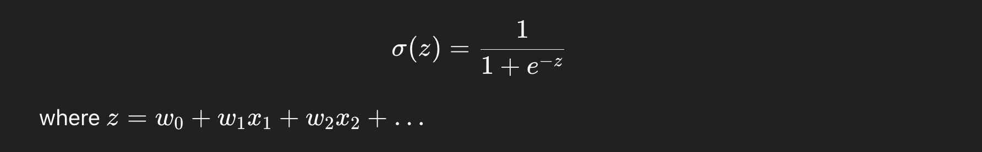
Logistic Regression in a nutshell 🚦:
🔹 The Trick
Logistic Regression takes a linear combination of inputs (like Linear Regression does), but instead of outputting any number on the real line, it squashes it into a range between 0 and 1 using the sigmoid function:
🔹 The Output
The output is interpreted as a probability:
If P(y=1∣x)>0.5 → predict class 1 (e.g., Highway).
If P(y=1∣x)≤0.5 → predict class 0 (e.g., Local).

Slide 25
Logistic Regression in a nutshell 🚦:
🔹 Why It’s Useful
Logistic Regression is one of the simplest, most interpretable classification algorithms.
It’s often a baseline model before trying more complex ones (like Decision Trees, Random Forests, or Neural Nets).
It gives you probabilities, not just a hard class label, which can be very valuable.
✅ In the Austin Traffic dataset example: We could use Logistic Regression to classify whether an incident is on a Highway (1) or Local road (0) based on features like latitude, longitude, issue_reported, etc.

Slide 26
2️⃣ Logistic Regression Baseline
Concept: Use address text and/or issue_reported as features.
Convert text to numeric with CountVectorizer or TfidfVectorizer.
Logistic Regression predicts probability of Highway vs Local.

Slide 27
Sidequest
🔹 CountVectorizer
Turns text into numbers by counting words.
It builds a vocabulary of all unique words across your dataset.
Each text entry (like an incident description) becomes a vector where each dimension is the count of a word in that entry.

Slide 28
Sidequest
🔹 CountVectorizer
Suppose we have three reports:
"Crash on highway"
"Stalled vehicle"
"Crash on local road"
Vocabulary = [crash, on, highway, stalled, vehicle, local, road]
Vectors:
"Crash on highway" → [1,1,1,0,0,0,0]
"Stalled vehicle" → [0,0,0,1,1,0,0]
"Crash on local road" → [1,1,0,0,0,1,1]

Slide 29
Sidequest
🔹 TfidfVectorizer (Term Frequency–Inverse Document Frequency)
Similar to CountVectorizer, but instead of raw counts, it weighs words by how important they are.
Common words like "on" or "road" appear in many reports → less informative → down-weighted.
Rare but meaningful words like "fatality" or "hazmat" get higher weight.

Slide 30
2️⃣ Logistic Regression Baseline
Concept: Use address text and/or issue_reported as features.
Convert text to numeric with CountVectorizer or TfidfVectorizer.
Logistic Regression predicts probability of Highway vs Local.

Slide 31
2️⃣ Logistic Regression Baseline
Concept: Use address text and/or issue_reported as features.
Convert text to numeric with CountVectorizer or TfidfVectorizer.
Logistic Regression predicts probability of Highway vs Local.

Slide 32
2️⃣ Logistic Regression Baseline
from sklearn.model_selection import train_test_split
from sklearn.feature_extraction.text import CountVectorizer
from sklearn.linear_model import LogisticRegression
from sklearn.metrics import classification_report
# Features and labels
X = df['address'].fillna("")
y = (df['road_type'] == "Highway").astype(int)
# Text to numeric features
vectorizer = CountVectorizer()
X_vec = vectorizer.fit_transform(X)
# Train/test split
X_train, X_test, y_train, y_test = train_test_split(X_vec, y, test_size=0.2, random_state=42)
# Train Logistic Regression
clf = LogisticRegression(max_iter=200)
clf.fit(X_train, y_train)
# Evaluate
y_pred = clf.predict(X_test)
print(classification_report(y_test, y_pred))

Slide 33
2️⃣ Logistic Regression Baseline
Logistic Regression is like drawing a smooth boundary between Local and Highway based on text features.
Challenge:
Try using issue_reported instead of address.
Compare performance: which feature gives better classification?

Slide 34
3️⃣ Decision Tree Approach
Concept: Visual, interpretable classification.
The tree splits on features like keywords in address.
from sklearn.tree import DecisionTreeClassifier, plot_tree
import matplotlib.pyplot as plt
# Train Decision Tree
tree = DecisionTreeClassifier(max_depth=4, random_state=42)
tree.fit(X_train, y_train)
# Evaluate
print("Accuracy:", tree.score(X_test, y_test))
# Visualize the tree
plt.figure(figsize=(16,10))
plot_tree(tree, feature_names=vectorizer.get_feature_names_out(),
class_names=["Local", "Highway"], filled=True, fontsize=10)
plt.show()

Slide 35
3️⃣ Decision Tree Approach
The Decision Tree is like a flowchart: each node asks a question (“Does the address contain I-35?”) and routes the incident down the appropriate branch.
Student Challenge:
Change max_depth and see how the tree grows/shrinks.
Identify which words/features the tree uses to split.
Compare Decision Tree vs Logistic Regression performance.

Slide 36
🔄 Discussion Prompts
Why might a simple query work well for Highway vs Local? When might it fail?
What advantages does ML provide over keyword rules?
How could you add additional features (time, lat/lon, issue_reported) to improve classification?
How would you evaluate whether Logistic Regression or Decision Tree is “better”?
Could you extend this to multi-class classification (e.g., different highway types or traffic incident types)?

Slide 37
✅ Challenges
Predict peak vs off-peak highway usage using time features.
Combine Decision Tree with latitude/longitude clustering to see patterns on a map.

Slide 38
Now: Clustering
Charlie Dey Texas Advanced Computing Center
charlie@tacc.utexas.edu
Susan Lindsey Texas Advanced Computing Center
slndsey@tacc.utexas.edu

Slide 39
1. What is Clustering?
Clustering is an unsupervised learning technique used to group data points that are similar to each other.
Unlike classification or regression (supervised learning), clustering doesn’t require labels. Instead, the algorithm looks at the data’s structure and tries to discover hidden groupings.
In practice, clustering answers the question: 👉 “Which data points look alike, and how can we group them?”

Slide 40
Supervised vs. Unsupervised Learning
Supervised Learning (Classification, Regression):
You give the algorithm input features and labels/outputs.
The goal is to predict labels for new data.
Example (Traffic Dataset): Predict whether an incident will cause a Crash Urgent (yes/no).
Unsupervised Learning (Clustering, Dimensionality Reduction):
You only give the algorithm input features (no labels).
The goal is to discover hidden structure in the data.
Example (Traffic Dataset): Find hotspots of incidents in Austin without knowing them in advance.

Slide 41
Why Clustering is Useful
Helps make sense of unlabeled data.
Reveals patterns that aren’t obvious.
Can serve as a preprocessing step for other ML tasks (e.g., group incidents before running classification).
Real-world applications:
Traffic Analysis: Identify accident-prone intersections or rush-hour clusters.
Retail: Group customers by shopping behavior (customer segmentation).
Healthcare: Discover subgroups of patients with similar symptoms.
Astronomy: Group galaxies or stars based on physical properties.

Slide 42
How Clustering Works (Conceptually)
Every clustering algorithm has two main ideas:
Measure similarity → Often done with distance (Euclidean, Manhattan, cosine similarity).
Group points together → Close points → same cluster; distant points → different clusters.
Example: If we plot traffic incidents by latitude & longitude, then nearby points form geographic clusters (like downtown Austin vs. I-35 corridor).

Slide 43
Common Clustering Algorithms
K-Means
Partitions data into k groups.
Each cluster has a "center" (centroid).
Simple, fast, but assumes round clusters.
A simple and widely used method to introduce clustering concepts.
DBSCAN (Density-Based Spatial Clustering of Applications with Noise)
Groups dense areas of data.
Automatically detects outliers (noise).
Works well when clusters are irregular shapes.
A density-based method that’s great for finding hotspots and handling outliers.
Hierarchical Clustering
Builds a tree of clusters (dendrogram).
Good for understanding relationships, but slower for large datasets.

Slide 44
Learning Objectives
With this intro, we'll cover:
Why clustering matters,
How it’s different from supervised learning,
What real-world questions it can answer (like “Where do most late-night accidents occur in Austin?”).
📌 Traffic Example:
We don’t know the "true labels" for traffic hotspots.
But we can group incidents by location + time of day to discover clusters like downtown congestion, highway accidents, etc.

Slide 45
🔹 K-MEANS

Slide 46
2. Load & Prepare the Data
import pandas as pd
import matplotlib.pyplot as plt
from sklearn.cluster import KMeans
from sklearn.preprocessing import StandardScaler
# Load dataset (replace path with actual file)
df = pd.read_csv("Austin_traffic_incidents.csv")

Slide 47
Load & Prepare the Data
# Preview
print(df.head())
# Select useful features for clustering
data = df[['latitude', 'longitude', 'published_date']].dropna()
# Convert published_date to hour of day (feature engineering)
data['published_date'] = pd.to_datetime(data['published_date'])
data['hour'] = data['published_date'].dt.hour
# Keep only features for clustering
X = data[['latitude', 'longitude', 'hour']]

Slide 48
SIDEQUEST: Why we only used ['latitude', 'longitude', 'hour'] in K-Means
Clustering algorithms (like K-Means) look for similarities across the features you feed in. So the choice of features is crucial.
In the example:
X = data[['latitude', 'longitude', 'hour']]
we used only latitude, longitude, and time of day because:
Latitude & Longitude → give us spatial patterns (geographic hotspots).
Hour → adds a temporal dimension (rush-hour vs late-night clusters)

Slide 49
SIDEQUEST: Why we only used ['latitude', 'longitude', 'hour'] in K-Means
We dropped the other columns (like incident ID, description, weather, etc.) because:
Many of them are categorical or text-based (e.g., issue_reported = "Crash", "Hazard", "Stalled Vehicle"). K-Means doesn’t handle categorical/text data directly.
Including irrelevant or noisy features can distort the clustering. For example, if we added a random ID number, the algorithm might cluster based on that meaningless difference.
For a first pass, it’s easier to keep clustering focused on a clear interpretation (location + time).

Slide 50
When Would We Add More Features?
We absolutely can include more features, but we usually need some preprocessing/feature engineering:
Categorical Features (e.g., issue_reported):
Use one-hot encoding (pd.get_dummies) so categories become numeric.
Example: Crash → [1,0,0], Hazard → [0,1,0], etc.
Text Columns (e.g., address):
Use TF-IDF vectorization or embeddings.
Numeric Features:
Can be included directly, but remember to scale them (StandardScaler).

Slide 51
When Would We Add More Features?
Example: Adding “Issue Reported”
Suppose we want to cluster not just by where/when, but also by type of incident.
# One-hot encode categorical feature
incident_type = pd.get_dummies(df['issue_reported'], prefix='issue')
# Combine with lat/lon/hour
X = pd.concat([data[['latitude', 'longitude', 'hour']], incident_type], axis=1)
# Scale everything
from sklearn.preprocessing import StandardScaler
scaler = StandardScaler()
X_scaled = scaler.fit_transform(X)

Slide 52
When Would We Add More Features?
✅ Key Point: Clustering is only as good as the features you choose.
Too few features → oversimplified clusters.
Too many irrelevant features → noisy, meaningless clusters.
Smart feature engineering → insightful, actionable clusters.

Slide 53
3. Feature Scaling
Clustering is sensitive to feature scales (lat/lon vs hours), so we standardize.
scaler = StandardScaler()
X_scaled = scaler.fit_transform(X)

Slide 54
4. Run K-Means Clustering
# Choose number of clusters (k)
k = 5
kmeans = KMeans(n_clusters=k, random_state=42)
clusters = kmeans.fit_predict(X_scaled)
# Add cluster labels to data
data['cluster'] = clusters

Slide 55
5. Visualize Clusters
We’ll plot clusters on a map-like scatter (lat vs lon), colored by cluster.
plt.figure(figsize=(10,6))
plt.scatter(data['longitude'], data['latitude'], c=data['cluster'], cmap='tab10', s=10)
plt.xlabel("Longitude")
plt.ylabel("Latitude")
plt.title("Traffic Incident Clusters in Austin")
plt.show()

Slide 56
What are we seeing?
The output plot
You’ll see Austin’s incident points colored into 5 groups.
Each colored blob is a traffic hotspot KMeans detected.
If clusters are tight, it means lots of incidents happen in that area.
If they’re spread out, it’s a broader region where incidents occur.

Slide 57
What are we seeing?
✅ In a nutshell:
This visualization shows you where in Austin the traffic incidents naturally cluster. Instead of raw points on a map, you now see 5 main hotspot zones, which could represent:
Downtown congestion
Highway accident zones
Busy intersections
Suburban traffic issues

Slide 58
6. Elbow Method
To pick the right k, we test different values.
inertia = []
for k in range(2, 11):
kmeans = KMeans(n_clusters=k, random_state=42)
kmeans.fit(X_scaled)
inertia.append(kmeans.inertia_)
plt.plot(range(2, 11), inertia, marker='o')
plt.xlabel("Number of Clusters (k)")
plt.ylabel("Inertia (Within-cluster Sum of Squares)")
plt.title("Elbow Method for Optimal k")
plt.show()

Slide 59
7. Mini-Challenges
Hotspot Clusters: Cluster only by latitude and longitude. Where are the biggest clusters of accidents?
Time-based Clusters: Cluster only by hour. What patterns do you see (rush-hour vs late night)?
Feature Engineering Experiment: Add a new feature: is_weekend. Does clustering look different?
Compare k=3 vs k=8: How does changing cluster size affect results?

Slide 60
8. Wrap-Up
Clustering is exploratory: There’s no “accuracy” metric like classification, instead we look for insightful groupings.
Austin Traffic Example: Helps identify geographic + temporal hotspots, useful for urban planning or resource allocation.

Slide 61
🔹 DBSCAN

Slide 62
1. Import & Prepare Data
import pandas as pd
import matplotlib.pyplot as plt
from sklearn.preprocessing import StandardScaler
from sklearn.cluster import DBSCAN
# Load dataset (replace with actual filename)
df = pd.read_csv("Austin_traffic_incidents.csv")

Slide 63
1. Import & Prepare Data
# Select location + time features
data = df[['latitude', 'longitude', 'published_date']].dropna()
# Convert date → hour of day
data['Date'] = pd.to_datetime(data['Published Date'])
data['hour'] = data['Date'].dt.hour
# Features for clustering
X = data[['Latitude', 'Longitude', 'hour']]
# Scale features
scaler = StandardScaler()
X_scaled = scaler.fit_transform(X)

Slide 64
2. Run DBSCAN
# eps = neighborhood size, min_samples = points to form a dense cluster
dbscan = DBSCAN(eps=0.5, min_samples=10)
clusters = dbscan.fit_predict(X_scaled)
# Add results to dataframe
data['cluster'] = clusters
cluster = -1 means the point was labeled as noise/outlier.

Slide 65
SIDEQUEST: WTH?
1. eps (epsilon) = Neighborhood size
Think of it as the radius of a circle around each point.
DBSCAN checks: “Which other points fall within this radius?”
If the radius is too small → many points won’t connect, you’ll get lots of tiny clusters or noise.
If the radius is too large → clusters may merge together into fewer, larger groups.
📍 In the traffic example:
eps = 0.5 (after scaling features) means: Two incidents are considered “neighbors” if they are within 0.5 distance units of each other in the standardized feature space (lat, lon, hour).

Slide 66
SIDEQUEST: WTH?
2. min_samples = Minimum number of points to form a dense cluster
Determines how many points must be inside that eps radius for a core point (the seed of a cluster).
If a point has fewer than min_samples neighbors, it’s labeled as noise/outlier.
Higher values → clusters must be denser.
Lower values → clusters can form more easily, but may be noisy.
📍 In the traffic example:
min_samples = 10 means: An incident is only considered part of a cluster if there are at least 10 incidents nearby (within the eps radius). Otherwise, it’s noise.

Slide 67
SIDEQUEST: WTH?
Putting It Together
DBSCAN grows clusters from dense regions:
Start with a point.
Look within eps radius.
If there are at least min_samples neighbors → make a cluster.
Expand cluster by checking neighbors of neighbors.
Points that never meet the threshold remain noise (-1).

Slide 68
SIDEQUEST: WTH?
✅ Traffic analogy:
Imagine you’re looking at incidents on a map.
Draw a circle of radius eps around each incident.
If at least min_samples incidents fall in that circle → boom, you’ve found a hotspot.
If an incident is too isolated, it gets marked as noise.

Slide 69
3. Visualize Clusters
plt.figure(figsize=(10,6))
plt.scatter(data['Longitude'], data['Latitude'], c=data['cluster'], cmap='tab10', s=10)
plt.xlabel("Longitude")
plt.ylabel("Latitude")
plt.title("DBSCAN Clustering of Traffic Incidents in Austin")
plt.show()
This map will show dense hotspots as clusters, while scattered incidents are marked as noise (-1).

Slide 70
4. Compare K-Means vs DBSCAN
K-Means: Always forces k clusters, even if data doesn’t naturally group.
DBSCAN: Finds clusters of arbitrary shapes, filters out noise.
Traffic Use Case:
K-Means: Good for broad “region-based” grouping.
DBSCAN: Good for detecting true hotspots of high density (e.g., one dangerous intersection).

Slide 71
5. Mini-Challenges for Students
Parameter Tuning: Change eps (radius of neighborhood) and min_samples. How do clusters change?
Hint: Smaller eps → more noise, more small clusters.
Larger eps → fewer, bigger clusters.
Compare with K-Means: Cluster only on location (lat, lon). Which method gives more meaningful groups?
Noise Analysis: Look at incidents labeled as -1. Are these rare events? Where do they happen?
Feature Engineering: Add is_weekend or rush_hour as features and rerun DBSCAN. Does it detect weekend vs weekday hotspots?

Slide 72
Questions? Comments?
Charlie Dey Texas Advanced Computing Center
charlie@tacc.utexas.edu
Susan Lindsey Texas Advanced Computing Center
slndsey@tacc.utexas.edu

