Slide 1
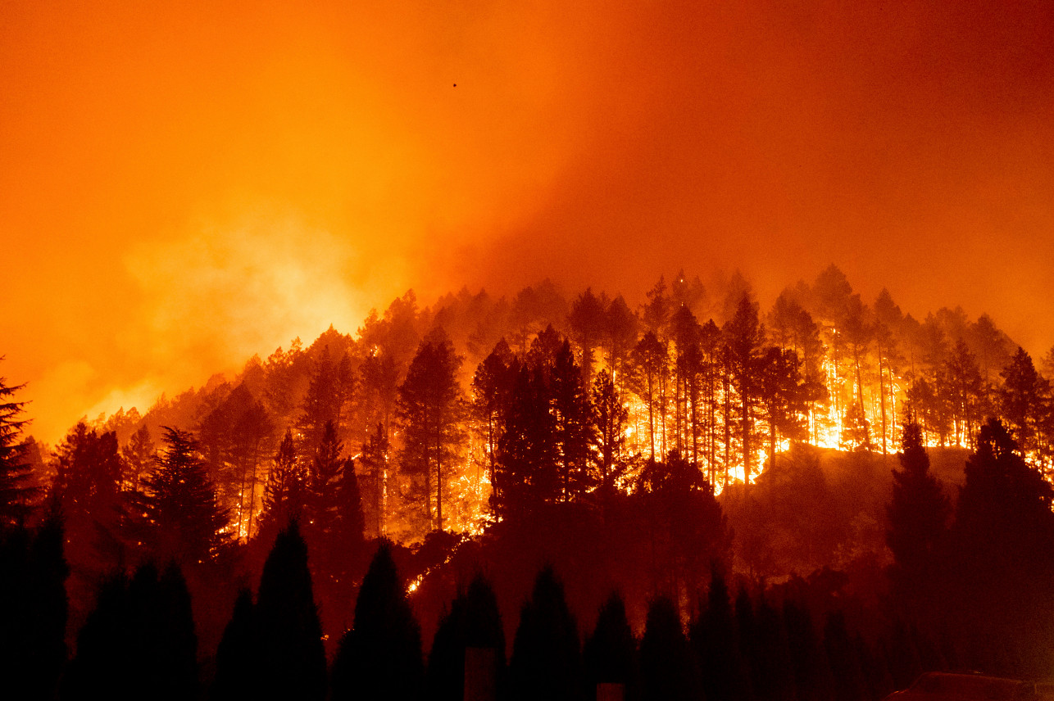
California Wildfire Costs Analysis
What regions in California have the highest costs of wildfire damage?
What are the human causes that cause the most damage?

Slide 2

Background
I have chosen datasets from four different years: 2019, 2018, 2017, 2016
Each data set presents the costs of human causes per Cal Fire Region
Basically, some counties are grouped in these regions, as a single Cal Fire unit can cover the entire area

Slide 3
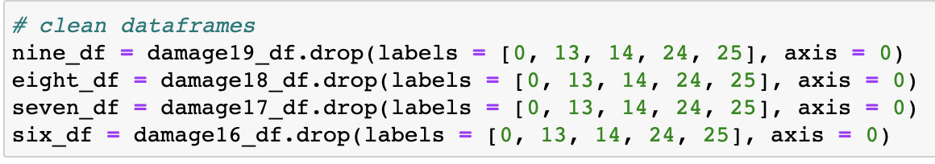
General Data Cleaning
Removed extraneous rows such as ”Northern Region” and ”Southern Region” as I analyzed the data with no distinction, and those rows had no data.

Slide 4
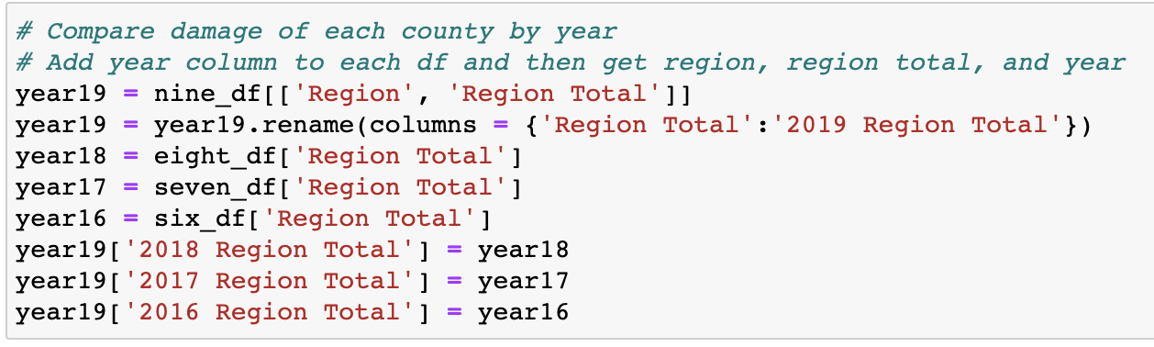
Combining Data for First Plot
I felt it would be easier to plot all four graphs at once if I combined data into one dataframe
Specifically chose region totals for this plot

Slide 5
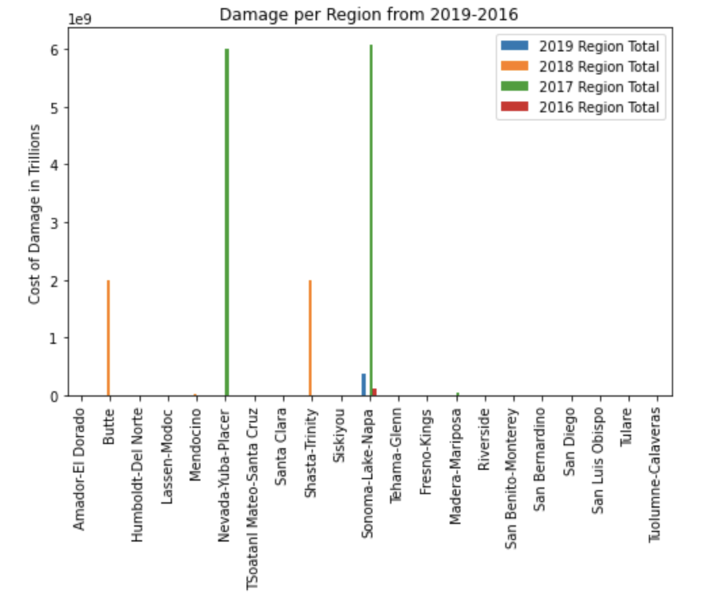
Damage per Region 2019-2016
Represents total cost of wildfire damages pre region (in Billions)
There are several regions with major outliers, which is why it looks like there is missing data
Sonoma-Lake-Napa has had massive damages in three of the past four years
This area clearly is a hotspot for wildfires, with Butte, Nevada-Yuba-Placer, and Shasta-Trinity being potentially dangerous spots

Slide 6
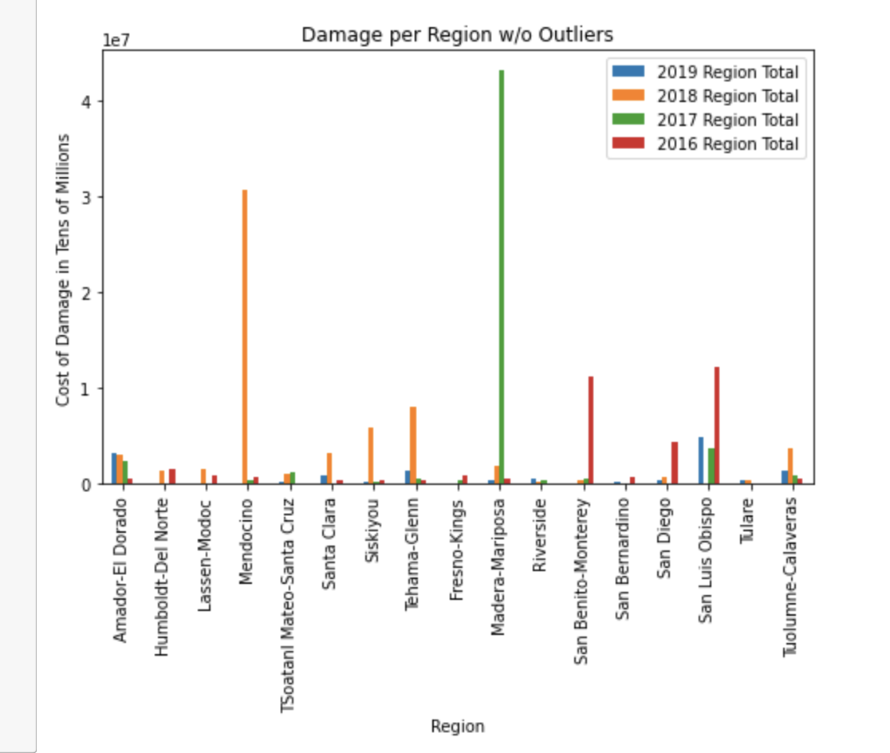
Damage per Region w/o Outliers
Dropped regions with the jumps in cost
Wanted to show how large the difference was between the outliers and “normal” fires

Slide 7
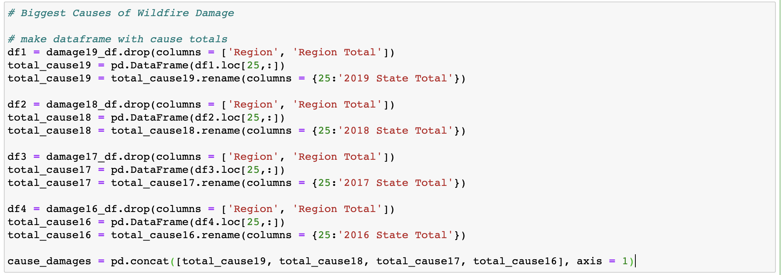
Create Dataframe for Costs per Cause
Create a Dataframe to pickout the costs of damages from human causes

Slide 8
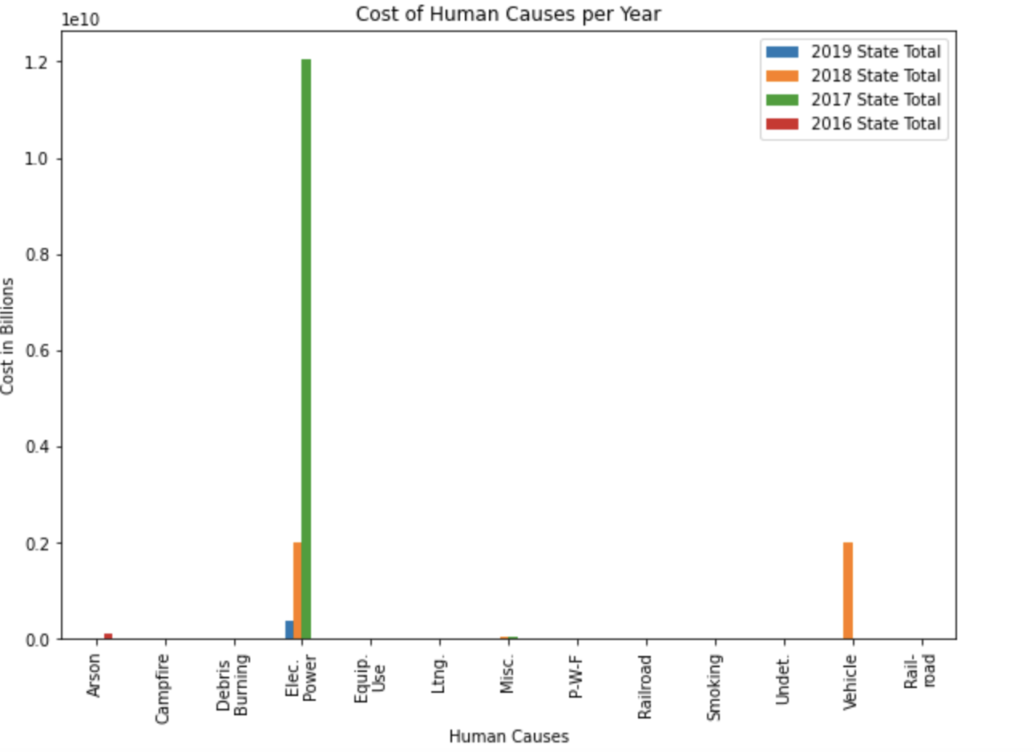
Costs for Human Causes per Year
Represents the costs of human causes per year
Similar to costs per region, there are clear outliers
Electric power seems to be the top cause of wildfires, with three out of four years seeing significant costs
The other costly causes would be from arson and vehicle fires

Slide 9
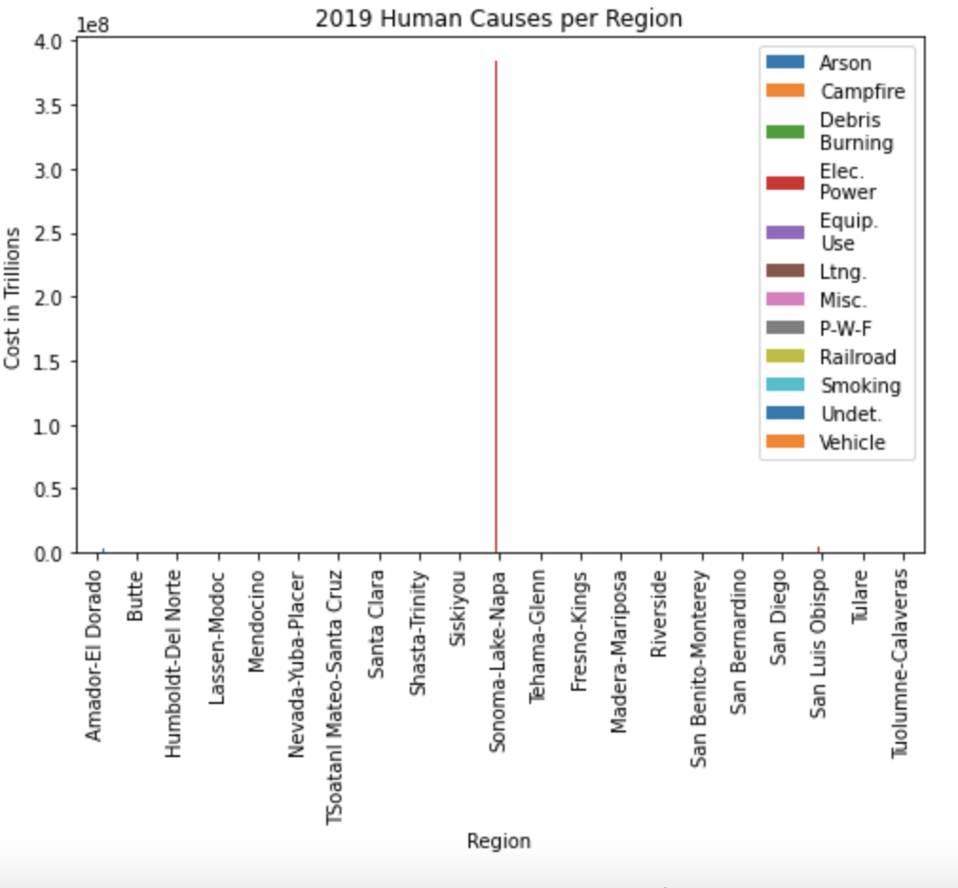
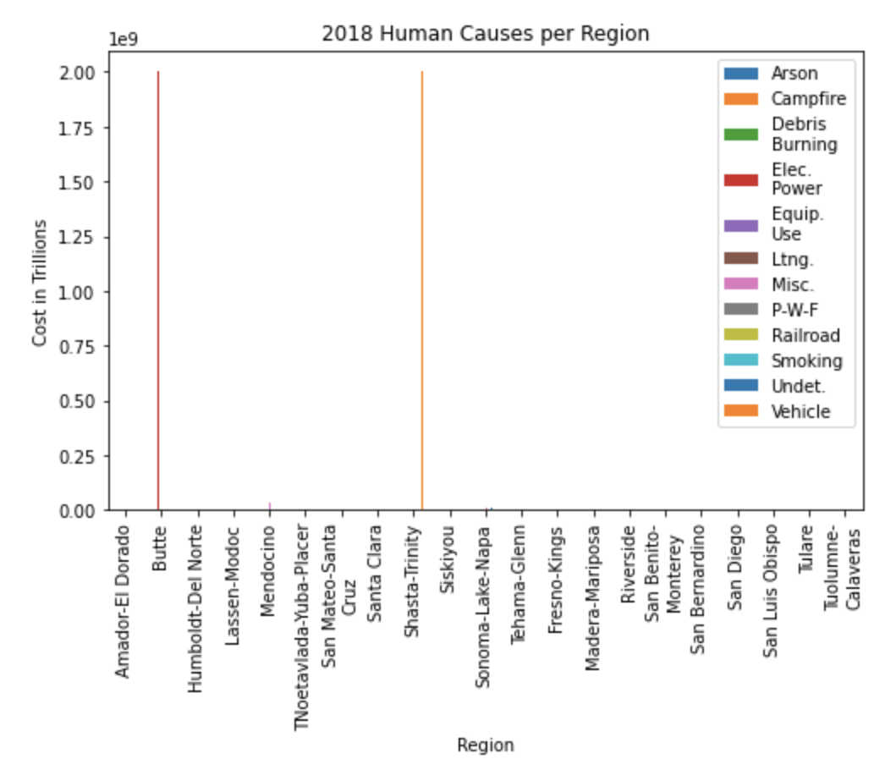
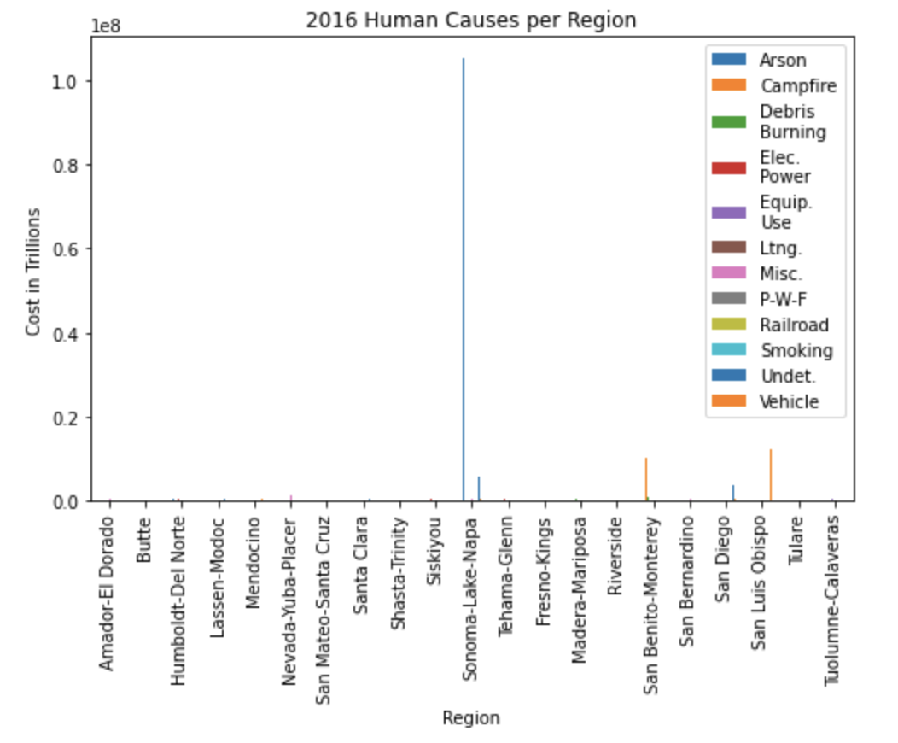
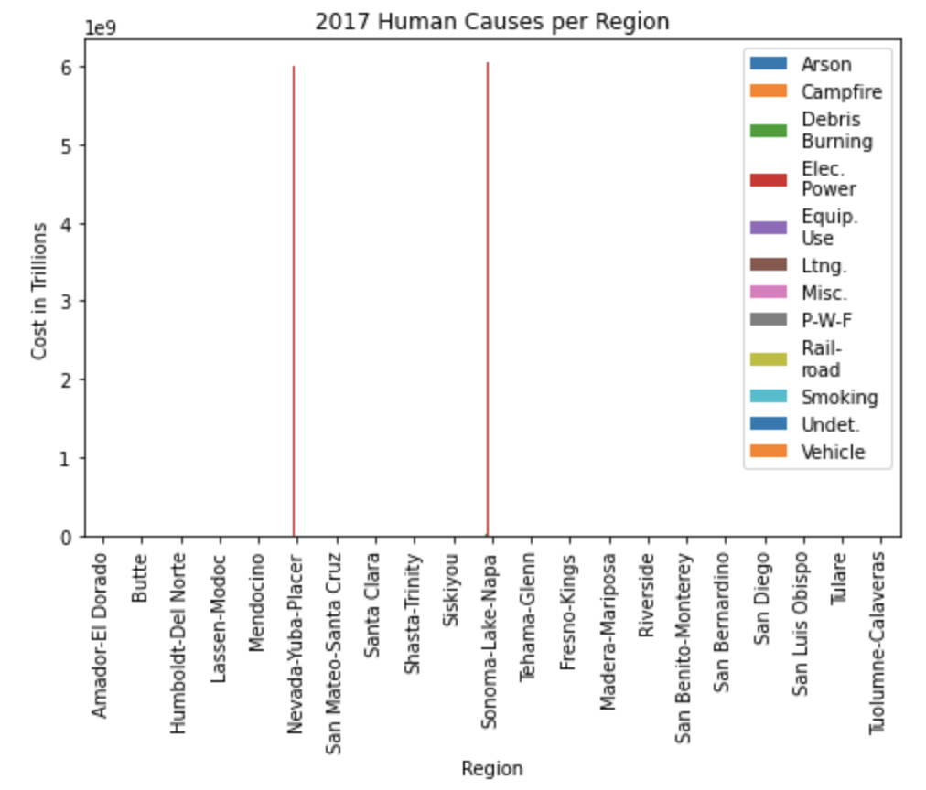
Costs of Human Causes per Region
Each graph represents a year
Bar plot represents major costs in human causes per region
As shown before, electric power is the primary cause for wildfires, along with arson and vehicles
Sonoma-Lake-Napa is once again the most prolific area for wildfires

