Slide 1
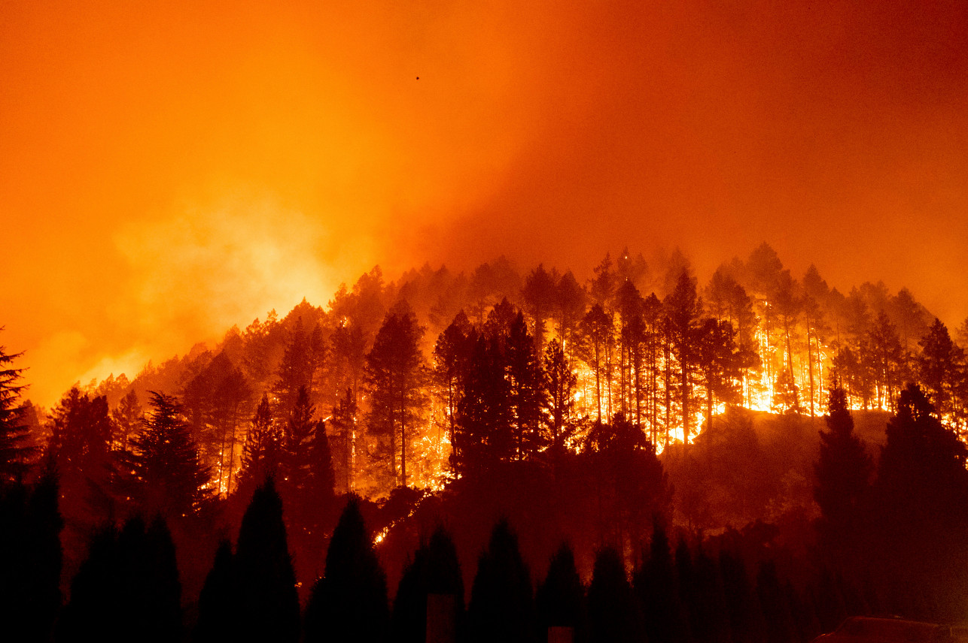
CALIFORNIA WILDFIRE CAUSE AND EFFECT ANALYSIS
JASON LEI
JOSH GALLAGHER
THADDEUS GRAY
WAN XIA (SUSAN)
YU-HAN CHEN (AMY)

Slide 2
Project Motivation
Motivation - With wildfires becoming an increasing problem in California, we wanted to see if we could find an trends in the causes and effects of the fires
Cause of wildfires - Weather factors - Human activities
Effects of wildfires
- Air quality - Financial cost

Slide 3
Data Source
kaggle.com U.S. Wildfire data (plus other attributes) which has a subset of 1.88 Million US wildfire database(Year 1995 - Year 2015). We concentrate on California wildfire dataset in our analysis.
California Department of Forestry and Fire Protection Wildfire Activity Statistics (Year 2016 - Year 2019)
https://www2.purpleair.com PurpleAir, which is a real time air quality monitor, providing real time measurement of air quality on a public map.
Google Maps Platform - API

Slide 4
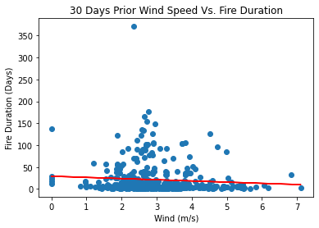
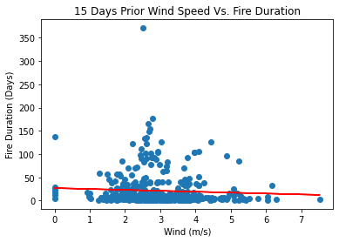
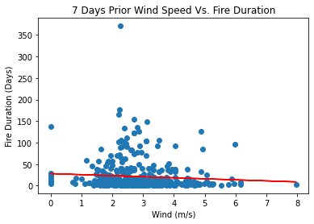
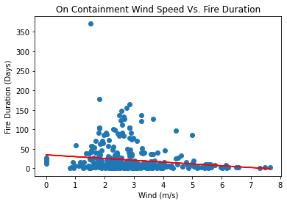
Wind
* r-squared are insignificant

Slide 5
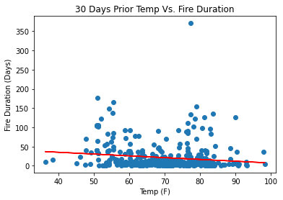
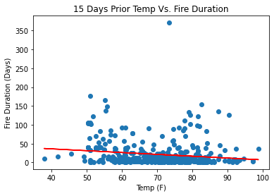
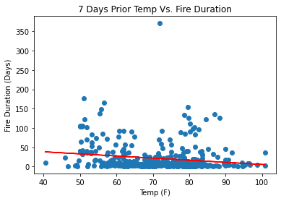
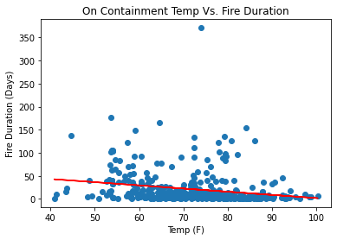
Temperature
* r-squared are insignificant

Slide 6
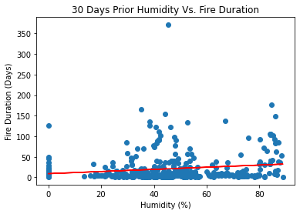
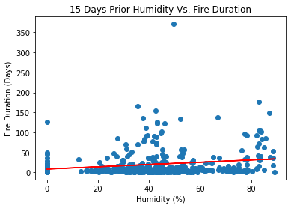
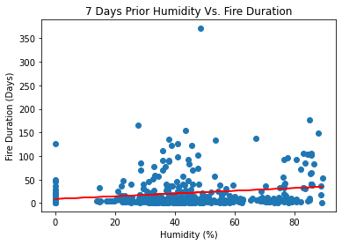
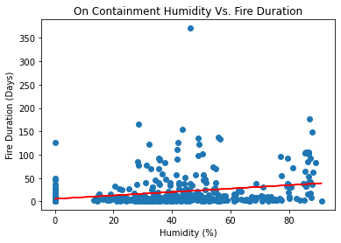
Humidity
* r-squared are insignificant

Slide 7
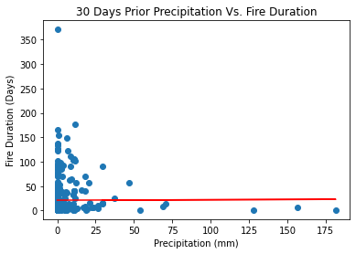
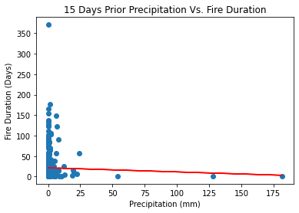
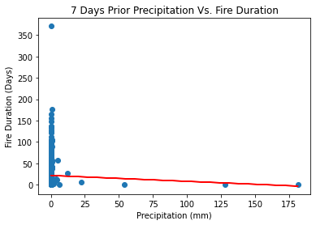
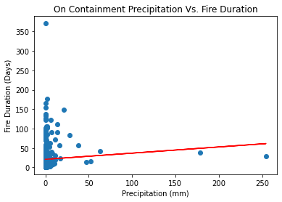
Precipitation
* r-squared are insignificant

Slide 8
Wildfire Maps
Questions:
Where were the wildfires located in California?
Where were the large scale wildfires located in California?
(from year 1995 through year 2015)

Slide 9
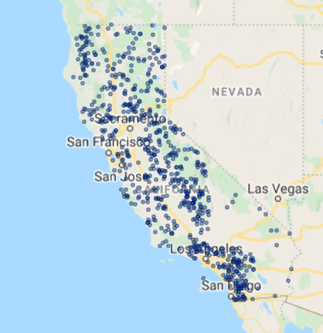
Fire Location Map - using API
Los Angeles and San Diego had slightly more fires happened during 1995 to 2015 according to the symbol map.

Slide 10
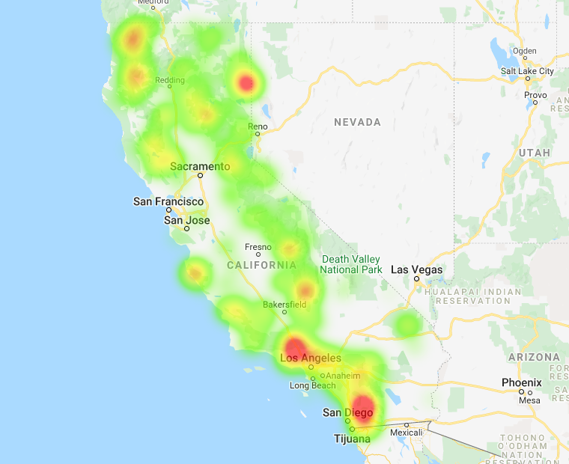
Fire Size Heatmap - using API
The majority of large scale wildfires happened from 1995 to 2015 were close to Los Angeles and San Diego according to the fire size heatmap.

Slide 11
Conclusions
From our analysis, the weather factors (Wind speed/Humidity/Temperature/Precipitation) have correlations with the fire size up until the date of containment, but it is unclear whether the weather impacted the fires or vice-versa
There Is a strong correlation between electrical power and wildfire costs, along with arson and vehicles. Additionally, electrical power in all areas seems to have a strong correlation with wildfires.
Wildfire increases air polution in surrounding areas

Slide 12
Limitations and Discussions
We are not able to merge our datasets: data are from different years
Real world data cleaning: missing information or wrong information
We couldn’t find enough scientific support on some trends that we observed from data analysis
More to explore:
- Impacts from wildfires on water resources: water quality within and downstream from a burn area may be significantly impacted.
- Climate change impacts

Slide 13



