Slide 1
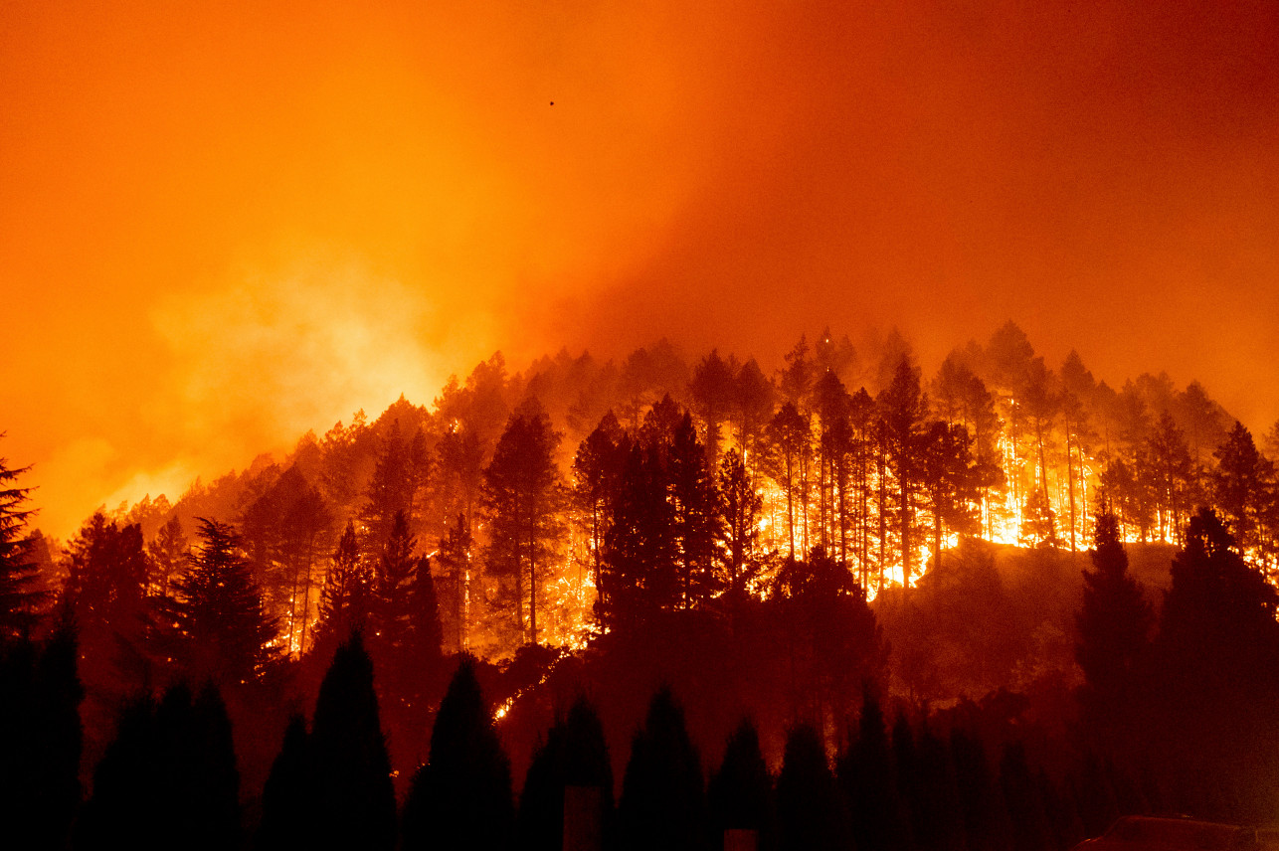
CALIFORNIA WILDFIRE CAUSE AND EFFECT ANALYSIS
JASON LEI
JOSH GALLAGHER
THADDEUS GRAY
WAN XIA (SUSAN)
YU-HAN CHEN (AMY)

Slide 2
Causes of Wildfires: Weather
Questions
Is there a difference between average weather on any day for a location, and the weather in the location of a fire?
Are there weather trends in the time prior to the fire being contained?

Slide 3
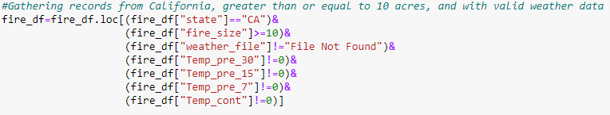
Weather Data Cleaning
Limited to California
Removed fires less than 10 Acres
Removed records that did not have weather files
Removed records where temperature equaled exactly 0

Slide 4
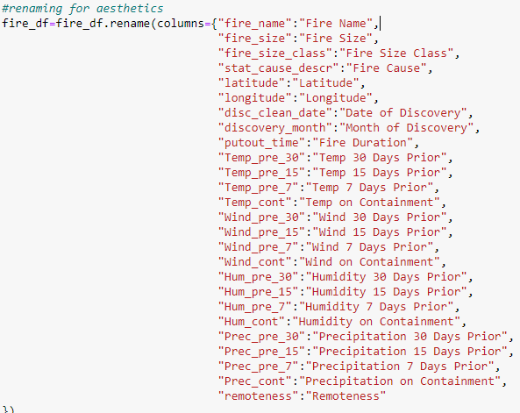
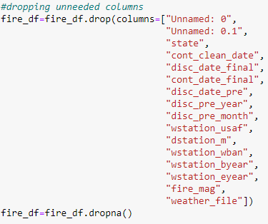
Weather Data Cleaning
Removed columns that would not be used
Renamed columns so Dataframe would be more aesthetically pleasing

Slide 5
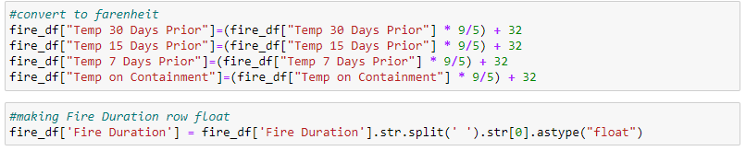
Weather Data Cleaning
Converted to Fahrenheit
Fire Duration column needed strings removed and to be turned into float for later calculations

Slide 6
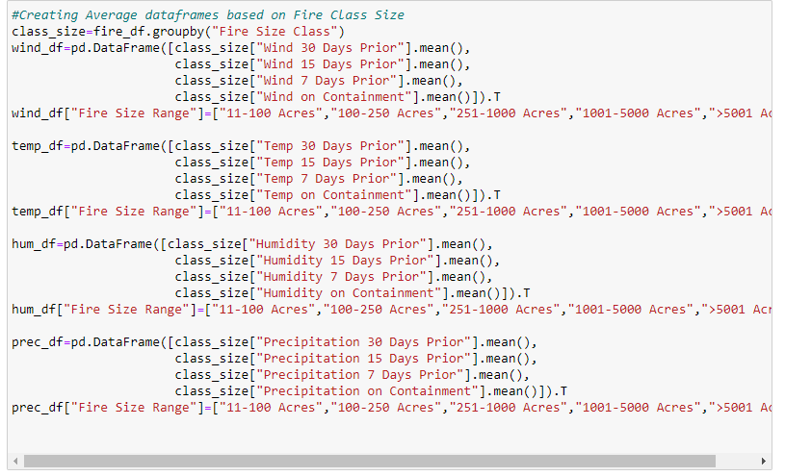
Weather Data Cleaning
Grouped data by the size of the fire
Created separate dataframes for wind, temperature, humidity, and precipitation
Took averages for time periods prior to fires’ containment

Slide 7
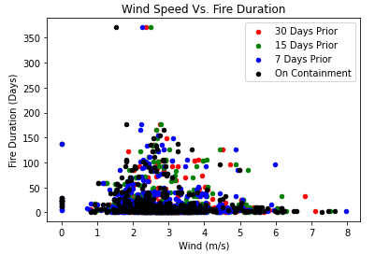
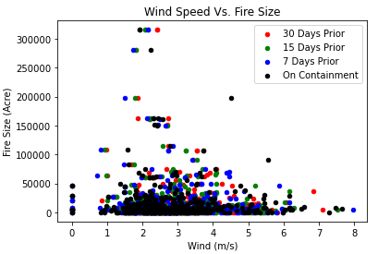
Wind
Mostly grouped in 1 to 5 m/s
Duration drops significantly above 5 m/s
Lots of datapoints at 0 m/s, however none in between until almost 1 m/s. Could be error in measurements or data.

Slide 8
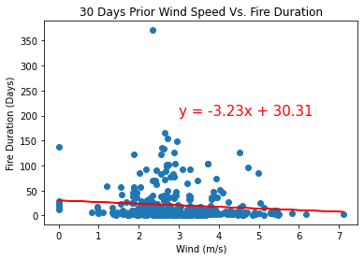
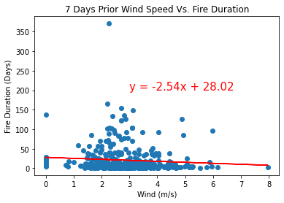
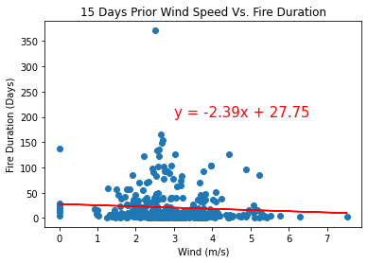
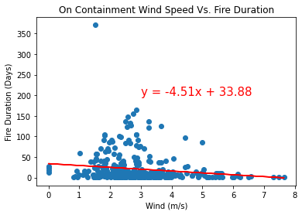
Wind

Slide 9
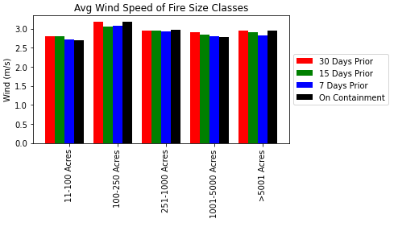
Wind
There appears to be a consistent pattern of wind speed averages dropping until date of containment

Slide 10
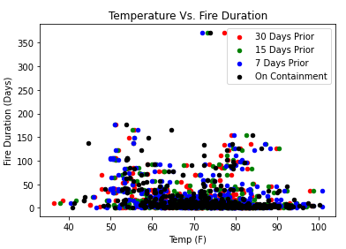
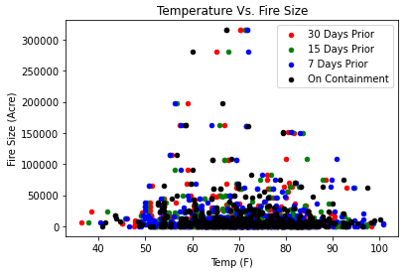
Temperature
Not much can be inferred from these graphs

Slide 11
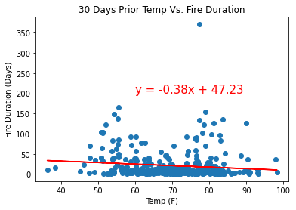
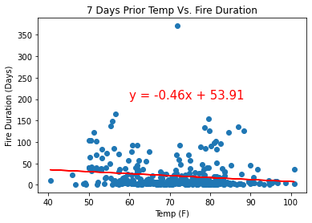
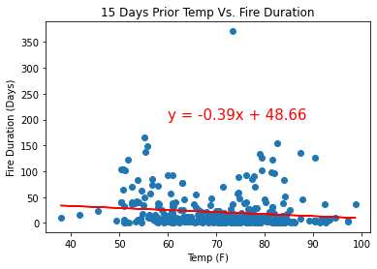
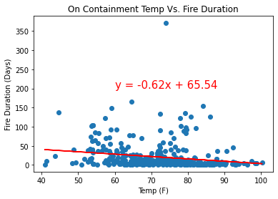
Temperature

Slide 12
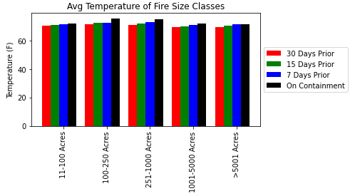
Temperature
The temperature rises up until date of containment
Temperature averages are consistent across all fire sizes

Slide 13
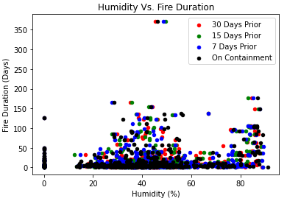
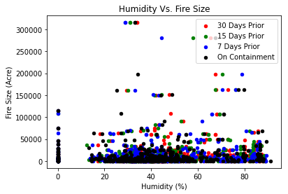
Humidity
Between 60 and 75% humidity, there is a decrease in the duration of the fires
Data clumped at 0% humidity, but none until about 10%

Slide 14
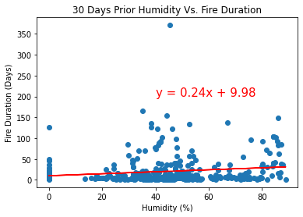
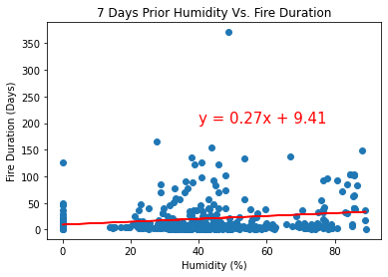
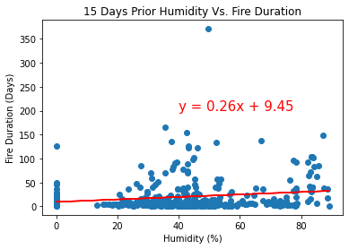
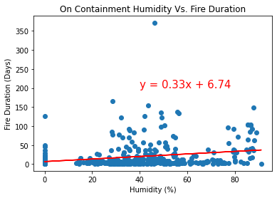
Humidity

Slide 15
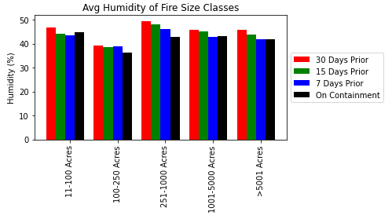
Humidity
Humidity decreases up until the date of containment
Fires 100-250 acres tend to have lower humidity

Slide 16
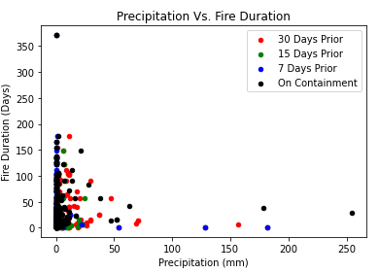
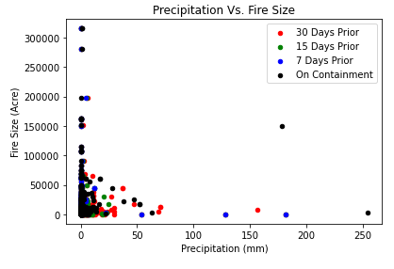
Precipitation
Data for both graphs is clumped at 0 precipitation
Fires greater than 75,000 acres have little to no precipitation

Slide 17
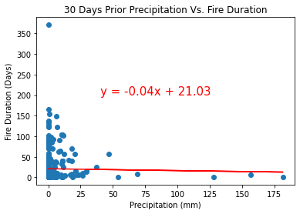
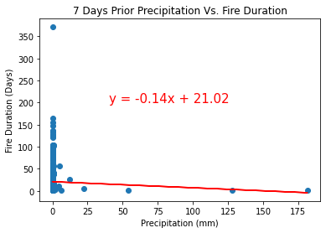
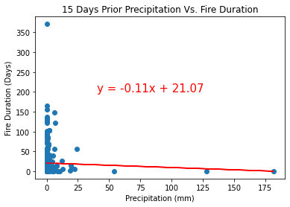
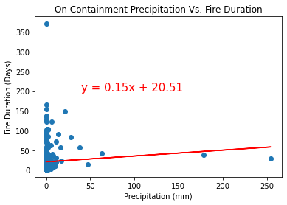
Precipitation

Slide 18
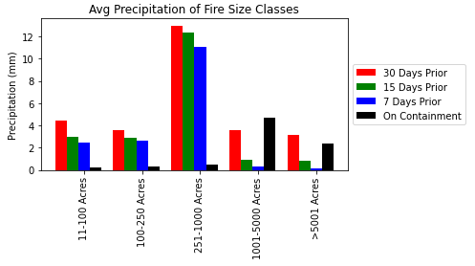
Precipitation
Precipitation averages are surprisingly high 30 days prior
Large fires have spike of precipitation on containment. Rainfall may have helped containment
Fires between 251 and 100 acres have much higher precipitation levels than other size groups
Could be related to storm systems with lighting causing mid-range fires
Precipitation for fires 11-250 acres is suspiciously low. Could be data error.

Slide 19
Visualization of Wildfire Map
Questions:
Where are the large scale wildfire located in California?
Where did the wildfires located in California?

Slide 20
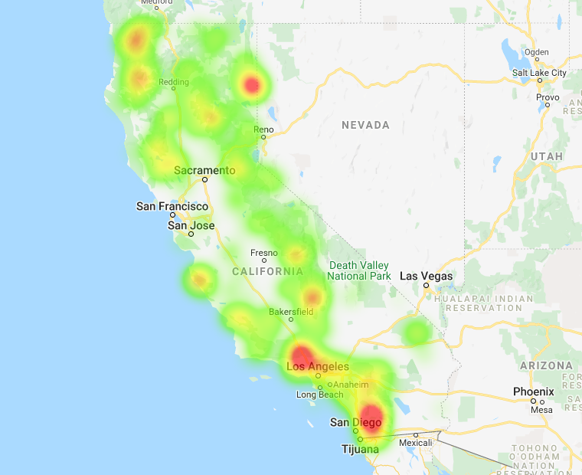
Fire Size Heatmap - using API
The majority of large scale wildfires happened from 1995 to 2015 were close to Los Angeles and San Diego according to the fire size heatmap.

Slide 21
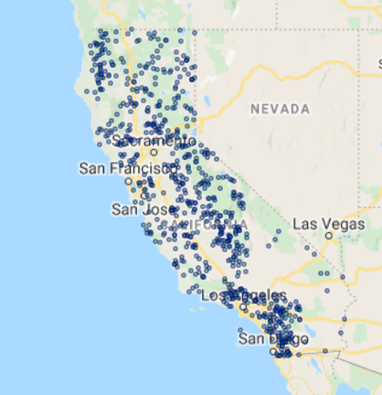
Fire Location Map - using API
Los Angeles and San Diego had slightly more fires happened during 1995 to 2015 according to the symbol map.

Slide 22
Conclusion
From our analysis, the weather factors (Wind speed/Humidity/Temperature/Precipitation) have some impacts on wild fire size/duration, but the impacts are not significant
Electric power, Arson, and Vehicular use are the top reasons for causing wildfires
Wildfire increases air polution in surrounding areas

Slide 23
Limitations and Discussions
We are not able to merge our datasets: data are from different years
Real world data cleaning: missing information or wrong information
More to explore:
- Impacts from wildfires on water resources: water quality within and downstream from a burn area may be significantly impacted.

Slide 24



