Slide 1

Frameworks:- Angular Vs Vue JS Vs React JS Vs Ember

Slide 2
What is Framework?
A framework is defined as a package made up of a structure of files and folders of standardized code.
Types Of Framework:-
Frontend Framework :-
Frontend frameworks usually consist of a package made up of a structure of files and folders of standardized code (HTML, CSS, JS documents etc.)
Backend Framework :-
The backend or the script-side of a dynamic application that works on request-response architecture comprises of API’s, database, frameworks, services worker and an operating system.

Slide 3

Angular
Angular is a MVW framework. Initially released in 2009, it has quickly risen to the top. Angular has received 56,478 GitHub stars. Angular is supported and maintained by Google.
Vevo, YouTube, LiveJournal, Freelancer, Udemy, TopCoder, Telegraph Web, etc made by using Angular.

Slide 4
Advantage | Disadvantage
Quick code production. Quick prototyping and dynamic single page apps creation. Two-way data binding with the DOM (Document Object Model). Intuitive alteration and UI design. Easy to test. HTML templates. | Difficult to learn. Hard to debug scopes. Complex syntax. Hard to use directives. Issues with documentation.

Slide 5

Vue JS
Vue.js is a JavaScript framework with various optional tools for building user interfaces.
Vue is used for Grammarly, Alibaba, Baidu, and WizzAir.

Slide 6
Advantages
Very Small Size.
Easy to Understand and Develop Applications.
Simple Integration.
Well written documentation.
Applicable both for simple and complex apps
Detailed Documentation.
Flexibility.
Two-Way Communication.

Slide 7
Disadvantage
Relatively small community.
Lack of resources.
Difficult to recognize because of flexibility.
Lots of plugins are in Chinese.
Lack of stable components.

Slide 8
React JS
React is a component-based library which is used to develop interactive UI’s. It is currently one of the most popular JavaScript front-end libraries which has a strong foundation and a large community supporting it. ReactJS is developed and maintained by Facebook.
React is used for Yahoo, Sberbank, Facebook, Whatsapp, Instagram, Khanacademy, etc.

Slide 9
Advantage
Easy to learn than Angular.
High level of flexibility and maximum of responsiveness.
Virtual DOM in ReactJS makes user experience better and developer’s work faster
Combined with ES6/7, ReactJS can work with the high load in an easy way.
Light-weighted than Angular.
100% open source JavaScript library.

Slide 10
Disadvantage
Lack of official documentation.
React is unopinionated .
Long time to master.
JSX as a barrier.

Slide 11

Ember
Ember, the framework is designed for creating ambitious web applications. Not only single page web applications (SPAs), but desktop and mobile apps, too.
Originally the framework was developed by SproutIt, but nowadays it gets support from Apple. It’s used for TinderBox, Netflix, Apple Music, Yahoo!, LinkedIn, PlayStation Now, and Vine.

Slide 12
Advantage
High performance.
Faster development due to Ember CLI.
Understandable documentation.
Two-way data binding.
Well-organized.
Own debugging tool (Ember Inspector).

Slide 13
Disadvantage
Complications with processing quick changes.
The heaviest of the frameworks.
Smaller community and extensive amount of outdated tutorials on the web.
Difficult to learn.
Too big for small projects.
Slowly release new versions with few new options.

Slide 14
Comparision

Slide 15
Github Stars (Till 2018)
37000

Slide 16
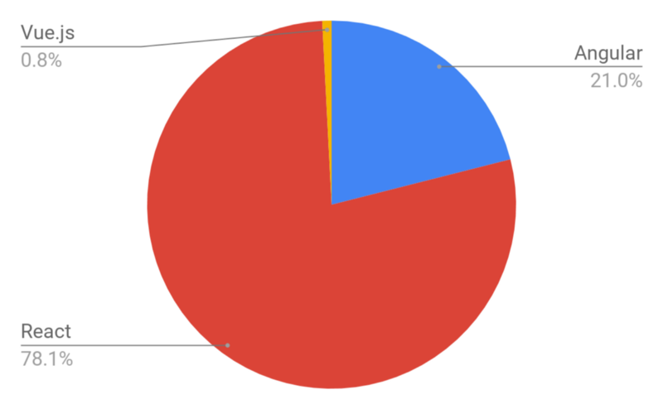
Popularity

Slide 17
My Opinion
If you are new in front-end frameworks, according to me go through the VueJS due to simplicity. In the Present era, VueJS gaining popularity.
After becoming master in VueJS you can go towards Angular and React or Ember.
If you are master in JavaScript and love to learn Typescripting langauge, then go to the angular.

Slide 18
Credit Link
https://medium.com/@TechMagic/reactjs-vs-angular5-vs-ue-js-what-to-choose-in-2018-b91e028fa91d
2. https://www.upwork.com/hiring/development/6-things-to-love-about-the-ember-js-framework/
3. https://jaxenter.com/angular-ember-or-vue-choice-135987.html
4. http://voidcanvas.com/angular-vs-react-vs-ember-vs-vue-js/
5. Photo Source:- Google image.

