Slide 1
CMS
Stands for "Content Management System." A CMS is a software tool that allows you to create, edit, and publish content. While early CMS software was used to manage documents and local computer files, most CMS systems are now designed exclusively to manage content on the Web.

Slide 2
Popular CMS
WordPress.
Joomla!.
Drupal.
Magneto.
TYPO3.
Blogger.
Shopify

Slide 3
WordPress
WordPress is an online, open source website creation tool written in PHP. When it comes to CMS comparison, it’s probably the easiest and most powerful blogging and website content management system (or CMS) in existence today. It can also be successfully used for designing simple websites.
Tech Guru, MTVNews, Facebook, Sony Music, Bata etc.....
Benefits of WordPress
It comes with preinstalled plugin and template function.
It’s ease-of-use.
User-friendly and best for beginners and amateurs.
It has over 45,000 Plugins for almost all the functionality.
WordPress offers lots of customization options of a theme.

Slide 4
Pros V’s Cons
Large community.
Minimal effort for installation and setup.
Intuitive user interface.
Simple integration of plugins and other extensions.
CMS functions require additional extension.
Plugins often have security gaps.
Limited stability and performance capability with high traffic.
More frequent security updates lead to additional administrative effort.

Slide 5
System requirements for WordPress
Webserver: Every server with PHP and MySQL.
Middleware: PHP 7.2 or higher.
Database: MySQL 5.6 or higher.
Hardware: The developer recommends a PHP memory limit of 32 MB or more

Slide 6
Joomla!
Joomla is a free and open-source content management system (CMS) for publishing web content. It’s great for e-commerce or social networking websites, but when it’s about CMS comparison it requires a basic understanding of technical skills. Joomla is designed to perform as a community platform, with strong social networking features.
Harvard University, The Hill, It Wire, The Fashion Spot etc...

Slide 7
Benefits of Joomla!
Joomla is an open source so its license is available free of cost.
Joomla can be used for Multipurpose like government applications and organizational websites.
It’s Easy to Use.
Not too Technical.
There are thousands of templates and themes available for Joomla CMS development.
Joomla CMS development can be easily migrated to any server.

Slide 8
Pros V’s Cons
Comparably simpler installations and configuration effort.
Large pool of extensions and designs.
User-friendly template creation
Inadequate rights management.
Advanced extensions can be pricey.
Extensions often require manual implementation.

Slide 9
System requirements for Joomla!
Webserver: Apache HTTP Server 2.0
Middleware: PHP 5.6 (7.0 or higher recommended)
Database: MySQl 5.1

Slide 10
Drupal
Drupal is the most difficult, but also the most powerful. It requires a familiar understanding of HTML, CSS, and PHP. Drupal an exceptionally SEO Friendly CMS it comes with the Clean code and effective modules.
Tesla, Tourism Fiji, White House, Redhat etc..

Slide 11
Benefits of Drupal
Drupal doesn’t require any specialized capacity for coding (like HTML coding).
it comes with Thousand of free Modules.
Drupal has Basic and Advanced Features.
Drupal comes with Readymade Professional Themes.

Slide 12
Pros V’s Cons
Compact software core.
Large selection of extension modules and predefined Drupal distributions.
Supports multi-domain management.
Complex configuration due to poor backend compatibility.
Slim basic installation requires lots of extra installations.
Module installation only possible via FTP.

Slide 13
System requirements for Drupal
Webserver: Apache, Nginx, MS IIS, or any other webserver with PHP support
Middleware: PHP 5.5.9 or higher
Database: MySQL 5.5.3,

Slide 14
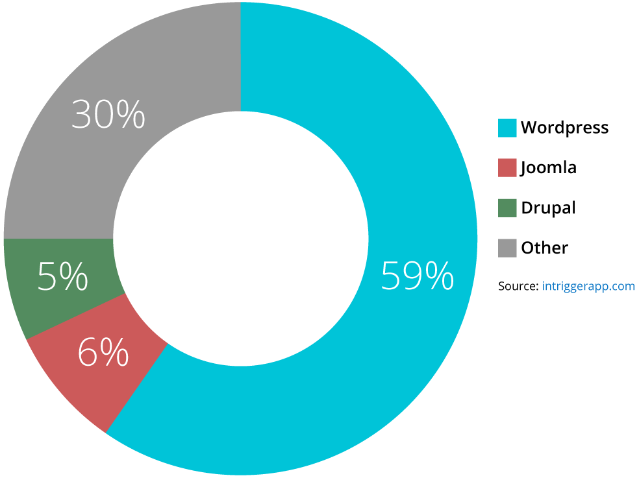

Slide 15
Community view
The one area where WP really stands out is its community. Just check out these stats: 900+ meetup groups for WP in multiple countries around the world!
Over 250,000 active members in WP meetup groups worldwide. You can find a meetup group in 60+ countries and 500+ cities.

Slide 16
My Over View
Wodpress CMS are best for me because
Its very easy to use...
Ref:- https://www.sktthemes.net/fyi/cms-comparison-wordpress-joomla-drupal/

