Slide 1
Vue JS

Slide 2
Introduction
Vue.js is actually a JavaScript framework with various optional tools for building user interfaces.
Developed by Evan You.
Due to it’s simplicity, it is good choice for beginners.
SPA easily developed by Vue JS.
Work on Virtual DOM technique.

Slide 3
What is Virtual DOM?

Slide 4
Example :-
<div id='app'>
<div id='myId'>hello world</div>
</div>
new Vue({
el: '#app',
data: {
message: 'hello world'
},
render() {
var node = this.$createElement;
return node(
'div',
{ attrs: { id: 'myId' } },
this.message
);
}
});

Slide 5
History
Started in 2013
First release Feb, 2014(v0.6)
October 2015 v1.0.0
Latest Version-2.6.8

Slide 6
Features
Small Size (21KB-26KB)
Easy to Understand and Develop Applications.
Simple Integration
Detailed Documentation
Latest Version-2.6.8
SEO Friendly

Slide 7
Company Which Use
Alibaba.com
GitLab
MI
Grammerly
Tencent
EuroNews
Baidu
Weex

Slide 8
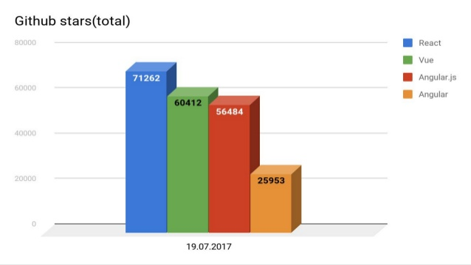
Github Stars

Slide 9
Installtion
CDN
NPM
CLI

Slide 10
CDN Link
<script src="https://cdn.jsdelivr.net/npm/vue">
</script>
body>
<div id="app">
{{ message }}
</div>
<script src="https://cdn.jsdelivr.net/npm/vue"></script>
<script>
var app = new Vue({
el: '#app',
data: {
message: 'Hello Vue!'
}
})
</script>
</body>

Slide 11
NPM
$node -v
npm -v
$ npm install vue
Vue --version

Slide 12
CLI
npm install -g @vue/cli
vue create vue-proj
After Creating Project
cd (your projrct name)
Npm run serve

Slide 13
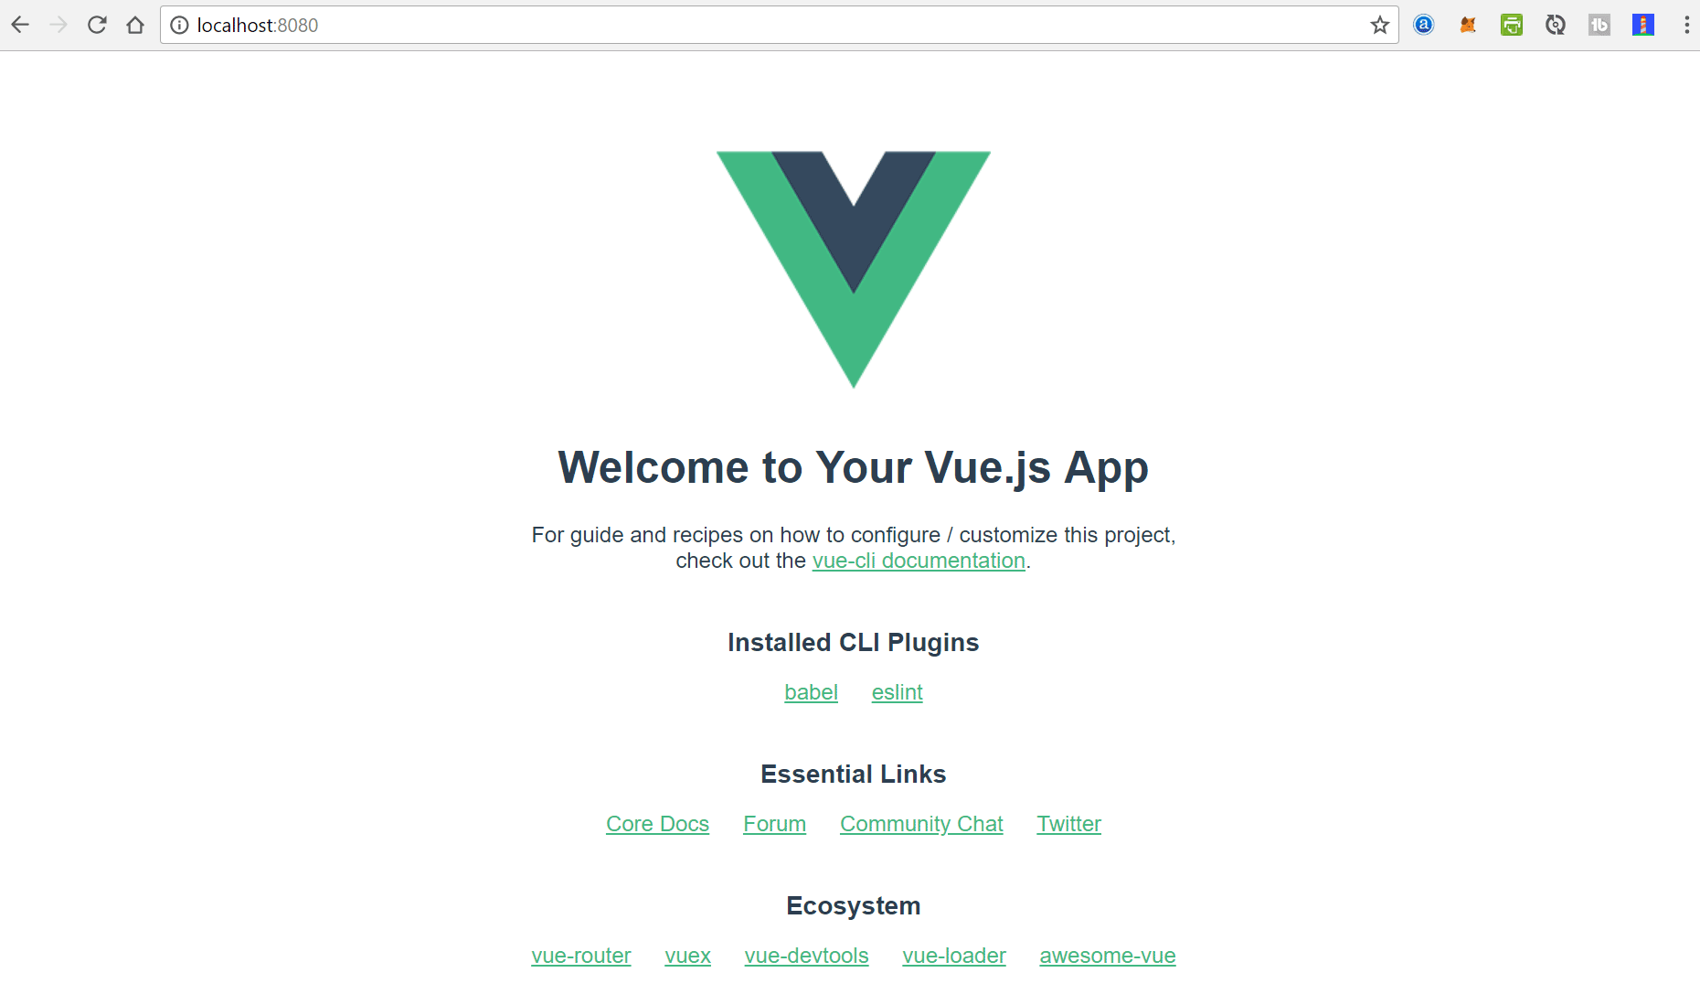
View of Vue project

Slide 14
Simple Code for printing Hello
<div id="app">
{{ message }}
</div>
var app = new Vue({
el: '#app',
data: {
message: 'Hello !'
}
})
Hello !!

Slide 15
https://hackernoon.com/what-is-vue-js-and-what-are-its-advantages-4071b7c7993d
https://coursetro.com/posts/code/133/How-to-Install-Vue-2---Through-CDN,-NPM-and-the-Vue-CLI
https://vuejs.org/v2/guide/

