Slide 1


AI-Powered Shopping Assistant for Smarter Task Management with Mobile Computing and Advanced Algorithms
Project Done by
S YOGESH (192421266)
B RAGHUL (192421249)
M SUSEENDHAR (192421247)
GUIDED BY,
Dr. K Saravanan,
AIML Departmant.

Slide 2
INTRODUCTION
Modern shopping is complex, time-consuming, and overwhelming.
Users face challenges in managing lists, tracking offers, and sticking to budgets.
Mobile computing provides anywhere, anytime accessibility for shopping tasks.
AI-powered assistants bring automation, personalization, and intelligent decision-making.

Slide 3
Objective
To develop an AI-powered shopping assistant that simplifies and automates shopping and task management.
To provide personalized product recommendations using advanced algorithms.
To generate and manage smart shopping lists based on user preferences and past behavior.
To assist users in tracking budgets, offers, and discounts effectively.

Slide 4
Problem Statement
Overloaded product information leads to confusion and decision fatigue.
Time-consuming process of comparing items manually.
Existing shopping apps offer generic suggestions instead of personalized help.
Difficulty in managing multiple tasks (shopping, reminders, budgeting).
Lack of integration between online and offline shopping experiences.

Slide 5
Methodology
Collect user requirements through surveys and identify shopping challenges.
Design the system architecture for a mobile app with AI integration.
Create modules such as Task Manager, Recommendation Engine, Price Comparison, Budget Tracker, and Voice Assistant.
Develop algorithms using Machine Learning for recommendations, NLP for voice/chat, Graph algorithms for route planning, and Scheduling algorithms for reminders.

Slide 6
System Architecture
The mobile app (Android/iOS) acts as the user interface for shopping lists, reminders, recommendations, and offers.
Users interact with the system through voice commands or text input.
The application layer processes tasks such as managing lists, giving recommendations, comparing prices, tracking budgets, and handling voice assistance.
The data layer stores user profiles, shopping history, and product details, and also connects with e-commerce/store APIs for real-time product and price updates.

Slide 7
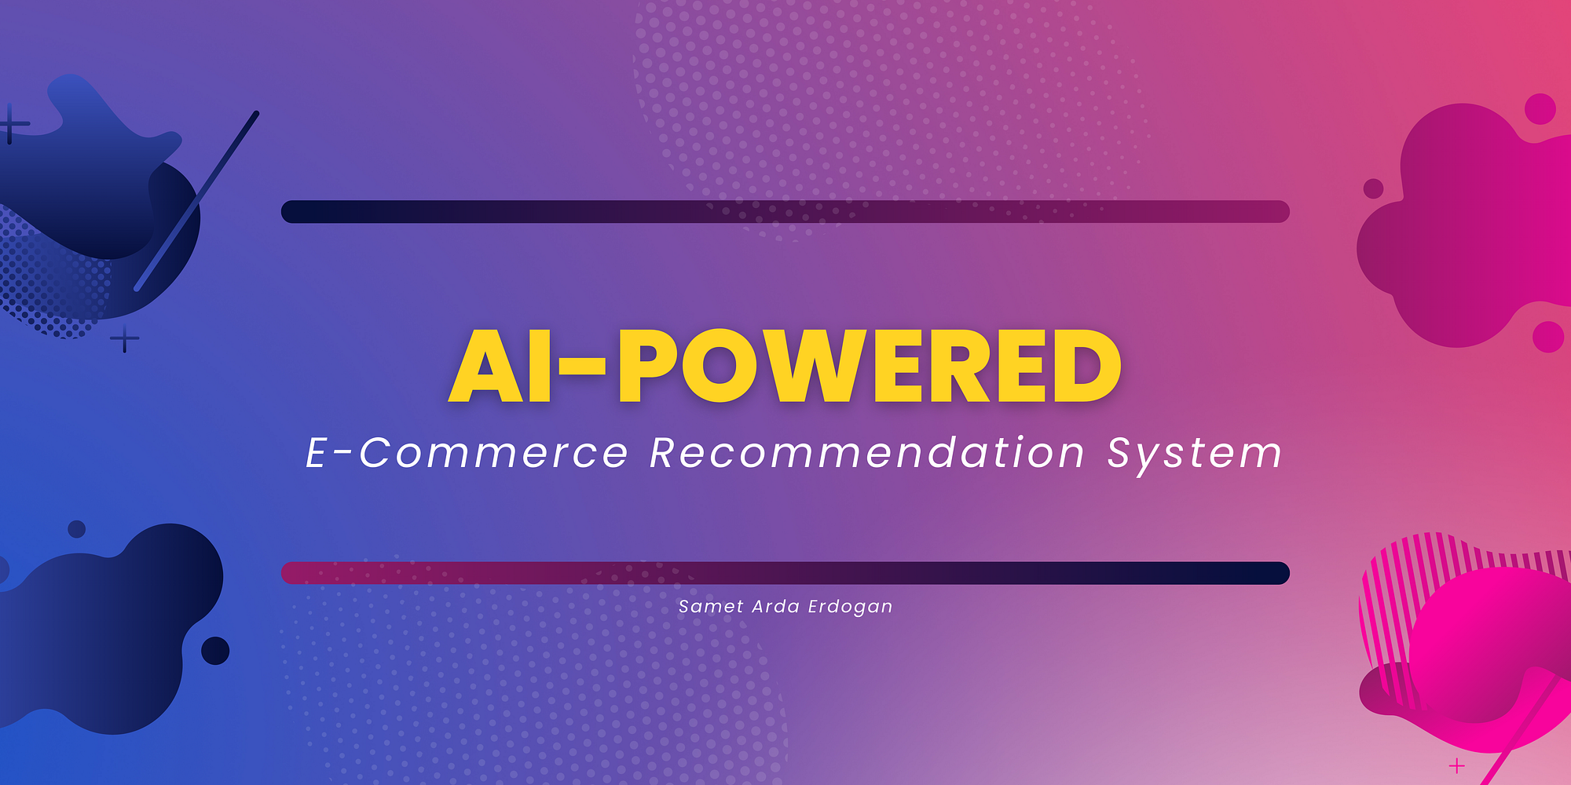
Module 1: Smart Shopping Recommendation Engine
Uses Machine Learning (ML) to suggest products based on user
history and preferences.
Provides personalized recommendations for better decision-making.
Fetches real-time product data from e-commerce APIs.
Compares products across vendors for price, quality, and offers.
Adapts dynamically as user shopping behavior changes.

Slide 8
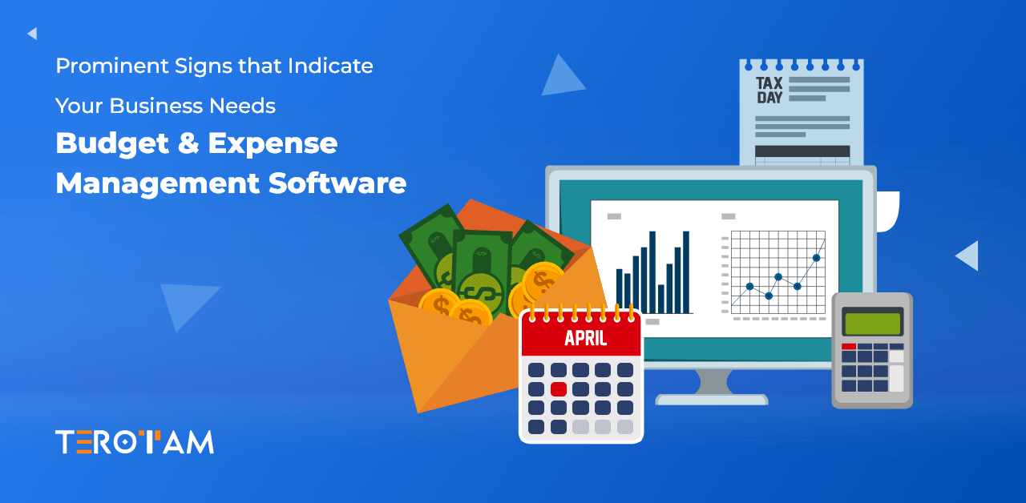
Module 2: Task & Budget Management System
Allows users to create and manage shopping lists.
Provides reminders and notifications for shopping tasks.
Tracks expenses and budget limits in real time.
Alerts users on overspending or upcoming offers.
Optimizes offline shopping with route planning.

Slide 9

Module 3: Intelligent Virtual Assistant Interface
Provides a chatbot and voice-enabled assistant for hands-free interaction.
Uses Natural Language Processing (NLP) to understand queries.
Assists with task management, recommendations, and budget queries.
Gives real-time responses on product availability and offers.
Enhances user experience with a natural, conversational interface.

Slide 10
Conclusion
The AI-powered shopping assistant makes shopping smarter, faster, and more personalized.
AI-powered recommendations help users save time and make better purchase decisions.
Task and budget management ensures organized shopping within financial limits.
Intelligent virtual assistant enhances user experience with voice and chat support.

Slide 11
Future Scope
Integration with IoT devices like smart refrigerators to auto-update shopping lists.
Use of AR/VR technologies for virtual shopping experiences and product trials.
Expansion of voice assistant support to multiple regional languages.
Predictive analytics to forecast user needs and seasonal demands.
Better integration of online and offline shopping platforms.

Slide 12
References
Satyanarayanan, M. (2001). Fundamental Challenges in Mobile Computing. ACM SIGMOBILE.
Han, J., Kamber, M., & Pei, J. (2012). Data Mining: Concepts and Techniques. Morgan Kaufmann.
Ghemawat, S., Gobioff, H., & Leung, S. (2003). The Google File System. ACM Symposium on Operating Systems Principles.
Zhang, Y., Zhao, R., & Chen, H. (2019). "AI-Powered E-Commerce Recommendation Systems." International Journal of Computer Applications, 178(35), 22–29.
Patel, A., & Desai, P. (2020). "Smart Budget Management using Mobile Applications." Journal of Emerging Technologies and Innovative Research (JETIR), 7(6), 450–456.

Slide 13
THANK YOU

