Slide 1
ClaimIQ
AI-Powered Healthcare Claim Review Assistant
Intelligent · Transparent · Human-Supervised
AWS AI & ML Capstone Project | June 28, 2026
#
Name
Role
1
Sushilkumar Nikam
Team Lead, Architect & AI/ML Engineer
2
Anupam
RAG Pipeline Engineer & Data Engineer
3
Ashish
AI/ML Engineer & LangGraph Workflow Architect
4
Bishwajit
Full Stack Developer, AI/ML Engineer & AWS Infrastructure Engineer
5
Arvind
AI/ML Engineer & Backend Developer
6
Azim
AI/ML Engineer & Backend Developer

Slide 2
Problem Statement
Healthcare claim processing is broken — and expensive
Insurance carriers spend $30–$50 per claim in manual processing costs. Even a 10 % reduction translates to billions in annual savings.
⏱ Processing Delays
❌ High Error Rates
⚖ Inconsistency
15–30 days average per claim due to manual review queues
Manual data entry mistakes in ICD-10 / CPT coding cause incorrect rejections
Different adjusters reach different decisions on identical claims
📋 Poor Audit Trail
🔍 Fraud Exposure
😓 Reviewer Burnout
Decisions tracked via paper notes and email chains — not auditable
Manual reviewers cannot cross-reference all historical claims simultaneously
High-volume, repetitive review tasks reduce accuracy over time
Core Gap: No unified system that can extract, validate, retrieve policy context, recommend a decision, and present it to a human — in a single automated workflow.

Slide 3
Selected Theme & Domain
Domain
Theme
🏥 Healthcare & Insurance Technology (HealthTech / InsurTech)
🤖 Agentic AI with Human-in-the-Loop Oversight
• Insurance claim review automation
• HIPAA-compliant data processing
• AI-assisted decision support for claims adjusters
• Fraud detection and compliance enforcement
• Multiple specialised AI agents collaborate in a defined workflow
• Each agent performs a distinct role: extract → validate → recommend
• LangGraph orchestrates the multi-agent pipeline as a StateGraph
• Mandatory human approval gate before every final decision
• All decisions are auditable and overridable by human reviewers
Why This Domain + Theme Combination?
• Healthcare claims are document-heavy, rule-intensive, and high-stakes — ideal for structured multi-agent AI.
• Policy rules change frequently — RAG lets the system stay current without retraining the model.
• Financial and patient-care consequences demand human oversight — the Human-in-the-Loop gate ensures AI is advisory, not authoritative.

Slide 4
Solution Overview
ClaimIQ — end-to-end AI claim review in under 20 seconds
ClaimIQ is an AI-powered, multi-agent healthcare claim review system that orchestrates four specialised AI agents using LangGraph, enhanced by a RAG knowledge base of insurance policy documents, culminating in a human-supervised final decision.
Agent 1
Agent 2
Agent 3
Human Gate
OCR Agent
Validation Agent
Recommendation Agent
Human Approval Gate
pdfplumber + GPT-4o-mini
▶
Rule-based logic
▶
RAG + GPT-4o-mini
▶
Streamlit UI
Extracts 15 structured fields from PDF
Checks 12 fields, codes & dates
Policy-grounded APPROVE/REJECT/REVIEW
Reviewer confirms or overrides AI
🔍 Transparent
👤 Human Control
🛡 Graceful Degradation
📁 Full Audit Trail
Every recommendation cites the exact policy clause
AI never finalises a claim unilaterally
Works even if OpenAI or S3 is unavailable
Every decision stored as timestamped JSON

Slide 5
System Architecture
Three-layer design: UI → Orchestration → Services
USER LAYER
Process New Claim
Review & Approve
Claims History
About / Info
Upload PDF / select sample
Human Approval Gate
Dashboard & metrics
System status
▼
ORCHESTRATION LAYER
LangGraph StateGraph (ClaimState)
OCR Agent
Validation Agent
Recommendation Agent
Human Gate
▶
▶
▶
▼
▼
▼
AI Services
Knowledge Base
Storage
SERVICES LAYER
• OpenAI GPT-4o-mini
• ChromaDB Vector Store
• Local JSON (data/outputs/)
• text-embedding-3-small
• 3 Policy PDFs (~150 chunks)
• AWS S3 (optional cloud)
Data Flow: PDF Upload → OCR → Validation → RAG Retrieval → LLM Recommendation → Human Approval → S3 Storage

Slide 6
Agent Workflow Design
LangGraph StateGraph — four nodes, one shared ClaimState
Agent 1 — OCR Agent
src/agents/ocr_agent.py
• Opens PDF with pdfplumber, extracts raw text
• Calls GPT-4o-mini with response_format=json_object
• Returns 15 structured fields (patient, provider, codes, amounts)
• Sets confidence: HIGH (12+ fields) / MEDIUM / LOW
Agent 2 — Validation Agent
src/agents/validation_agent.py
• Checks 6 mandatory fields — any missing → severity HIGH
• Checks 6 important fields — missing → severity MEDIUM
• Validates ICD-10, CPT, NPI formats via regex
• Validates date logic: treatment ≤ claim date, filed within 365 days
Agent 3 — Recommendation Agent
src/agents/recommendation_agent.py
• Fast-path rules: duplicate, dental, experimental, >$25K → instant decision
• Retrieves top-5 policy chunks from ChromaDB via cosine similarity
• Calls GPT-4o-mini with claim data + policy context
• Returns APPROVE / REJECT / MANUAL_REVIEW with citations
Human Approval Gate
app.py + finalize_claim()
• Pipeline pauses at awaiting_human_approval = True
• Reviewer sees extracted fields, validation results, AI recommendation
• Can Approve, Reject, or Override (override requires written justification)
• finalize_claim() persists decision as timestamped JSON + S3 upload

Slide 7
RAG Pipeline
Retrieval-Augmented Generation — grounding AI in current policy documents
Policy documents change — RAG lets the system use current rules without retraining the model. Every recommendation includes the exact policy clause that justified it.
INGESTION PIPELINE (scripts/ingest_documents.py)
📄 Policy PDFs (3 documents)
📝 Text Extraction (pdfplumber)
✂️ Text Chunking 800 chars / 100 overlap
🔢 OpenAI Embeddings text-embedding-3-small
🗄 ChromaDB ~150 chunks persisted
→
→
→
→
RETRIEVAL PIPELINE (at claim review time)
📋 Claim Fields (extracted)
🔍 Build Query String diagnosis + procedure + amount
🔢 Query Embedding text-embedding-3-small
📊 ChromaDB Search top-5 cosine similarity
💡 Inject into LLM Prompt
→
→
→
→
Embedding Model Details
🛡 Fallback Strategy
Model:
text-embedding-3-small
If ChromaDB is unavailable or index is empty, the retriever returns a hard-coded FALLBACK_POLICY_CONTEXT with key rules extracted from all three policy documents — ensuring the Recommendation Agent always has some policy grounding.
Dimensions:
1,536
Retrieval top-k:
5 (cosine similarity)
Chunk size:
800 chars / 100 overlap

Slide 8
AWS Deployment Overview
Two patterns: EC2 Docker Compose (dev) and ECS Fargate (production)
Pattern A — EC2 + Docker Compose
Pattern B — ECS Fargate + ALB
Instance:
Ubuntu 22.04, t3.medium (2 vCPU / 4 GB)
Compute:
ECS Fargate — 1 vCPU / 2 GB Memory
Storage:
20 GB gp3 EBS
Registry:
Amazon ECR — Docker image store
Region:
us-east-1
Secrets:
AWS Secrets Manager (OpenAI key)
Access:
Port 8501 (Streamlit) / 80+443 (Nginx)
Load Bal.:
ALB → port 80/443 → target 8501
Use Case:
Development, demos, low cost (~$30/mo)
Logs:
CloudWatch /ecs/claimiq
services: claimiq: build: . ports: ["8501:8501"] env_file: .env volumes: [./data:/app/data] restart: unless-stopped
Use Case:
Production auto-scaling (~$40/mo)
AWS Services Used
EC2
ECS Fargate
ECR
S3
Secrets Manager
IAM
ALB
CloudWatch

Slide 9
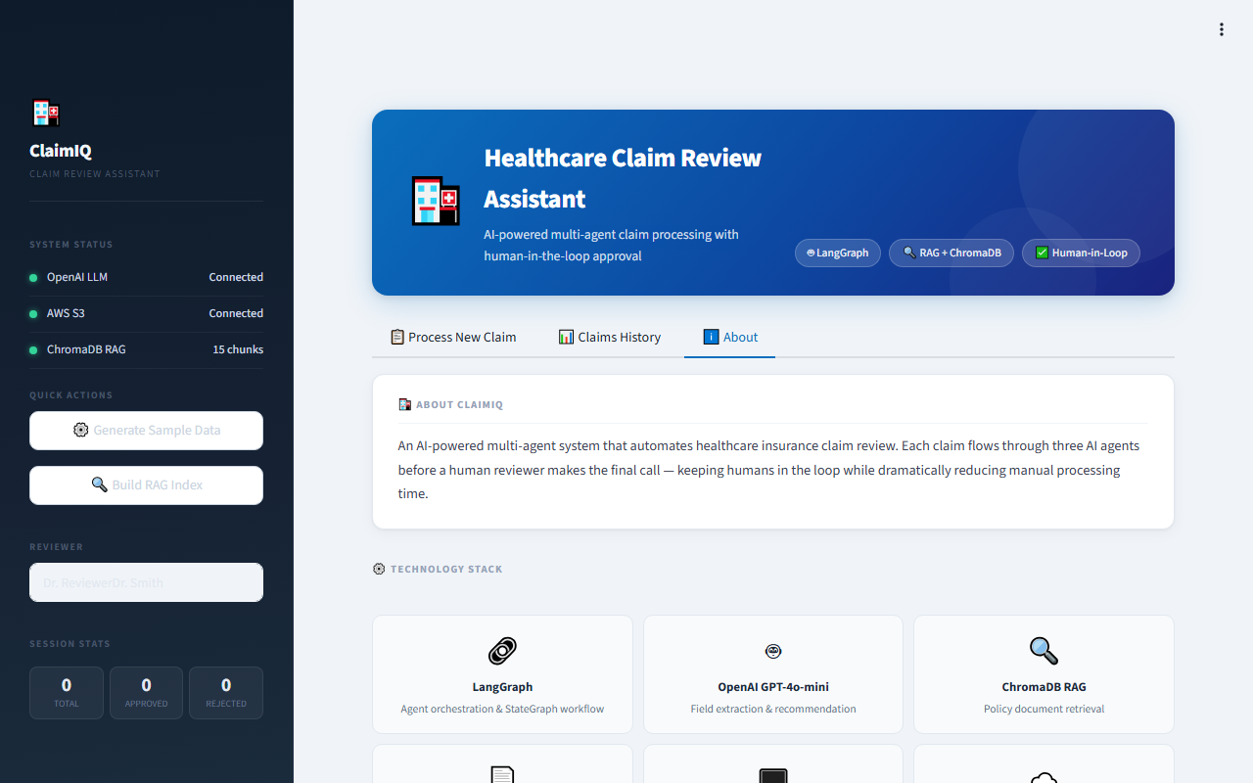
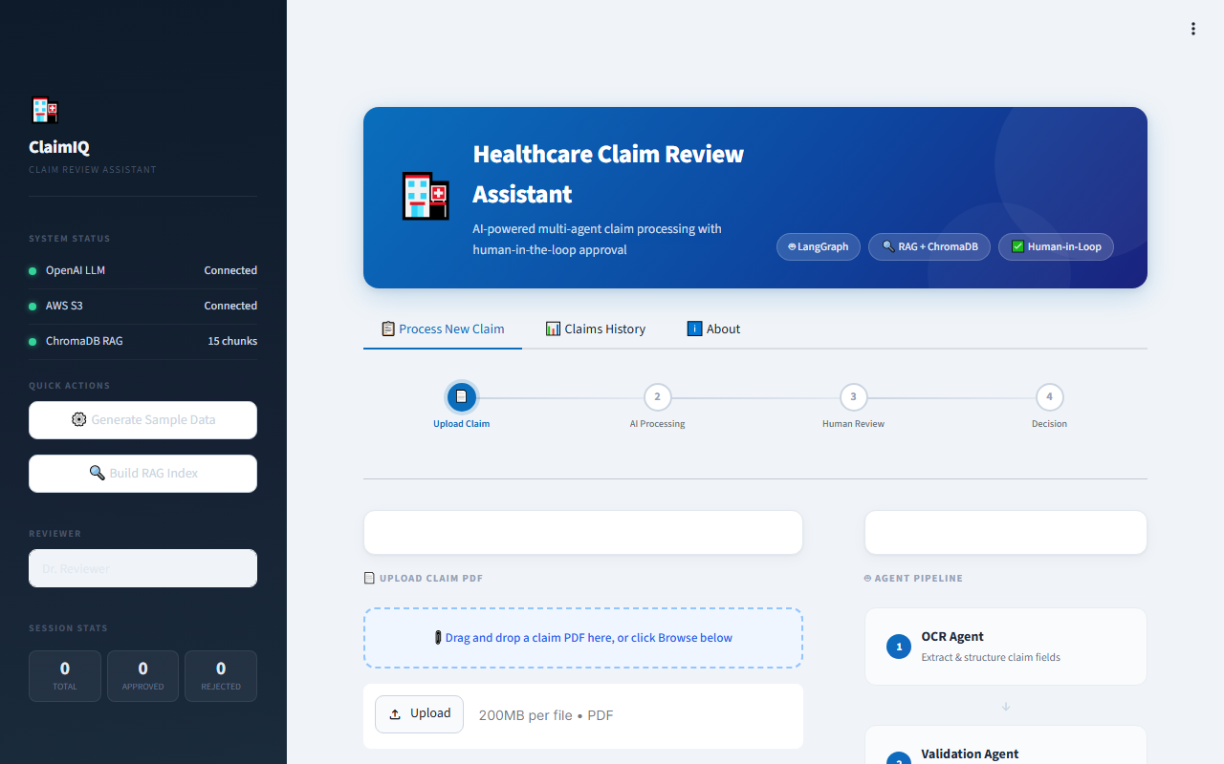
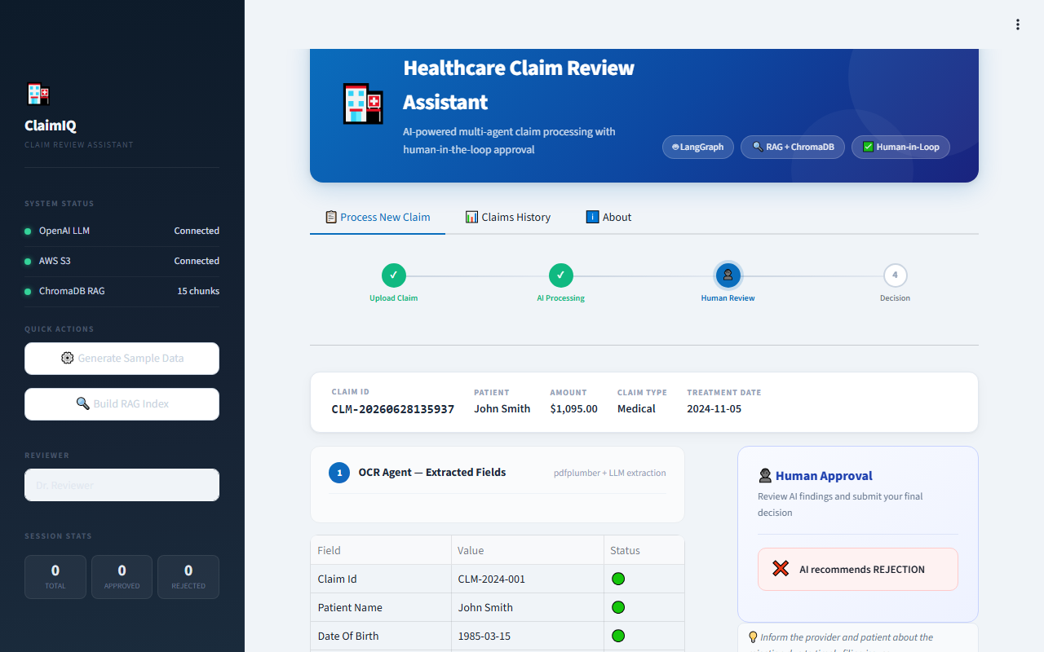
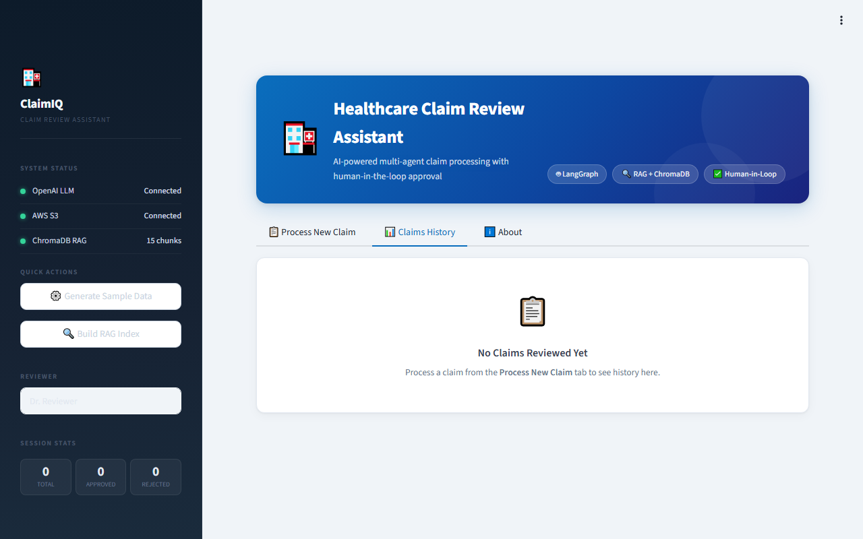

Demo Screenshots
Streamlit web application — five key screens
Live Demo | ClaimIQ on AWS EC2 ap-south-1 | http://13.206.252.215:8501

Slide 10
Key Outcomes & Results
100 % accuracy on all 10 synthetic claim scenarios
94.1 %
100 %
100 %
< 20 s
Average OCR Field Extraction Rate
Validation Severity Accuracy (10/10)
Recommendation Accuracy (10/10)
End-to-End Processing Time
Business Impact — Manual Process vs ClaimIQ
Step
Manual Process
ClaimIQ (AI)
Improvement
Extract claim fields
5–10 minutes
8–12 seconds
~50× faster
Validate rules
3–5 minutes
< 1 second
300× faster
Look up policy context
5–15 minutes
2–4 seconds
~200× faster
Total before human review
15–30 minutes
~15–20 seconds
~100× faster
Audit trail completeness
Inconsistent
100 % JSON
Fully auditable
Decision consistency
Variable
Deterministic
Fully reproducible

Slide 11
Challenges & Learnings
Seven production-grade challenges resolved during development
Image-based PDFs
LangGraph Serialization
ChromaDB Corruption
❌ pdfplumber extracts no text from scanned PDFs
❌ Non-primitive types in ClaimState crashed the pipeline
❌ Interrupted ingestion left partial, misleading index
✅ Text-length guard + graceful MANUAL_REVIEW fallback
✅ Agents store only strings/dicts/lists; json.dumps validation at each node
✅ --reset flag to wipe and recreate; chunk count validation post-ingestion
LLM JSON Parsing
Session State Race Cond.
EC2 Docker Permissions
❌ GPT-4o-mini wrapped JSON in markdown code fences
❌ Two concurrent submissions interleaved UI results
❌ ubuntu user not in docker group on fresh EC2
✅ 3-step cleaning: direct parse → strip fences → regex extract → fallback
✅ processing_lock flag; claim_id correlation; explicit state reset on new claim
✅ usermod -aG docker ubuntu step added to DEPLOYMENT.md checklist
Cold Start Latency
❌ First claim took 25–40 s — blank spinner confused users
✅ Module-level initialisation; Streamlit progress spinner with status text
Key Learnings
• LangGraph StateGraph requires all state values to be JSON-serialisable — design state contracts early
• RAG citation quality depends heavily on chunk size and overlap — 800/100 chars proved optimal for policy docs
• Graceful degradation must be designed in from day one — every external call needs a fallback path
• Human-in-the-loop UI needs clear confidence signals — confidence badges and policy citations drive reviewer trust

Slide 12
Future Scope & Enhancements
Building on ClaimIQ's foundation — the roadmap ahead
🔍 AWS Textract Integration
🔄 Live Policy Document Updates
🧠 Feedback Loop & Fine-Tuning
Replace pdfplumber with AWS Textract to handle image-based (scanned) PDFs without requiring a digital text layer — critical for real-world claim submissions.
Trigger automatic RAG re-ingestion via S3 event notifications when new policy PDFs are uploaded — keeping the knowledge base always current with zero manual intervention.
Capture human override decisions as training signal to iteratively improve the Recommendation Agent's prompt and reduce override rates over time.
🏥 Multi-Plan Support
📊 Explainability Dashboard
🔔 Notification Integration
Parameterise the RAG retriever to filter by insurance plan code — enabling a single ClaimIQ instance to serve multiple insurance products simultaneously.
Visualise which specific policy chunks influenced each recommendation and display their cosine similarity scores — full AI decision explainability for compliance teams.
Email / Slack alerts to reviewers when high-priority claims arrive (experimental treatments, amounts > $25K) — reducing review turnaround for critical cases.
ClaimIQ Squad • Sushilkumar | Anupam | Ashish | Bishwajit | Arvind | Azim • June 2026

