Slide 1
Elite
Team members: -
Sushant p
Vivek Kumar
Kenn Rippon

Slide 2
AI TOOLs USed
WHISPER : Whisper is an automatic speech recognition (ASR) system developed by OpenAI.
TRANSFORMER : They are state of art machine learning models for natural language processing task [nlp]
STEPS TO BE FOLLOWED NEXT

Slide 3
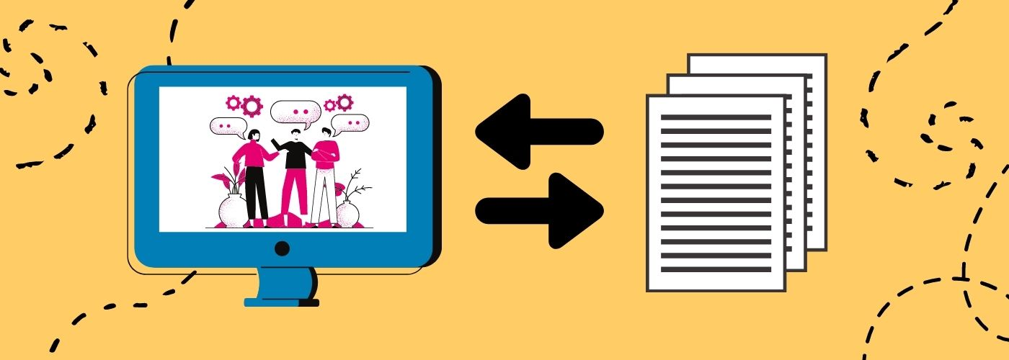
TRANSCRIBING THE VIDEO

Slide 4




VIDEO
AUDIO
AUDIO ENHANCED
Extracting
Enhancing

Slide 5

VIDEO
CAPTIONS
EXTRACTING CAPTION AND TIMESTAMPS

Slide 6
API REQUIREMENTS
openai-whisper
Streamlit
transformers
pydub
moviepy
ffmpeg

Slide 7
Software used
Jupyter Notebook
Visual Studios
Github Desktop
Google Collab

