Slide 1

MARL for Google Cloud Platform Resource Management
Thesis Project Overview Name: Sushant Patil
Student ID: 2717062

Slide 2
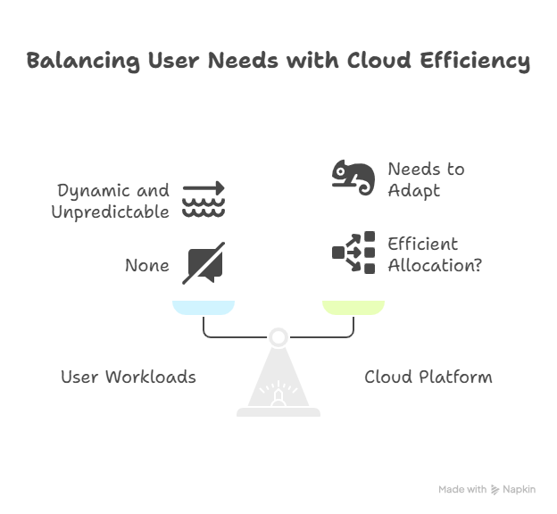
Background / Motivation
Cloud platforms like GCP need to manage lots of resources for many users and jobs.
It's hard to do this efficiently because workloads change all the time.
Multi-Agent Reinforcement Learning (MARL) lets us use many smart agents that learn to make good decisions together, adapting to changes.

Slide 3
Project Goals
Build
- Build a system using MARL to make resource allocation smarter in a cloud-like environment.
Use
- Usage of Google clusters data. Link of the GitHub repository : https://github.com/google/cluster-data
Compare
- Compare MARL with traditional scheduling methods:
- First-Come, First-Served (FCFS): Jobs are handled in the order they arrive.
- Static Thresholds: Fixed rules for resource allocation.
Show
- Show that the approach adapts and performs better than these fixed-rule methods.

Slide 4
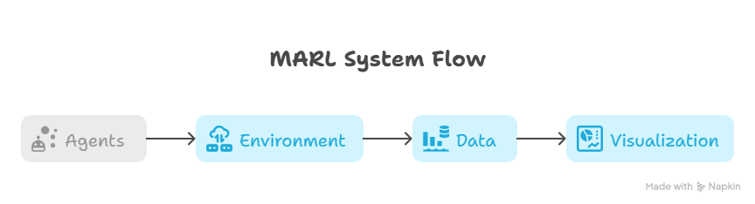
System Flow & Methodology
- Algorithms Used
- Implemented TD3 (Twin Delayed Deep Deterministic Policy Gradient) for agent training.
- Focused on TD3 as the main RL algorithm for this project.
- Data Preprocessing
- Cleaned and filtered raw data to remove inconsistencies.
- Extracted relevant features (e.g., resource usage, job events) for agent input.
- Split data into training and testing sets to evaluate agent performance.
- Training Process
- Trained 4 agents in parallel, each responsible for managing a subset of resources.
- Ran training for 576 episodes (each episode = one complete simulation run with a different data segment).
- Visualized training progress for each agent across episodes.

Slide 5
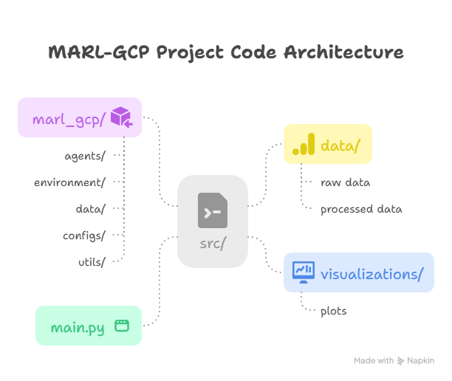
Technology Stack-
Programming Language:
Python- Key Libraries & Frameworks:
NumPy, Pandas (data processing and analysis)
Matplotlib, Seaborn (visualization)
Stable-Baselines3 (reinforcement learning algorithms)
Gym (environment simulation)
Data Source: Google Cluster Data
Project Structure:
Modular codebase: agents, environment, data, utilities, visualization
Version Control: Git & GitHub
Documentation & IDEs: Markdown, Vscode

Slide 6
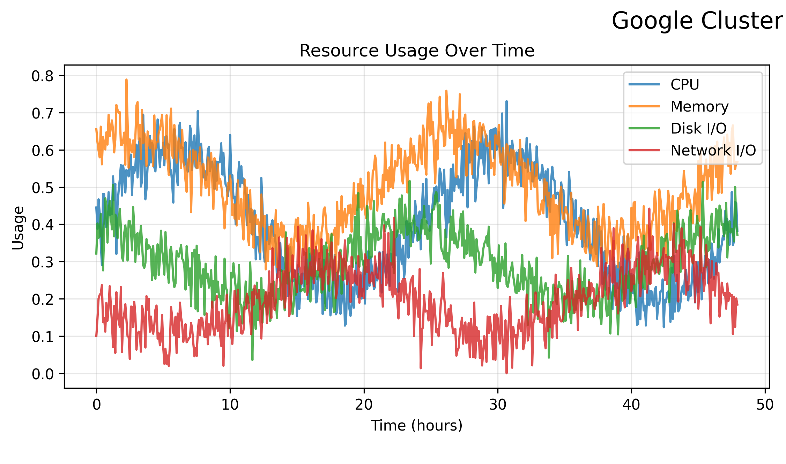
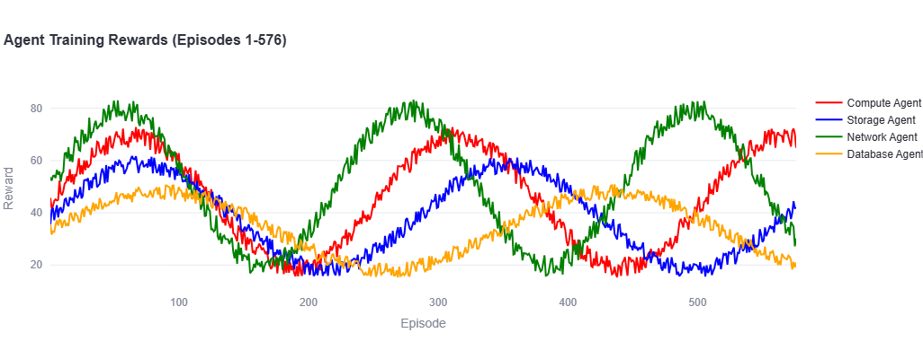
Results
Cluster Data Analysis
The first image shows analysis of Google cluster data, including:
Resource usage trends over time for CPU, memory, disk I/O, and network I/O.
Feature statistics and correlations, helping identify which resources are most variable and how they relate to each other.
This analysis guided the feature selection and agent design for the MARL system.
Training Reward Function
The second image displays the training rewards for each agent (Compute, Storage, Network, Database) across 576 episodes.
Increasing and stabilizing reward curves indicate that agents are learning effective resource allocation strategies over time.

Slide 7
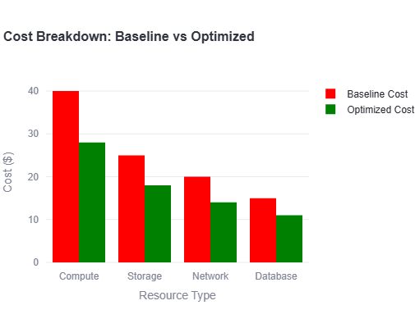
Results
The red bars represent the costs using the baseline (static/manual) allocation.
The green bars show the costs after optimization with MARL agents.
Significant cost savings are observed across all resource types, especially in compute and storage.
This demonstrates the effectiveness of your approach in reducing operational expenses.
Resource Utilization Improvement
The MARL system not only reduced costs but also improved resource utilization.
Agents dynamically allocated resources, minimizing idle and wasted capacity.
Latency and Responsiveness: By adapting to workload changes in real time, the system reduced latency.
Learning Stability and Robustness: The system maintained performance across different workload patterns, showing robustness.
Constraint Handling: The system respected budget and resource constraints, applying penalties for violations.

Slide 8
Conclusion and Future Work
Conclusion
MARL-based system enables adaptive and efficient cloud resource management.
Achieved significant cost savings and improved resource utilization.
Reduced latency
Agents learned stable and effective allocation strategies using Google Cluster data.
System is robust, scalable, and applicable to cloud environments.
Future Work
Scale the system to larger clusters and more diverse workload types.
Integrate with live cloud platforms for real-time resource management.
Explore advanced agent coordination and multi-objective optimization.
Extend sustainability analysis and environmental impact tracking.
Develop more comprehensive evaluation frameworks and visualization tools.

