Slide 1
UBER SUPPLY-DEMAND GAP

Slide 2
Abstract
This analysis is aimed at addressing the problem of Supply-Demand gap being faced by Uber, leading to the loss of potential revenue.
The Problem of supply-demand gap have the highest magnitude for the Airport trips and is caused due to two reasons,
Drivers Cancelling requests.
Unavailability of Cabs.
The strategy is to identify the reason(s) and recommend possible improvement(s) to the situation by,
Identifying most pressing problems.
Finding the gap between supply and demand.
During the course of our analysis we will be visually digging down the trends and indicators to find-out the root-cause and derive possible hypotheses of the problem and recommend ways to improvement.

Slide 3
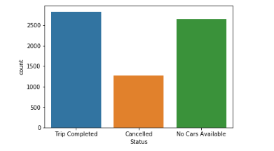
Identifying most pressing problems
Status-wise Frequency of Requests
Here we can clearly see that approximately 60% requests were either getting Cancelled or Cars were not available, that is only 40% service availability for Airport requests.
Furthermore, out of the total Not-Served requests around 30% were Cancelled while in 70% cases Availability was the issue.

Slide 4
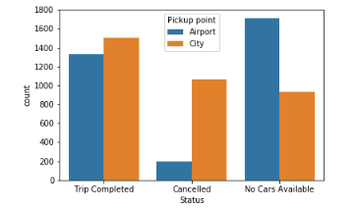
Identifying most pressing problems(Contd.)
Status-wise Frequency of Requests (Pickup point Comparision)
Here comparing the Pickup points on the basis of different status, two things which are very clear are
Both request types(City to Airport & Airport to City) are equally problematic.
There are more cases of Cancellation from City while Availability is a serious concern at Airport.

Slide 5
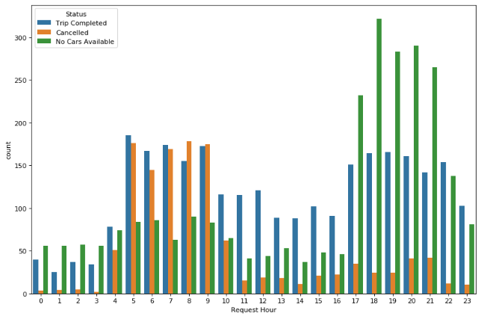
Identifying most pressing problems(Contd.)
Hour-wise Frequency of Requests (Status Comparison)
This is where we see the most affected time-slots in a day, while during 5-9 A.M. Cancellation is the concern, on the other hand during 5-9 P.M. Availability is extremely low.

Slide 6
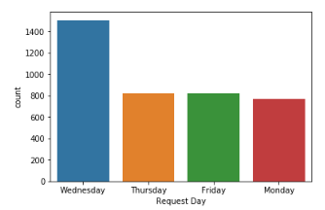
Identifying most pressing problems(Contd.)
Day-wise Frequency of Requests
When looking at the Frequency distribution of requests for each day of a week, another derivation is that Wednesday is the most affected day of a week.

Slide 7
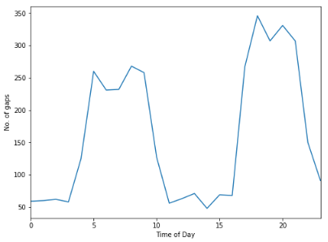
Finding the gap between supply and demand
Time Series Variation of Gaps
As the plot clearly indicates, there are two spikes representing the two time-slots 4-10 A.M. Early morning and 5-10 P.M. Late evening where gaps increases on ay given day.

Slide 8
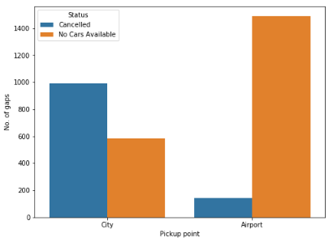
Finding the gap between supply and demand(Contd.)
Effect on Requests during two Time-Slots
Looking at the gaps for requests from City and Airport for the two identified time-slots, it’s evident that magnitude of gaps being same for both Pickup-points but,
More Cancellations from City.
Most Unavailability from Airport.

Slide 9
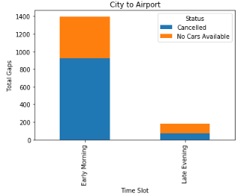
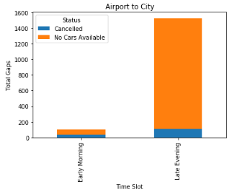
Finding the gap between supply and demand(Contd.)
Slot-wise Gaps in Requests from City and Airport
Finally we can see that the gaps are at different locations for different time-slots, Early morning from City to Airport and Late evening from Airport to City.

Slide 10
Conclusions
To conclude the analysis we have clearly found,
Demand is high from City in the mornings and from Airport in the evenings.
Supply is low with an insightful trend
Drivers tend to Cancel requests from City and don’t want to go to the Airport in the mornings.
Cars are hardly available at the Airport in the evenings.
Therefore clearly, the drivers don’t want to go to Airport in the morning as there are no flight arrivals and they won’t get a return booking to City, while the evening time is Flight Arrival time but there is no availability due to no Flight Departures.
We can improve the situation by offering our Driver partners bonuses on Airport Trips during the affected slots.

Slide 11
Thank You

