Slide 1

AUTOMATED BIOMETRIC ATTENDANCE SYSTEM
St. John College of Engineering and Management, SJCEM
Presented by
Group N0. -08
Kirti patil(32)
Shubham raut(36)
Sushama shetty(47)
Vaibhavi save(44)
Project Guide: mr. ronald laban
Assistant professor

Slide 2
INTRODUCTION
St. John College of Engineering and Management, SJCEM
What is an automated biometrics attendance system ?
It is a system that records the attendance making use of biometric scanner with unique feature inputs such as face recognition, iris recognition, thumb impression etc.
Here the project uses wireless automated biometric system.
This system is used to overcome the draw backs faced in RFID system.

Slide 3
Literature Review:
St. John College of Engineering and Management, SJCEM
Reference paper | Method of Implementation | Advantages | Disadvantages
‘ Easy Access Attendance Management System(EAMS)’ | RFID scanner | No complex system requirement such as microcontroller, GSM. | Lower efficiency i.e barcode tag can be accessed by another person.
‘Bluetooth Smart Based Attendance Management System.’ | RFID scanner, bluetooth module | Low power consumption. High data transfer rate. Small size of chips and low cost. | Bluetooth application can be hacked easily and Accessing of the RFID tags by any other student can take place.

Slide 4
St. John College of Engineering and Management, SJCEM
Reference paper | Method of Implementation | Advantages | Disadvantages
‘Wireless Fingerprint Attendance Management System’ ‘Attendance Management System (AMS) with Fast Track Analysis’. | Zigbee Module, Finger print Scanner, Microcontroller(ARM LPC 2148) RFID Scanner, Motion Sensors | This technique has low cost, small size, efficient with low energy consumption. Quick process in updating current attendance. | The different working such as transmission , comparison of data, computation can be done on a single system. Only a small data can be recorded on this system. Motion sensor may also be affected by rapid environmental changes and direct sunlight.

Slide 5
St. John College of Engineering and Management, SJCEM
Reference paper | Method of Implementation | Advantages | Disadvantages
Fingerprint Based System Using IOT. | ARDUINO , Finger print scanner, Wifi-Module | This system has an advantage over RFID system and has better operating speed than microcontroller because of the use of the Arduino. Use of IoT can provide a better application for this system. | The internal memory of Arduino is less which posses a issue for the applications to work smoothly. Cost of implementation of this project is high as compared to other systems if the requirement of Arduino for various process increases.

Slide 6
BLOCK DIAGRAM & FLOWCHART
St. John College of Engineering and Management, SJCEM
R305 FINGERPRINT MODULE
RASPBERY PI 3
END SERVER(APACHE SERVER)
16x2 LCD
4x3 KEYPAD
DATABASE
POWER SUPPLY
WIRELESS USB MODEM

Slide 7
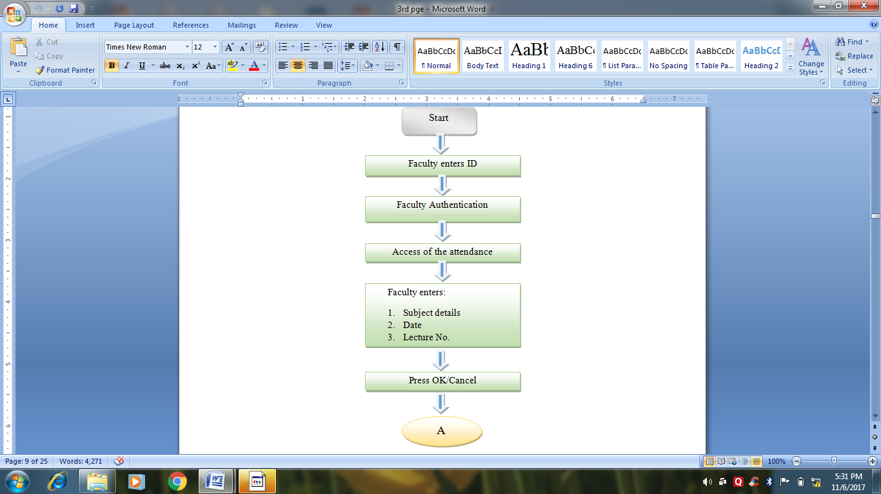
Flow chart
St. John College of Engineering and Management, SJCEM

Slide 8
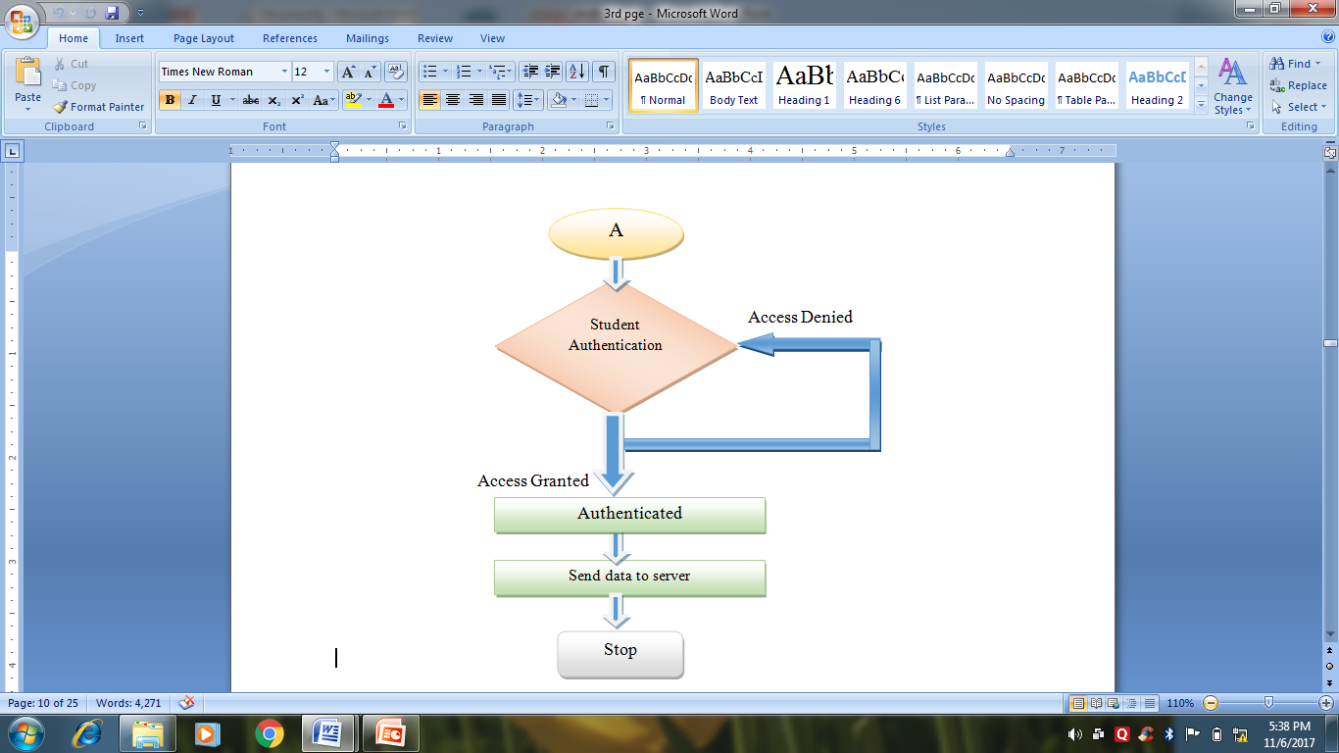
St. John College of Engineering and Management, SJCEM

Slide 9
SOFTWARE REQUIREMENT
St. John College of Engineering and Management, SJCEM
php myadmin
Xampp server
Mysql

Slide 10
HARDWARE COMPONENTS USED
St. John College of Engineering and Management, SJCEM
R305 fingerprint module
Raspberry pi 3
LCD
Power suppy- 3.7v lipo battery,TP4056W booster module

Slide 11
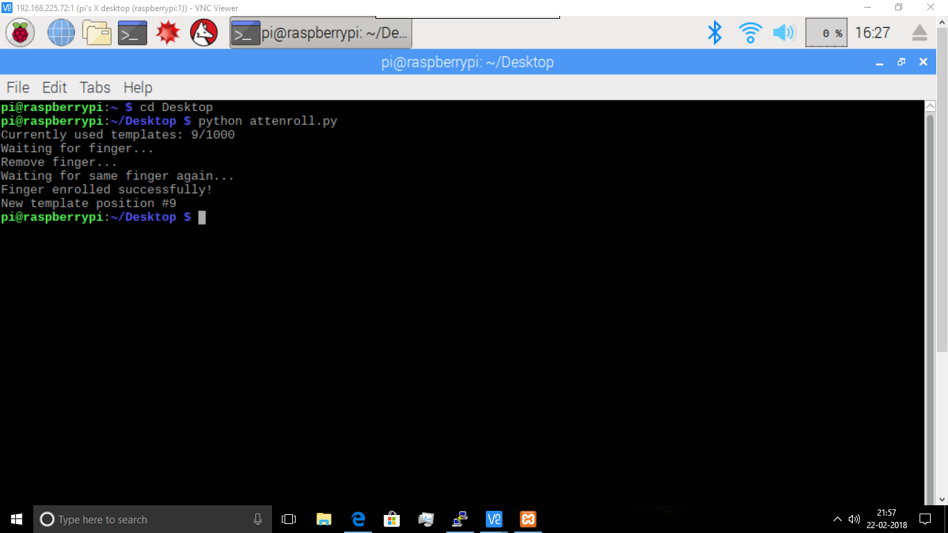
Result
St. John College of Engineering and Management, SJCEM

Slide 12
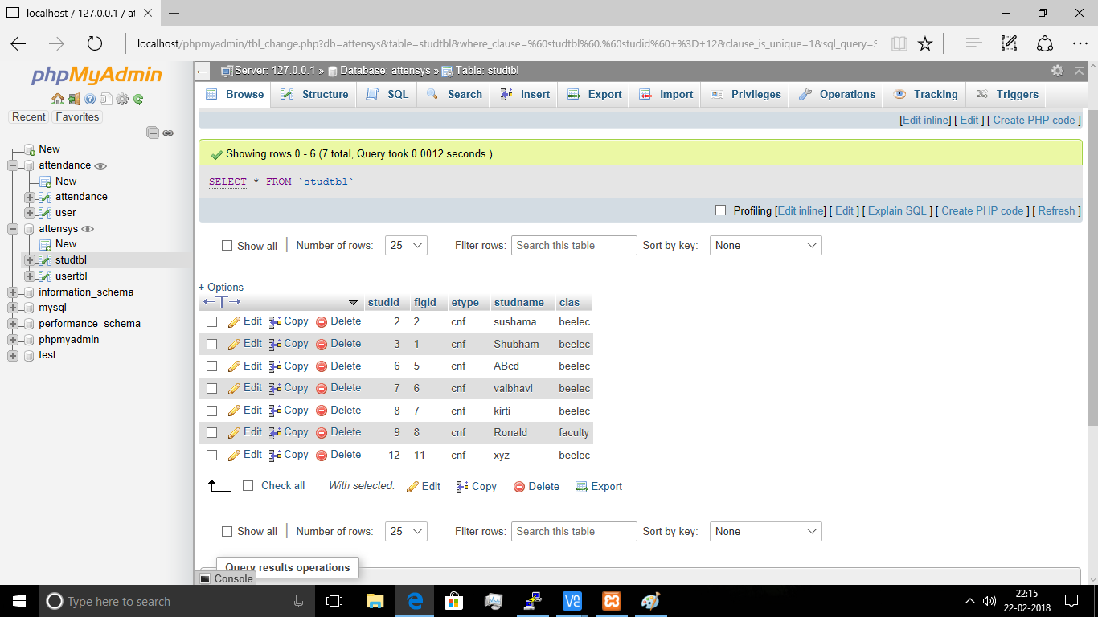
St. John College of Engineering and Management, SJCEM

Slide 13
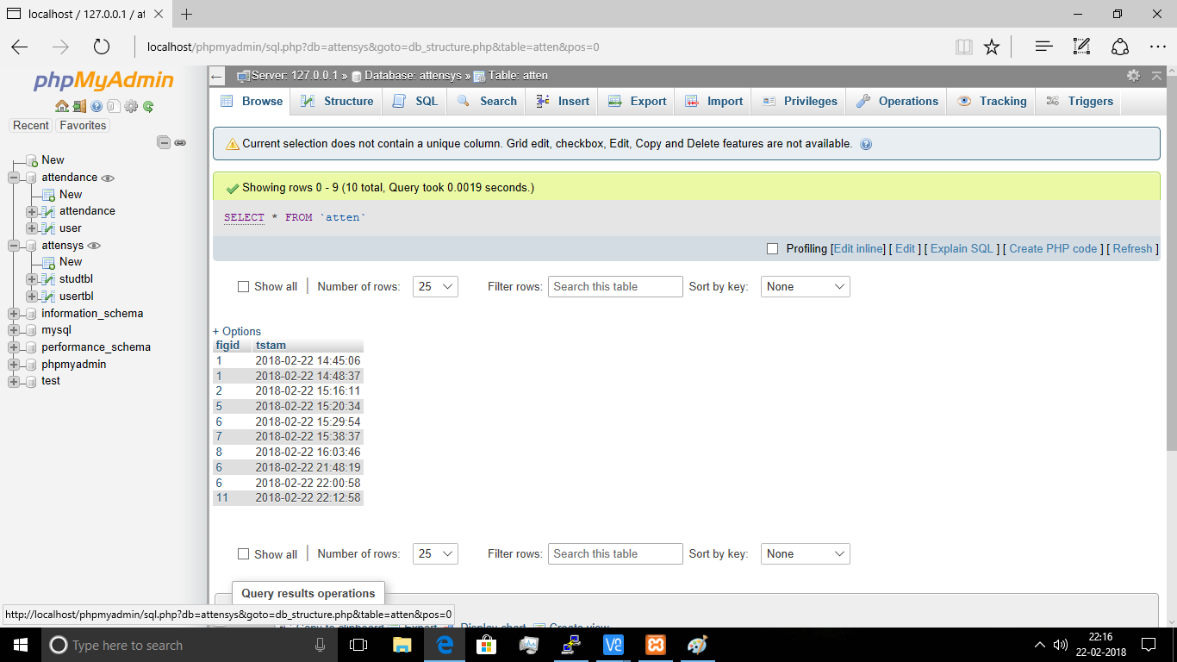
St. John College of Engineering and Management, SJCEM

Slide 14
APPLICATIONS
St. John College of Engineering and Management, SJCEM
Higher level of security for information access.
Reduction in human error and higher efficiency in attendance system.
Can be used in elite organizations such as institutes, military etc.

Slide 15
FUTURE SCOPE
St. John College of Engineering and Management, SJCEM
In future our system can include online accounting system , good backup and restore facility.
System can be made flexible with future extension to the biometric techniques such as iris recognition, face recognition, palm geometry etc.
We can add online student admission as well as pay online fees.

Slide 16
St. John College of Engineering and Management, SJCEM
THANK YOU

