Slide 1

IDS Project
Data set used : WA_Fn-UseC_-Telco-Customer-Churn

Slide 2
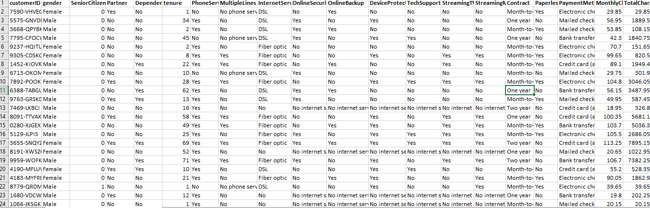

Slide 3

Data Cleaning
Cleaning of numerical and character data

Slide 4
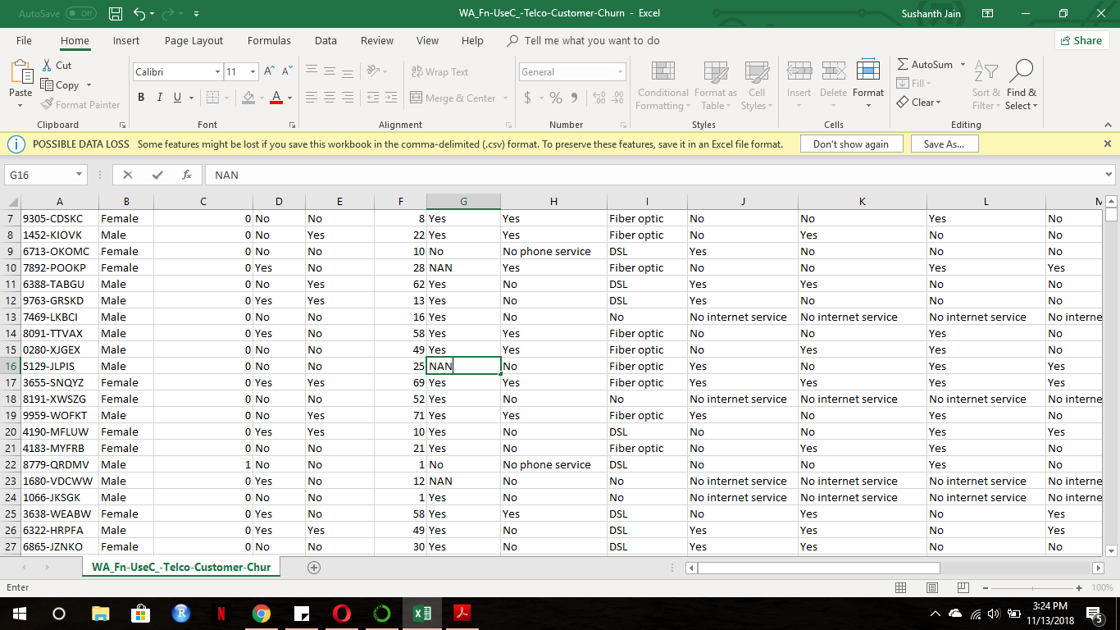
Picture of data set before cleaning the character data

Slide 5
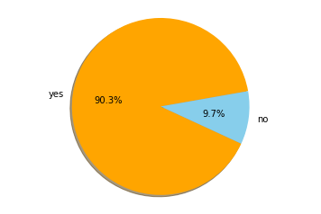
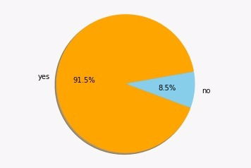
Plot before and after cleaning of the character data
Phone services
This pie chart shows how many number of people use the phone service.
The first pie chart shows the before cleaning and the second ne shows after cleaning.
Basically the NaN values is not replaced by the mean values but it is replaced by the precious value.
We chose pie chart because it was a yes or no question and pie chart shows it more clearly.

Slide 6
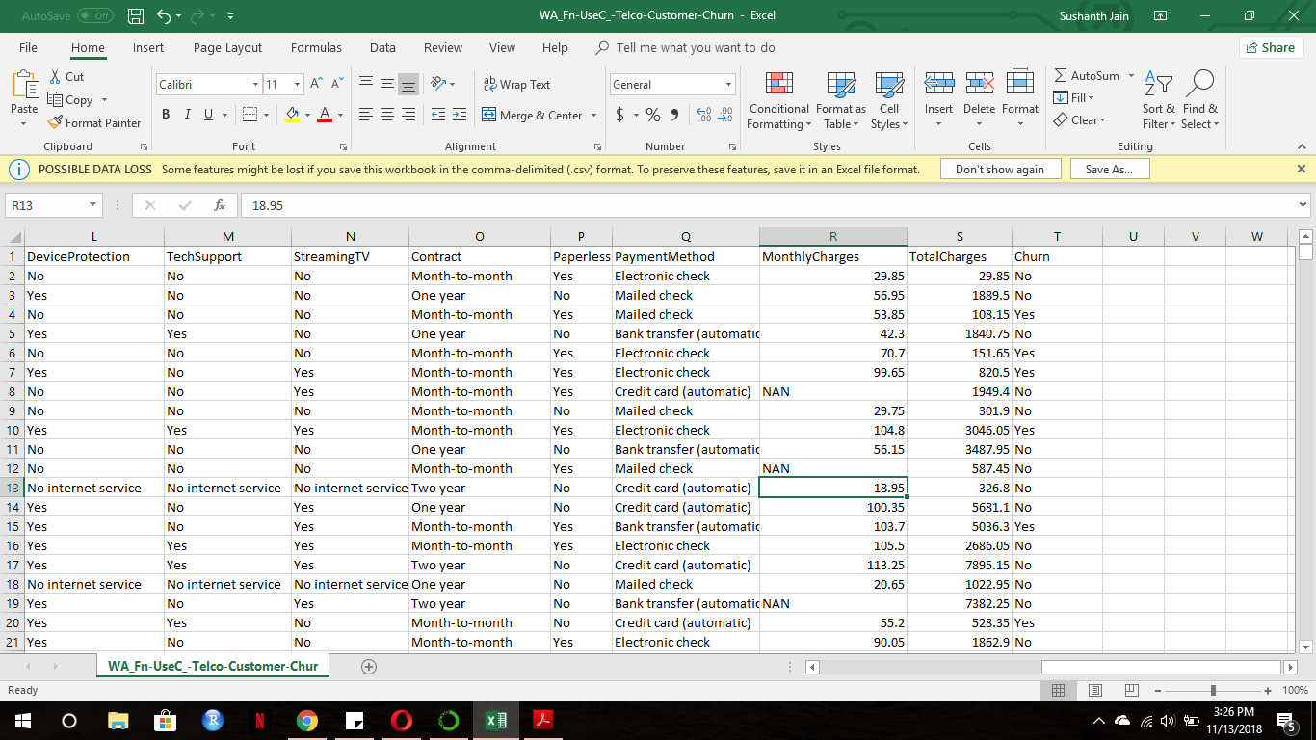
Picture of data set before cleaning the numerical data

Slide 7
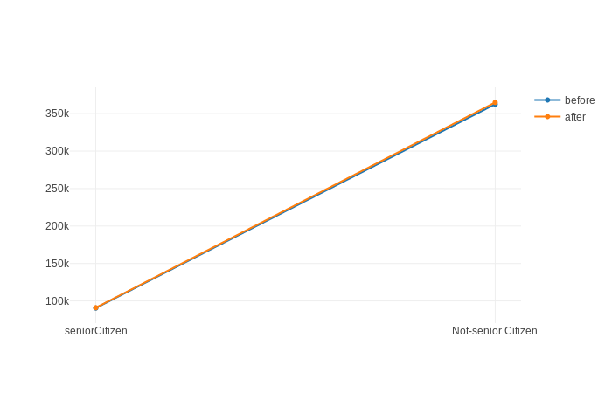
Plot before and after cleaning of the numerical data
This is the line graph
The blue line indicates the monthly charges of the people.
Orange line indicates the monthly expenses of the after the data cleaning.
We replaced the NaN values with the mean.
So we can clearly see that the orange line is slightly higher and they are almost the same sicne we have replaced it using a mean.
Line graph

Slide 8
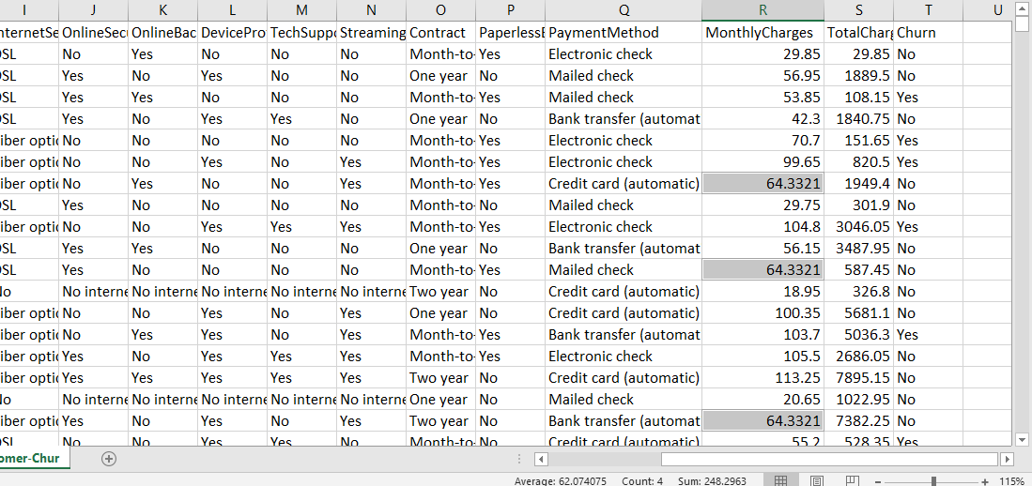
After cleaning of data

Slide 9
Normalization
Mean zero
Variance one

Slide 10
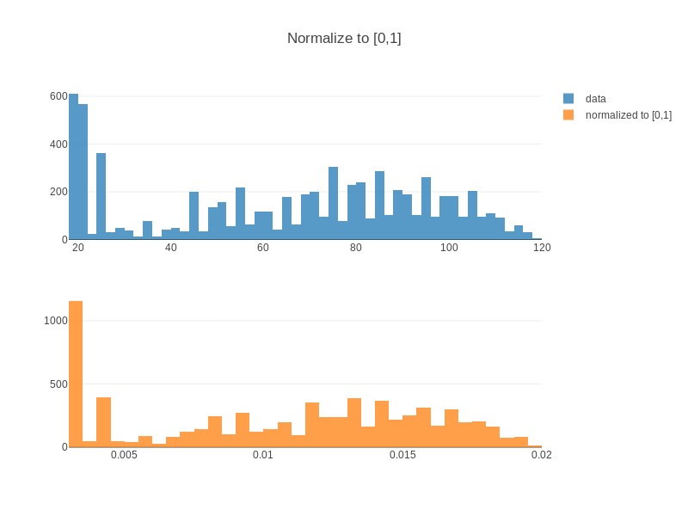
Normalization of graph

Slide 11
NORMALIZATION
Data normalization is a process in which data attributes within a data model are organized to increase the cohesion of entity types. In other words, the goal of data normalization is to reduce and even eliminate data redundancy. It is very important consideration for application developers. Advantages=> 1)Increased Consistency 2)Easier object-to-data mapping

Slide 12

Graph visualization
Visualization the dataset to infer some meaning insights about it.

Slide 13
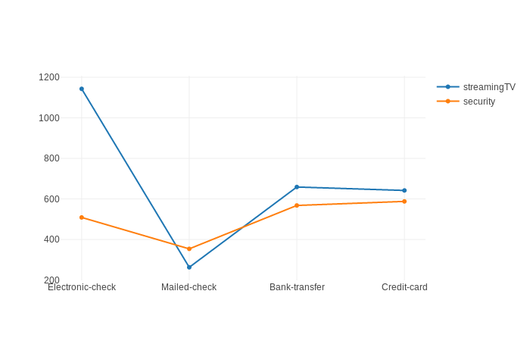
Graph plotted to show payment method
Line graph

Slide 14
Insights
The people who use offline transaction like mailed check are mole likely to be less active using internet for streaming ,security or any other online activity.
We can also conclude that people who use internet for paying bills are more likely to get a online protection plan(online security).

Slide 15
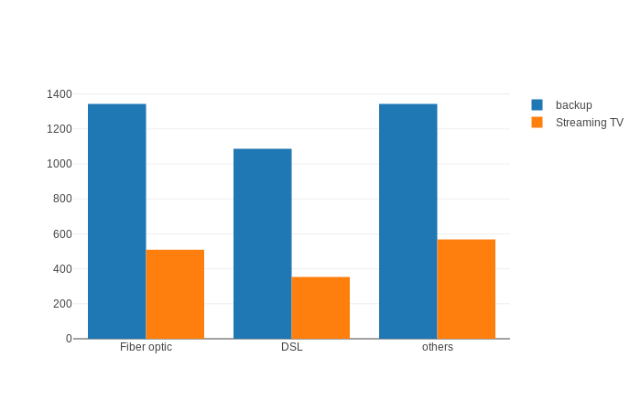
Representation of people who use what type of internet services and what will they decide to do with their it
Bar graph
From this graph wen can conclude that people prefer to backup their data (give their the higher priority) by using the internet rather than watching TV shows.
From this we can also conclude that people prefer high speed internet because clearly maximum number of people have opted to fibre optics

Slide 16
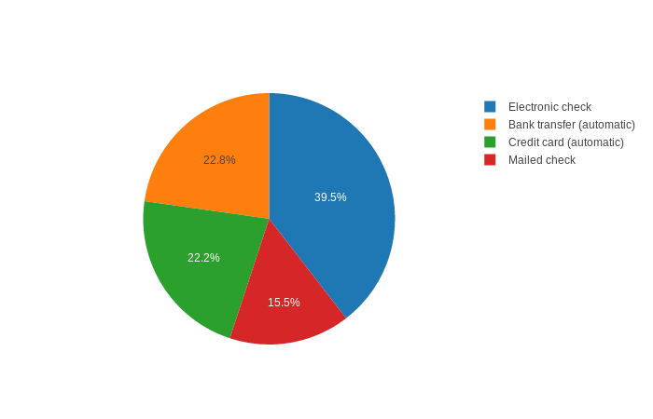
Representation of what type of the payment method they use
Pie chart
From this pie chart we can conclude that more than 84.5% of people do no use hard cash for their transaction.
This also concludes that online money transaction are safe, less time consuming and easy so most people prefer that .

Slide 17
Hypothesis Testing

Slide 18
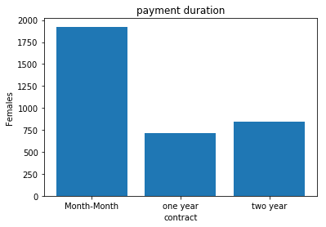
Bar graph to show the payment duration for the females
H0: All females use long term contract for payment duration
Ha: most of females use short term contract for payment duration

Slide 19
Hypothesis testing
Ho : x<=1000
H1 : x>1000
actual Zvalue=1.5
Pvalue=0.05
Hypothesis z value=3.56
From the above data we say that “we can reject Null hypothesis “
From looking graph we can see that no. of females who make payment for 2 year or more than two year are less when compared to ones who make contract with less than 2 year.

Slide 20
The Brainiac
Thank you
Adeesh Acharya
Nithish Ravindra
Sushanth jain

Slide 21




Thank You
The Brainiac
9632155147
sushanthjain7@gmail.com
www.github.com

Slide 22
These all are extras

Slide 23
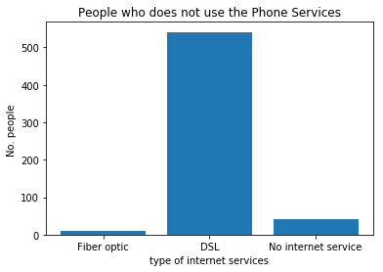
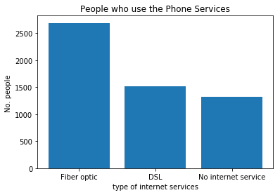
H0: if a person uses optic fiber internet services then he/she is more likely to use phone services.
Ha: if a person uses optic DSL internet services then he/she is more likely not to use phone services.

