Slide 1
RestoReview
Find the worthy places to eat

Slide 2
Website Description
In the website we allow the user to rate the food that they have eaten.
We in our website ask the user how was their food,
and to write a review about the food as well as their experience with the food.
So this details will be stored and can be viewed by any other user who visits
our page.
This helps both user and the restaurant owners (to improve themselves)
And also helps the people (to find the worthy places to eat) .

Slide 3
Hosting link
http://sushant7.pythonanywhere.com/

Slide 4
Individual Contributions
⇢ Nithish Ranjan yemol
Templates, html pages
⇢ Sushanth jain
Django database storing and getting it back, front-end

Slide 5
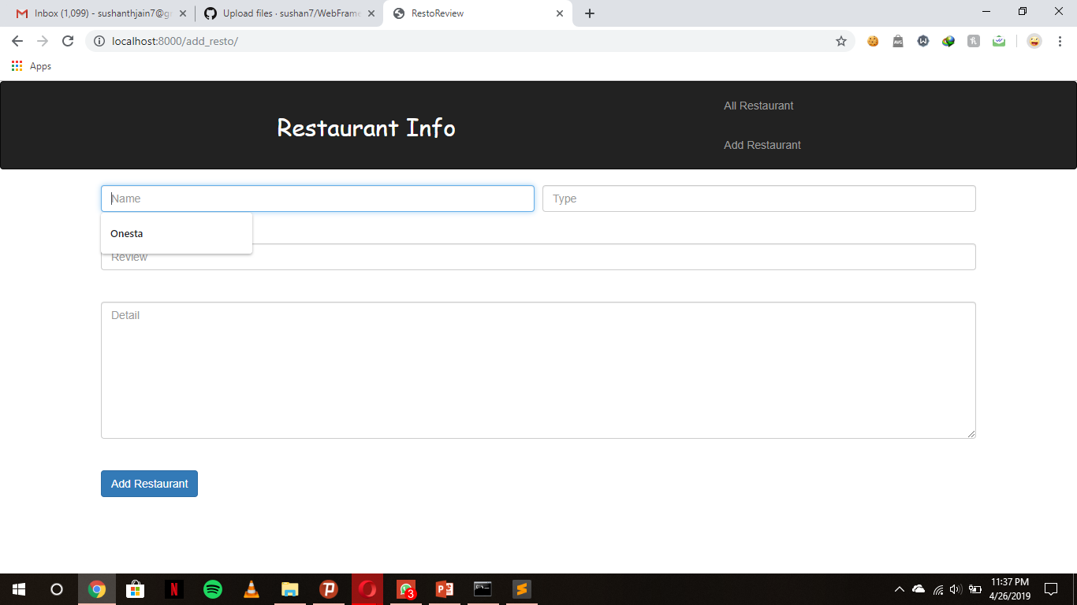
Screen shots

Slide 6
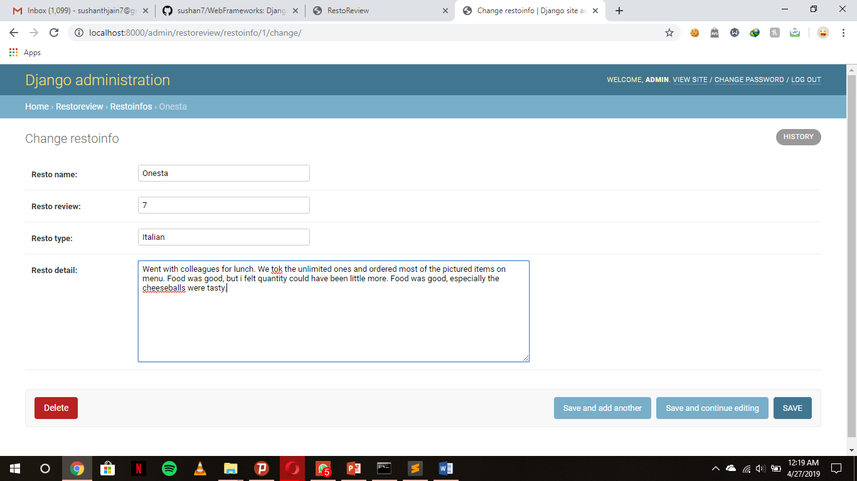
Database

Slide 7
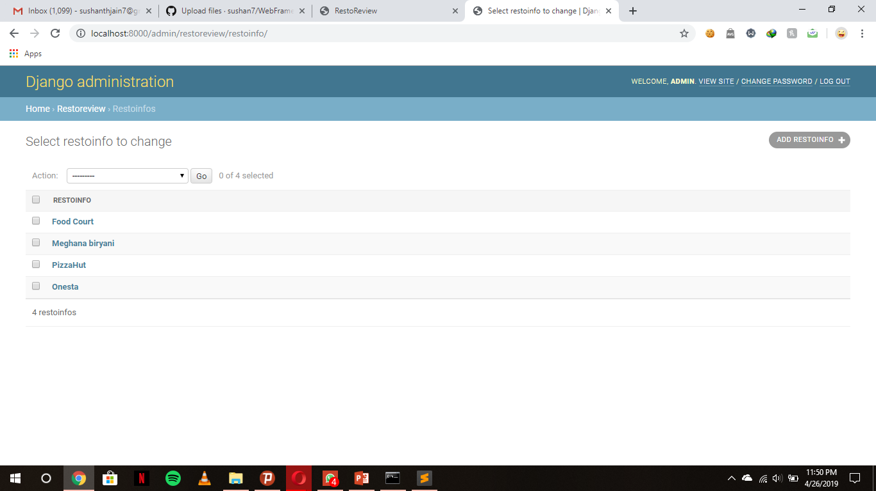

Slide 8
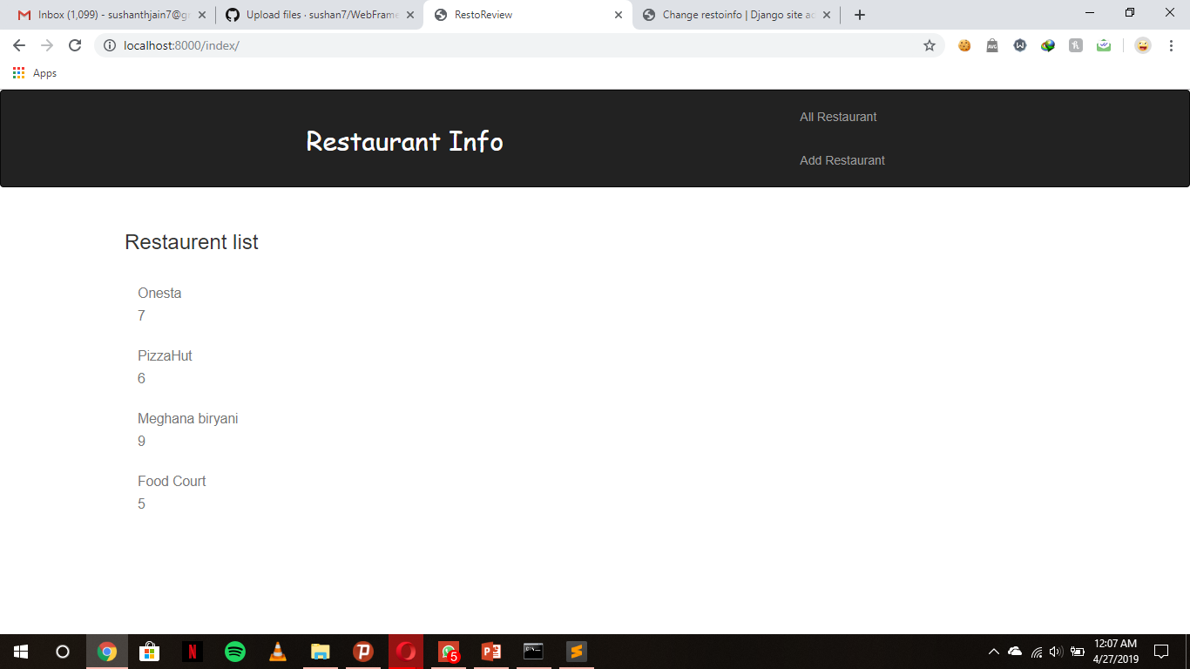
User view

Slide 9
Takeaways
⇢ Fetching the data from django database and displaying
⇢ Creating models, templates, loading css for the webpages
⇢ Developing a fully functional website on django framework

Slide 10
Challenges
⇢ Linking the pages and the urls
⇢ Loading static data on the page
⇢ Understanding the django framework, collaboration of html and python

Slide 11
Project Team
⇢ Sushanth jain
PES1201700992
Email : sushanthjain7@gmail.com
⇢ Unnati Chaturvedi
PES1201700965

