Slide 1


DHARATI AgroTech
PAN IIT Gen-AI Competition Submission
KisaanGPT
Your assistant for all agricultural queries
Telephone
Address
Website
January 2024
+91-XXXXX-XXXXX
Kameng Hostel,
IIT Guwahati
www.kisaangpt.com

Slide 2


PROBLEM
Krishi Seva Kendra faces challenges during peak seasons due to staff shortages, leading to delayed responses to farmers' queries.
SOLUTION
Implement a chatbot designed to promptly respond to farmers' inquiries, leveraging historical data from Krishi Seva Kendra (KSK) for informed and accurate assistance.

Slide 3
Reranker-Based RAG Pipeline Architecture Overview
IMPLEMENTATION
LanceDB for Vector Embeddings Storage
LanceDB is employed to store vector embeddings of the dataset, facilitating efficient data retrieval and management.
Web Interface
ChatGPT-like Interface for KisaanGPT
A user-friendly interface similar to ChatGPT for intuitive interaction, ensuring ease of use for farmers with varying tech-savviness.
AI Models Integration
BAAI/llm-embedde model is used for generating initial embeddings of the query and dataset.
used BAAI/bge-reranker-base model to rerank the results based on relevance to the query.
utilized mistral API for generating coherent and contextually appropriate answers from the large language model (LLM).
Web Development
Creation of a website using HTML, CSS, and Javascript to host KisaanGPT. This ensures wide accessibility and seamless user experience.
Distinct Web Pages
The website will feature a dedicated home page for initial user engagement and information, and a separate, integrated bot interface page for direct interaction with KisaanGPT.
Flask for API Development
Flask, a lightweight web application framework, is used to create a user-friendly API.
The API serves as an interface for external applications to interact with the RAG pipeline, submitting queries and receiving responses.
DHARATI AgroTech

Slide 4
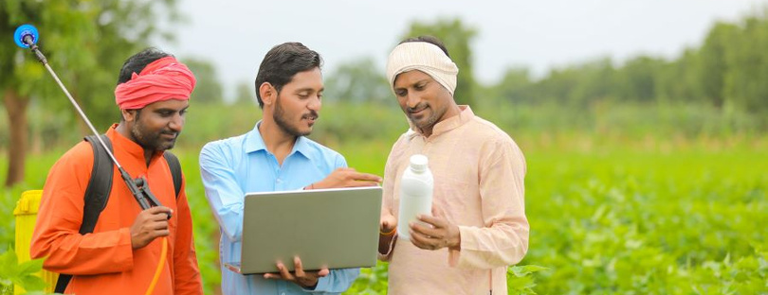
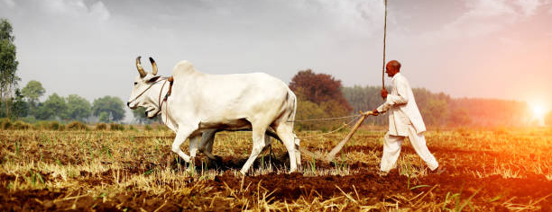
SOCIAL IMPACT
Enhancing decision-making for farmers
By providing real-time, data-driven insights, the chatbot enables farmers to make more informed decisions about crop selection, pest control, and resource management.
Promoting sustainable and efficient agricultural practices
It guides farmers in adopting practices that conserve water, improve soil health, and reduce chemical usage.
Contributing to increased productivity and economic growth
With tailored advice, farmers can significantly improve crop yields and quality.
DHARATI AgroTech

