Slide 1


CSE20110 · COMPUTER NETWORKS LABORATORY
CampusVault
P2P
Peer-to-Peer File and Notes Sharing Platform
Share notes directly between peers, with every file integrity-verified.
Department of Computer Engineering and Technology
Academic Year 2026–2027
Students name and PRNs -:
Aayush Patil 126224184
Sushant Chaudhari 1262242201
Abu Hadeed Siddiqui 1262242275
Ruchita Chavan 1262242306
[Group-] · [Panel-J] · [Batch-1]
Faculty-Dr Uma Pujeri
Notes:
Introduce CampusVault P2P, the Computer Networks Laboratory project.
Names, PRNs, group, panel, batch, faculty and date are placeholders to fill in.

Slide 2


DISCOVERY SEPARATE FROM DELIVERY
Problem and Objectives
Central-server star
Peer mesh + tracker
Central File Server
Peer A
All file delivery passes through here
Connects to the file server only
Peer A
Peer B
Initiates TCP connection and shares files directly.
Exchanges data with others over persistent TCP links.
File Server Hub
Peer C
Tracker
Peer C
Peer B
Receives and forwards content through direct TCP sessions.
Discovers peers and coordinates addresses for connections.
Connects to the file server only
Connects to the file server only
Discover available peers and shared files
Transfer files using TCP communication
Verify integrity using SHA-256
1
2
3
02
Notes:
Central file servers are a single point of failure and a bandwidth bottleneck.
They also offer no built-in way to verify that a received file is intact.

Slide 3

SYSTEM ARCHITECTURE
System Architecture
Register / announce / seeder lookup (in-process calls)
Flask Web Server
Tracker / Peer Discovery
User (browser)
HTTP requests
server.py · port 5000
p2p_core/tracker.py · CampusTracker
index.html + app.js
/api/notes · /api/notes/upload · /api/p2p/download
Local hub peer Campus-Hub-01 · port 7001
In-memory peer registry · file hash → peer IDs
Peer discovery / metadata
Legend
━━ HTTP / in-process calls (control)
━━ Discovery / metadata traffic
━━━ File data over direct TCP
Emerald = repo-verified flow
storage/notes_data.json (note metadata)
storage/files/<sha256>.bin (file payloads)
TCP connection
Peer A
Peer B
Seeder (shared files)
Requesting peer (downloader)
File data transfer
peer_node.py · TCP listener
peer_cli.py terminal peer
Per-chunk SHA-256 check
Yes
Direct peer-to-peer link (file data does not pass through the tracker)
HANDSHAKE / HANDSHAKE_ACK → REQUEST_CHUNK → CHUNK_PAYLOAD (64 KB chunks)
Full-file SHA-256
matches?
File received and verified
No
Multithreaded TCP listener, one thread per connection
Transfer aborted (integrity error)
03
Tech stack: Python · Flask · TCP sockets · HTML/CSS/JS · JSON metadata · SHA-256
Notes:
Walk the flow left to right: browser to Flask, Flask to tracker for discovery only, then the direct peer-to-peer TCP transfer, verified by per-chunk and full-file SHA-256.

Slide 4
FROM STARTUP TO VERIFIED FILE
Implementation and Working
Repository responsibilities
Start server
01
server.py
Flask web server and tracker runner
Start peers
02
peer_cli.py
Discover peers and files
Terminal peer node
03
p2p_core/
Transfer selected file
04
protocol.py handles framing, chunking and SHA-256.
peer_node.py provides the threaded TCP server and client.
tracker.py maintains the peer registry.
Verify SHA-256 per chunk
05
Rebuild the file only if every chunk hash matches.
04
Notes:
Five steps take a peer from server start to a verified file.
Each chunk is checked with SHA-256, then the full file is checked before it is rebuilt.

Slide 5
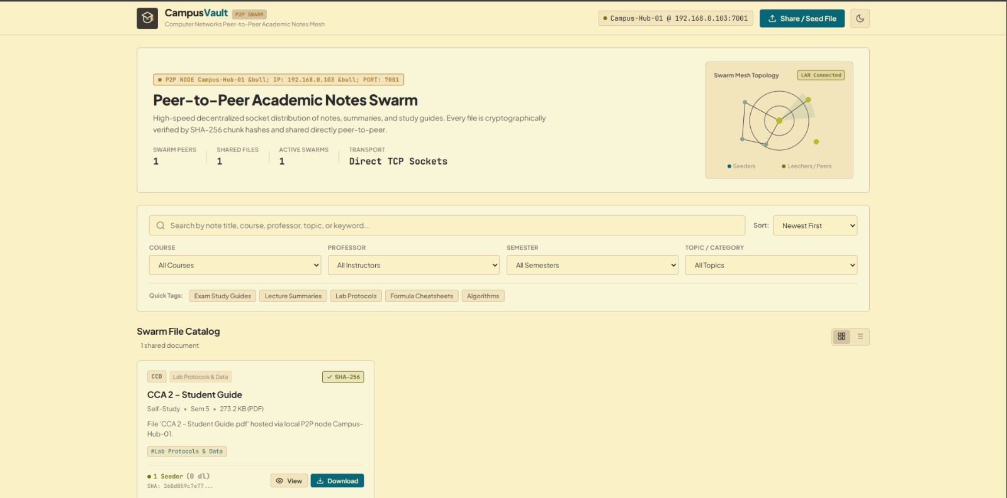
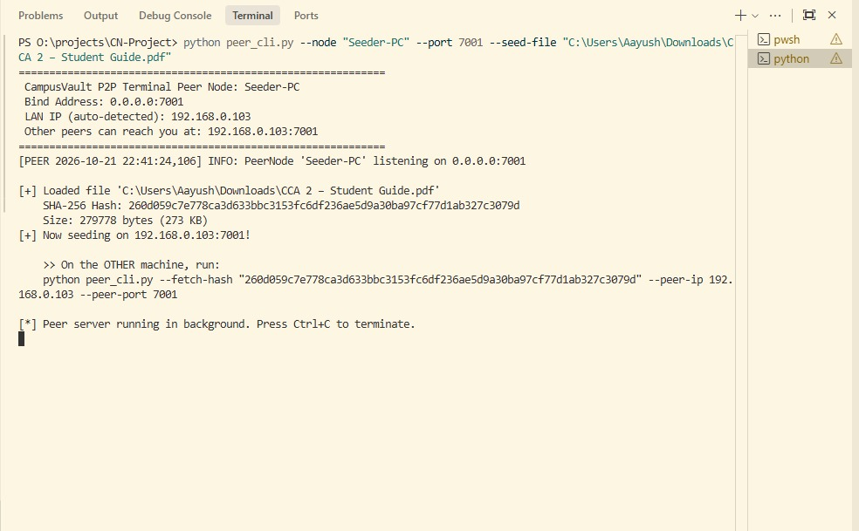
VALIDATION DASHBOARD
Testing and Results
Server startup
Peer discovery
Expected behaviour: Flask application and tracker start and accept requests.
Expected behaviour: registered peers and their shared files are discoverable.
Observed result: Pending validation
Observed result: Pending validation
[Insert actual terminal output or screenshot]
[Insert actual terminal output or screenshot]
File transfer
Integrity verification
Expected behaviour: the selected file reaches the receiving peer over TCP.
Expected behaviour: every chunk hash matches before file reconstruction.
Observed result: Pending validation
Observed result: Pending validation
[Insert actual terminal output or screenshot]
[Insert actual terminal output or screenshot]
05
Notes:
Results are placeholders until the test runs are recorded.
Fill in observed results, pass or fail status, file size and transfer time.

Slide 6
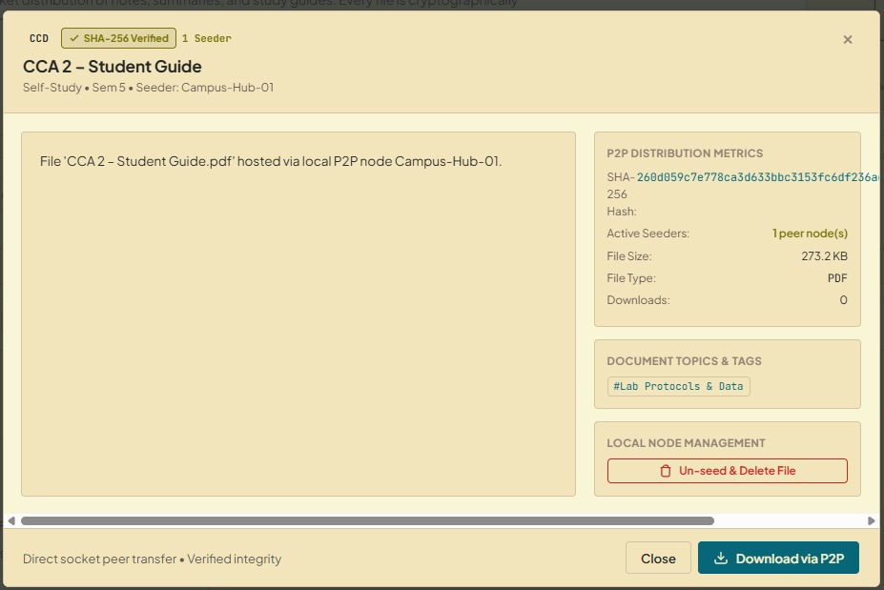
LIVE EXECUTION
Working Demonstration
01
02
03
Peer setup
Discovery and transfer
Received file and integrity
Launch Flask server and start peers.
Show discovery; transfer a sample file.
Show the received file and verification result.
REAL DEMONSTRATION EVIDENCE
Success criterion
[Insert actual screenshot]
The receiving peer obtains the selected file and its SHA-256 verification passes.
Received file and SHA-256 verification output
06
Notes:
Show peer setup, then discovery and transfer, then the received file.
Close on the integrity result: the SHA-256 verification must pass.

Slide 7

CAPABILITIES AND ACCOUNTABILITY
Conclusion and Contributions
Demonstrates peer discovery, TCP file transfer and SHA-256 integrity checks in Python for sharing academic notes and files across peers.
Current limitation
Future scope
Peers must be on the same local subnet.
Encrypted transfers, access control and tracker scalability.
Team contributions
[Name – responsibility] for each member
07
Notes:
Summarise what was built, its limitations, and the future scope.
Team contributions and the AI-use disclosure are placeholders to complete.

Slide 8
SOURCE MATERIAL
References
[1] CampusVault P2P repository
https://github.com/sushant-C7/CN-Project
[2] Python documentation
https://docs.python.org/3/
[3] Flask documentation
https://flask.palletsprojects.com/
[4] Python socket module and hashlib
https://docs.python.org/3/library/socket.html
https://docs.python.org/3/library/hashlib.html
08
Notes:
List the sources used for the project, tools and documentation.
Each reference carries its URL below the title.

