Slide 1
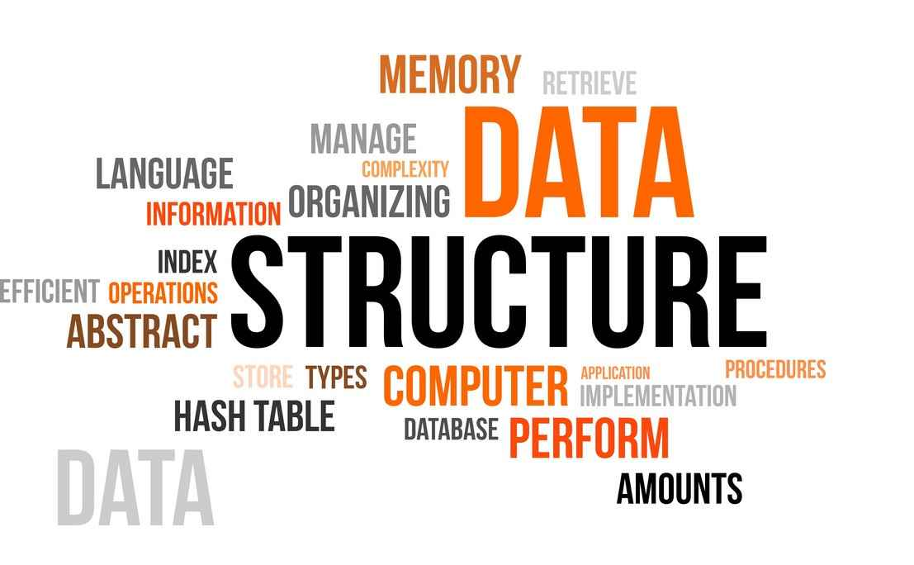
Data Structure and Algorithm

Slide 2
Introduction to DSA
Unit-1

Slide 3
Introduction of DS
DSA stands for Data Structures and Algorithms. It is a fundamental topic in computer science that deals with the organization and manipulation of data in an efficient manner.
Data structures refer to the way data is organized and stored in memory, while algorithms are a set of steps that are performed to solve a problem or achieve a specific task.
Data (e.g. studentName, studentRoll) Structure (e.g Graphs,array,list)
Understanding data structures and algorithms is essential for software developers as it allows them to write efficient and scalable code. It enables programmers to optimize the performance of their applications, reduce the memory usage and improve the overall efficiency of the code.
Notes:
Example :-Array with binary search algorithm, Hashing also like key/word---key-value pair search, big companies,programming

Slide 4
Need of DSA
Efficient data storage and retrieval
Faster computation
Better memory utilization
Improved software design
Better problem-solving skills
Better performance of applications
More on Scalability

Slide 5
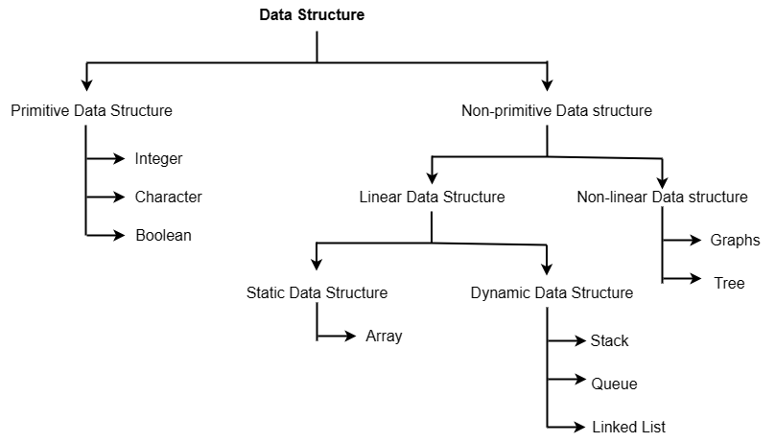
Data Structure types (Classification)

Slide 6
Data Structure types
Primitive data structures are basic data types that are built into programming languages and are used to store simple values. These data types are generally predefined by the programming language and are directly supported by the computer hardware.
Non-primitive data structures are the data structures that are created using primitive data structures. Non-primitive data types are used to represent complex structures and relationships that cannot be represented using primitive data types.
In linear data structures, the elements are arranged in sequence one after the other.
Linear Data types two :- 1. Static Data structure 2. Dynamic Data structure
Static data structure has a fixed memory size. It is easier to access the elements in a static data structure.
dynamic data structure, the size is not fixed. It can be randomly updated during the runtime which may be considered efficient concerning the memory (space) complexity of the code.
Non-linear data structures are data structures that do not have a sequential order.

Slide 7
Abstract data types (ADT)
ADTs are like user defined data types which defines operation on values using function without specifying what is there inside the function and how the operations are performed
An ADT is a theoretical concept that describes a set of data values and the operations that can be performed on those values.
It involves what can be done with the data, not how has to be done.
It is called “abstract” because it abstracts away (hide) the implementation details and focuses on what operations can be performed on the data type and what properties those operations should satisfy.
Think it is like “black-box” where Developers can design and implement ADTs without worrying about how they will be used or by whom, and users can use ADTs without worrying about how they are implemented or how they work internally.
Notes:
For example : - Car Specification – Engine, brake, tires, flue tank , Car Mechanism – driving(), etc

Slide 8

Example of ADTs
Abstract
Implementation
4 gb ram
2.5 ghz processor
Dual camera
50 mege pixel
5.5 inch display screen
(What we know, show to us)
Class smartphones{
private:
int ram_size;
char camera_count;
int screen_size;
public:
call();
text(); operations
upload();
}
(Don’t know how they work, hide from us)

Slide 9
Abstract data types (ADT)
All data that is being processed is maintained in a data structure and its implementation must not to be known to the user. (ADTs Structure)
Data is inserted, deleted and updated through the application program via the interface. (ADTs Operation)

Slide 10
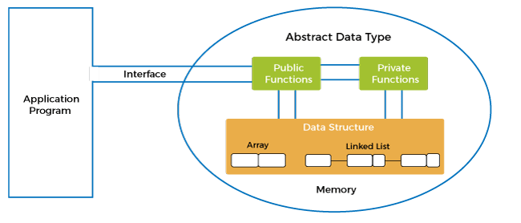
Abstract Data types Model
abstract data type model at level first encapsulation is performed then at second level abstraction is performed on the data structure.
Abstraction means hiding internal details and showing only functionality.
Encapsulation Combining the data and the member function in a single unit is considered encapsulation.

Slide 11
Types of ADT
ADTs allow users to effectively implement complex mathematical and logical programs as they are flexible and independent of language.
List
Queue
Stack
Tree

Slide 12
Queue ADTs
The queue is a linear ADT which allows insertion from one end and deletion from another. As per the name, It works on the FIFO (first in, first out) principle.
some common operations associated with Queue ADTs
enqueue(element): Adds an element to the back of the queue.
dequeue(): Removes and returns the element at the front of the queue.
peek(): Returns the element at the front of the queue without removing it.
isEmpty(): Returns true if the queue is empty, false otherwise.

Slide 13
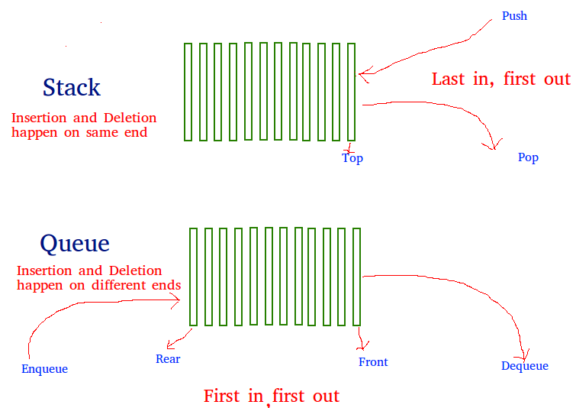

Slide 14
Stack ADTs
A stack is a linear ADT that restricts users from inserting and deleting elements from only one end, known as the top of the stack. It uses LIFO (last in, first out) as its basic working principle.
some common operations associated with Stack ADTs
push(element): Adds an element to the top of the stack.
pop(): Removes and returns the element at the top of the stack.
peek(): Returns the element at the top of the stack without removing it.
isEmpty(): Returns true if the stack is empty, false otherwise.

Slide 15
List ADTs
The list ADT is a sequential combination of one or more than one element. Each element has its positional value and a referential pointer to the next element.
some common operations associated with List ADTs
insert(element): Inserts an element into the list at a specified position.
delete(element): Deletes the specified element from the list.
get(index): Returns the element at the specified index in the list.
isEmpty(): Returns true if the list is empty, false otherwise.

Slide 16
Tree ADTs
A tree is a non-linear data structure that consists of nodes connected by edges. Each node in the tree has a parent node and zero or more child nodes.
some common operations associated with Tree ADTs:
insert(element): Inserts an element into the tree at the appropriate position.
delete(element): Deletes the specified element from the tree.
find(element): Returns true if the specified element is present in the tree, false otherwise.
traverse(): Visits each node in the tree in a specific order.

Slide 17
Scope of ADTs
ADT is robust and reusable.
It is based on the principles of Object-Oriented Programming (OOP)
An ADT can be re-used at several places, and it reduces the coding efforts
ADT ensures a robust (Strong) data structure
Allows better conceptualization (clear and concise) and modelling of the real world

Slide 18
Algorithm
Algorithm refers to a set of instructions or rules that are followed to solve a particular problem.
Algorithms are used in computer programming to solve problems by breaking them down into smaller, more manageable steps that can be executed by a computer.
It may involve various operations such as mathematical computations, logical decisions, comparisons, iterations, and data manipulation to achieve the desired output.
Characteristics of algorithm
Unambiguous (Clear)
Input
Output
Effectiveness
Time Complexity
Space Complexity
Notes:
1. Clear

Slide 19
Algorithm Analysis
Asymptotic analysis is a powerful tool for comparing the performance of different algorithms.
To analyze the algorithm we have two level :-
Prior Analysis
Prior algorithm analysis is useful for comparing the performance of different algorithms in a theoretical sense.
2. Posterior Analysis
Posterior algorithm analysis is the analysis of an algorithm based on its actual performance, as measured on a specific implementation.

Slide 20
Algorithm Analysis
Best Case
The best case of an algorithm refers to the scenario in which the algorithm performs optimally, achieving the lowest possible time complexity for a given input size.
Average Case
The average case of an algorithm refers to the scenario in which the algorithm's performance is analyzed based on the statistical average of all possible inputs of a given size.
Worst Case
The worst case of an algorithm refers to the scenario in which the algorithm performs the least efficiently, achieving the highest possible time complexity for a given input size.
e.g. Linear search (class)

Slide 21
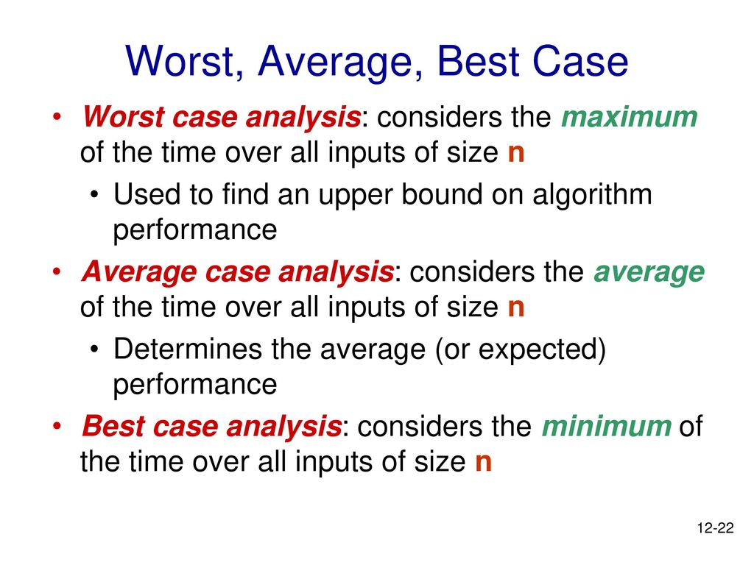

Slide 22
Rate of Growth
The most important resource to analyze is generally the running time. Several factors affect the running time of a program.
What is Running Time Analysis?
It is the processing time vs the size of the input. The input may be of different types based on problems. Commons inputs are
Size of array
Number of elements in a matrix
Asymptotic analysis is important mathematical tool in algorithm analysis. It involves analyzing the behavior of a function as the input size approaches infinity.
In Asymptotic Analysis, we evaluate the performance of an algorithm in terms of input size.
We calculate, how the time taken by an algorithm increases with the input size.

Slide 23
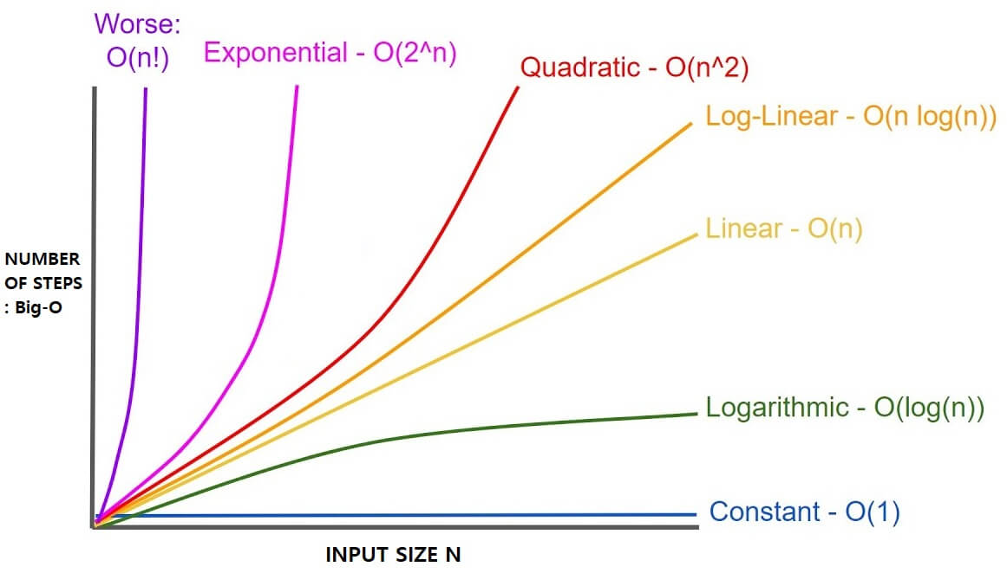
What to analyze ?

Slide 24
Performance analysis and measurement
Running Time Calculation
To analyze the given algorithm we need to know on what inputs the algorithm is taking less time (performing well) and on what inputs the algorithm is taking a huge time.
e.g.
Integer add/subtract ,Integer multiply/divide ,Float add/subtract,Float multiply/divide = Θ(1)
For loop =Θ(n) ,Nested loop= Θ(n2)
Recursive function =Θ(n)
//Calculating the running time of Algorithms

Slide 25
Performance analysis and measurement
int numbers[] = {10, 20, 30, 40, 50};
int n = sizeof(numbers) / sizeof(numbers[0]);
for (int i = 0; i < n; i++)
{
printf("numbers[%d] = %d\n", i, numbers[i]);
}
return 0;
Time Complexity and Space Complexity
Notes:
3x³ +x² + x + 2 solve it simple concept, space complexity only consider data store thing like I in loop only takes integer constant space. , time complexity O(n) and Space Complexity (1)

Slide 26
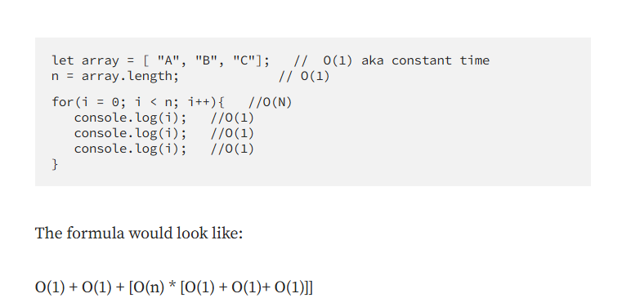
Practice
For loop; (i++,i=i*2)
Nested for loop
If and else

Slide 27
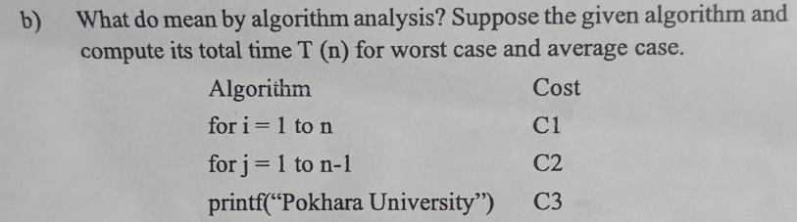

Slide 28
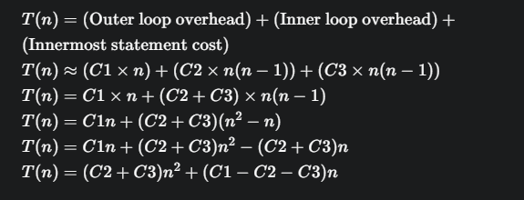

Slide 29
Algorithm Design Techniques
Incremental approach
Greedy Algorithm
Divide and Conquer
Backtracking Algorithm
Dynamic Programming:
store data into table rather than recursive call and call function dynamically to get results,eg. Fibonacci Numbers

